Slide 1
COVID-19 Related Hateful Tweets Detection
Song Liao
Clemson University

Slide 2
Background
The outbreak of COVID-19 pandemic has greatly changed our life as well as communication mode
The hate towards some groups related to COVID-19 also increased on social medias
Detect and analyze tweets with hateful content related to COVID-19
Notes:
In this period, we could also find some kinds of hate toward some groups related to covid19, such as hate toward Asian, hate toward the old and hate toward specific person such as Dr.Fauci.
This kind of hate increased a lot in his specific period.

Slide 3
Work
Data collection
Methods comparison
Different methods
Different datasets
Apply method to our dataset
Futher analysis
Notes:
Choose best method to apply on our dataset

Slide 4
Data collection
Huge number of tweets related to COVID-19 and low percentage of hateful tweets among all the tweets
Collect our dataset with potential hateful keywords
28 keywords
Jan 1 to Oct 15
Collect tweets
A tool to get tweets id
Twitter official API to get tweets
Notes:
There are more than 500 millions tweets in a covid19 related dataset from Southern California University
[1] Chen, Emily, Kristina Lerman, and Emilio Ferrara. "Covid-19: The first public coronavirus twitter dataset." arXiv preprint arXiv:2003.07372 (2020).

Slide 5
Data collection - keywords
 | Keywords | Tweets number
China | chinavirus, chinesevirus, wuhancoronavirus, wuhanvirus, coronaviruschina, ccpvirus, chinacoronavirus, chinaliedpeopledied, wuflu, kungflu | 2,869,456
Trump | trumpvirus, trumpkills, trumpliedpeopledied, trumppandemic, trumpkillsamericans, trumpviruscatastrophe, trumpvirusdeathtoll186k, trumplied200kdied | 2,271,866
Fauci | fauci, drfauci, firefauci, faucithefraud, tonyfauci, drfaucitimecover, faucifraud | 850,989
All | 28 keywords | 5,992,311
Notes:
All these keywords are hot keywords on Twitter from January.
Since twitter would ignore the case when searching tweets with keywords, here we use keywords with lower cases.

Slide 6
Comparison - datasets
Davidson’s dataset (2017)
24,784 tweets
Waseem’s dataset (2016)
10,444 tweets
Semeval-2019 task 6 (2019)
13,240 tweets
Dataset from Georgia Institute of Technology (2020)
2400 labeled tweets about COVID hate
Notes:
We tested different methods on several different popular datasets and all of them are related to hateful tweets detection.
[1] Thomas Davidson, Dana Warmsley, Michael W. Macy, and Ingmar Weber. 2017. Automated Hate Speech Detection and the Problem of Offensive Language. In Proceedings of the Eleventh International Conference on Web and Social Media, ICWSM 2017, Montréal, Québec, Canada, May 15-18, 2017. AAAI Press, 512–515. https://aaai.org/ocs/index.php/ICWSM/ICWSM17/paper/view/15665
[2] Zeerak Waseem and Dirk Hovy. 2016. Hateful Symbols or Hateful People? Predictive Features for Hate Speech Detection on Twitter. In Proceedings of the Student Research Workshop, SRW@HLT-NAACL 2016, The 2016 Conference of the North American Chapter of the Association for Computational Linguistics: Human Language Technologies, San Diego California, USA, June 12-17, 2016. 88–93. http://aclweb.org/anthology/N/N16/N16-2013.pdf
[3] Zampieri, Marcos, et al. "Semeval-2019 task 6: Identifying and categorizing offensive language in social media (offenseval)." arXiv preprint arXiv:1903.08983 (2019).
[4] Ziems, Caleb, et al. "Racism is a Virus: Anti-Asian Hate and Counterhate in Social Media during the COVID-19 Crisis." arXiv preprint arXiv:2005.12423 (2020).

Slide 7
Comparison - methods
Naive Bayes
Logistic Regression
Support Vector Machine
BERT (Bidirectional Transformers for Language Understanding)
Word embedding
Google word2vec
Glove-twitter
Notes:
Pre-trained word vectors on Twitter
[1] Devlin, Jacob, et al. "Bert: Pre-training of deep bidirectional transformers for language understanding." arXiv preprint arXiv:1810.04805 (2018).
[2] Mikolov, Tomas, et al. "Efficient estimation of word representations in vector space." arXiv preprint arXiv:1301.3781 (2013).
[3] MLAPennington, Jeffrey, Richard Socher, and Christopher D. Manning. "Glove: Global vectors for word representation." Proceedings of the 2014 conference on empirical methods in natural language processing (EMNLP). 2014

Slide 8
Comparison
Dataset/ F1-score | Word embedding | Naive Bayes | Logistic Regression | SVM | BERT
Davidson | word2vec | 0.241 | 0.350 | 0.340 | 0.567
 | glove-twitter-100 | 0.329 | 0.313 | 0.272
Waseem | word2vec | 0.483 | 0.607 | 0.554 | 0.825
 | glove-twitter-100 | 0.427 | 0.593 | 0.570
Semeval-Task6 | word2vec | 0.435 | 0.511 | 0.529 | 0.723
 | glove-twitter-100 | 0.343 | 0.519 | 0.493
GIT | word2vec | 0.508 | 0.635 | 0.614 | 0.773
 | glove-twitter-100 | 0.441 | 0.571 | 0.561
Notes:
1 for differnet word embedding, word2vec is better than glove.
2 for different methods except BERT, the Logistic Regression can get best performance.
3 BERT always outperforms other methods a lot and it has been proved in several papers that BERT is powerful on language understanding
we use F1 score instead of accuracy since some datasets are not balanced with lots of True Negtive.
Preprocess: remove links in tweet, ignore case, process hashtags.

Slide 9
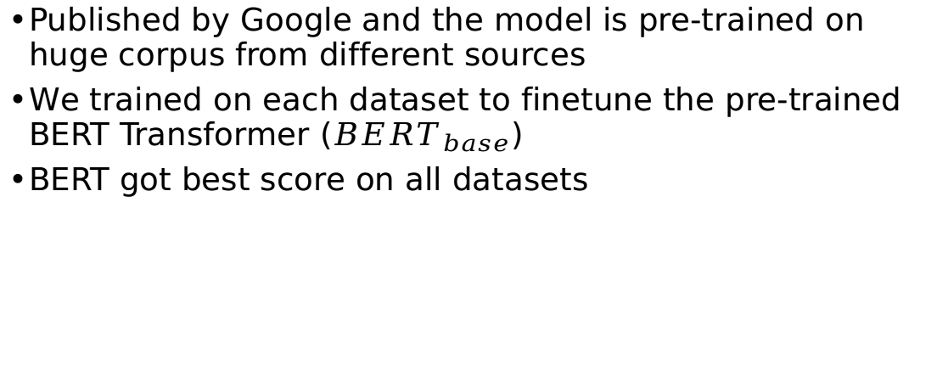
BERT
Published by Google and the model is pre-trained on huge corpus from different sources
We trained on each dataset to finetune the pre-trained BERT Transformer (${BERT}_{base}$)
BERT got best score on all datasets
Notes:
There are tens of BERT Model and we user the base BERT model. (12 transformer blocks, 12 self-attention headers and 768 hidden dimensions)

Slide 10
Applying BERT
Based on labeled data from Georgia Institute of Technology [1]
2400 labeled data about hate
Similar work with us
Detect hateful tweets in our dataset
Hate in three types
[1] Ziems, Caleb, et al. "Racism is a Virus: Anti-Asian Hate and Counterhate in Social Media during the COVID-19 Crisis." arXiv preprint arXiv:2005.12423 (2020).

Slide 11
Result
 | Tweets number | Hateful tweets | Percentage
China | 2,869,456 | 537,084 | 18.7%
Trump | 2,271,866 | 561,045 | 24.7%
Fauci | 850,989 | 137,897 | 16.2%
Notes:
Since we user some potential hateful keywords, the percentage of hateful tweets are high.

Slide 12
Futher analysis
Notes:
Based on the daily tweets number, we could draw the figure to view the trend in last 9 months.
This is the trend of tweets about China. The blue line is tweets number, and the yellow line is hateful tweets number. The red line means the percentage of hateful tweets.
hateful tweets number and percentage would both increase when more tweets were disccuing this topic, which means more tweets puclished, higher percent of hateful tweets published.
However, the percentage of hateful tweets didn’t drop obviously, especially after March. the percentage of hateful tweets keep in a higher degeree and did‘nt drop after that.

Slide 13
Futher analysis
Notes:
I also did the analysis about Trump and Fauci. The percentage of hateful tweets keeps in a degree and didn’t drop in last 6 months.

Slide 14
Futher analysis - changepoints
Trump admitted that he downplayed the risk of the coronavirus
03-17
7-6
9-9
10-2
Trump called “Chinese virus” on Twitter
Trump called “China virus” three times on Twitter
Trump had covid
Notes:
1 We found that the trend of hate toward China and hate toward trump are similar on most of time.
2 To detect the peek of the trend, we use an algorithm named PELT (Pruned Exact Linear Time) to get changepoint for each trend and found several important changepoints are same for both of them, such as changepoints at March 17, Oct 2 and July 6.
3 After that, we checked and found these changepoints were triggered by some real-world events
4 an exception is that on September nineth, there are number of hateful tweets toward Trump and hate towards China didn’t increase.
[1] Killick, Rebecca, Paul Fearnhead, and Idris A. Eckley. "Optimal detection of changepoints with a linear computational cost." Journal of the American Statistical Association 107.500 (2012): 1590-1598.

Slide 15
Thank you!

Slide 16
Number of tweets
Percentage

Slide 17
03-17
7-6
10-2
Number of tweets

Slide 18
Number of tweets
Percentage

