Slide 1


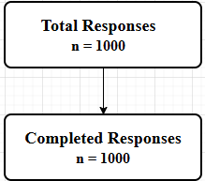
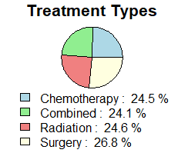
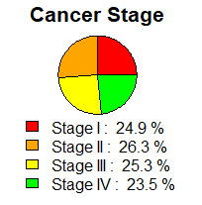
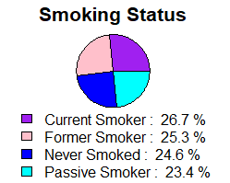
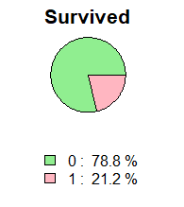
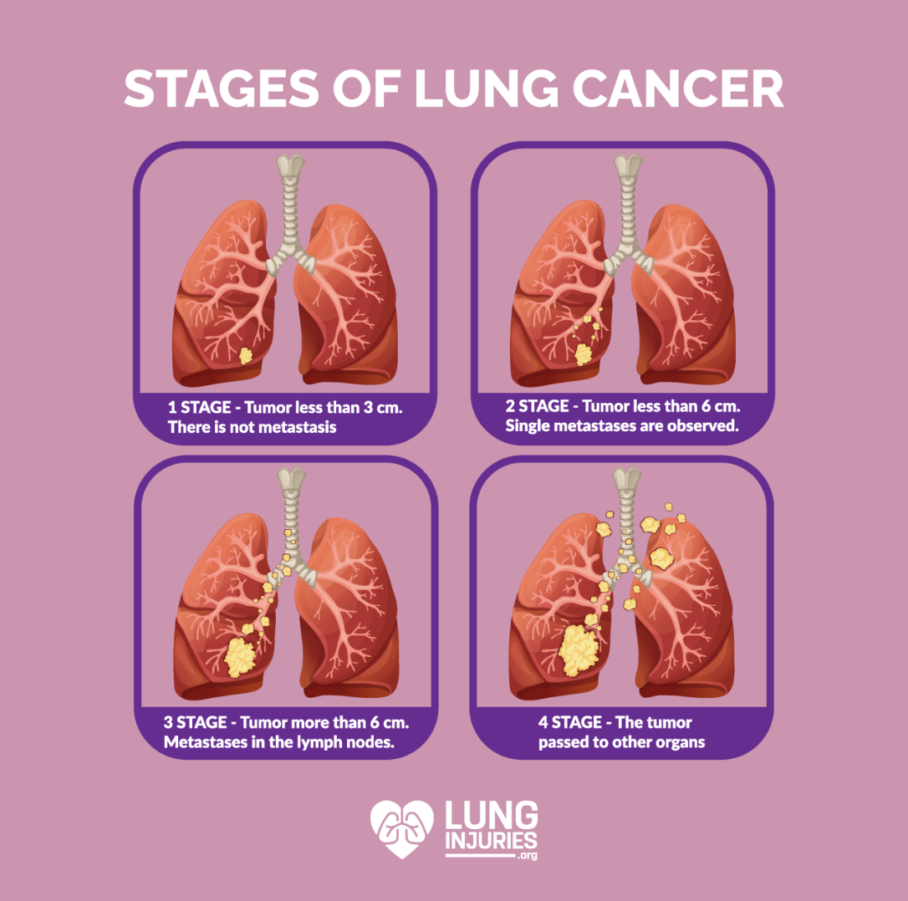
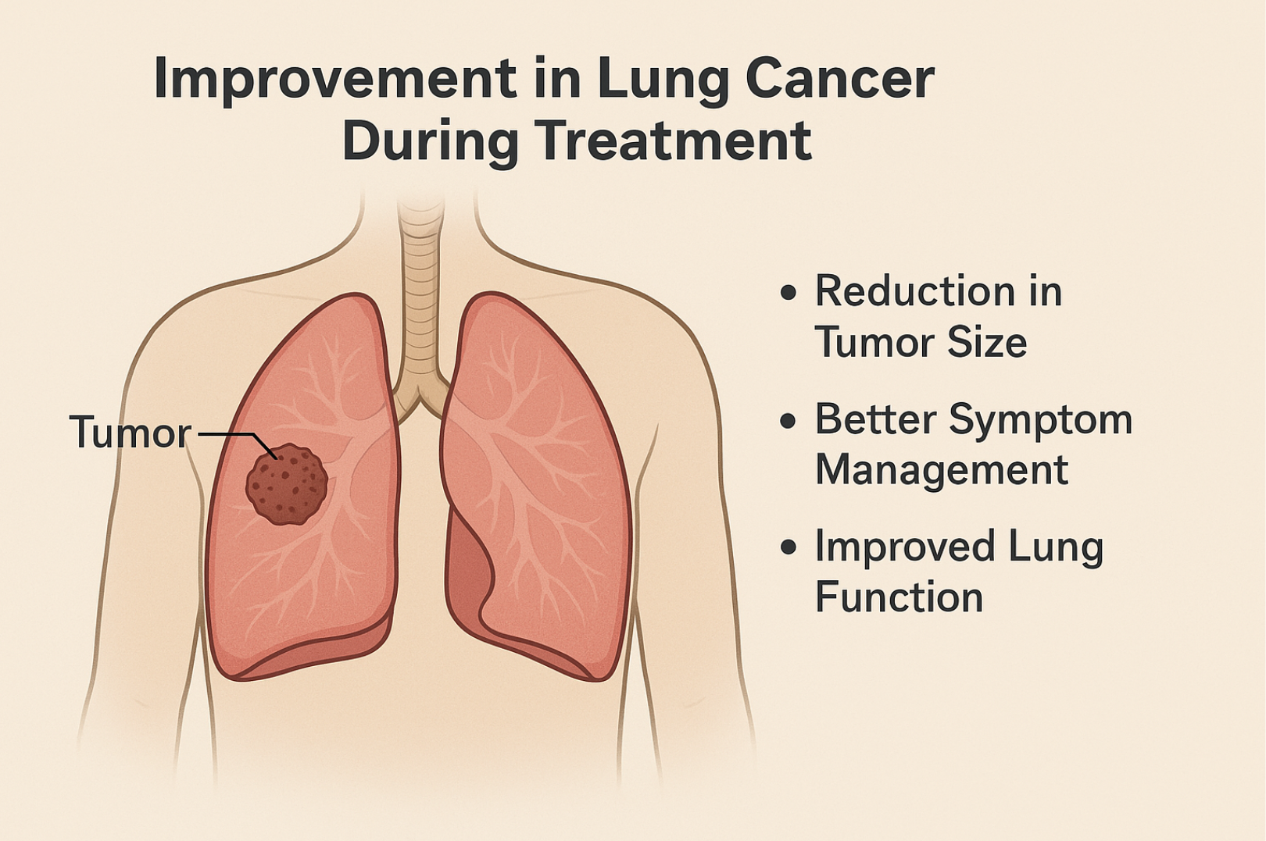
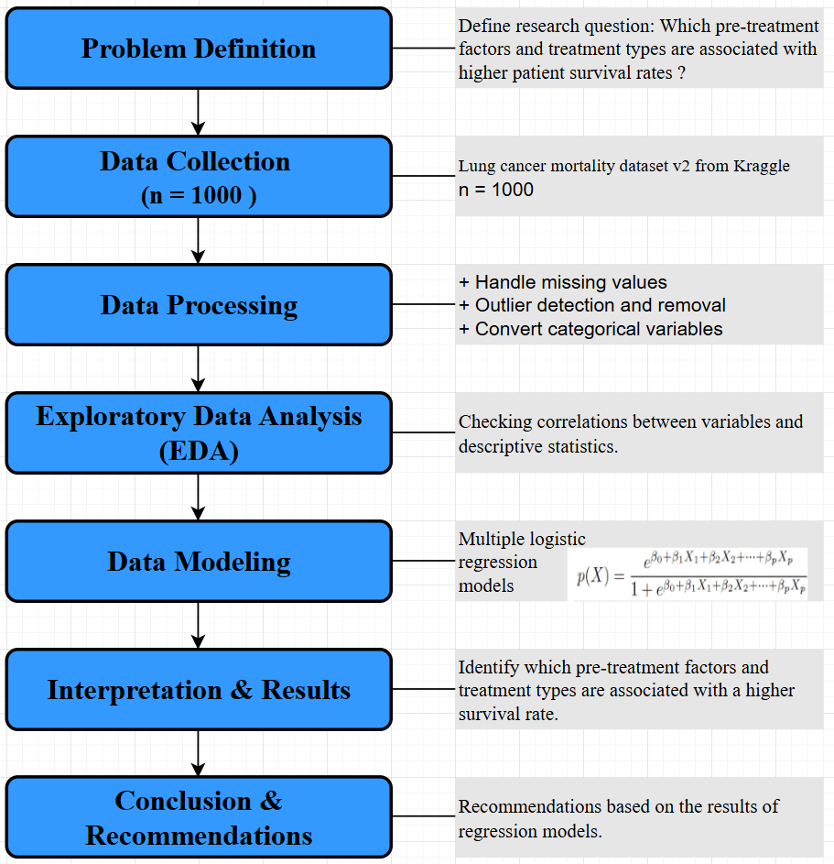
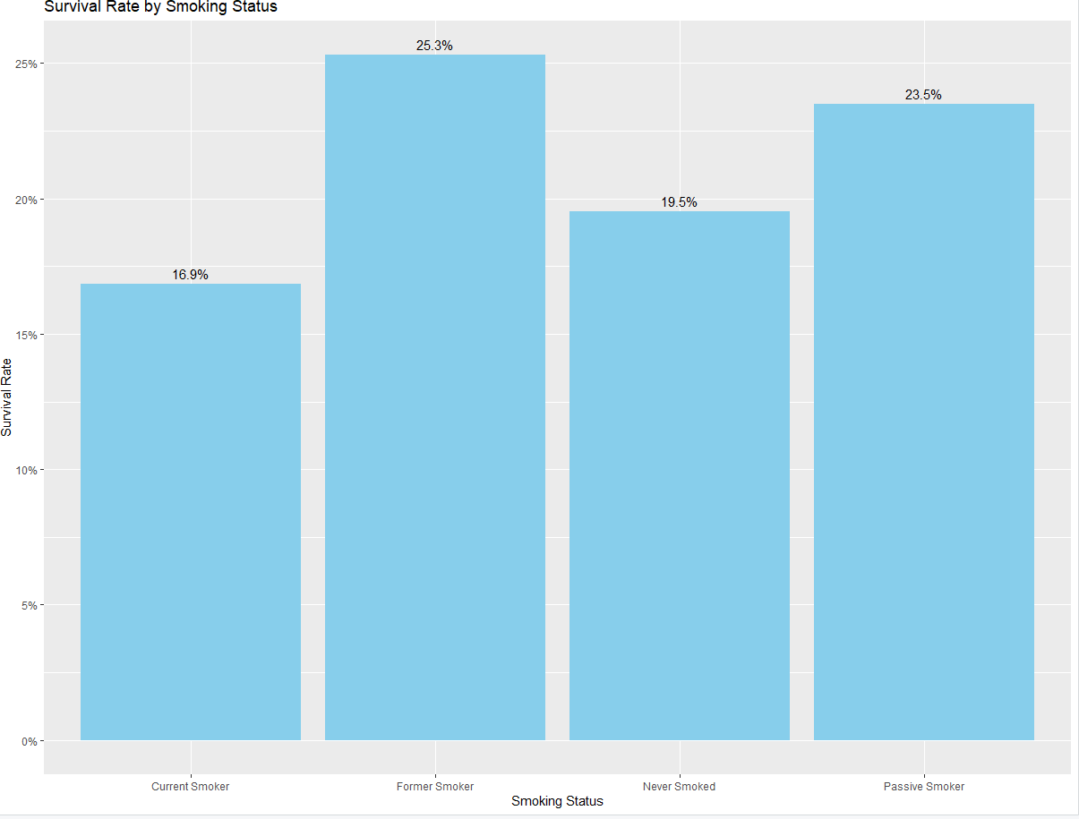
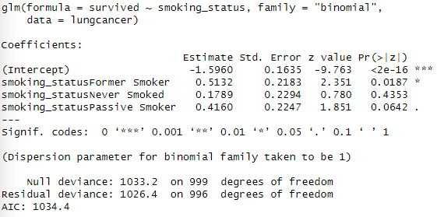
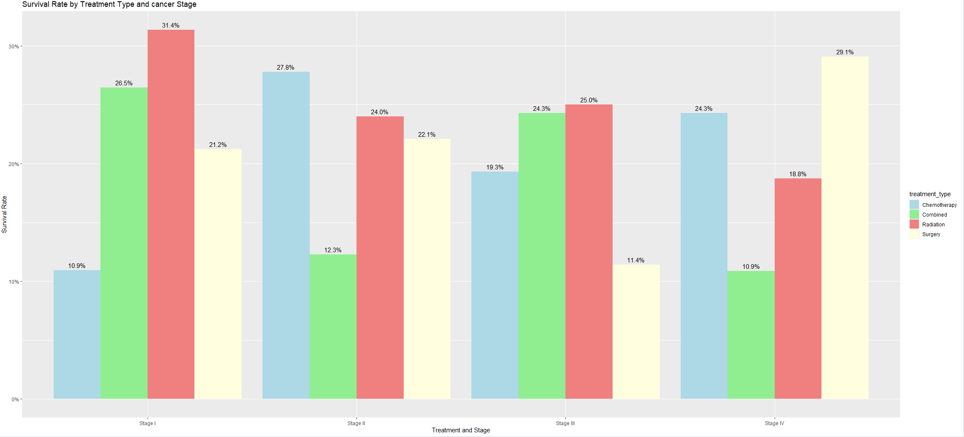
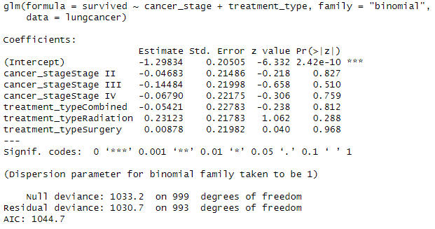



From Smoking to Staging: Understanding Lung Cancer Mortality Through Logistic Models
Thuy Dong, An Nguyen
INTRODUCTION
Advisor: Dr. Ruvini Jayamaha, Applied Regression Analysis Spring 2025
RESULTS
Lung cancer is a leading cause of cancer-related deaths worldwide, with survival rates varying significantly based on factors like cancer stage and treatment type.
To explore these factors, we aim to identify how different variables contribute to survival rates, and how various treatment types influence lung cancer survival outcome.
This project analyzes lung cancer survival outcomes using a dataset that contains patient health information, cancer stage, and treatment types.
This study identifies significant survival predictors, assesses treatment effects across cancer stages, and quantifies the impact of pre-treatment health profiles on survival rates.
Sample Respondents
Model 1: The impact of smoking status on lung cancer survival
The visualization shows:
Former Smoker has the highest survival rate at 25.3%
Current Smoker has the lowest survival rate at 16.9%
p-value = 0.0187. Former smokers showed a statistically significant association with survival status (p < 0.05) compared to Current Smoker.
Coefficient 0.5132 translates to odds ratio of ~1.67, meaning Former Smoker has 67% higher odds of survival compared to Current Smoker.
Model 2: How cancer stage and treatment type affect survival outcomes
p-values > 0.05. No variables were statistically significant.
Among Treatment, Radiation had the highest positive coefficient (0.231)
Across Cancer Stages, all coefficients were negative, suggesting decreasing odds of survival compared to Stage I
Lung Cancer Stages vs During Treatment
METHODS
CONCLUSIONS
Model 1: Smoking status was the only significant predictor of survival. Former smokers had approximately 67% higher odds of survival compared to current smokers, reinforcing the positive impact of smoking cessation on lung cancer patients.
Model 2: Although no predictors were statistically significant, the result suggests that there is no single best treatment for lung cancer; instead, the most effective treatment may vary depending on the cancer stage.
Future research: Incorporate additional variables such as genetic data, medical history, environmental exposure, or treatment adherence to improve survival predictions.
Model 1: The Impact of Smoking Status on Lung Cancer Survival
LIMITATIONS
Logistic regression was selected due to the binary nature of the outcome variable and was used to examine how factors like smoking status, cancer stage, and treatment type influence the likelihood of survival.
Model 2: How Cancer Stage and Treatment Type Affect Survival Outcomes
Limitations of our study
The dataset may not represent the broader population of lung cancer patients, particularly if it is skewed by factors like geography or treatment availability.
Unmeasured confounders, like genetic factors or lifestyle variables, may influence survival outcomes but are not accounted for.
CODE LINKEDIN
REFERENCE
MasterDataSan. (n.d). Lung Cancer Mortality Datasets v2 [Data set]. Kaggle. Retrieved April 7, 2025, from
https://www.kaggle.com/datasets/masterdatasan/lung-cancer-mortality-datasets-v2?select=lung_cancer_mortality_data_test_v2.csv
Thuy Dong An Nguyen

