Slide 1

DELE CA1 PART A (Convolutional Neural Network)
By Lim Song Han

Slide 2
Overview of Workflow
Loading Dataset
Exploratory Data Analysis
Data Preparation
Data Augmentation Comparison w/ baseline models
Modeling & Evaluation
Conclusion

Slide 3
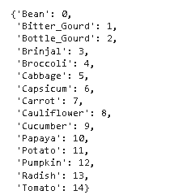

LOADING OF DATASET
We load the dataset and can see the amount of images in each dataset , and the number of classes

Slide 4
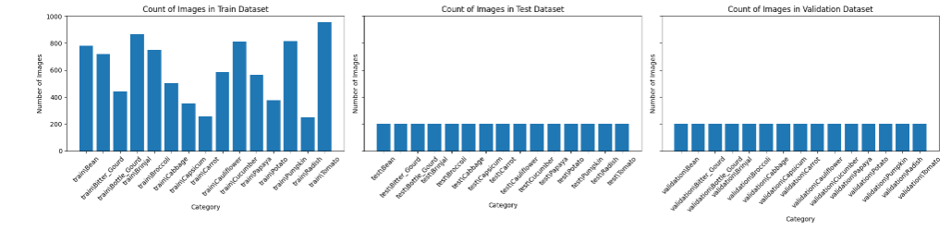
EDA
We can see the amount of images in each class now.
We also see that there is class imbalance in the train dataset

Slide 5
EDA
Images with a similar shade like the green vegetables might cause problems for the model for its, which might suggest that it is harder to predict these classes

Slide 6
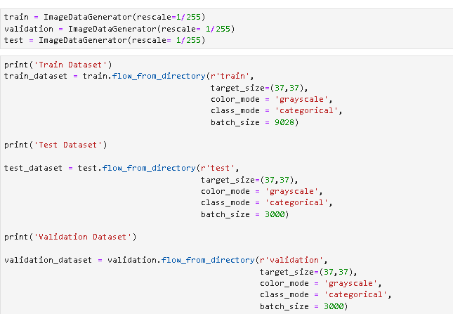
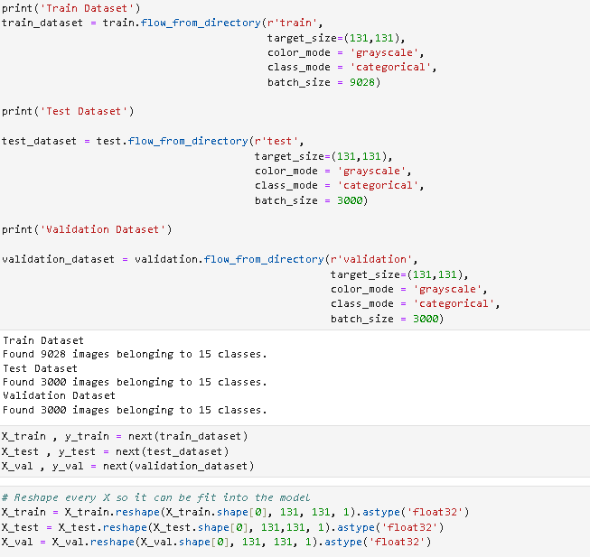
Data Preparatiom
We prepare our data by grey scaling it and making it categorical so that it is easier for the model to train on

Slide 7
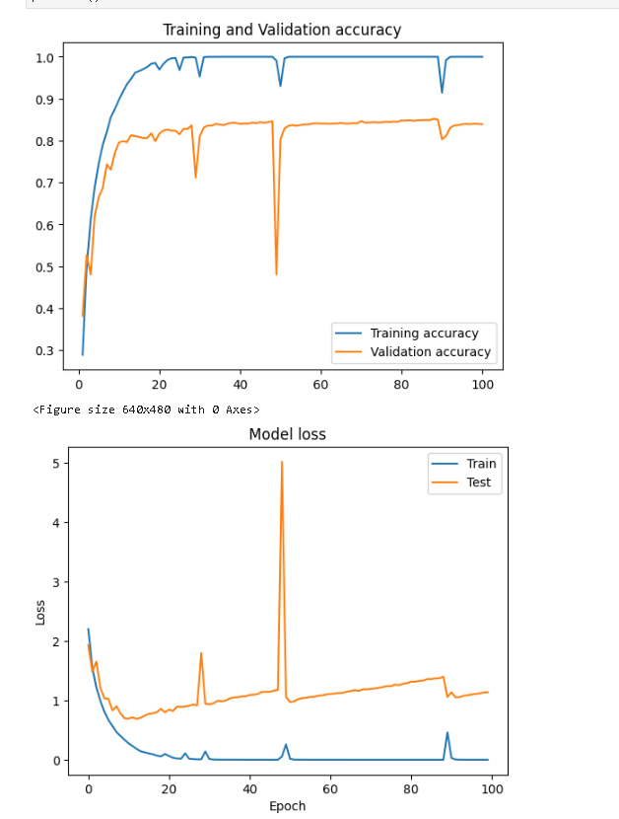
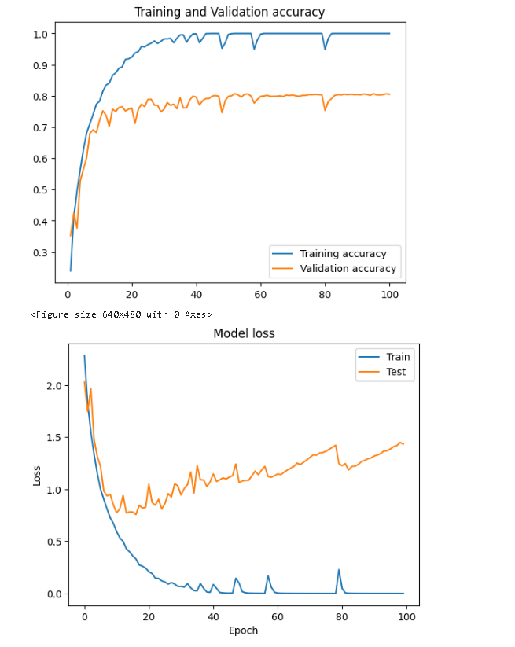
Data Augmentation Comparison
Baseline Model without Augmentation
Baseline Model with Augmentation
We can see that the Data Augmentation helps that model with inconsistency.

Slide 8
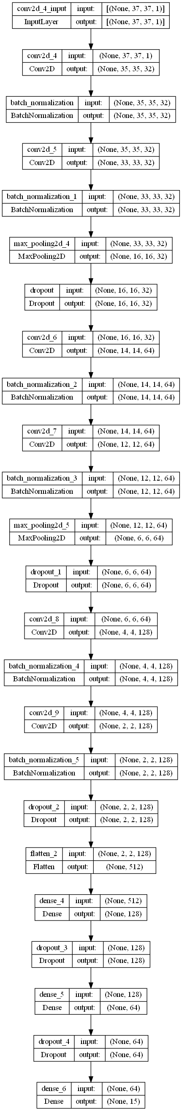
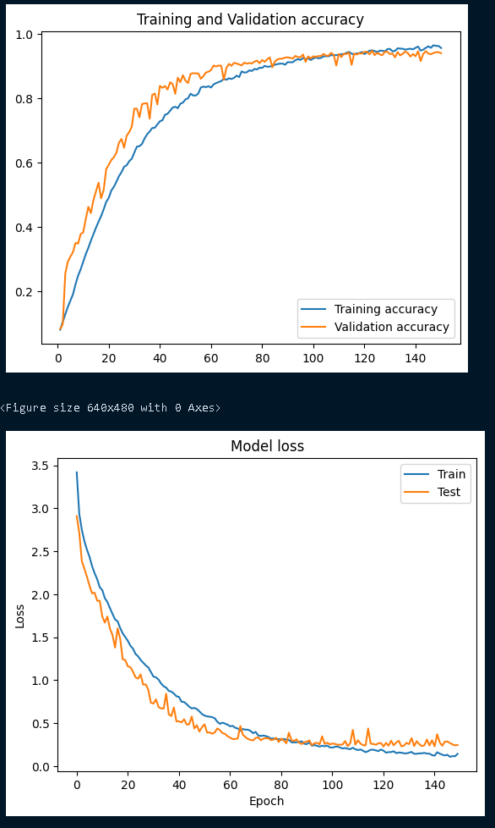
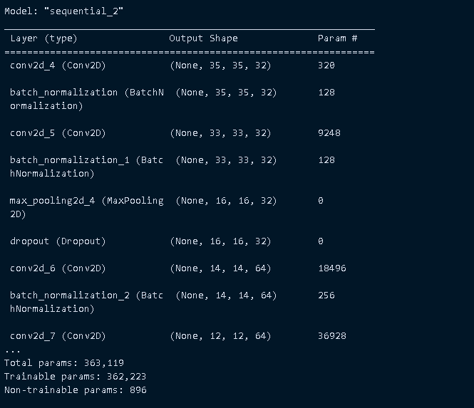
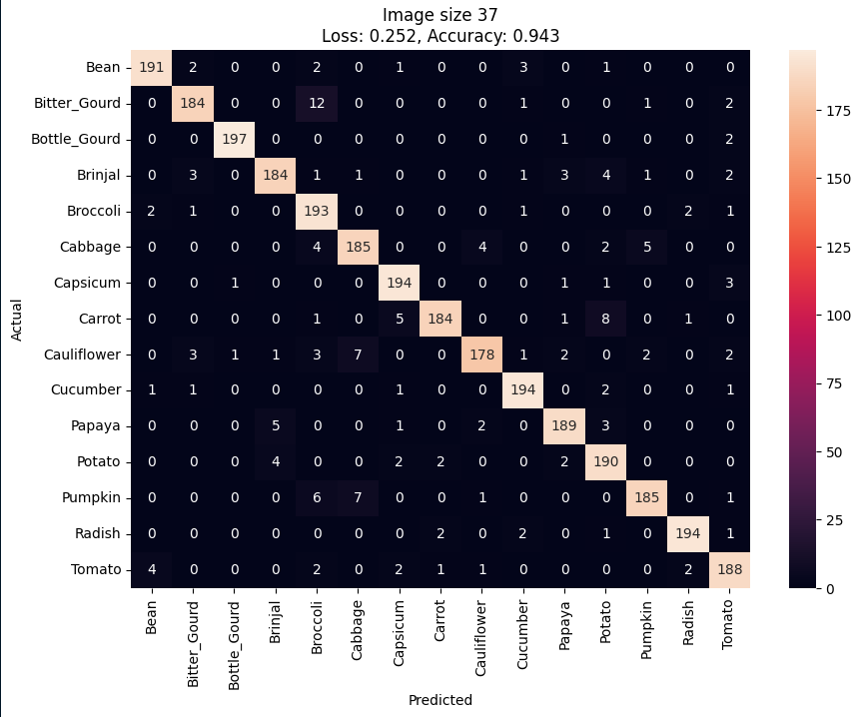
Model (37Pixel)
For Model Improvement to optimize this model , we added Class Weights, BatchNormalization & Dropout layers , experimented with different filters and learning rates
Accuracy: 94.3% We can see that the model is well fitted.

Slide 9
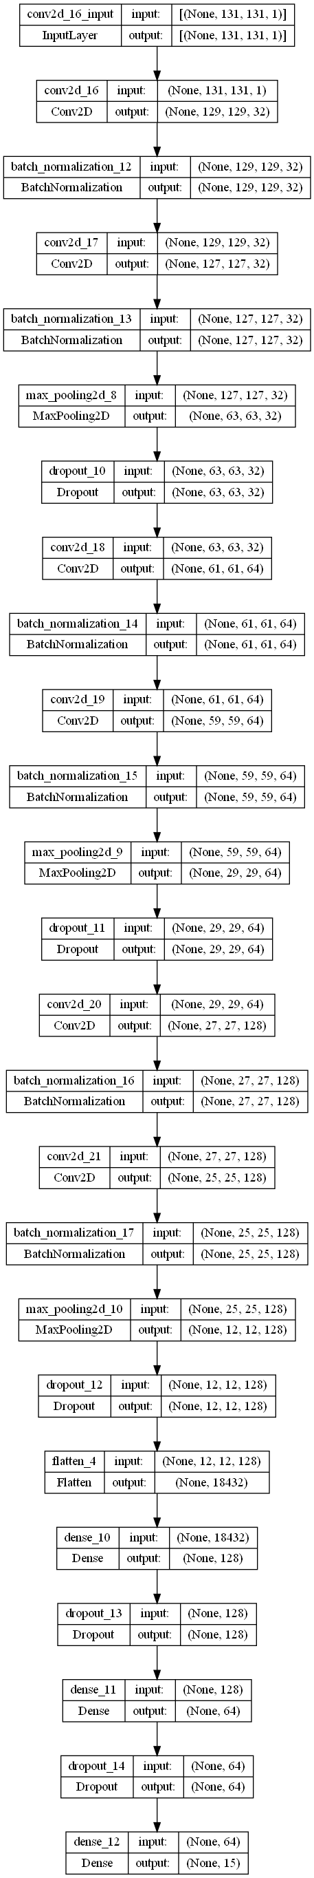
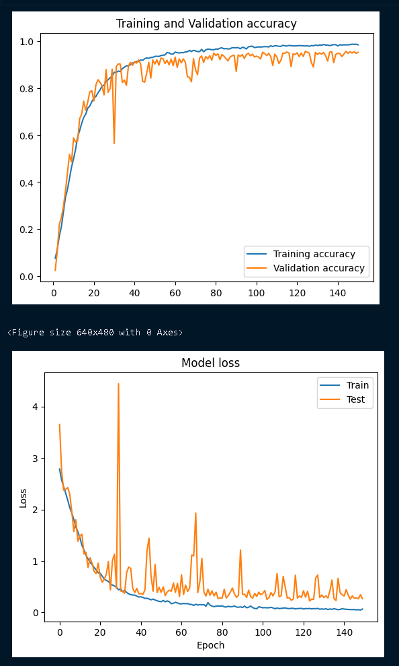
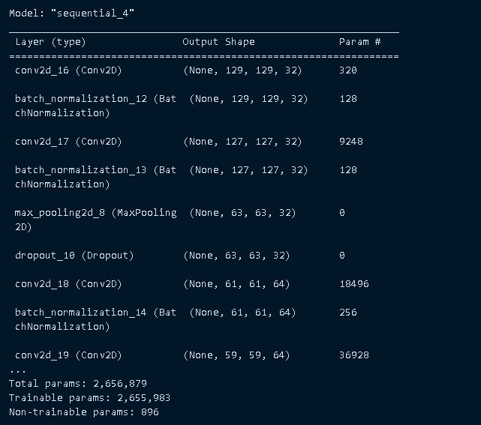
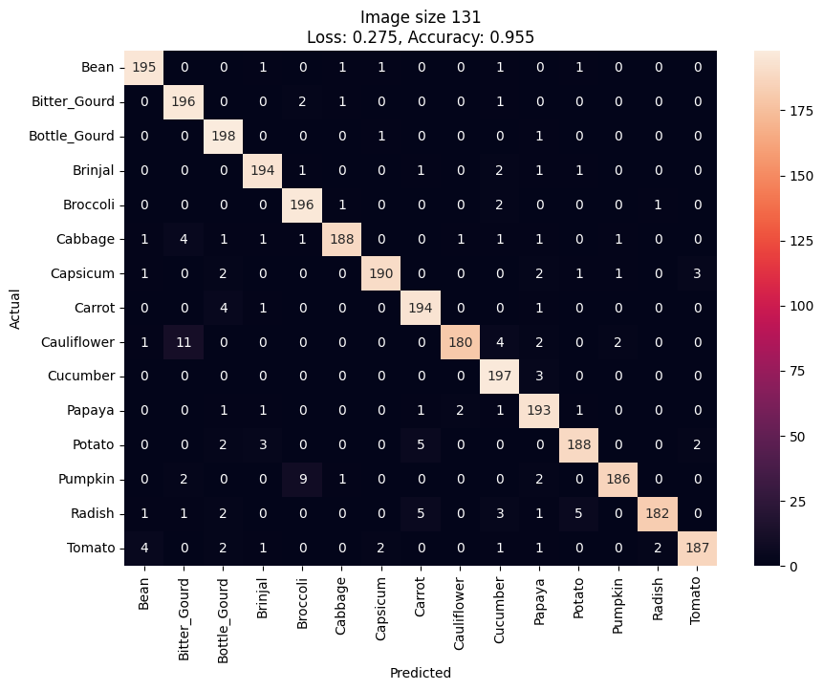
Model (131Pixel)
Same Model Improvements as the 37pixel Model, just added an additional MaxPooling2D layer
Accuracy: 95.5% We can see that the model is well fitted, but is slightly inconsistent .This maybe be because of the large amount of params.

