Slide 1

CS 546 – Web Programming I
MongoDB

Slide 2
Patrick Hill
Adjunct Professor Computer Science Department
Patrick.Hill@stevens.edu

Slide 3
Extremely Brief Prelude

Slide 4
JSON
Very often, we use JavaScript style objects to transmit data between processes, servers, systems, etc. The standard followed when transmitting objects is called JSON: JavaScript Object Notation.
Formally, “JSON is a syntax for serializing objects, arrays, numbers, strings, booleans, and null”.
https://developer.mozilla.org/en-US/docs/Web/JavaScript/Reference/Global_Objects/JSON
In MongoDB, data is stored in a binary version of JSON. In general, we will be using JSON for the rest of the semester to translate information between clients, servers, processes, etc.
We can parse a JSON string to be an object using JSON.parse(someJSONstring)
We can take a JavaScript object and serialize it to JSON using JSON.stringify(myObject)

Slide 5
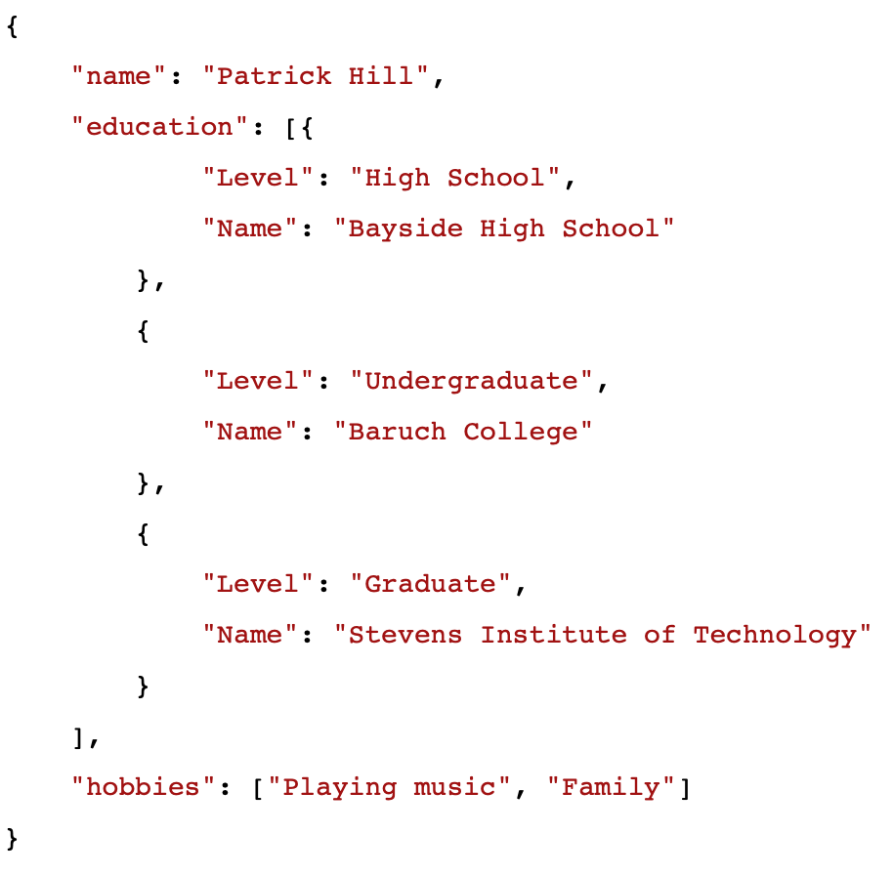
JSON

Slide 6
Introduction to Databases

Slide 7
What Is a Database?
A database is an organized collection of data. It allows you to create, read, update, and delete data. Unlike storing in memory, databases allow you to persist your data.
MongoDB is a document-based database.
Document-based databases store semi-structured data (think, JSON!) and only lookup by key (a unique identifier)
You interact with MongoDB by submitting queries to your database that describe operations that you wish to do.

Slide 8
What Is a Document-Based Database?
Traditional databases are stored in tables that are composed of columns describing data and rows of data. They have a pre-defined schema to them, constraining the type of data you can store in each table.
Document-based databases forgo this and allow you to simply store and retrieve data at a particular location. They are very good at ID lookups but suffer slightly on querying.
This is less off an issue now than in previous years.

Slide 9
Why MongoDB?
MongoDB is incredibly easy to setup and use, allowing you to focus on web-development as a whole and how all the parts work together, rather than focusing on the nuances of databases.
It stores JSON-like structures, making it easy to conceptualize.
Easy to have nested objects (subdocuments)
Much like objects, each collection stores data in a dictionary fashion using a key/value pair.
The querying language is composed by JSON that describe queries, making it easy to pick up.

Slide 10
The Structure of MongoDB
MongoDB only has a few layers to it:
Databases: You can create a database to contain related collections
Collections: Each database has a number of collections. Collections are sets of documents that you decide are related by their content. Your documents do not have to have the same fields.
Documents: Documents are self contained pieces of data that you store in a collection. Each document must have an ID and can have any other set of fields; these fields can be smaller subdocuments.
Subdocuments: A document field can describe another document that will be stored in its parent. This is akin to an object that has a second object stored as a property. This is referred to as a subdocument.

Slide 11
Basic Operations in MongoDB
For now, we will be focusing on four different operations:
Insert: will take an object and insert it into the database.
Find: will take an object describing fields and values to match and returns an array of matching documents.
Update: will take two objects; one that contains an object describing fields and values to match, and one that will describe the update to perform. It can update multiple if you provide a third object with settings telling it to update multiple documents.
Remove: will take an object describing fields and values to match and will remove the object. It can remove multiple if you provide a second object with settings telling it to update multiple documents.

Slide 12
Demonstration
https://github.com/stevens-cs546-cs554/CS-546/tree/master/lecture_04/code
The first thing you should take note of is a file called mongoConnection.js
This file allows you to create one shared database connection for your entire app!
The second thing you should take note of is a file called mongoCollections.js
In this file, you can setup a module that will export async functions (promises) that resolve to database collections; this ensures that the connection is working and allows you to organize code better.
The third thing you should notice is dogs.js
This file sets up a module that shows the basic pattern of Create, Read, Update, and Delete!

Slide 13
Demonstration This Week
This week, we will be looking at a dog blog. Yes, for dogs that blog.
We will be following code that takes us through the blogs of 3 dogs:
Sasha, a Cheagle (Chihuahua-Beagle) that runs a blog about different types of cheese.
Max, a grizzled ex-cop Mastiff with a heart of gold.
Pork Chop, a confused Golden Labrador Retriever that, coincidentally, does not like pork and is fonder of turkey.

Slide 14

In honor of the previous professor, Phil Barresi, I have left his dog blogging pic

Slide 15
Connecting to MongoDB

Slide 16
MongoDB Flow

Slide 17
Installing the MongoDB Driver Package
We will be using the official MongoDB driver released by the official Mongo team.
Other drivers add complexity that we need not worry about for the scope of this course.
npm install mongodb
Using the driver is simple, since MongoDB natively uses JSON to query and store documents.
We will be using this driver in order to setup connections do basic querying against MongoDB.
http://mongodb.github.io/node-mongodb-native/
See the API section for the most recent driver for documentation!
The MongoDB driver methods return promises, which means we can await them from inside of async functions.

Slide 18
Connecting to Your Database
Once we deal with installing the package to the project and requiring it, we can create a database connection. This is demonstrated in mongoConnection.js file we saw before.
The basic algorithm of using a database is simple:
You use connection information in order to connect to the database
You store this database connection in a variable and use it to access collections
You store this collection reference in a variable and use it to access collection operations

Slide 19
Connecting to Your Database
const MongoClient = require("mongodb").MongoClient;
const settings = require("./settings");
const mongoConfig = settings.mongoConfig;
let _connection = undefined;
let _db = undefined;
module.exports = async() => {
if (!_connection) {
_connection = await MongoClient.connect(mongoConfig.serverUrl,{useNewUrlParser:true,useUnifiedTopology: true });
_db = await _connection.db(mongoConfig.database);
}
return _db;
};

Slide 20
Creating and Using a Collection
In order to create, read, update, or delete documents you must first have a collection. Collections will be automatically created when a document is first inserted into a new collection.
We can retrieve data from a collection by retrieving a reference to the collection and querying it, which you can see in dogs.js
We need to set up our collections in mongoCollections.js

Slide 21
Creating and Using a Collection
const dbConnection = require("./mongoConnection");
/* This will allow you to have one reference to each collection per app */
/* Feel free to copy and paste this this */
const getCollectionFn = collection => {
let _col = undefined;
return async () => {
if (!_col) {
const db = await dbConnection();
_col = await db.collection(collection);
}
return _col;
};
};
/* Now, you can list your collections here: */
module.exports = {
posts: getCollectionFn("posts"),
dogs: getCollectionFn("dogs")
};

Slide 22
Abstracting Your Queries
It is often very useful to create a file to abstract away your database querying.
By creating a layer between your application code and your database, you will allow yourself to:
More easily make changes to the database later on
Allow non-database programmers to more easily use the database (separation of concerns!)
More easily improve performance at a later time
Easier and more consistent error checking throughout your entire application.
Make it a reasonable task to change your entire database when the first database your company chose ends up being unable to support large amounts of data and you need to transition over to another database.
Also helps when this happens again 2 years later.
In dogs.js we abstract the queries to hide them away from the rest of our application.

Slide 23
Basic Data Manipulation in MongoDB

Slide 24
Inserting Into Your Collection
Let’s take a look at app.js now.
In this file, we will start off by creating our dogs, whom will be our bloggers today. We will be calling the methods exported from dogs.js in order to use those functions more easily.
In MongoDB, you insert documents; these documents are just JSON objects; we insert documents into collections, as you can see from the addDog method in dogs.js

Slide 25
Inserting Into Your Collection
async addDog(name, breeds) {
if (!name) throw 'You must provide a name for your dog’;
if (!breeds || !Array.isArray(breeds)) throw 'You must provide an array of breeds’;
if (breeds.length === 0) throw 'You must provide at least one breed.’;
const dogCollection = await dogs();
let newDog = {
name: name,
breeds: breeds
};
const insertInfo = await dogCollection.insertOne(newDog);
if (insertInfo.insertedCount === 0) throw 'Could not add dog’;
const newId = insertInfo.insertedId;
const dog = await this.getDogById(newId);
return dog;
}

Slide 26
Retrieving Data
In MongoDB, you retrieve documents by querying for matching properties. In our case, we query dogs based on their _id field. The _id field is auto-generated on insert. We can also search for dogs based on matching names, or other properties (to be seen soon!).
The getDogById method demonstrates retrieving a single dog that matches the query.
The getAllDogs method demonstrates retrieving all dogs from the database.

Slide 27
Retrieving Data
async getDogById(id) {
if (!id) throw 'You must provide an id to search for’;
const dogCollection = await dogs();
const doggo = await dogCollection.findOne({_id: id});
if (doggo === null) throw 'No dog with that id’;
return doggo;
}

Slide 28
Retrieving Data
async getAllDogs() {
const dogCollection = await dogs();
const dogs = await dogCollection.find({}).toArray();
return dogs;
}

Slide 29
Updating Data
In MongoDB we can update one or more documents at a time by passing an object that describes what documents you want to match, and a document describing how you want the update to occur.
For now, we will be replacing the document entirely by passing a new version of the document to the update call.

Slide 30
Updating Data
async updateDog(id, name, breeds) {
if (!id) throw 'You must provide an id to search for’;
if (!name) throw 'You must provide a name for your dog’;
if (!breeds || !Array.isArray(breeds)) throw 'You must provide an array of breeds’;
if (breeds.length === 0) throw 'You must provide at least one breed.’;
const dogCollection = await dogs();
const updatedDog = {
name: name,
breeds: breeds
};
const updatedInfo = await dogCollection.updateOne({_id: id}, {$set: updatedDog});
if (updatedInfo.modifiedCount === 0) {
throw 'could not update dog successfully’;
}
return await this.getDogById(id);
}

Slide 31
Deleting Data
In MongoDB we can delete one or more documents at a time by passing an object that describes what documents you want to match.
async removeDog(id) {
if (!id) throw 'You must provide an id to search for’;
const dogCollection = await dogs();
const deletionInfo = await dogCollection.removeOne({_id: id});
if (deletionInfo.deletedCount === 0) {
throw `Could not delete dog with id of ${id}`;
}
}

Slide 32
Questions?

