Slide 1
从一个维度 看浏览器安全

Slide 2
Cookie Attributes
How many attributes does the cookie have？

Slide 3
Let’s review cookie
Name
can be any US-ASCII characters except control characters (CTLs), spaces, or tabs.
Value
can optionally be set in double quotes and any US-ASCII characters excluding CTLs, comma, semicolon, and backslash are allowed.
Domain
Specifies those hosts to which the cookie will be sent.
Expires
The maximum lifetime of the cookie as an HTTP-date timestamp.
HttpOnly
HTTP-only cookies aren't accessible via JavaScript through the Document.cookie property, the XMLHttpRequest
Secure
A secure cookie will only be sent to the server when a request is made using SSL and the HTTPS protocol.

Slide 4
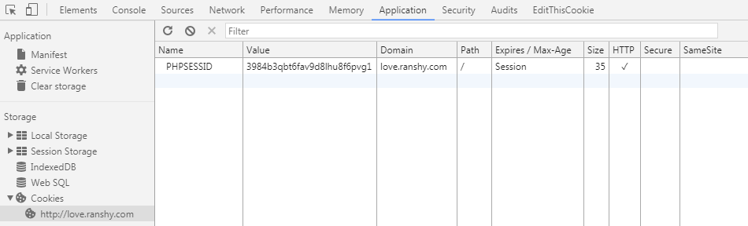
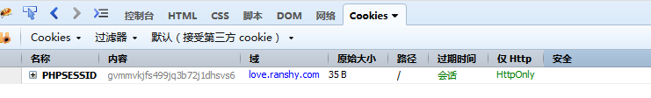

Slide 5
1.
CSRF
cross site request forgery

Slide 6

CamCard Note!
csrf.ranshy.com
It stems from the simple capability that a site has
to issue a request to another site.

Slide 7
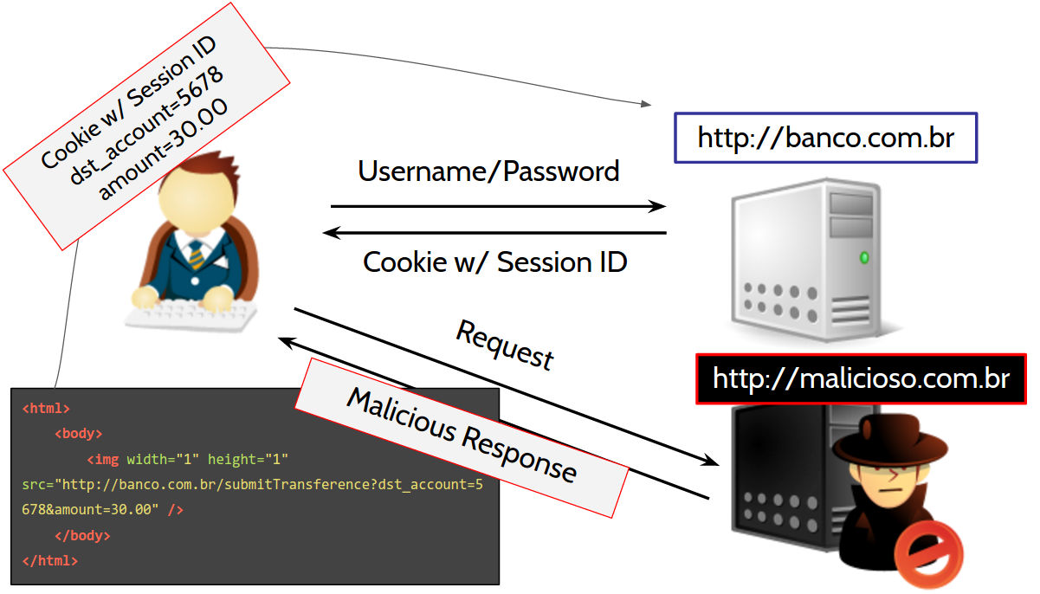

Slide 8
2.
Same-Origin Policy
web application security model

Slide 9
IETF RFC 6453
The same scheme
The same host
The same port
All modern browsers implement some form of the Same-Origin Policy as it is an important security cornerstone.
https://tools.ietf.org/html/rfc6453

Slide 10
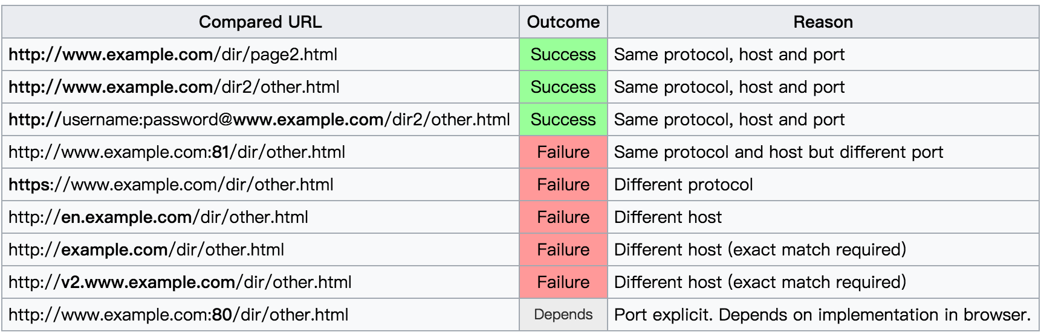
For Example
http://www.example.com/dir/page.html

Slide 11
Ajax
Cookie
Iframe
Doms
Same-Origin Policy

Slide 12
Hack CamCard
<form method="POST" name="form0" action="https://www.camcard.com:443/note/save?_script_key=1">
<input name="card_id" value="6CF3E53BB5114327VY9PK7WX.vcf"/>
<input name="json" value='[{"Type":0,"Time":1504594222.804,"Content":"testtest"}]'/>
<input name="YII_CSRF_TOKEN" value="a7f7b8c135d9c0fce13517da79286111"/>
<input type="submit" value="Submit" />
</form>

Slide 13
3.
CSRF Tester
OWASP CSRF Tester Project

Slide 14
CSRF WAYS
iframe
form
a/img

Slide 15

Cross-Origin Resource Sharing

Slide 16
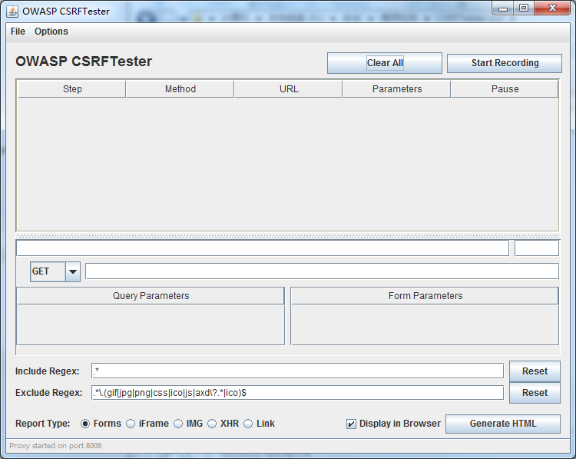
CSRF TESTER
Cross-Site Request Forgery (CSRF) is an attack whereby the victim is tricked into loading information from or submitting information to a web application for which they are currently authenticated. The problem is that the web application has no means of verifying the integrity of the request. The OWASP CSRFTester Project attempts to give developers the ability to test their applications for CSRF flaws.
https://www.owasp.org/index.php/Category:OWASP_CSRFTester_Project

Slide 17
4.
Hack Demo
wechat voting by csrf

Slide 18

服务号 给企业和组织提供更强大的业务服务与用户管理能力，帮助企业快速实现全新的公众号服务平台。
订阅号 为媒体和个人提供一种新的信息传播方式，构建与读者之间更好的沟通与管理模式。
小程序 一种新的开放能力，可以在微信内被便捷地获取和传播，同时具有出色的使用体验。

Slide 19
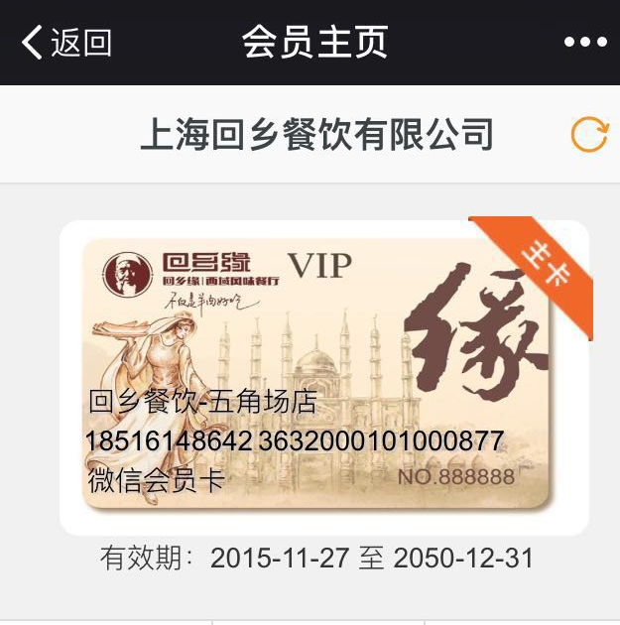
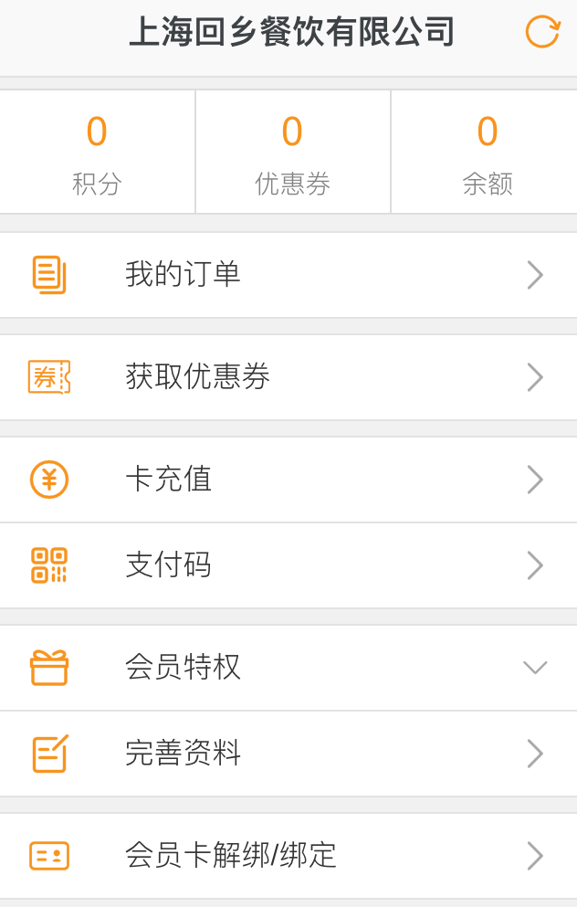
Hui Xiangyuan VIP Card

Slide 20
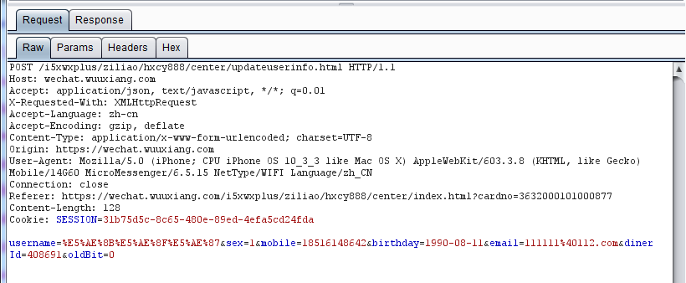

Slide 21
UED
Voting
Video
Verity
User Experience Design

Slide 22
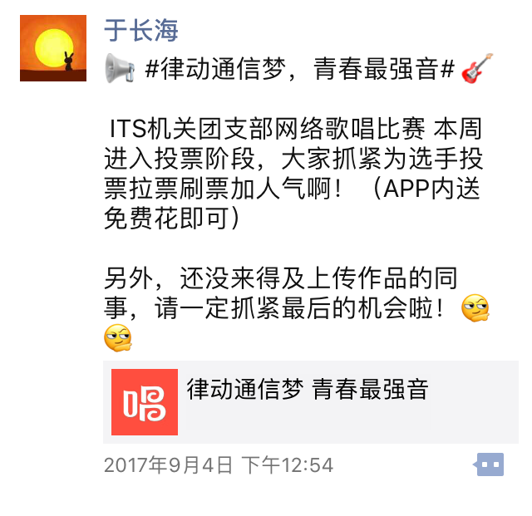
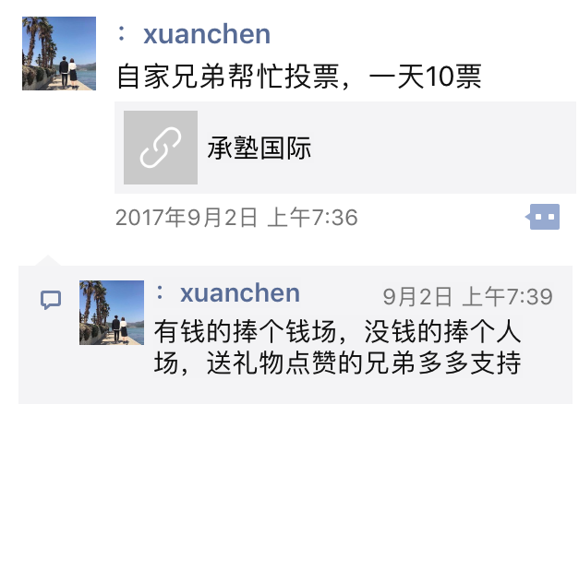
CSRF User Experience Design

Slide 23
Safe CSRF ?
Only when the user logs in, we implement the csrf attack.

Slide 24

Ajax
Cookie
Iframe
Doms
Same-Origin Policy

Slide 25
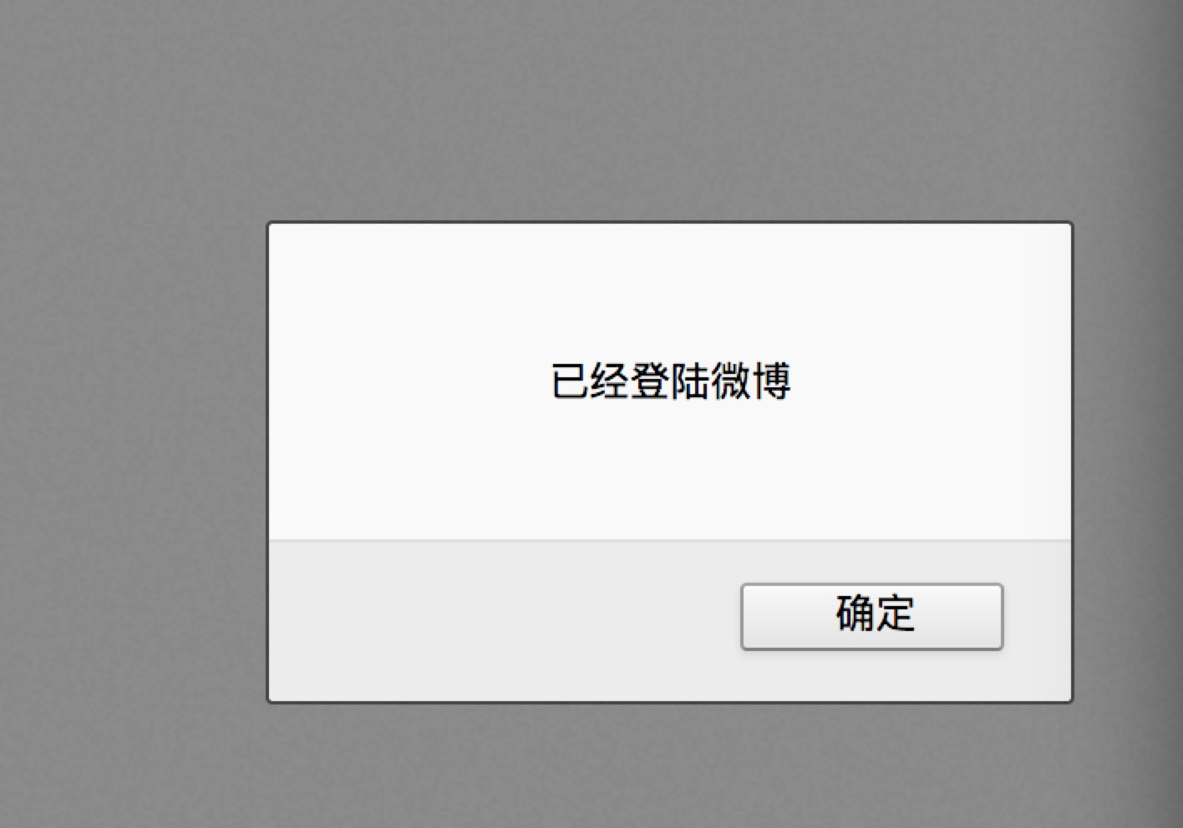
Log In Checking
Redirect + favicon + img + onerror
http://weibo.com/login.php?url=http://weibo.com/favicon.ico

Slide 26
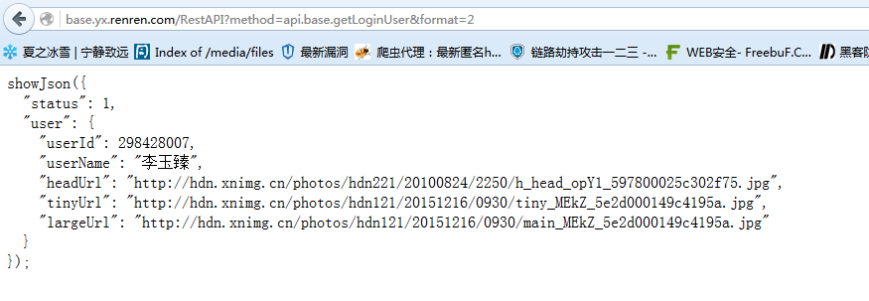
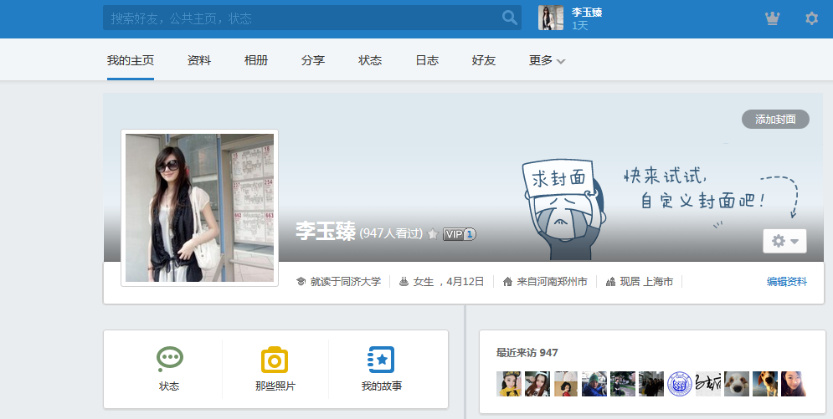
Log In Checking
JsonP -- JSON with Padding

Slide 27
5.
Anti-CSRF tokens

Slide 28
Check the origin
When receiving a request we potentially have two pieces of information available to us that indicate where the request came from. These are the Origin header and the Referer header. You can check one or both of these values to see if the request originated from a different origin to your own. If the request was cross-origin you simply throw it away. The Origin and Referer header do get some protection from browsers to prevent tampering but they may not always be present either.

Slide 29
Anti-CSRF tokens
<form action="https://w102.camcard.com/user/login" method="POST">
<input type="hidden" name="csrf_token" value="d82c90fc4a14b01224gde6ddebc23bf0">
<input type="email" id="email" name="email">
<input type="password" id="password" name="password">
<button type="submit" class="btn btn-primary">Login</button>
</form>

Slide 30
Why don't we just tell the browser to stop doing the thing we don't want it to do?...
Now we can!

Slide 31
5.
Same-Site Cookies

Slide 32
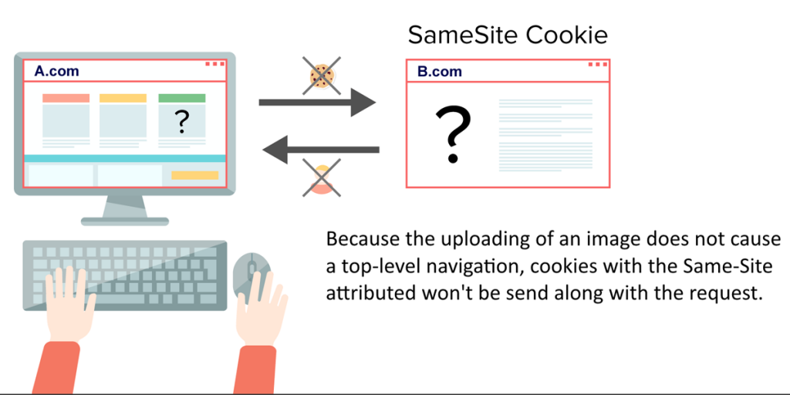
CSRF is dead

Slide 33
Set-Cookie: sess=abc123; path=/
Set-Cookie: sess=abc123; path=/; SameSite

Slide 34
IETF RFC 6265
Strict
When operating in Strict mode the browser will not send the cookie on any cross-origin request, at all, so CSRF is completely dead in the water.
Lax
In Lax mode there is a single exception to allow cookies to be attached to top-level navigations that use a safe HTTP method. The "safe" HTTP methods are defined in Section 4.2.1 of RFC 7321 as GET, HEAD, OPTIONS and TRACE, with us being interested in the GET method here.
https://tools.ietf.org/html/rfc6265
https://tools.ietf.org/html/rfc7231#section-4.2.1

Slide 35
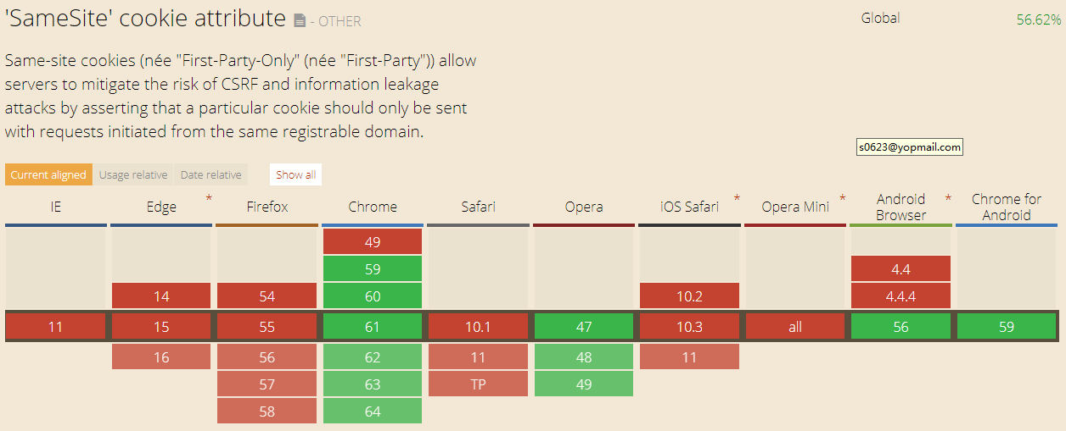
Browser Support

Slide 36
PHP: https://bugs.php.net/bug.ph... Edge: https://wpdev.uservoice.com... Firefox: https://bugzilla.mozilla.or... Safari: https://bugs.webkit.org/sho... ASP.NET Core: https://github.com/aspnet/S... Django: https://code.djangoproject.... Python: https://github.com/python/c...

Slide 37
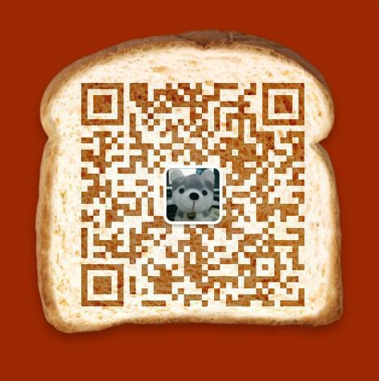
Thanks!
Any questions?

