Slide 1
Graph Theory
Hongbao Song
2016.04.19
Notes:
公式、数字
数学分支

Slide 2
Applications
Graphs can be used to model many types of relations and processes.
Physical
Biological
Social
Information Systems
… …
Notes:
关系、程序建模
物理
生物
社会
信息系统

Slide 3
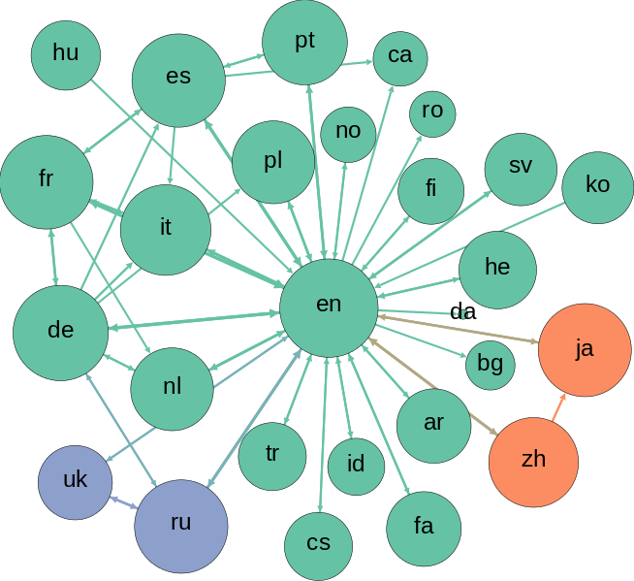
Computer Science
Networks of Communication
Data Organization
Computational Devices
The Flow of Computation
Graph Databases
… …
Notes:
通信
数据组织
计算机组成
数据流
图形数据库
监控投票
维基

Slide 4
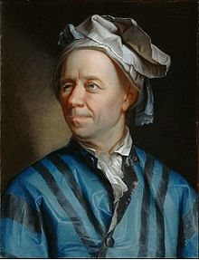
History
Leonhard Euler in 1736 laid the foundations of graph theory and prefigured the idea of topology.
Notes:
拓扑
不等式
φ(n) = n （1 – 1 / p₁）（1 – 1 / p₂）···（1 – 1 / p_{i-1}）（1 – 1 / p_{i}）
φ(p) = p -1
φ(p^{k}) = p^{k} – p^{k-1}

Slide 5
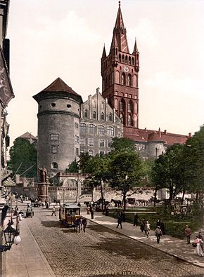
Königsberg
1255, founded by Teutonic Knights during the Northern Crusades.
1525, Duchy of Prussia.
1641, East Prussia.
Königsberg was the easternmost large city in Germany.
Notes:
柯尼斯堡
条顿人; 北欧人; 日耳曼人
1255年条顿骑士团北方十字军建立
普鲁士公国
东普鲁士
德国文化中心之一

Slide 6
The War
The Jewish community in the city had its origins in the 16th century.
The total number of Jewish inhabitants was less than 500 in the middle of the 18th century.
At the end of World War II, the surrender and civilian dead in the city were estimated at 42,000.
120,000 survivors remained, died from disease or deliberate starvation.
The remaining 20,000 German residents were expelled.
In 1945, the city was captured by the Soviet Union. As agreed by the Allies at the Potsdam Conference, northern Prussia.
Notes:
犹太人遭受迫害和驱逐
1941莫斯科报复
1943 11000磅 5吨
1944年初 英基地 不是特别成功 边缘炸
3天后 41％被破坏，189架轰炸机，德国击毙15架 几近摧毁

Slide 7
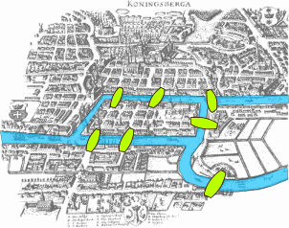
Seven Bridges of Königsberg
The islands could only be reached by the bridges and every bridge once accessed must be crossed to its other end.
The starting and ending points of the walk need not be the same.
Notes:
七桥，两桥彻底毁灭

Slide 8
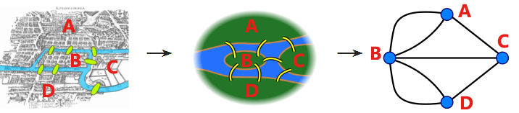
Leonhard Euler
The choice of route inside each land mass is irrelevant.
The only important feature of a route is the sequence of bridges crossed.
Notes:
联通，起点无关
顺序有关

Slide 9
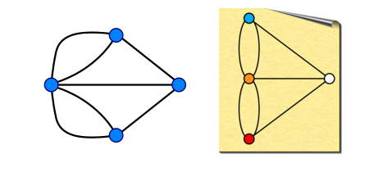
A Variety of Solutions
Understanded
Or
Beautiful

Slide 10
Euler's analysis
During any walk in the graph, the number of times one enters a non-terminal vertex equals the number of times one leaves it.

Slide 11
Properties
An undirected graph has an Eulerian trail if and only if exactly zero or two vertices have odd degree, and if all of its vertices with nonzero degree belong to a single connected component.

Slide 12

The Party Problem
You're going to throw a party, but haven't yet decided whom to invite. How many people do you need to invite to guarantee that at least m people will all know each other, or at least n people will all not know each other ?

Slide 13
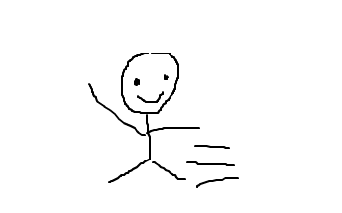
Graph
The essence of graph theory is graph.
Notes:
图论之根本

Slide 14


The Party Problem
Blue edges will connect two vertices to represent that the people are mutual acquaintances.
Red, dashed edges will connect two vertices to represent that the people are mutual strangers

Slide 15
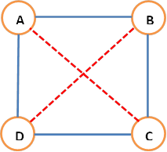
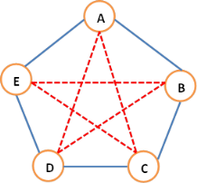
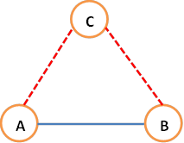
At Least -- Example

Slide 16
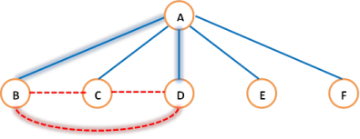
Six People

Slide 17
Ramsey's Theorem
r, s | 1 | 2 | 3 | 4 | 5 | 6 | 7 | 8 | 9 | 10
1 | 1 | 1 | 1 | 1 | 1 | 1 | 1 | 1 | 1 | 1
2 | 1 | 2 | 3 | 4 | 5 | 6 | 7 | 8 | 9 | 10
3 | 1 | 3 | 6 | 9 | 14 | 18 | 23 | 28 | 36 | 40–42
4 | 1 | 4 | 9 | 18 | 25 | 36–41 | 49–61 | 58–84 | 73–115 | 92–149
5 | 1 | 5 | 14 | 25 | 43–49 | 58–87 | 80–143 | 101–216 | 126–316 | 144–442
6 | 1 | 6 | 18 | 36–41 | 58–87 | 102–165 | 113–298 | 132–495 | 169–780 | 179–1171
7 | 1 | 7 | 23 | 49–61 | 80–143 | 113–298 | 205–540 | 217–1031 | 241–1713 | 289–2826
8 | 1 | 8 | 28 | 58–84 | 101–216 | 132–495 | 217–1031 | 282–1870 | 317–3583 | 331–6090
9 | 1 | 9 | 36 | 73–115 | 126–316 | 169–780 | 241–1713 | 317–3583 | 565–6588 | 581–12677
10 | 1 | 10 | 40–42 | 92–149 | 144–442 | 179–1171 | 289–2826 | 331–6090 | 581–12677 | 798–23556
Notes:
拉姆齐

Slide 18
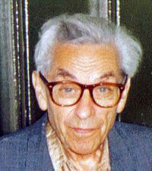
Erdős Citation
Aliens invade the earth and threaten to obliterate it in a year's time unless human beings can find R(5,5). We could marshal the world's best minds and fastest computers, and within a year we could probably calculate the value.
If the aliens demanded the Ramsey number for R(6,6), however, we would have no choice but to launch a preemptive attack.
Notes:
保罗·埃尔德什

Slide 19
To Draw
Not
Drawing

