Slide 1

IEEE Inter. Conf. on Networking, Architecture, and Storage (NAS 2011)
July 28-30, 2011, Dalian, China
Feedback based Sparse Recovery
for Motion Tracking
in RF Sensor Networks
Heping Song, Tong Liu,
Xiaomu Luo and Guoli Wang
2011-7-28
P. <number>/30

Slide 2
Outline
Introduction
Linear Model
Motivation
3
Sparse Recovery
Experiments
Discussions
2011-7-28
P. <number>/30

Slide 3
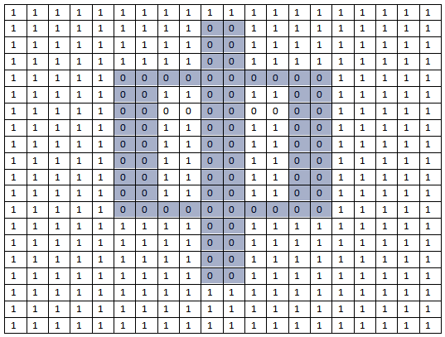
An image is a grid of pixels
Matrix = a grid of pixels
color by number
2011-7-28
P. <number>/30

Slide 4
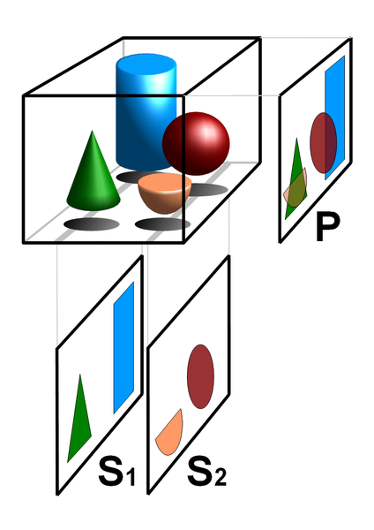
Tomography
Tomo-
means
“a slice/section/part”
in Greek
Wikipedia
2011-7-28
P. <number>/30

Slide 5
Magic Square
4 | 9 | 2
3 | 5 | 7
8 | 1 | 6
15
15
15
15
15
15
15
2011-7-28
P. <number>/30

Slide 6
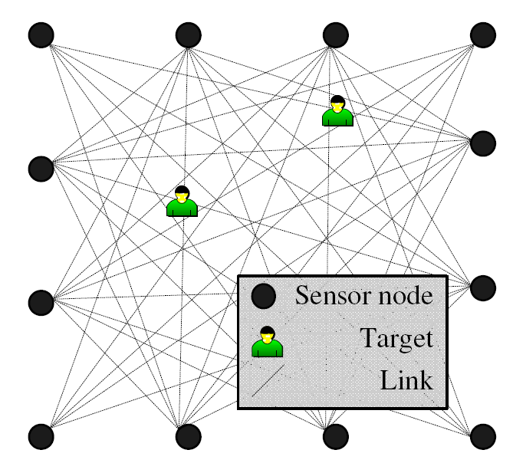
RF Sensor Networks
2011-7-28
P. <number>/30

Slide 7
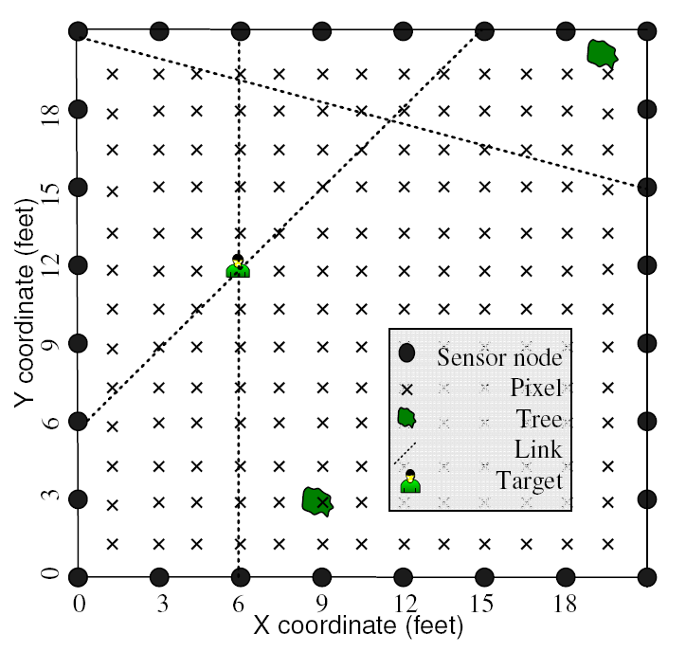
The Network Layout
2011-7-28
P. <number>/30

Slide 8
Radio Tomography Imaging
x₁ | x₄ | x₇
x₂ | x₅ | x₈
x₃ | x₆ | x₉
y₆
y₅
y₄
Weighted Sum
y₁
y₂
y₃
Inverse problem
y
x
2011-7-28
P. <number>/30

Slide 9
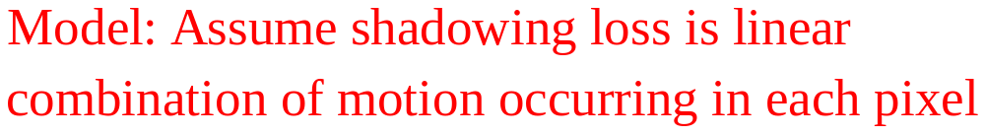
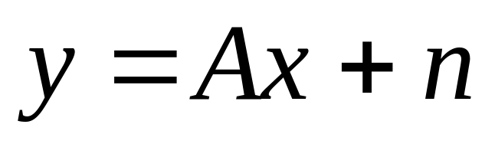
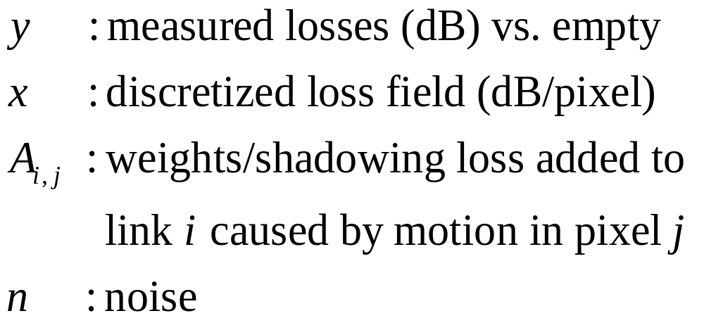
Linear Model
2011-7-28
P. <number>/30

Slide 10
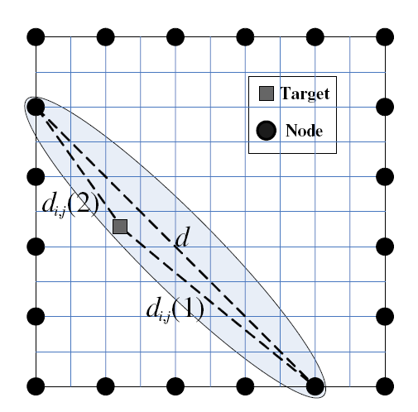
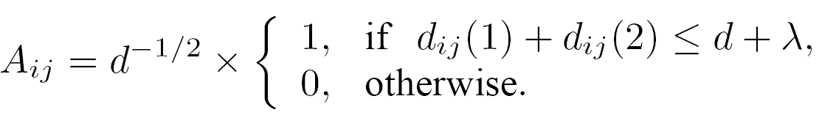
Elliptical Weight Model
2011-7-28
P. <number>/30

Slide 11
Device-free Localization (DFL)
Video cameras. Don’t work in dark, through smoke or walls. Privacy concerns.
Thermal imagers. Limited by walls. High cost.
Motion detectors. Also limited by walls. High false alarms.
Ultra wideband (UWB) radar. High cost.
Received signal strength (RSS) in WSN
2011-7-28
P. <number>/30

Slide 12
Motivation
Track image max x/ Kalman filter
The sparse nature of location finding
Directly track the location of moving targets
2011-7-28
P. <number>/30

Slide 13
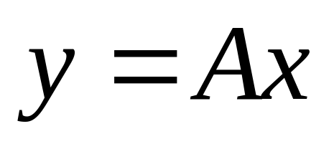
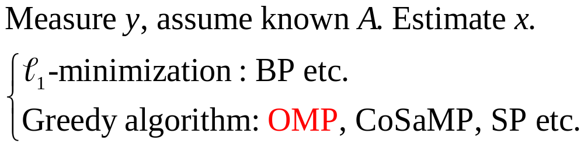
Sparse Recovery
2011-7-28
P. <number>/30

Slide 14
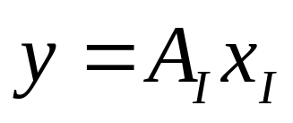
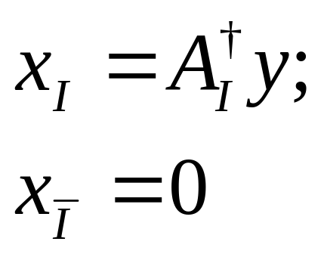
Greedy Sparse Recovery
Support Detection
A, y
x
Signal Estimation
2011-7-28
P. <number>/30

Slide 15
Support Detection Strategy
Select atoms of measurement matrix A to generate y
Determine active atoms in sparse representation of x
2011-7-28
P. <number>/30

Slide 16
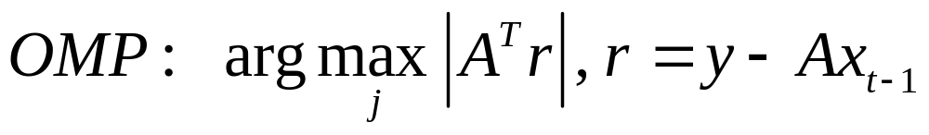
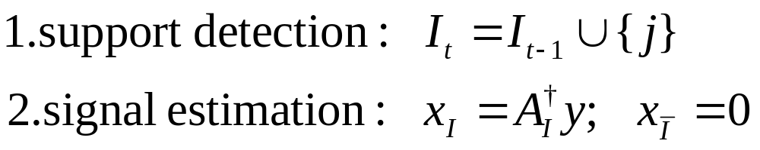
Orthogonal Matching Pursuit (OMP)
2011-7-28
P. <number>/30

Slide 17
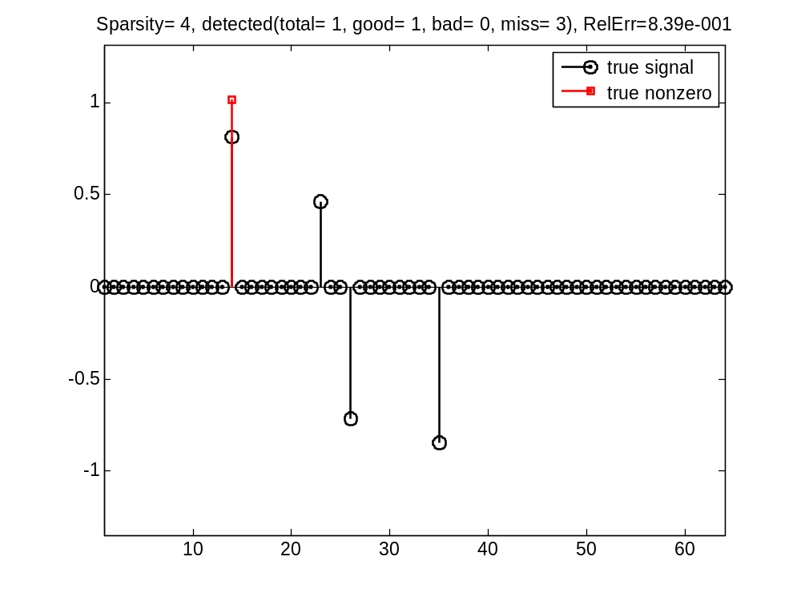
Demo - OMP(1)
2011-7-28
P. <number>/30

Slide 18
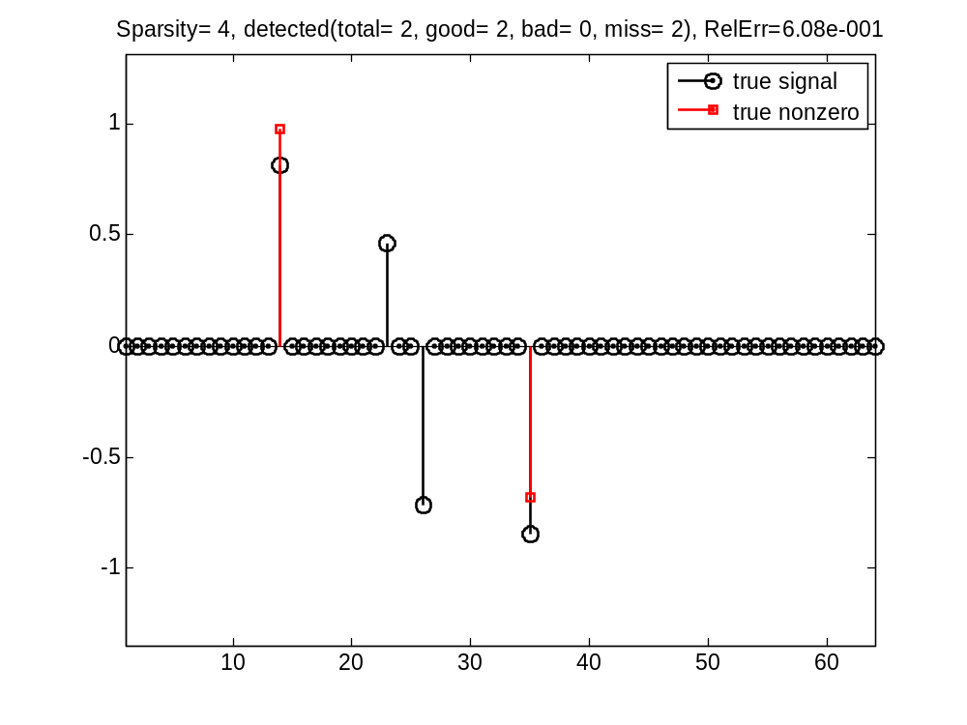
Demo - OMP(2)
2011-7-28
P. <number>/30

Slide 19
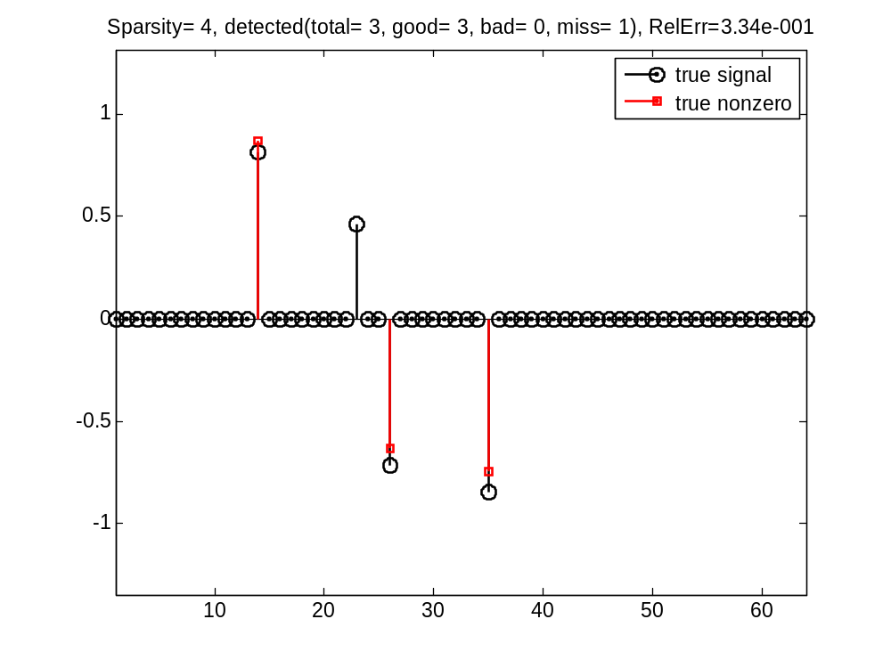
Demo - OMP(3)
2011-7-28
P. <number>/30

Slide 20

Demo - OMP(4)
2011-7-28
P. <number>/30

Slide 21
Compressed Measurements
Weight matrix
--overcomplete dictionary
Feedback information
2011-7-28
P. <number>/30

Slide 22
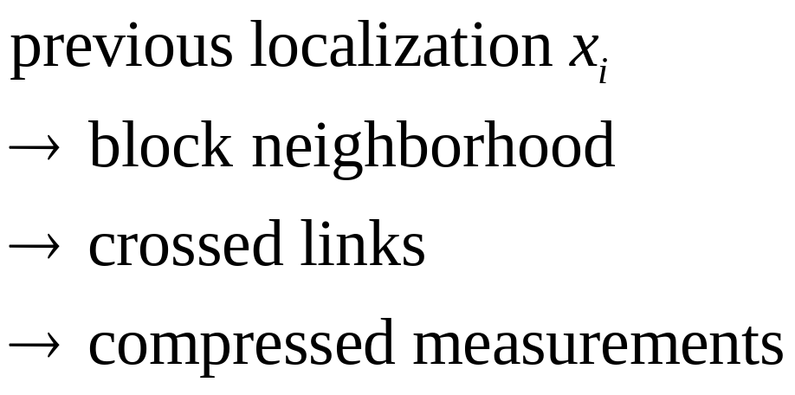
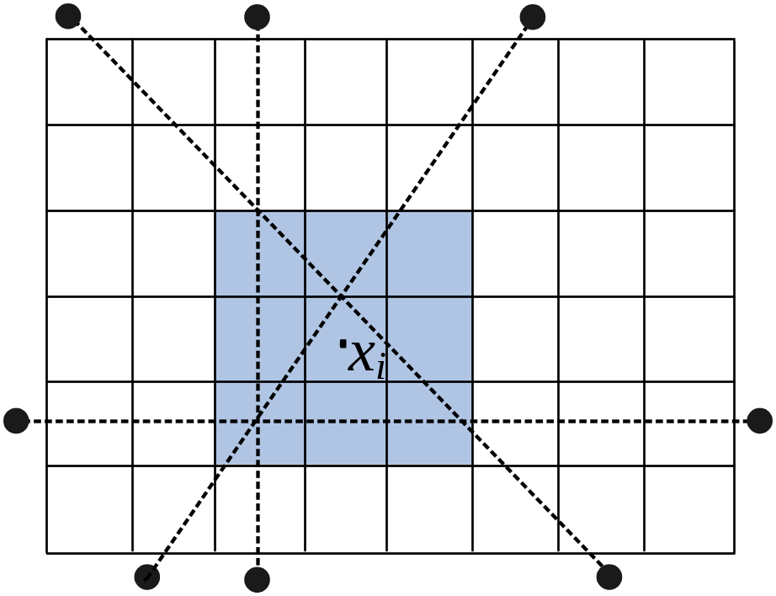
Heuristic Selection via Feedback Info.
2011-7-28
P. <number>/30

Slide 23
Feedback Structure
The locations of
the previous frame
Predicted support
Sparse recovery
Recovered support
Next frame
2011-7-28
P. <number>/30

Slide 24
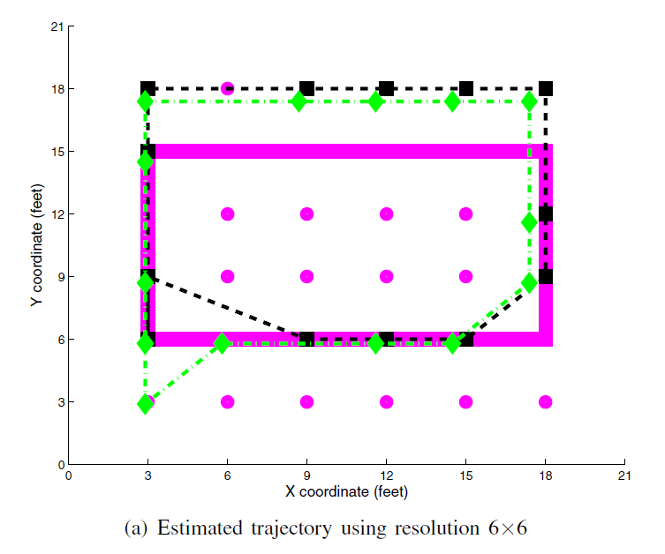
Experiments-1 resolution 6x6
2011-7-28
P. <number>/30

Slide 25
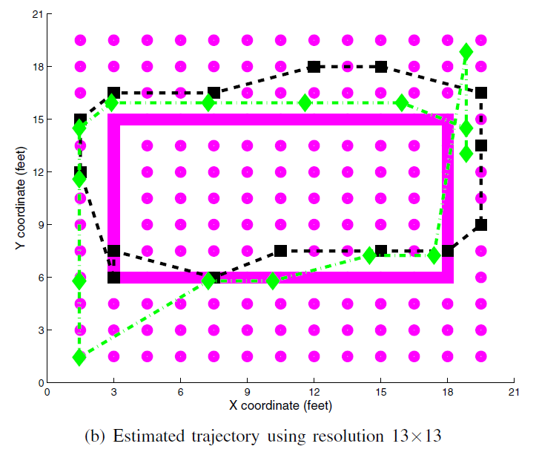
Experiments-2 resolution 13x13
2011-7-28
P. <number>/30

Slide 26
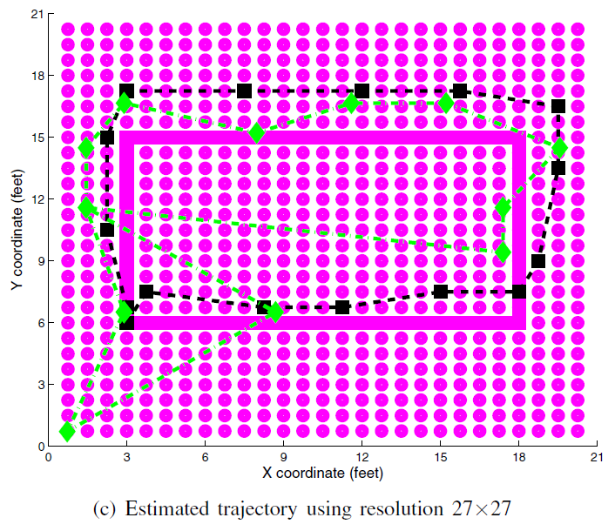
Experiments-3 resolution 27x27
2011-7-28
P. <number>/30

Slide 27
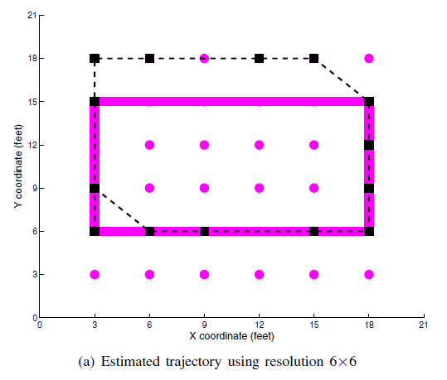
Experiments-4 compressed meas.
2011-7-28
P. <number>/30

Slide 28
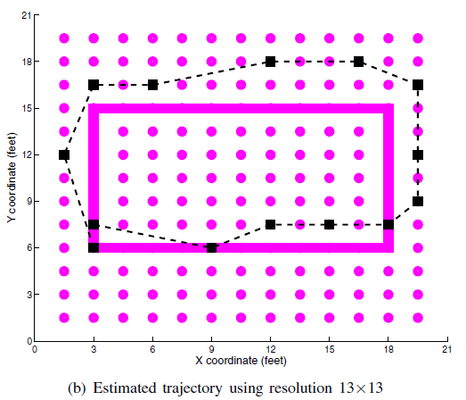
Experiments-5 compressed meas.
2011-7-28
P. <number>/30

Slide 29
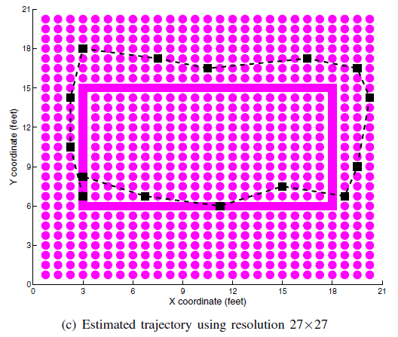
Experiments-6 compressed meas.
2011-7-28
P. <number>/30

Slide 30


Discussions
Thank You!
2011-7-28
P. <number>/30

