Slide 1
Machine Learning to Deep Learning_2
Tutorial code: https://github.com/leejaymin/TensorFlowLecture
2017. 02. 03
Jemin Lee (leejaymin@cnu.ac.kr)
Hompage: https://leejaymin.github.io/index.html
Notes:
역사
알고리즘 약간은 깊이 있는 이해
그것을 통한 실제 구현 과 응용
시스템 Area에서의 Deep-Learning

Slide 2
Table of Contents
Fundamental Machine Learning (1일차)
Linear Regression: Gradient Descent Algorithm (optimization)
Logistic Regression (Single Neuron=Perceptron): Sigmoid (Logistic function), Convexity, Cross Entropy, Decision Boundary
Multiple Perceptron (Hidden Layer): Backpropagation algorithm
Deep Neural Network Breakthrough (2-3일차)
Rebirth of Neural Network, renamed DNN
TensorFlow Basic
DNN, ReLU, Pre-training, Dropout
Convolutional Neural Network (CNN)
How to apply DNN into real world problem (4일차)
Use-case: smarttention 2016

Slide 3
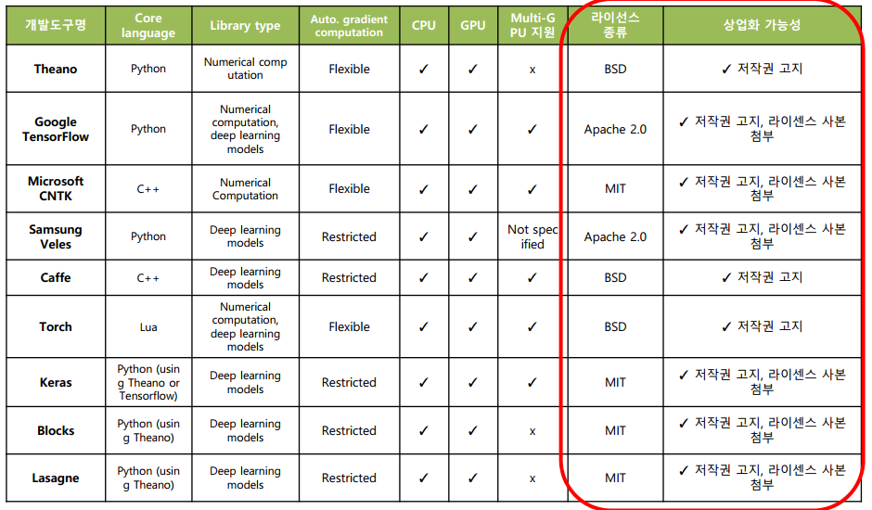
Deep Learning Framework

Slide 4

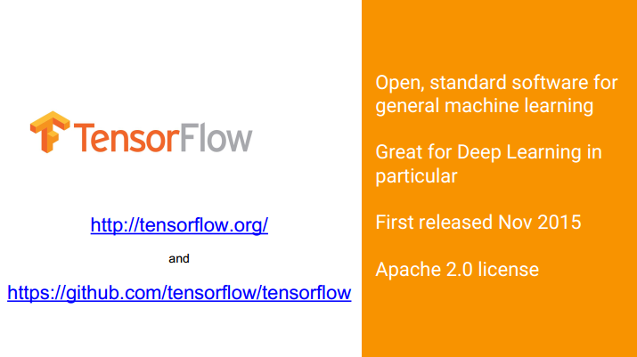
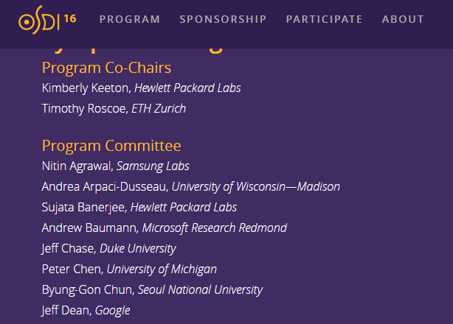
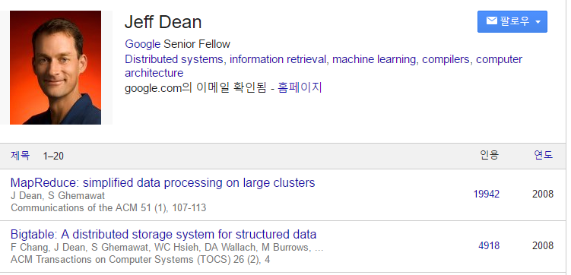
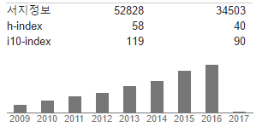
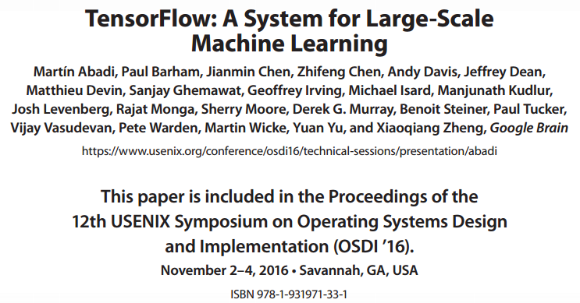
왜 TensorFlow 인가?

Slide 5
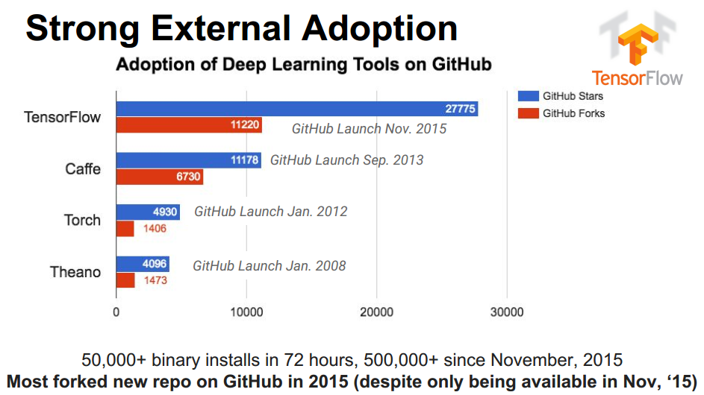
Large-Scale Deep Learning With TensorFlow, JeffDean 2016

Slide 6
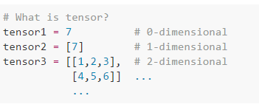
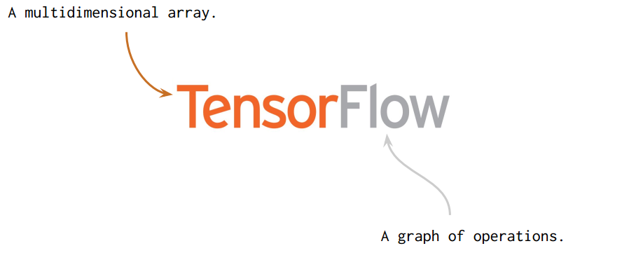
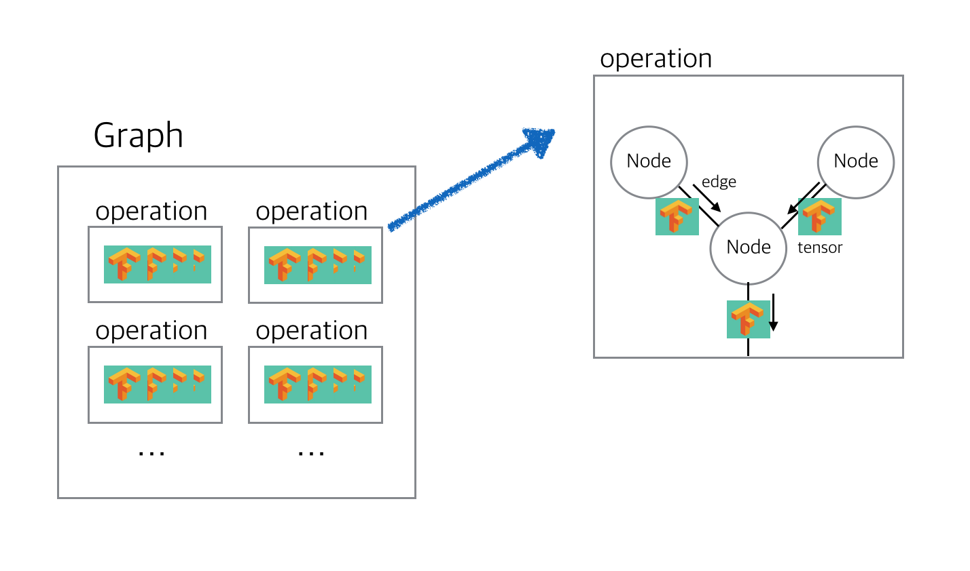
Large-Scale Deep Learning With TensorFlow, JeffDean 2016

Slide 7
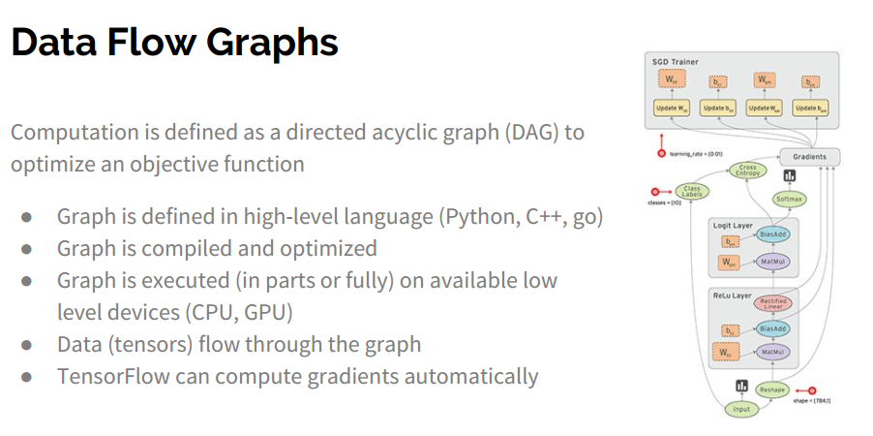
Large-Scale Deep Learning With TensorFlow, JeffDean 2016

Slide 8
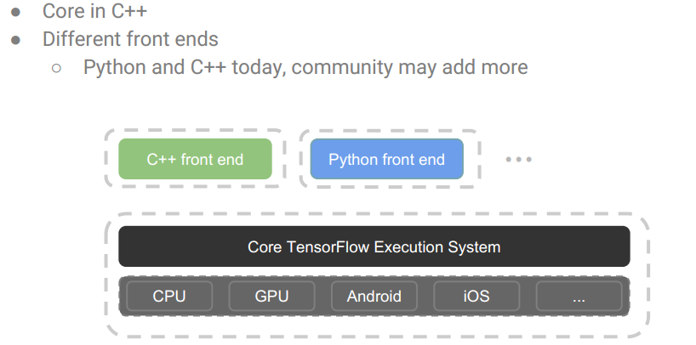
Architecture
Large-Scale Deep Learning With TensorFlow, JeffDean 2016

Slide 9
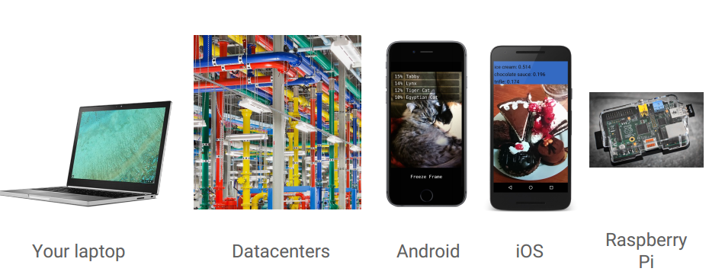
Portable & Scalable
Large-Scale Deep Learning With TensorFlow, JeffDean 2016

Slide 10

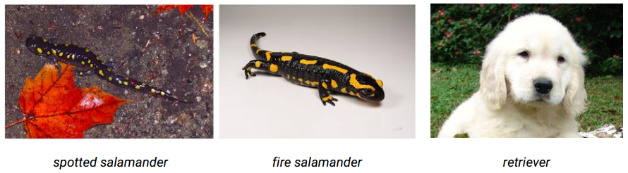
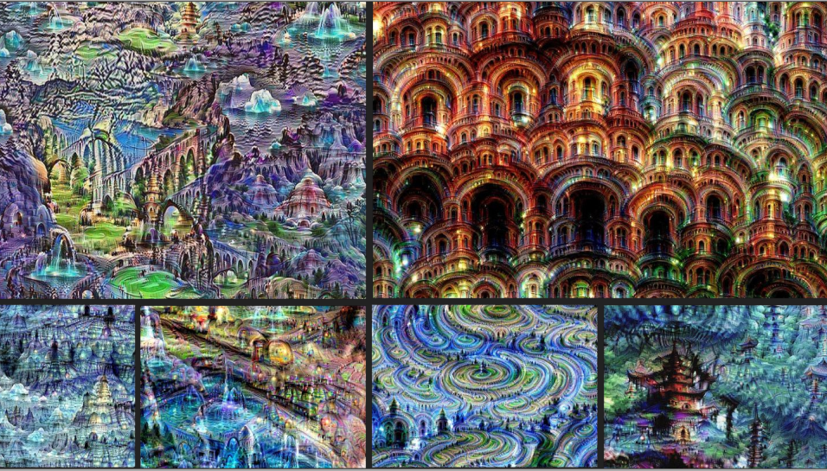

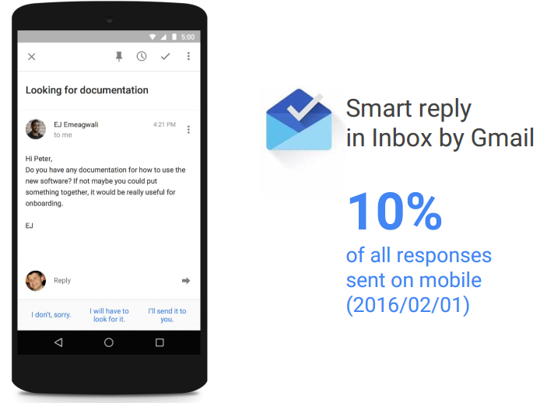
How is TensorFlow used at Google?
Recognizing Images with Inception
Voice Recognition
Smart reply in inbox by Gmail
Large-Scale Deep Learning With TensorFlow,
JeffDean 2016

Slide 11
실습: Basic TensorFlow
Notes:
역사
알고리즘 약간은 깊이 있는 이해
그것을 통한 실제 구현 과 응용
시스템 Area에서의 Deep-Learning

Slide 12
Graph, Node, Edge
선언부와 실행부가 다름
“앞으로 어떻게 동작 할 것이다”라는 계획을 Graph로 표현한 것이 TensorFlow 이다.
Operation: 동작을 정의
Node: Operation 정의 포함
Edge: node와 node를 연결함.
코드 위치
0.2.Basic/Basic Tutorial.ipynb

Slide 13
실습2: MNIST
Notes:
역사
알고리즘 약간은 깊이 있는 이해
그것을 통한 실제 구현 과 응용
시스템 Area에서의 Deep-Learning

Slide 14
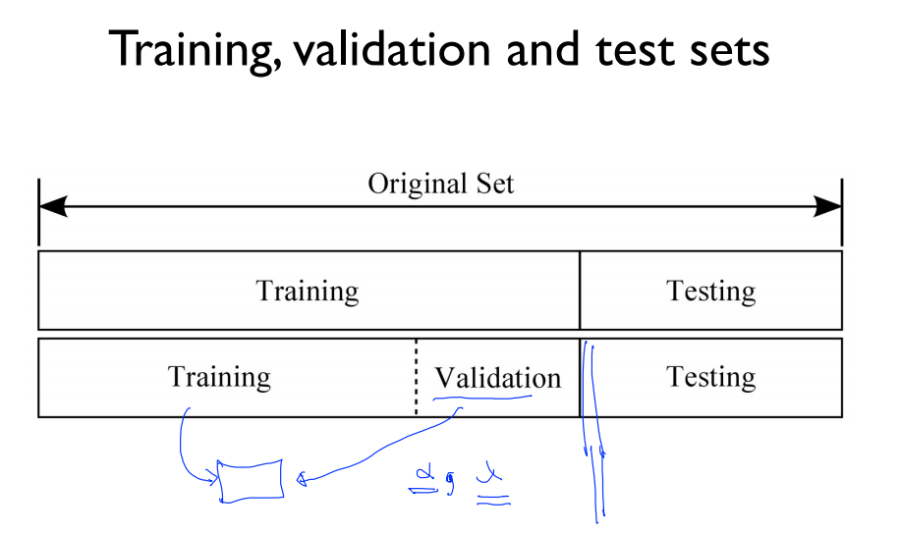
출처: 모두를 위한 머신러닝 시즌1, 김성훈 교수님

Slide 15
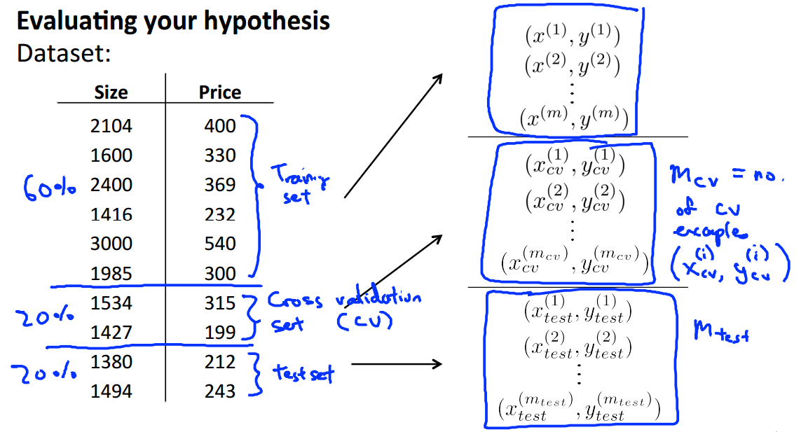
Coursera, Machine Learning, Andrew Ng

Slide 16
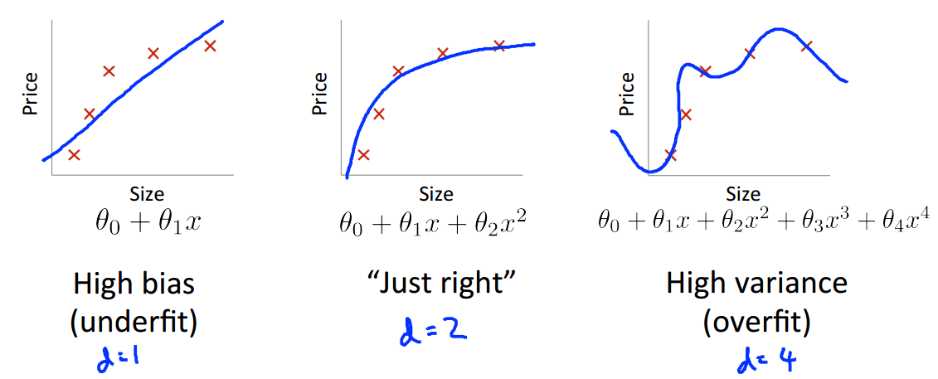
Diagnosing bias vs. variance
High Bias problem == underfitting
High variance problem == overfitting
Coursera, Machine Learning, Andrew Ng

Slide 17
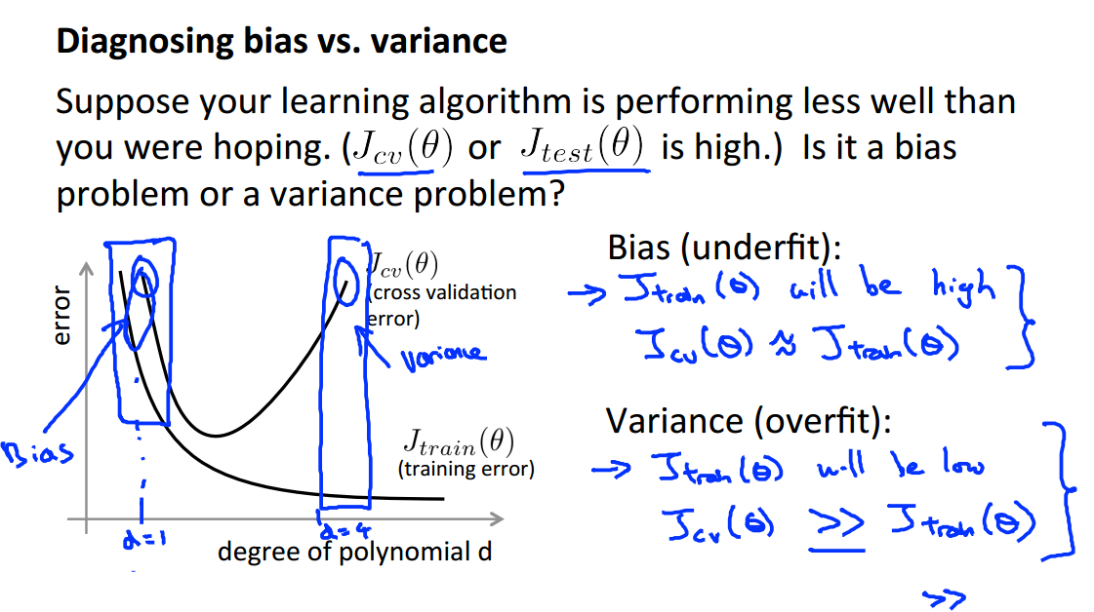
Coursera, Machine Learning, Andrew Ng

Slide 18
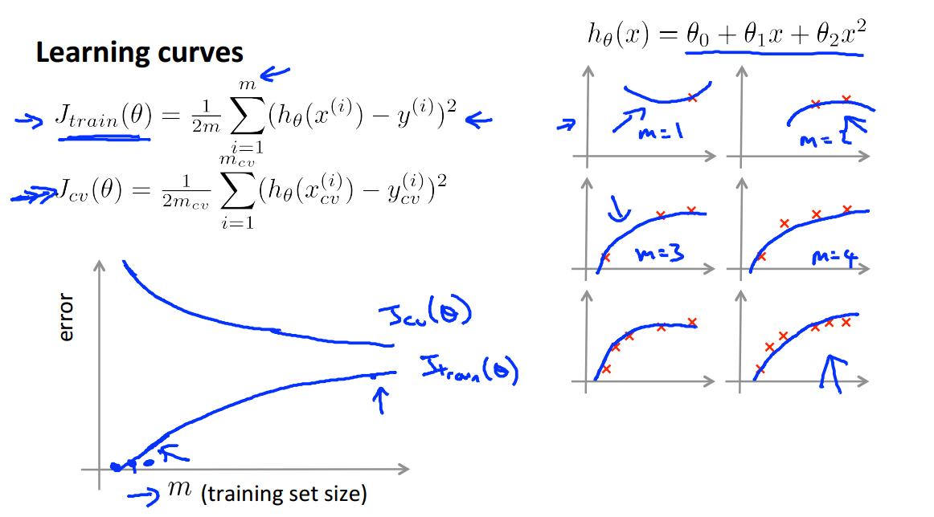
Learning curves[1/3]
Coursera, Machine Learning, Andrew Ng

Slide 19
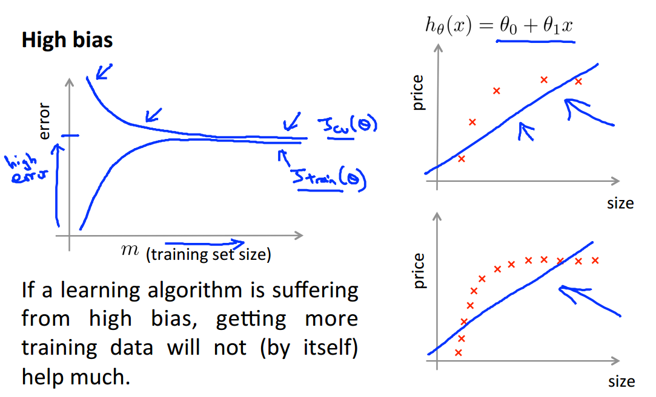
Learning curves[2/3]
Coursera, Machine Learning, Andrew Ng

Slide 20
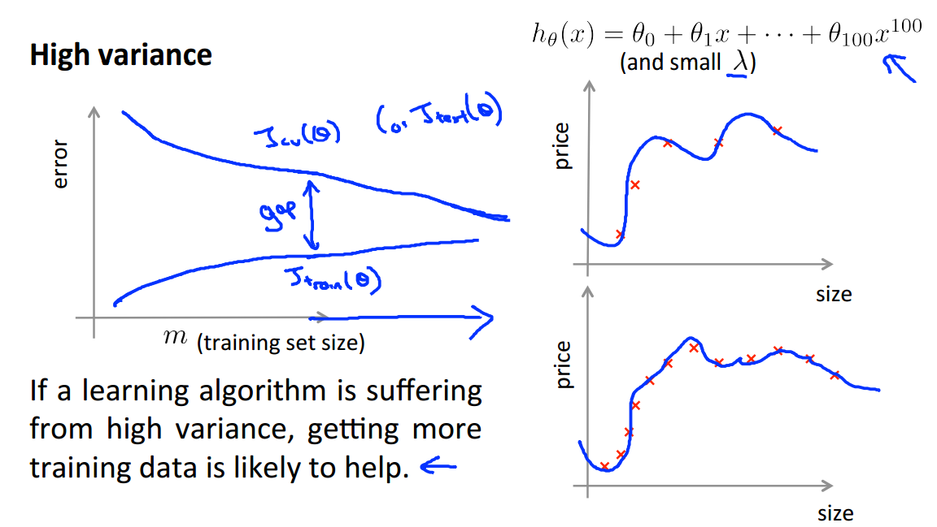
Learning curves[3/3]
Coursera, Machine Learning, Andrew Ng

Slide 21
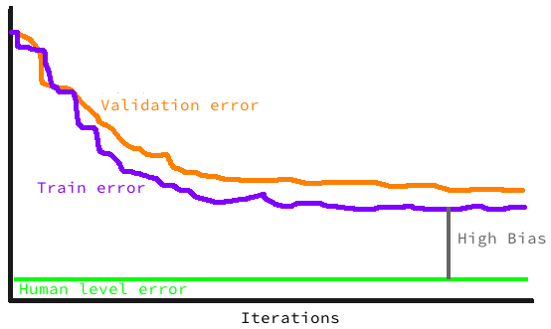
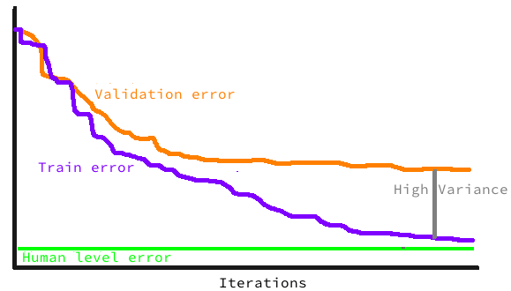
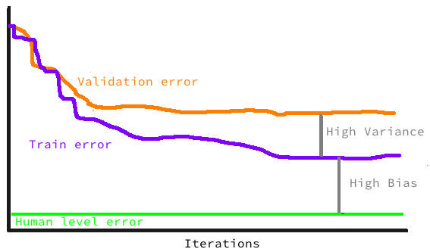
Summarized bias vs. variance
Coursera, Machine Learning,
Andrew Ng

Slide 22
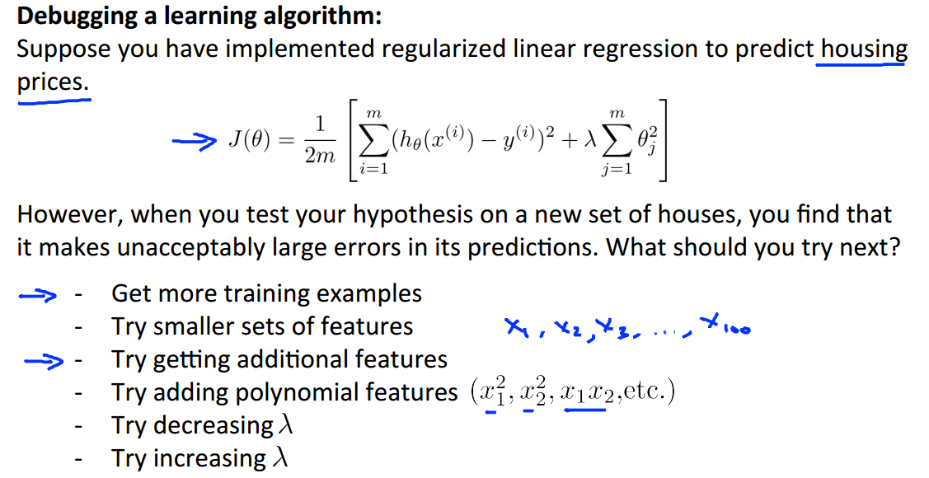
Coursera, Machine Learning, Andrew Ng

Slide 23
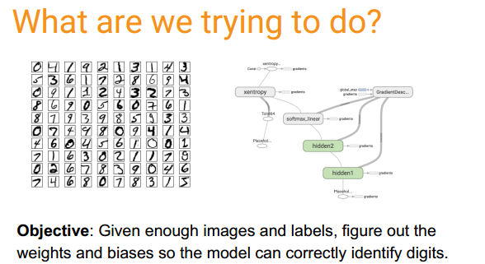
코드 위치
https://github.com/leejaymin/TensorFlowLecture/blob/master/4.MNIST/MNIST_Tutorial_DNN.ipynb

Slide 24
구현 내용
기본적인 MLP 구현
One hidden layer
Testing accuracy: ~92%
11-layer MLP with ReLU
ReLU, Sigmoid, Softmax
Testing accuracy: ~97%
Pre-training and Dropout
Xavier init. and new regularization
Testing accuracy: ~99%
Convolutional Neural Network
Testing accuracy: ?%

