Slide 2
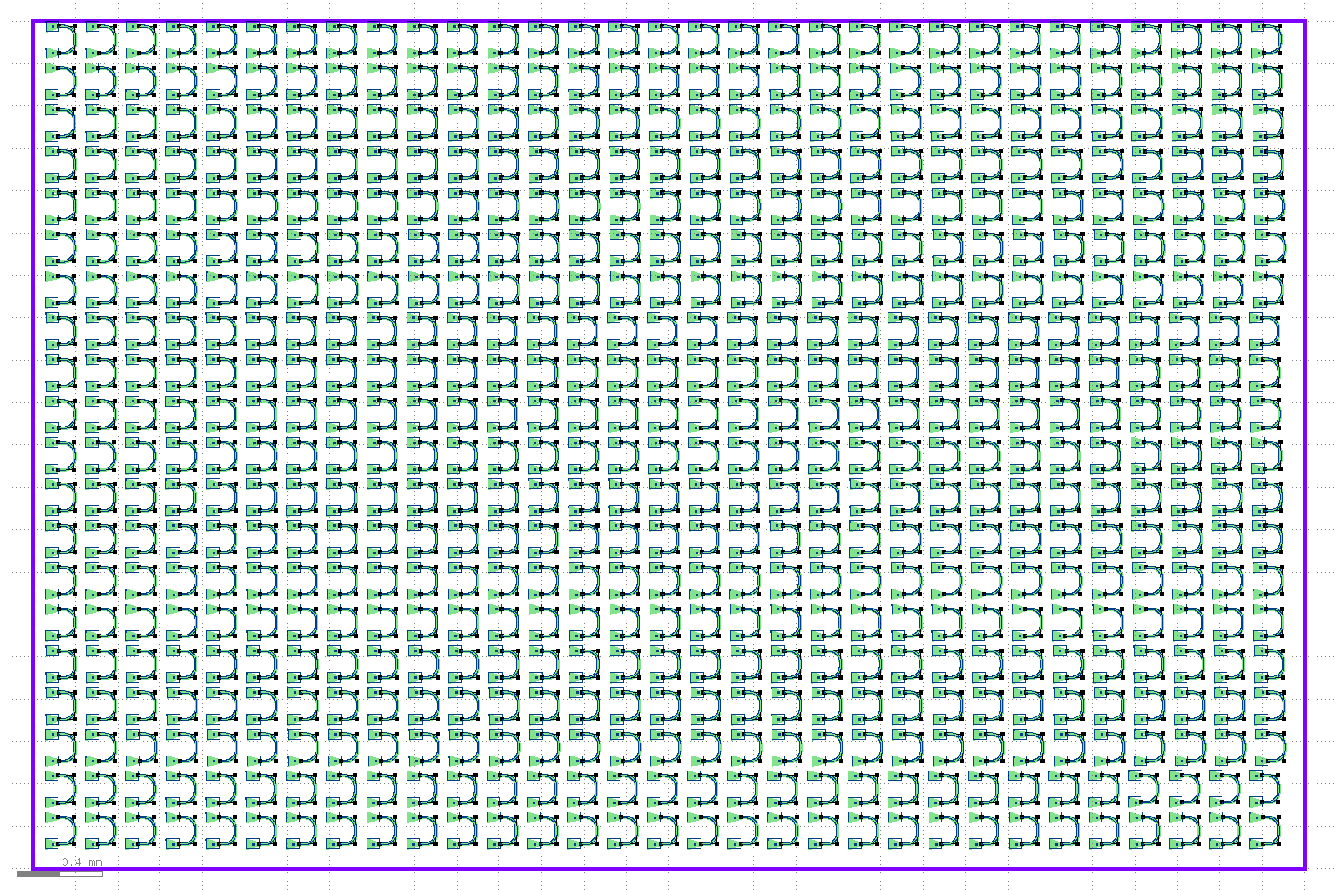
GC_sweep area
620 devices

Slide 3
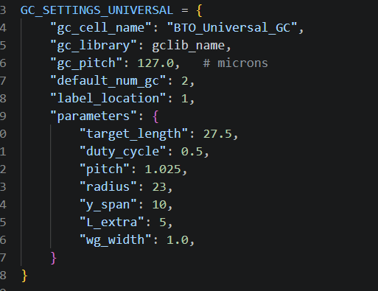
310 devices
620 devices
targetL | DC | Pitch | R | yspan | Lextra | Total#
27.5 | 0.5 | 1.025 | 23 | 10 | 5
 | 35:5:70 #8 | 0.975: .01 : 1.085 # 12 0.815,0.83,0.845 |  |  |  | 120
 | 45:5:55 #3 | 1.015:1.055 #5
15,20,30,40 #4 |  |  | 15,20,30,40 #4 |  |  | 240
 |  |  |  | 8,12.5,15,20 #4 | 5,7.5,10 #3 | 180

Slide 4
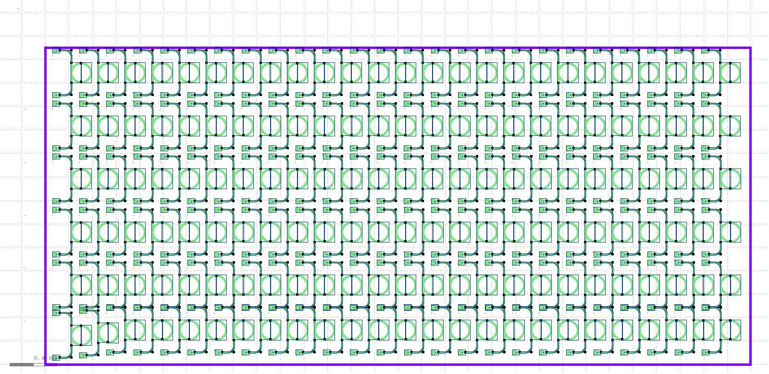
Ring_sweep
150 devices

Slide 5
gc | radius | gap | num
1.025 | 80 | 75:25:1050 | 40
1.025 | 100 | 50:50:1000 | 20
1.045 | 80 | 50:50:1000 | 20

