Slide 1




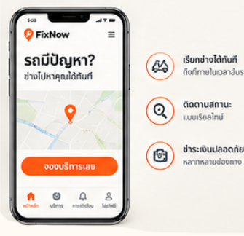
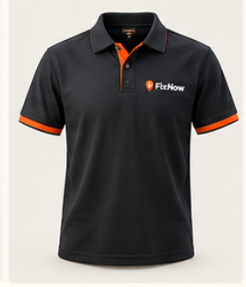
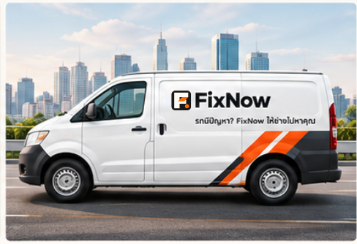

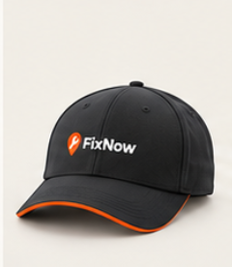
FixNow
YOUR CAR HELP,
RIGHT NOW
รถมีปัญหา? FixNow ให้ช่างไปหาคุณ
FAST
HELPFUL
DEPENDABLE
PRECISE
LOGO SYSTEM
COLOR PALETTE
TYPOGRAPHY
MANROPE + ANUPHAN
FixNow
Aa
กข
FixNow
YOUR CAR HELP,
RIGHT NOW
MANROPE
ANUPHAN
YOUR CAR HELP, RIGHT NOW
ACTION
ORANGE
BURNT
ORANGE
GARAGE
BLACK
STEEL
GRAY
COOL
SILVER
WORKSHOP
700 600 400
700 600 400
รถมีปัญหา? FixNow ให้ช่างไปหาคุณ
ABCDEFGHIJKLMNOPQRSTUVWXYZ
abcdefghijklmnopqrstuvwxyz
0123456789
ภาษาไทยสำหรับแบรนด์
ป้ายบริการและข้อความ
0123456789
#FF5A18
#C83D0A
#17191C
#6E747B
#DDE1E4
#F4F2ED
PRIMARY LOGO (HORIZONTAL)
REVERSED LOGO (ON DARK)
SYMBOL (ISOLATED)
APP ICON
SERVICE ICONS
MASCOT VOICE
BATTERY
SERVICE
TIRE
SERVICE
TOW TRUCK
SERVICE
ENGINE
REPAIR
LOCATION
TRACKING
BOOKING
ONLINE
SAFETY
GUARANTEE
READY TO HELP
FAST & FRIENDLY
PROFESSIONAL
พร้อมช่วยเหลือ
รวดเร็ว เป็นกันเอง
เชี่ยวชาญ มั่นใจได้
BRAND APPLICATIONS

Slide 2
FIXNOW / LOGO SYSTEM
Each mark and wordmark is built from editable shapes and text.
PRIMARY HORIZONTAL LOCKUP
REVERSED / ON DARK
FixNow
FixNow
YOUR CAR HELP,
RIGHT NOW
ไทย: รถมีปัญหา? FixNow ให้ช่างไปหาคุณ
YOUR CAR HELP, RIGHT NOW
SYMBOL (ISOLATED)
APP ICON
LOGO CONSTRUCTION
Frame
Counter
F structure
Action slash
Pin dot
Separate mark components
For mobile and launcher use
Colors and text stay editable; photo-based assets remain separate image objects.

Slide 3
FIXNOW / SERVICE ICONS
Line icon family · orange outline ring · dark steel strokes
BATTERY SERVICE
TIRE SERVICE
TOW TRUCK SERVICE
ENGINE REPAIR
EDITABLE VECTOR
EDITABLE VECTOR
EDITABLE VECTOR
EDITABLE VECTOR
LOCATION TRACKING
BOOKING ONLINE
SAFETY GUARANTEE
EDITABLE VECTOR
EDITABLE VECTOR
EDITABLE VECTOR

Slide 4
FIXNOW / COLOR & TYPOGRAPHY
Brand colors are represented as native editable shapes; type samples are editable text.
ACTION ORANGE
BURNT ORANGE
GARAGE BLACK
STEEL GRAY
COOL SILVER
WORKSHOP
#FF5A18
#C83D0A
#17191C
#6E747B
#DDE1E4
#F4F2ED
LATIN TYPE
THAI TYPE
Aa
กข
ACTION
ORANGE
MANROPE / 700 · 600 · 400
ANUPHAN / 700 · 600 · 400
Use for calls to action,
status highlights and markers.
ABCDEFGHIJKLMNOPQRSTUVWXYZ
abcdefghijklmnopqrstuvwxyz
0123456789
ตัวอย่างภาษาไทยสำหรับข้อความแบรนด์
ป้ายบริการและข้อความในแอปพลิเคชัน
0123456789

Slide 5
FIXNOW / BRAND APPLICATIONS
Every photograph/mockup below is its own separate image object and can be moved, resized or replaced.
MOBILE APP / SERVICE FLOW
STAFF UNIFORM
CAP / UNIFORM
SERVICE VAN / VEHICLE BRANDING
PROMOTIONAL CREATIVE
Mascot images are intentionally retained as raster assets from the source board; redraw as 3D assets if you need editable facial/clothing details.

