Slide 1


Who Goes First?
Detecting Go Concurrency Bugs via
Message Reordering
Ziheng Liu*, Shihao Xia*, Yu Liang, Linhai Song and Hong Hu
Pennsylvania State University
* Ziheng Liu and Shihao Xia are co-first authors

Slide 2



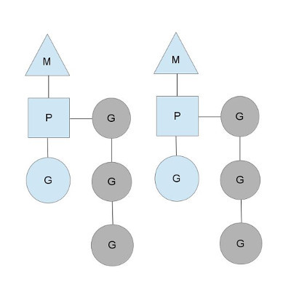
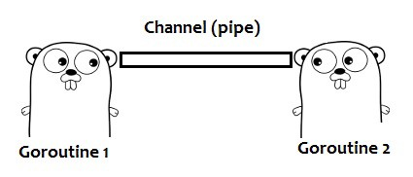

Go Programming Language
A young but widely-used programming lang.
Designed for efficient and reliable concurrency
Provide lightweight threads, called goroutines
Support both message passing and shared memory
message
channel
Memory

Slide 3
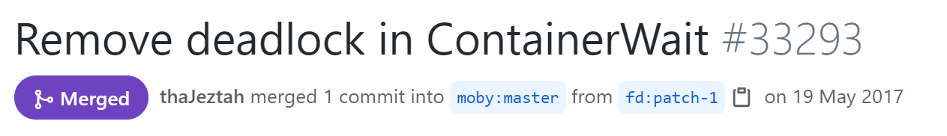
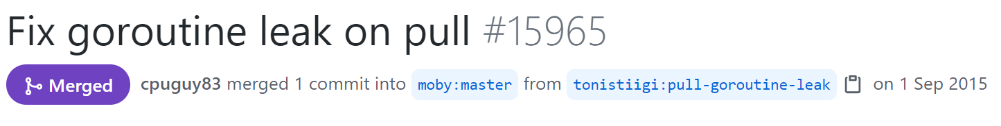
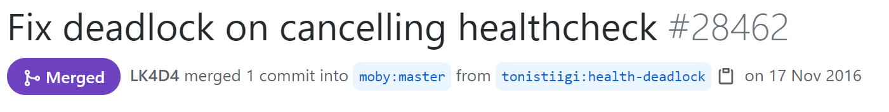
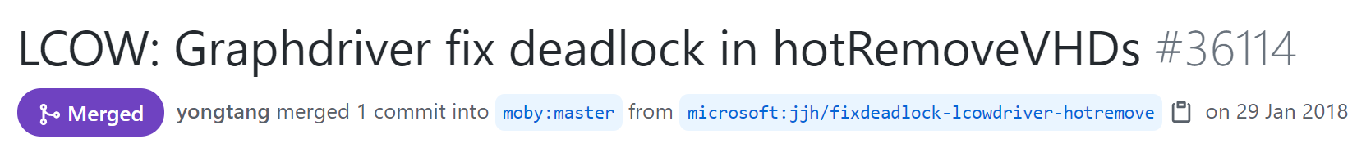
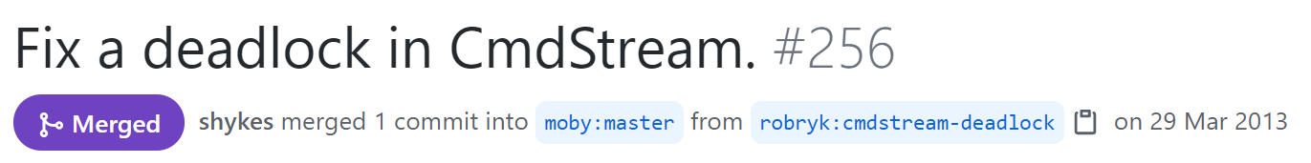
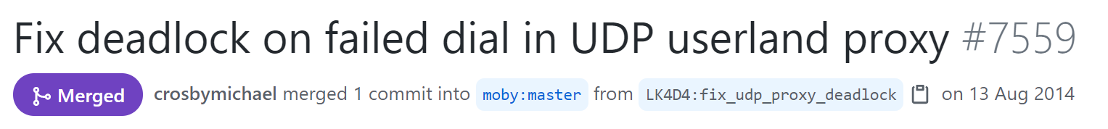
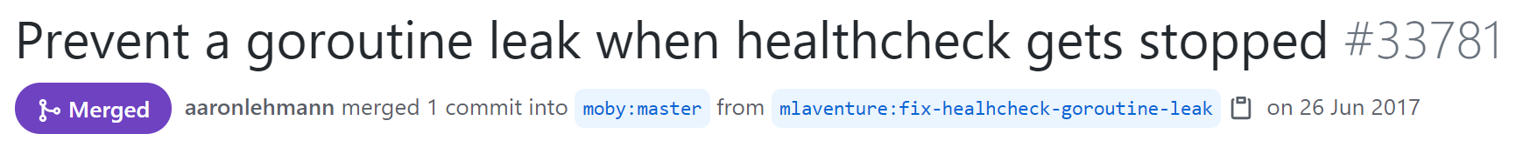
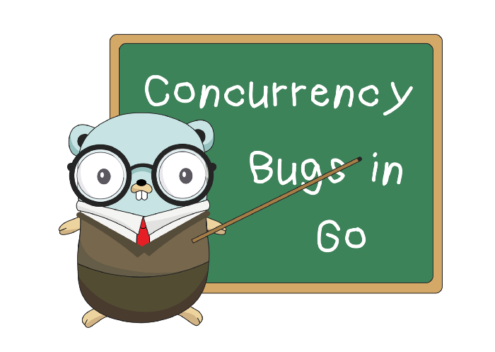
Concurrency Bugs in Go
Many concurrency bugs are in Go programs
Channel may be more error-prone than mutex
36% more blocking bugs are due to channels [1]
[1] Tengfei Tu, Xiaoyu Liu, Linhai Song and Yiying Zhang. “Understanding Real-World Concurrency Bugs in Go.” In ASPLOS’19.

Slide 4
A Concurrency Bug in Docker
Parent Goroutine
func parent() {
…
ch, errCh := dis.Watch()
select {
case <- Fire(1 * T.Second):
Log(“Timeout!”)
case e := <- ch:
…
case e := <- errCh:
Log(“Error!”)
}
return
}
func (s *Discover) Watch() (…) {
ch := make(chan Entries)
errCh := make(chan error)
go func() {
entries, err := s.fetch()
if err != nil {
errCh <- err
} else {
ch <- entries
} …
}()
return ch, errCh
}

Slide 5
A Concurrency Bug in Docker
Parent Goroutine
Child Goroutine
after 1 second
func parent() {
…
ch, errCh := dis.Watch()
select {
case <- Fire(1 * T.Second):
Log(“Timeout!”)
case e := <- ch:
…
case e := <- errCh:
Log(“Error!”)
}
return
}
func (s *Discover) Watch() (…) {
ch := make(chan Entries)
errCh := make(chan error)
go func() {
entries, err := s.fetch()
if err != nil {
errCh <- err
} else {
ch <- entries
} …
}()
return ch, errCh
}
a msg from the child
send a message

Slide 6
A Concurrency Bug in Docker
Parent Goroutine
Child Goroutine
unbuffered
func parent() {
…
ch, errCh := dis.Watch()
select {
case <- Fire(1 * T.Second):
Log(“Timeout!”)
case e := <- ch:
…
case e := <- errCh:
Log(“Error!”)
}
return
}
func (s *Discover) Watch() (…) {
ch := make(chan Entries)
errCh := make(chan error)
go func() {
entries, err := s.fetch()
if err != nil {
errCh <- err
} else {
ch <- entries
} …
}()
return ch, errCh
}
blocking endless!!
no goroutines can pull messages
from ch or errCh

Slide 7
Limitations of Existing Techniques
Parent Goroutine
cannot resolve indirect function calls
Child Goroutine
func parent() {
…
ch, errCh := dis.Watch()
select {
case <- Fire(1 * T.Second):
Log(“Timeout!”)
case e := <- ch:
…
case e := <- errCh:
Log(“Error!”)
}
return
}
func (s *Discover) Watch() (…) {
ch := make(chan Entries)
errCh := make(chan error)
go func() {
entries, err := s.fetch()
if err != nil {
errCh <- err
} else {
ch <- entries
} …
}()
return ch, errCh
}
don’t increase the chance of exposing concurrency bugs
do not analyze channel operations

Slide 8


Intuitions
Building a dynamic technique
To avoid limitations of static analysis
Focusing on concurrent messages
Their processing order is non-deterministic
Some orders may not be carefully implemented
Mutating their processing order to detect bugs
select {
case <- Fire(1 * T.Second):
Log(“Timeout!”)
case e := <- ch:
…
case e := <- errCh:
Log(“Error!”)
}

Slide 9

Challenges
How to identify concurrent messages?
Goroutine1
Goroutine2
: channel operation

Slide 10


Challenges
How to identify concurrent messages?
How to identify suspicious message orders?
How to capture triggered channel-related bugs?
Goroutine1
Goroutine2
Goroutine3
suspicious orders
order space
: channel operation

Slide 11
Contributions
GFuzz: a dynamic Go concurrency bug detector
Use select to identify concurrent messages
Leverage fuzzing to pinpoint suspicious msg orders
Propose a novel sanitizer to capture triggered bugs
Thorough experiments to evaluate GFuzz
Detect 184 previously unknown bugs
Developers have confirmed 124 bugs and fixed 67 bugs
Detect significantly more bugs than SOTA

Slide 12
Outline
Introduction
Reordering Concurrent Messages
Favoring Propitious Orders
Capturing Triggered Concurrency Bugs
Implementation and Evaluation
Conclusion

Slide 13
Outline
Introduction
Reordering Concurrent Messages
Favoring Propitious Orders
Capturing Triggered Concurrency Bugs
Implementation and Evaluation
Conclusion
Introduction
Reordering Concurrent Messages
Favoring Propitious Orders
Capturing Triggered Concurrency Bugs
Implementation and Evaluation
Conclusion

Slide 14
Concurrent Channel Operations (Ops)
Channel ops have no happens-before relation
Their processed messages are concurrent
Challenging to find all concurrent channel ops
GFuzz focuses on select statements
Select allows a goroutine to wait for >1 channel ops
Channel ops within the same select are concurrent
select {
case <- Fire(1 * T.Second):
Log(“Timeout!”)
case e := <- ch:
…
case e := <- errCh:
Log(“Error!”)
}
can happen simultaneously

Slide 15
Encode Concurrent Message Orders
Use selected cases to represent an order
Assign each select a unique ID
Allocate a local index to each case
An order → [(s₀, c₀, e₀) …(s_{n}, c_{n}, e_{n})]
case index
id: 0
select id
the number of cases
select {
case <- Fire(1 * T.Second):
Log(“Timeout!”)
case e := <- ch:
…
case e := <- errCh:
Log(“Error!”)
}
chosen twice
[(0, 3, 1), (0, 3, 1)]

Slide 16
Code Transformation
switch FetchOrder(…) {
}
select {
case <- Fire(1 * T.Second):
Log(“Timeout!”)
case e := <- ch:
…
case e := <- errCh:
Log(“Error!”)
}
3 cases

Slide 17
Code Transformation
switch FetchOrder(…) {
case 0:
case 1:
case 2:
default:
}
select {
case <- Fire(1 * T.Second):
Log(“Timeout!”)
case e := <- ch:
…
case e := <- errCh:
Log(“Error!”)
}
3 cases + 1 default
3 cases

Slide 18
Code Transformation
switch FetchOrder(…) {
case 0:
case 1:
case 2:
default:
}
select {
case <- Fire(1 * T.Second):
Log(“Timeout!”)
case e := <- ch:
…
case e := <- errCh:
Log(“Error!”)
}
no order is specified

Slide 19
Code Transformation
switch FetchOrder(…) {
case 0:
select {
case <- Fire(1 * T.Second):
Log(“Timeout!”)
case <- time.After(T):
……
}
case 1:
case 2:
default:
}
select {
case <- Fire(1 * T.Second):
Log(“Timeout!”)
case e := <- ch:
…
case e := <- errCh:
Log(“Error!”)
}

Slide 20
Code Transformation
switch FetchOrder(…) {
case 0:
select {
case <- Fire(1 * T.Second):
Log(“Timeout!”)
case <- time.After(T):
……
}
case 1:
case 2:
default:
}
select {
case <- Fire(1 * T.Second):
Log(“Timeout!”)
case e := <- ch:
…
case e := <- errCh:
Log(“Error!”)
}

Slide 21
Code Transformation
switch FetchOrder(…) {
case 0:
select {
case <- Fire(1 * T.Second):
Log(“Timeout!”)
case <- time.After(T):
……
}
case 1:
case 2:
default:
}
select {
case <- Fire(1 * T.Second):
Log(“Timeout!”)
case e := <- ch:
…
case e := <- errCh:
Log(“Error!”)
}

Slide 22
Code Transformation
switch FetchOrder(…) {
case 0:
select {
case <- Fire(1 * T.Second):
Log(“Timeout!”)
case <- time.After(T):
……
}
case 1:
case 2:
default:
}
the message arrives within T
select {
case <- Fire(1 * T.Second):
Log(“Timeout!”)
case e := <- ch:
…
case e := <- errCh:
Log(“Error!”)
}
the message does not arrive within T

Slide 23
Code Transformation
switch FetchOrder(…) {
case 0:
select {
case <- Fire(1 * T.Second):
Log(“Timeout!”)
case <- time.After(T):
……
}
case 1:
select {
case e := <- ch:
……
case <- time.After(T):
……
}
case 2:
……
default:
……
}
select {
case <- Fire(1 * T.Second):
Log(“Timeout!”)
case e := <- ch:
…
case e := <- errCh:
Log(“Error!”)
}

Slide 24
Outline
Introduction
Reordering Concurrent Messages
Favoring Propitious Orders
Capturing Triggered Concurrency Bugs
Implementation and Evaluation
Conclusion
Introduction
Reordering Concurrent Messages
Favoring Propitious Orders
Capturing Triggered Concurrency Bugs
Implementation and Evaluation
Conclusion

Slide 25
Fuzzing Message Orders
Continuously mutating exercised orders
Enforcing new orders to detect bugs
Bugs
Instrumented Go program
Execution feedback
…
…
FIFO Order Queue
Mutator
New orders
?

Slide 26
Interesting Orders
Triggering a new interleaving of channel ops
Reaching a new channel state
New channel creation, new channel closing
Maximum fullness
Bugs
Instrumented Go program
Execution feedback
…
…
FIFO Order Queue
Mutator
New orders
?

Slide 27
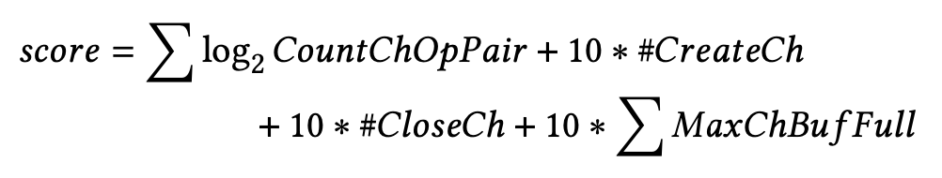
Prioritizing Valuable Orders
number of distinct created channels
sum of max channel fullness
number of triggered
channel interleavings
number of distinct closed channels
Bugs
Instrumented Go program
Execution feedback
…
…
FIFO Order Queue
Mutator
New orders
?

Slide 28
Outline
Introduction
Reordering Concurrent Messages
Favoring Propitious Orders
Capturing Triggered Concurrency Bugs
Implementation and Evaluation
Conclusion
Introduction
Reordering Concurrent Messages
Favoring Propitious Orders
Capturing Triggered Concurrency Bugs
Implementation and Evaluation
Conclusion

Slide 29
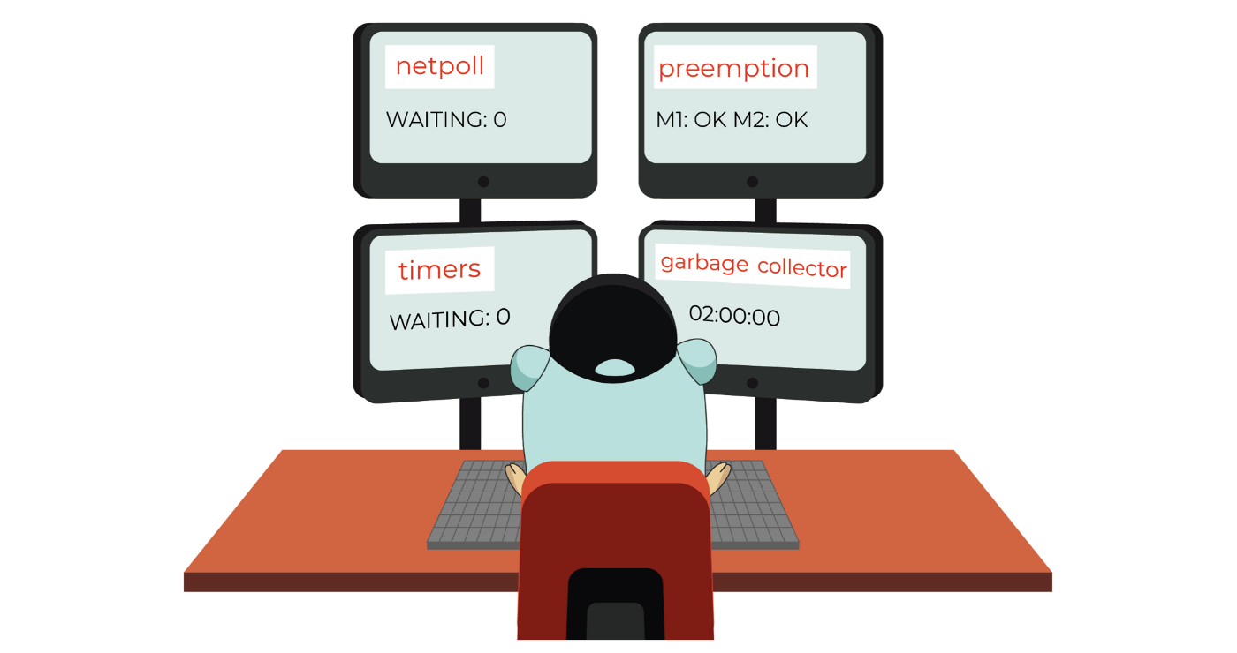
Sanitizer Design
Focus on channel-related blocking bugs
The Go runtime captures non-blocking bugs
Hybridize two methods to record dynamic info.
Source-to-source instrumentation
Modifying the Go runtime
go func() {
+ GainChRef(ch)
+ GainChRef(errCh)
entries, err := s.fetch()
if err != nil {
errCh <- err
} else {
ch <- entries
} …
}()
GFuzz

Slide 30
Blocking Bug Detection
GoInfo
ChInfo
goroutine | channel
channel | goroutine

Slide 31
Blocking Bug Detection
GoInfo
ChInfo
goroutine | channel
channel | goroutine
parent
ch errCh
ch
parent
errCh
parent
func parent() {
…
ch, errCh := dis.Watch()
select {
case <- Fire(1 * T.Second):
Log(“Timeout!”)
case e := <- ch:
…
case e := <- errCh:
Log(“Error!”)
}
return
}
func (s *Discover) Watch() (…) {
ch := make(chan Entries)
errCh := make(chan error)
go func() {
entries, err := s.fetch()
if err != nil {
errCh <- err
} else {
ch <- entries
} …
}()
return ch, errCh
}

Slide 32
Blocking Bug Detection
GoInfo
ChInfo
goroutine | channel
channel | goroutine
parent
ch errCh
ch
parent
child
child
ch errCh
errCh
parent
child
func parent() {
…
ch, errCh := dis.Watch()
select {
case <- Fire(1 * T.Second):
Log(“Timeout!”)
case e := <- ch:
…
case e := <- errCh:
Log(“Error!”)
}
return
}
func (s *Discover) Watch() (…) {
ch := make(chan Entries)
errCh := make(chan error)
go func() {
entries, err := s.fetch()
if err != nil {
errCh <- err
} else {
ch <- entries
} …
}()
return ch, errCh
}

Slide 33
Blocking Bug Detection
GoInfo
ChInfo
goroutine | channel
channel | goroutine
parent
ch errCh
ch
parent
child
child
ch errCh
errCh
parent
child
func parent() {
…
ch, errCh := dis.Watch()
select {
case <- Fire(1 * T.Second):
Log(“Timeout!”)
case e := <- ch:
…
case e := <- errCh:
Log(“Error!”)
}
return
}
func (s *Discover) Watch() (…) {
ch := make(chan Entries)
errCh := make(chan error)
go func() {
entries, err := s.fetch()
if err != nil {
errCh <- err
} else {
ch <- entries
} …
}()
return ch, errCh
}

Slide 34
Blocking Bug Detection
GoInfo
ChInfo
goroutine | channel
channel | goroutine
ch
child
child
ch errCh
errCh
child
func parent() {
…
ch, errCh := dis.Watch()
select {
case <- Fire(1 * T.Second):
Log(“Timeout!”)
case e := <- ch:
…
case e := <- errCh:
Log(“Error!”)
}
return
}
func (s *Discover) Watch() (…) {
ch := make(chan Entries)
errCh := make(chan error)
go func() {
entries, err := s.fetch()
if err != nil {
errCh <- err
} else {
ch <- entries
} …
}()
return ch, errCh
}
blocking bug!!

Slide 35
Outline
Introduction
Reordering Concurrent Messages
Favoring Propitious Orders
Capturing Triggered Concurrency Bugs
Implementation and Evaluation
Conclusion
Introduction
Reordering Concurrent Messages
Favoring Propitious Orders
Capturing Triggered Concurrency Bugs
Implementation and Evaluation
Conclusion

Slide 36
Implementation & Evaluation
Implementing GFuzz using Go-1.16
Leveraging the SSA and AST packages
Modifying the Go runtime
Applying to the recent versions of 7 Go apps
App | Star | LoC | Test
Kubernetes | 74K | 3453K | 3176
Docker | 60K | 1105K | 1227
Prometheus | 35K | 1186K | 570
Etcd | 35K | 181K | 452
Go-Ethereum | 28K | 368K | 1622
TiDB | 27K | 476K | 264
gRPC | 13K | 117K | 888

Slide 37
Effectiveness of Bug Detection
184 previously unknown bugs
App | chan_{b} | select_{b} | range_{b} | NBK | Total
Kubernetes | 28 | 4 | 9 | 2 | 43
Docker | 17 | 2 | - | - | 19
Prometheus | 14 | - | 1 | 3 | 18
Etcd | 7 | 12 | - | 1 | 20
Go-Ethereum | 11 | 43 | 6 | 2 | 62
TiDB | - | - | - | - | -
gRPC | 15 | - | 1 | 6 | 22

Slide 38
Effectiveness of Bug Detection
184 previously unknown bugs
170 blocking bugs
App | chan_{b} | select_{b} | range_{b} | NBK | Total
Kubernetes | 28 | 4 | 9 | 2 | 43
Docker | 17 | 2 | - | - | 19
Prometheus | 14 | - | 1 | 3 | 18
Etcd | 7 | 12 | - | 1 | 20
Go-Ethereum | 11 | 43 | 6 | 2 | 62
TiDB | - | - | - | - | -
gRPC | 15 | - | 1 | 6 | 22

Slide 39
Effectiveness of Bug Detection
184 previously unknown bugs
170 blocking bugs
wait for one channel operation
App | chan_{b} | select_{b} | range_{b} | NBK | Total
Kubernetes | 28 | 4 | 9 | 2 | 43
Docker | 17 | 2 | - | - | 19
Prometheus | 14 | - | 1 | 3 | 18
Etcd | 7 | 12 | - | 1 | 20
Go-Ethereum | 11 | 43 | 6 | 2 | 62
TiDB | - | - | - | - | -
gRPC | 15 | - | 1 | 6 | 22

Slide 40
Effectiveness of Bug Detection
184 previously unknown bugs
170 blocking bugs
wait for multiple channel operation
App | chan_{b} | select_{b} | range_{b} | NBK | Total
Kubernetes | 28 | 4 | 9 | 2 | 43
Docker | 17 | 2 | - | - | 19
Prometheus | 14 | - | 1 | 3 | 18
Etcd | 7 | 12 | - | 1 | 20
Go-Ethereum | 11 | 43 | 6 | 2 | 62
TiDB | - | - | - | - | -
gRPC | 15 | - | 1 | 6 | 22

Slide 41
Effectiveness of Bug Detection
184 previously unknown bugs
170 blocking bugs
drain a channel in a loop
App | chan_{b} | select_{b} | range_{b} | NBK | Total
Kubernetes | 28 | 4 | 9 | 2 | 43
Docker | 17 | 2 | - | - | 19
Prometheus | 14 | - | 1 | 3 | 18
Etcd | 7 | 12 | - | 1 | 20
Go-Ethereum | 11 | 43 | 6 | 2 | 62
TiDB | - | - | - | - | -
gRPC | 15 | - | 1 | 6 | 22

Slide 42
Effectiveness of Bug Detection
184 previously unknown bugs
170 blocking bugs
14 non-blocking bugs
12 FPs due to imprecise static analysis
App | chan_{b} | select_{b} | range_{b} | NBK | Total
Kubernetes | 28 | 4 | 9 | 2 | 43
Docker | 17 | 2 | - | - | 19
Prometheus | 14 | - | 1 | 3 | 18
Etcd | 7 | 12 | - | 1 | 20
Go-Ethereum | 11 | 43 | 6 | 2 | 62
TiDB | - | - | - | - | -
gRPC | 15 | - | 1 | 6 | 22

Slide 43
Advancement
Compare GFuzz with static detector GCatch
Run GFuzz on each application for three hours
Apply GCatch on all packages that can be compiled
85 > 25
App | GFuzz₃ | GCatch
Kubernetes | 18 | 3
Docker | 5 | 4
Prometheus | 8 | -
Etcd | 7 | 5
Go-Ethereum | 40 | 5
TiDB | - | -
gRPC | 7 | 8

Slide 44
Bugs Missed by GFuzz
GFuzz detects 5 bugs captured by GCatch
GFuzz misses 20 bugs for four reasons
2 bugs are missed due to the implementation
5 bugs detected by GFuzz
8 bugs do not have good unit tests
6 bugs need a longer fuzzing time
4 bugs cannot be helped by message reordering

Slide 45
Runtime Overhead
The average overhead of GFuzz is 3.0X
The average overhead of the sanitizer is 32.3%
App | Gfuzz_{o} | Sanitizer_{o}
Kubernetes | 8.7X | 36.65%
Docker | 22.7X | 44.53%
Prometheus | 3.0X | 18.08%
Etcd | 0.9X | 14.43%
Go-Ethereum | 20.1X | 75.18%
TiDB | 1.6X | 17.65%
gRPC | 8.5X | 20.00%
Comparable with ASAN
and TSAN

Slide 46
Contribution of Gfuzz’s Components
Apply GFuzz on gRPC using 4 different settings:
Enable all components
Disable one of the three components
Full Features
Unique Bugs
Hours

Slide 47
Contribution of Gfuzz’s Components
Apply GFuzz on gRPC using 4 different settings:
Enable all components
Disable one of the three components
Full Features
Unique Bugs
No feedback
Hours

Slide 48
Contribution of Gfuzz’s Components
Apply GFuzz on gRPC using 4 different settings:
Enable all components
Disable one of the three components
Full Features
Unique Bugs
No feedback
No sanitizer
Hours

Slide 49
Contribution of Gfuzz’s Components
Apply GFuzz on gRPC using 4 different settings:
Enable all components
Disable one of the three components
Full Features
Unique Bugs
No feedback
No sanitzer
No reorder
Hours

Slide 50
Conclusion
GFuzz: an effective dynamic bug detector
Change message order to explore program states
Use feedback to prioritize suspicious orders
Propose a sanitizer to capture blocking bugs
Detected 184 previously unknown bugs in real Go apps
Future work
Integrate other mutation mechanisms
Identify more concurrent messages

Slide 51
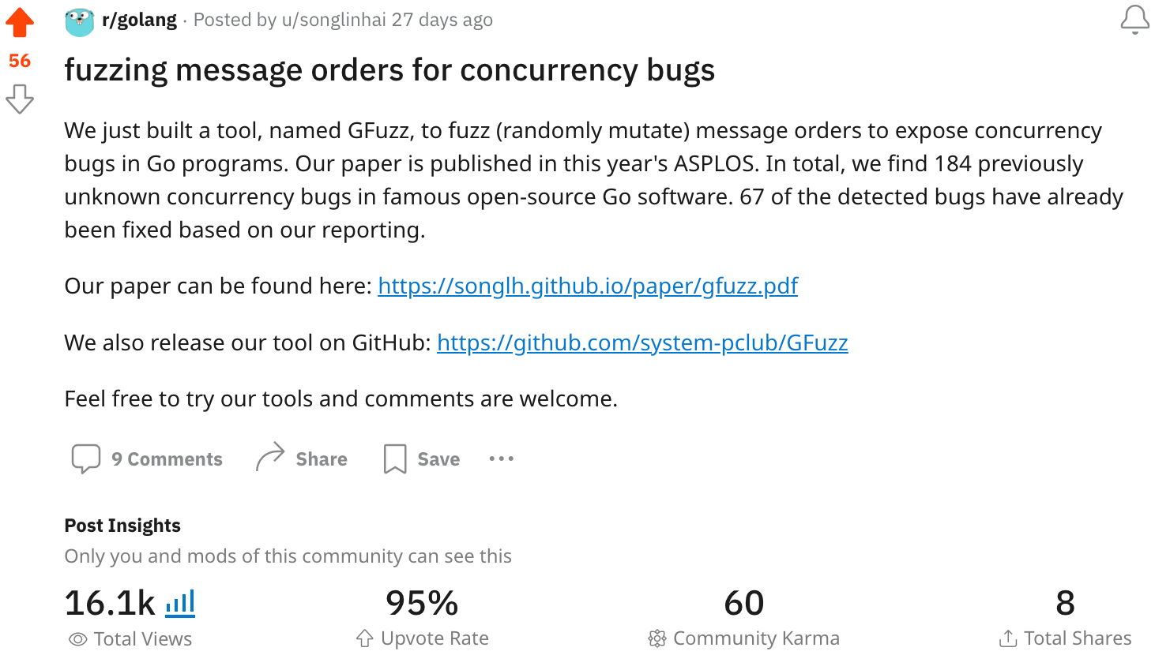



Thanks a lot!
Contact: Shihao Xia (szx5097@psu.edu)

Slide 52
Questions?
How to identify concurrent messages?
How to identify suspicious message orders?
How to capture triggered channel-related bugs?
Goroutine1
Goroutine2
suspicious orders
ch1 <- m
m <- ch1
ch2 <- m
order space

Slide 53

Backup

Slide 54
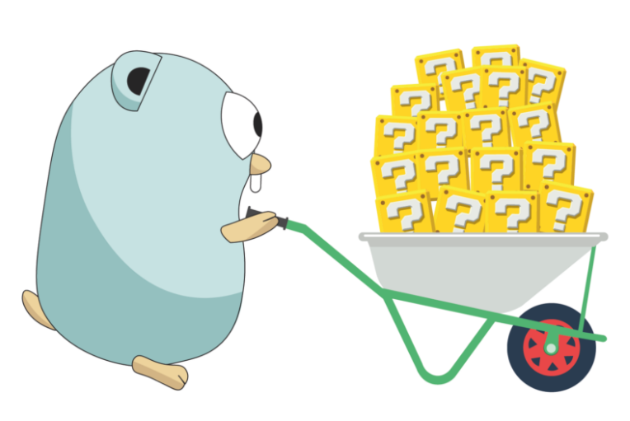
Questions?
Our three challenges
How to enforce a particular message order
How to pinpoint the most effective message order
How to capture bug
Notes:
Please do not hesitate to ask me any questions

