Slide 1






How to Save My Gas Fees: Understanding and Detecting Real-World Gas Wastes in Solidity Programs
Mengting He¹, Shihao Xia¹, Boqin Qin², Nobuko Yoshida³, Tingting Yu⁴, Yiying Zhang⁵, and Linhai Song⁶
¹Pennsylvania State University, ²China Telecom Cloud Computing,
³University of Oxford, ⁴University of Connecticut,
⁵University of California, San Diego, ⁶SKLP, ICT, Chinese Academy of Sciences

Slide 2







Ethereum
A decentralized blockchain with smart contract functionality
Smart contracts are self-executing digital agreements
An Ethereum transaction initiated by a user message
Send Ethers (Ethereum’s cryptocurrency) or invoke smart contracts
Smart contracts foster a booming digital economy on Ethereum
1 million daily transactions, $4 billion total volume
Many projects reach valuations above $1 billion

Slide 3







Gas Fee
Ethereum charges gas fees on transactions
Gas: the unit of computation to execute Ethereum transactions
Gas Price: the cost per unit of gas, measured in gwei (10⁻⁹ Ether)
Gas Fee: the total transaction cost (gas used * gas price)
gasLimit = XXX
maxGasPrice = YYY
Tip = ZZZ
gas mechanism
Option-1: success and return the remaining gas
Contract API and parameters
execute
Option-2: out of gas and revert the transaction
smart contracts
Validator

Slide 4
Gas Usage Computation
Depending on a complex model, considering
instructions, data store areas, and data values
How many tokens exist
How many tokens for each address
contract ERC20 {
uint public totalSupply;
mapping(address => uint) public balanceOf;
function _mint(address to, uint256 value) internal {
totalSupply += value;
balanceOf[to] += value;
}
function transfer(address to, uint value) external returns (bool) {
require(balanceOf[msg.sender] >= value);
uint old = balanceOf[msg.sender];
unchecked {old -= value;}
balanceOf[msg.sender] = old;
balanceOf[to] += value;
return true;
}}
c
Transfer tokens
c
c
c
the caller and the sender
c

Slide 5
Gas Usage Computation
Depending on a complex model, considering
instructions, data store areas, and data values
contract ERC20 {
uint public totalSupply;
mapping(address => uint) public balanceOf;
function _mint(address to, uint256 value) internal {
totalSupply += value;
balanceOf[to] += value;
}
function transfer(address to, uint value) external returns (bool) {
require(balanceOf[msg.sender] >= value); // 223 gas units
uint old = balanceOf[msg.sender]; // 208 gas units
unchecked {old -= value;} // 21 gas units
balanceOf[msg.sender] = old; // 214 gas units
balanceOf[to] += value; // 22415 gas units
return true;
}}
gas cost increases to 171 after removing uncheck

Slide 6
Gas Wastes
The complex gas-consumption model often leads to gas wastes
Accessing an expensive store area, but the data is also in a cheap area
Repeatedly changing storage slots between zero and non-zero values
Failing to use Solidity’ gas-saving features (e.g., unchecked)
Gas Wastes: code sites unnecessarily costing more gas
Can be fixed while preserving the original semantics
Widespread in real-world contracts and wasting money
Fixing the gas wastes we detected can save $0.76 million daily gas fee
Addressing gas wastes is both important and urgent

Slide 7
Comparing Gas Wastes with Performance Bugs
Differ from perf. bugs in traditional programming lang.
Impact: measured in money, not execution time
Store system: opcodes can access all store areas, no caching
Architecture: stack-based, lacks registers and certain instructions
Techniques built for perf. bugs are ineffective for gas wastes
EVM
Store System
Traditional Store System
How EVM computes 3+5？
Gas Wastes
Perf. Bugs
Step 1
Step 2
Step 3
Stack
CPU
push 0x03
push 0x05
add
Cause
Cause
VS
Registers
Calldata
Opcode
Memory
Stack
Stack
Stack
L1/L2
Money
Slow Execution
0x05
Top
Storage
Memory
Disk
0x03
Top
0x03
0x08
Top

Slide 8
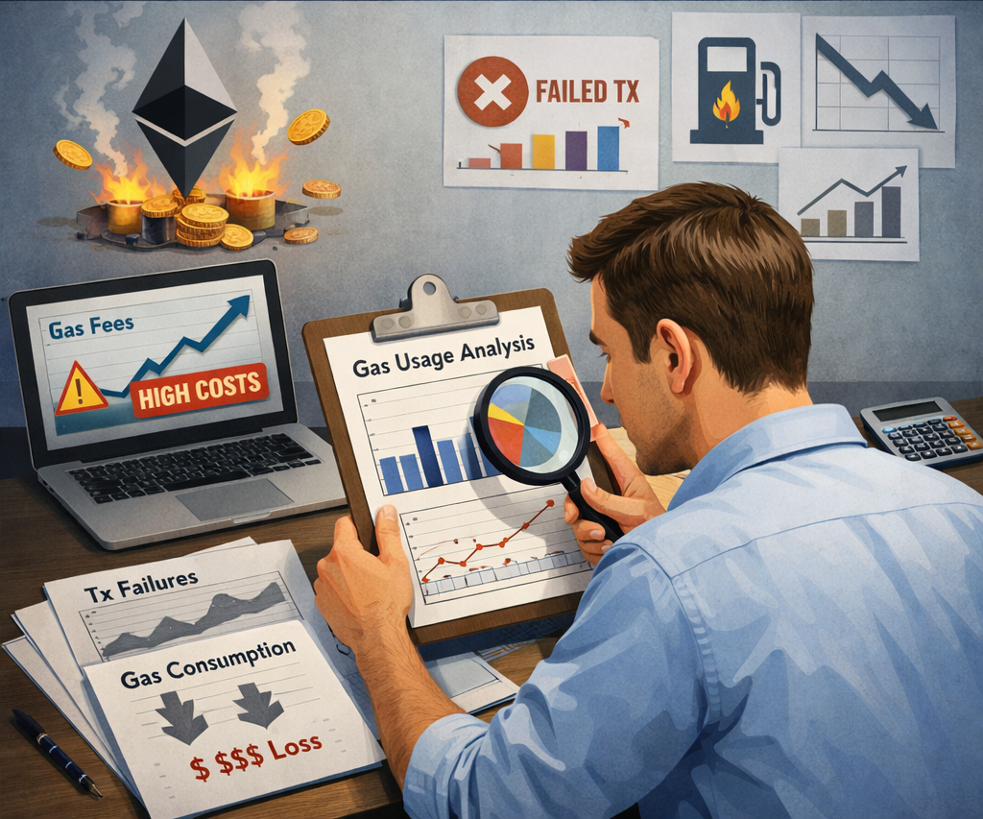
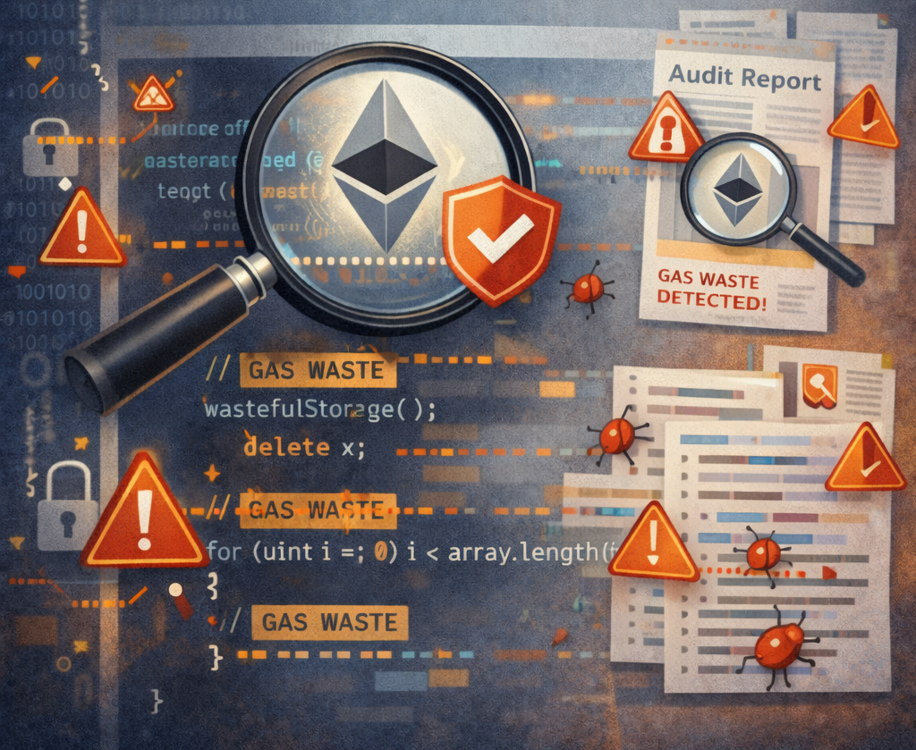
Our Work
Empirical Study on Gas Wastes
Gas Waste Detection

Slide 9
Empirical Study on Real-World Gas Wastes
Analyzing fixed gas wastes in well-known Solidity programs
Dataset: 100 gas wastes, including 54 unique to Solidity
How we perform the analysis?
Identify which data store areas gas inefficiency occurs
Inspect root causes, fixing strategies, and why compiler optimizations fail
Analyzing on-chain traces for unnoticed gas wastes
Dataset: 10 million transactions, accounting for $160 million in gas fee
Focusing on two types of opcode sequences:
Frequently executed sequences
Sequences without side effects

Slide 10



Gas Waste Detection
PeCatch: a suite of static gas-waste checkers
Input: Solidity source code, output: gas wastes’ line numbers
Covering all data store areas
Focusing on Ethereum’s unique features (e.g., calldata, unchecked)
Manually inspecting the Solidity compiler’s source code
Guided by the opcode patterns identified from the trace analysis
Identifying implementation mistakes in the Solidity compiler
Insights
PeCatch
Compiler Code Analysis
Programmers miss many opportunities of leveraging language features for trading security for lower gas.
Specific patterns of reading and writing to storage could always lead to extra gas.
The gas-cost model can be tricky, requiring careful consideration to find the best way to write code.
…
4 Store Areas
Empirical Study
Ethereum features

Slide 11


Highlighted Results
11 insights and 4 suggestions gained from the empirical study
Most are not reported in previous research
Found 302 previously unknown gas wastes from Solidity Apps
Found 14 bugs from the Solidity compiler

Slide 12
Outline
Introduction
Studying Gas Wastes in Solidity Programs
Analyzing On-Chain Transaction Traces
Gas Waste Detection
Conclusions

Slide 13
Outline
Introduction
Studying Gas Wastes in Solidity Programs
Analyzing On-Chain Transaction Traces
Gas Waste Detection
Conclusions

Slide 14
Outline
Introduction
Studying Gas Wastes in Solidity Programs
Analyzing On-Chain Transaction Traces
Gas Waste Detection
Conclusions

Slide 15
Methodology
How we collect gas wastes?
Target 5 well-known open-source Solidity projects
Search commit histories using keywords (e.g., “gas”, “opt”)
Apps | Start Time | Stars | Commits | Used by | LoC
OpenZeppelin | 2016/08 | 22623 | 3311 | 20534 | 9684
Uniswap V3 | 2019/08 | 3725 | 1005 | 6090 | 4247
uniswap-lib | 2020/04 | 140 | 73 | 17946 | 666
solmate | 2021/07 | 3231 | 426 | 476 | 6833
Seaport | 2022/01 | 1992 | 5400 | - | 61077

Slide 16
Methodology
How we collect gas wastes?
Target 5 well-known open-source Solidity projects
Search commit histories using keywords (e.g., “gas”, “opt”)
100
Apps | Start Time | Stars | Commits | Used by | LoC | Gas Wastes
OpenZeppelin | 2016/08 | 22623 | 3311 | 20534 | 9684 | 23
Uniswap V3 | 2019/08 | 3725 | 1005 | 6090 | 4247 | 27
uniswap-lib | 2020/04 | 140 | 73 | 17946 | 666 | 4
solmate | 2021/07 | 3231 | 426 | 476 | 6833 | 25
Seaport | 2022/01 | 1992 | 5400 | - | 61077 | 21

Slide 17
Methodology
How we collect gas wastes?
Target 5 well-known open-source Solidity projects
Search commit histories using keywords (e.g., “gas”, “opt”)
54
Apps | Start Time | Stars | Commits | Used by | LoC | Gas Wastes | Unique
OpenZeppelin | 2016/08 | 22623 | 3311 | 20534 | 9684 | 23 | 14
Uniswap V3 | 2019/08 | 3725 | 1005 | 6090 | 4247 | 27 | 13
uniswap-lib | 2020/04 | 140 | 73 | 17946 | 666 | 4 | 1
solmate | 2021/07 | 3231 | 426 | 476 | 6833 | 25 | 13
Seaport | 2022/01 | 1992 | 5400 | - | 61077 | 21 | 13

Slide 18
Methodology
How we collect gas wastes?
Target 5 well-known open-source Solidity projects
Search commit histories using keywords (e.g., “gas”, “opt”)
How we analyze gas wastes?
Examine code diffs, surrounding context, and related discussion
Apps | Start Time | Stars | Commits | Used by | LoC | Gas Wastes | Unique
OpenZeppelin | 2016/08 | 22623 | 3311 | 20534 | 9684 | 23 | 14
Uniswap V3 | 2019/08 | 3725 | 1005 | 6090 | 4247 | 27 | 13
uniswap-lib | 2020/04 | 140 | 73 | 17946 | 666 | 4 | 1
solmate | 2021/07 | 3231 | 426 | 476 | 6833 | 25 | 13
Seaport | 2022/01 | 1992 | 5400 | - | 61077 | 21 | 13

Slide 19
Research Questions
RQ-1: Where is the data accessed by gas-inefficient code stored?
RQ-2: Why can't the Solidity compiler optimize the wastes?
RQ-3: What strategies are employed to fix the wastes?

Slide 20
Research Questions
RQ-1: Where is the data accessed by gas-inefficient code stored?
RQ-2: Why can't the Solidity compiler optimize the wastes?
RQ-3: What strategies are employed to fix the wastes?

Slide 21
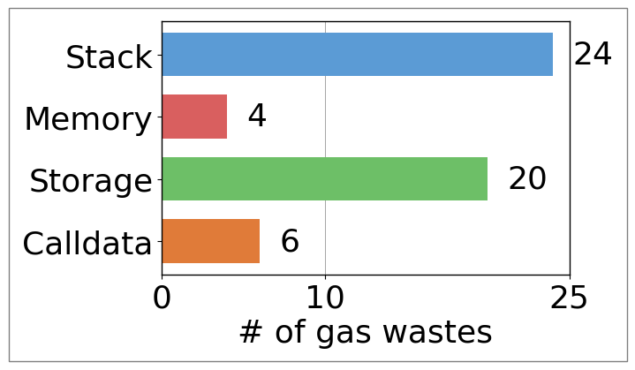
Gas Wastes on Different Store Areas
4 store areas with different instructions and gas models
Stack: cheapest; holds most operands and intermediate results
Memory: more expensive than stack; volatile and byte-addressable
Storage: most expensive; persistent key-value data store
Calldata: read-only; used for passing data across contracts

Slide 22
Gas Wastes on Different Store Areas
4 store areas with different instructions and gas models
Stack: cheapest; holds most operands and intermediate results
Memory: more expensive than stack; volatile and byte-addressable
Storage: most expensive; persistent key-value data store
Calldata: read-only; used for passing data across contracts
Most frequently accessed store area, and most wastes

Slide 23
Not Using unchecked When Possible
Over/under flows are automatically checked for stack variables
Keyword unchecked can disable the checks
Unchecked is not used when possible causes 12 gas wastes
contract ERC20 {
uint public totalSupply;
mapping(address => uint) public balanceOf;
…
function transfer(address to, uint value) external returns (bool) {
require(balanceOf[msg.sender] >= value); // 223 gas units
uint old = balanceOf[msg.sender]; // 208 gas units
old -= value; // 171 gas units
…
}}
Insight 1: Programmers miss many opportunities of leveraging language features of Solidity for trading security for lower gas usage.
cannot underflow
+ unchecked{old -= value;} // 21 gas units

Slide 24
Gas Wastes on Different Store Areas
4 store areas with different instructions and gas models
Stack: cheapest; holds most operands and intermediate results
Memory: more expensive than stack; volatile and byte-addressable
Storage: most expensive; persistent key-value data store
Calldata: read-only; used for passing data across contracts
Operations with the highest cost, and the second most wastes

Slide 25
Repetitive Reads to Storage
Repetitive reads to the same storage slot causes 14 gas wastes
Copying storage data to stack and reading the copied version fix them
Insight 4: Specific patterns of reading and writing to storage could always lead to extra gas.
contract ERC20 {
uint public totalSupply;
mapping(address => uint) public balanceOf;
…
function transfer(address to, uint value) external returns (bool) {
require(balanceOf[msg.sender] >= value); // 223 gas units
uint old = balanceOf[msg.sender]; // 208 gas units
unchecked{old -= value;} // 21 gas units
…
}}
Repeated reads to the same storage slot
+ uint old = balanceOf[msg.sender]; // 208 gas units
+ require(old >= value); // 33 gas units

Slide 26
Research Questions
RQ-1: Where is the data accessed by gas-inefficient code stored?
RQ-2: Why can't the Solidity compiler optimize the wastes?
RQ-3: What strategies are employed to fix the wastes?

Slide 27
Why Not Optimized?
For the 54 gas wastes with patterns unique to Solidity
32 are due to the lack of related compiler optimizations
Lack compiler optimizations

Slide 28
Why Not Optimized?
For the 54 gas wastes with patterns unique to Solidity
32 are due to the lack of related compiler optimizations
Lack compiler optimizations
contract ERC20 {
uint public totalSupply;
mapping(address => uint) public balanceOf;
…
function transfer(address to, uint value) external returns (bool) {
require(balanceOf[msg.sender] >= value); // 223 gas units
uint old = balanceOf[msg.sender]; // 208 gas units
old -= value; // 171 gas units
…
}}
The compiler does not check whether two storage read access the same slot

Slide 29
Why Not Optimized?
For the 54 gas wastes with patterns unique to Solidity
32 are due to the lack of related compiler optimizations
14 are introduced deliberately for better reliability
Lack compiler optimizations
For better reliability

Slide 30
Why Not Optimized?
For the 54 gas wastes with patterns unique to Solidity
32 are due to the lack of related compiler optimizations
14 are introduced deliberately for better reliability
Lack compiler optimizations
contract ERC20 {
uint public totalSupply;
mapping(address => uint) public balanceOf;
…
function transfer(address to, uint value) external returns (bool) {
require(balanceOf[msg.sender] >= value); // 223 gas units
uint old = balanceOf[msg.sender]; // 208 gas units
old -= value; // 171 gas units
…
}}
The underflow check is added for better contract reliability
For better reliability

Slide 31
Why Not Optimized?
For the 54 gas wastes with patterns unique to Solidity
32 are due to the lack of related compiler optimizations
14 are introduced deliberately for better reliability
8 are due to Solidity compiler bugs
Lack compiler optimizations
Compiler bugs
For better reliability

Slide 32
Outline
Introduction
Studying Gas Wastes in Solidity Programs
Analyzing On-Chain Transaction Traces
Gas Waste Detection
Conclusions

Slide 33
Outline
Introduction
Studying Gas Wastes in Solidity Programs
Analyzing On-chain Transaction Traces
Gas Waste Detection
Conclusions

Slide 34
PeCatch
A suite of six static gas-waste checkers
Non-overflowable computation
Allocation in a loop
Loop invariant
Replaceable sloads
Boolean contract fields
Calldata Parameter
Implemented based on the Slither framework
Performing the analysis on SSA
Containing 2065 lines of source code
stack
memory
storage
calldata

Slide 35
Detecting Non-overflowable Computation
Pattern-1: non-overflow is ensured by the path conditions
contract ERC20 {
uint public totalSupply;
mapping(address => uint) public balanceOf;
function _mint(address to, uint256 value) internal {
totalSupply += value;
balanceOf[to] += value;
}
function transfer(address to, uint value) external returns (bool) {
require(balanceOf[msg.sender] >= value);
uint old = balanceOf[msg.sender];
old -= value;
balanceOf[msg.sender] = old;
balanceOf[to] += value;
return true;
}}
Pattern-1

Slide 36
Detecting Non-overflowable Computation
Pattern-1: non-overflow is ensured by the path conditions
Pattern-2: given a>=b, “b+x” can be unchecked if “a+x” exists
contract ERC20 {
uint public totalSupply;
mapping(address => uint) public balanceOf;
function _mint(address to, uint256 value) internal {
totalSupply += value;
balanceOf[to] += value;
}
function transfer(address to, uint value) external returns (bool) {
require(balanceOf[msg.sender] >= value);
uint old = balanceOf[msg.sender];
old -= value;
balanceOf[msg.sender] = old;
balanceOf[to] += value;
return true;
}}
a
can be unchecked
sum(balanceOf) is b

Slide 37
Evaluation Methodology
Benchmarks
the 5 Solidity programs in the empirical study + 4 additional programs
Baselines
Existing Techs: Slither, python-solidity-optimizer, GasSaver, MadMax
Compilers: the Solidity compiler (solc), LLVM
Evaluation Metrics
Effectiveness: How many gas wastes are detected
Accuracy: How many false positives are reported
Coverage: the proportion of gas wastes is covered

Slide 38
Effectiveness and Accuracy
 | PeCatch | SL | PO | GS | MM | solc | LLVM
OpenZeppelin | 139₀ | 3₁ | 0₆ | 53₁ | - | - | 23
Uniswap V3 | 8₀ | - | 0₁ | - | - | 1 | 1
uniswap-lib | 4₀ | - | 2₂ | - | - | - | -
solmate | 2₀ | - | - | - | - | - | 2
Seaport | 50₀ | - | - | 2₀ | - | 2 | 3
SeaDrop | 5₀ | - | - | 2₁ | - | - | -
V3-Periphery | 59₀ | 1₄ | 2₃ | 6₀ | - | - | 9
V2-Periphery | 32₀ | 4₀ | - | 0₁ | - | - | 4
Uniswap V2 | 3₀ | - | - | - | - | 2 | -
Total | 302₀ | 8₅ | 4₁₂ | 63₆ | - | 5 | 42
SL: Slither
PO: python-solidity-optimizer
GS: GasSaver
MM: MadMax
more gas wastes than baselines

Slide 39
Effectiveness and Accuracy
 | PeCatch | SL | PO | GS | MM | solc | LLVM
OpenZeppelin | 139₀ | 3₁ | 0₆ | 53₁ | - | - | 23
Uniswap V3 | 8₀ | - | 0₁ | - | - | 1 | 1
uniswap-lib | 4₀ | - | 2₂ | - | - | - | -
solmate | 2₀ | - | - | - | - | - | 2
Seaport | 50₀ | - | - | 2₀ | - | 2 | 3
SeaDrop | 5₀ | - | - | 2₁ | - | - | -
V3-Periphery | 59₀ | 1₄ | 2₃ | 6₀ | - | - | 9
V2-Periphery | 32₀ | 4₀ | - | 0₁ | - | - | 4
Uniswap V2 | 3₀ | - | - | - | - | 2 | -
Total | 302₀ | 8₅ | 4₁₂ | 63₆ | - | 5 | 42
SL: Slither
PO: python-solidity-optimizer
GS: GasSaver
MM: MadMax
zero false positives
Notes:
Moreover, PeCatch does not report any false positives, showcasing its accuracy.

Slide 40
Effectiveness and Accuracy
 | PeCatch | SL | PO | GS | MM | solc | LLVM
OpenZeppelin | 139₀ | 3₁ | 0₆ | 53₁ | - | - | 23
Uniswap V3 | 8₀ | - | 0₁ | - | - | 1 | 1
uniswap-lib | 4₀ | - | 2₂ | - | - | - | -
solmate | 2₀ | - | - | - | - | - | 2
Seaport | 50₀ | - | - | 2₀ | - | 2 | 3
SeaDrop | 5₀ | - | - | 2₁ | - | - | -
V3-Periphery | 59₀ | 1₄ | 2₃ | 6₀ | - | - | 9
V2-Periphery | 32₀ | 4₀ | - | 0₁ | - | - | 4
Uniswap V2 | 3₀ | - | - | - | - | 2 | -
Total | 302₀ | 8₅ | 4₁₂ | 63₆ | - | 5 | 42
SL: Slither
PO: python-solidity-optimizer
GS: GasSaver
MM: MadMax
fixing them saves $0.73 million in gas fee

Slide 41
Conclusions
Empirical study on real-world gas wastes
Analyzing 54 Solidity-unique gas wastes from 5 open-source programs
Analyzing more than 10 million transactions’ trace
11 insights and 4 suggestions gained
Please refer to our paper for more details about the study
Gas-waste detection
PeCatch reports 302 previously unknown wastes from Solidity Apps
Manual inspection identifies 14 bugs in the Solidity compiler
Future research: automatically fixing gas wastes

Slide 42
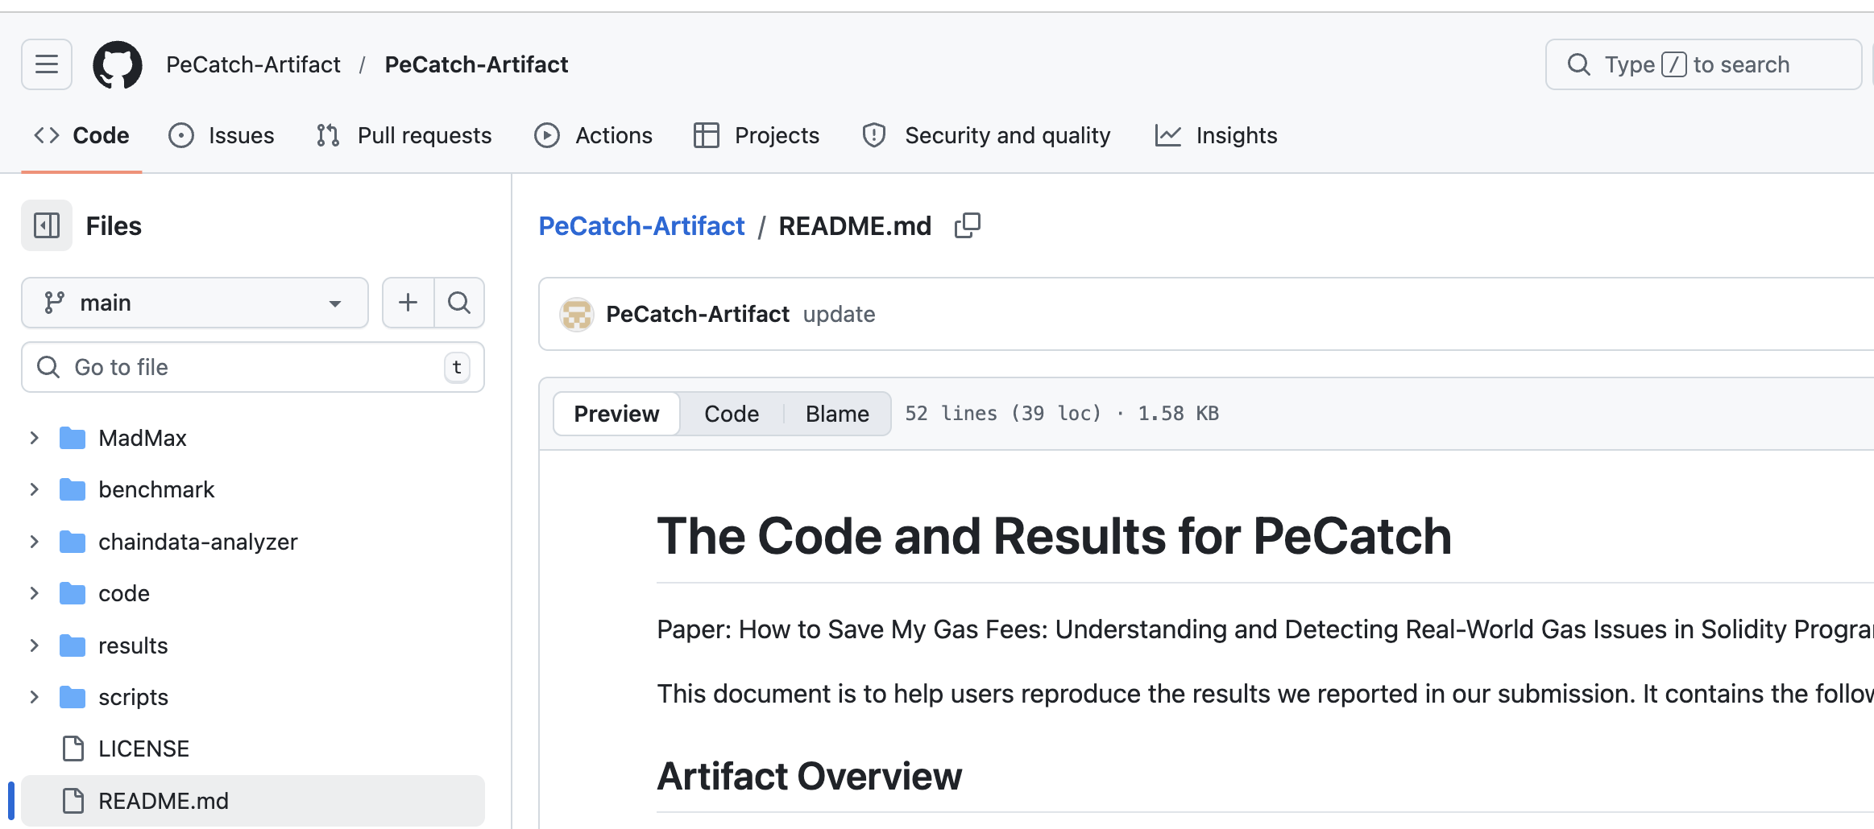

Thank you!
Acknowledgement
National Science Foundation
Engineering and Physical Sciences Research Council

Slide 43
Questions?
Analyzing fixed gas wastes in well-known Solidity programs
Analyzing on-chain traces for unnoticed gas wastes
PeCatch: a suite of static gas-waste checkers
Manual inspection of the Solidity compiler’s source code
Insights
PeCatch
Compiler Code Analysis
Programmers miss many opportunities of leveraging language features for trading security for lower gas.
Specific patterns of reading and writing to storage could always lead to extra gas.
The gas-cost model can be tricky, requiring careful consideration to find the best way to write code.
…
4 Store Areas
Empirical Study
Ethereum features
43

Slide 44
Gas Wastes
The complex gas consumption model easily leads to gas wastes
Gas wastes: code sites unnecessarily costing more gas
Can be fixed while keeping the original semantics
Widely existing in real-world contracts and wasting money
Different from performance bugs in traditional programming lang.
Impacts are measured in different ways: money vs. execution time
Store systems work differently: whether having opcodes accessing all areas
Ethereum provides unique features (e.g., overflow checks), but lacks registers
Novel techniques are needed to combat gas wastes

Slide 45
Gas Usage Analysis In On-chain Traces
Storage opcodes account for the majority of gas usage
SSTORE ranks first
19.96% of gas is spent on those initialization operations
LOG3, JUMPI, EXTCODESIZE, PUSH1, JUMP: 6.14%
Others: 6.52%
Memory/Calldata: 1.5%
Stack: 34.1%
SSTORE: 40.67%
(19.96%: initialization)
Storage: 64.4%
STATICCALL: 9.07%
DELEGATECALL: 13.25%
SLOAD: 23.72%

Slide 46
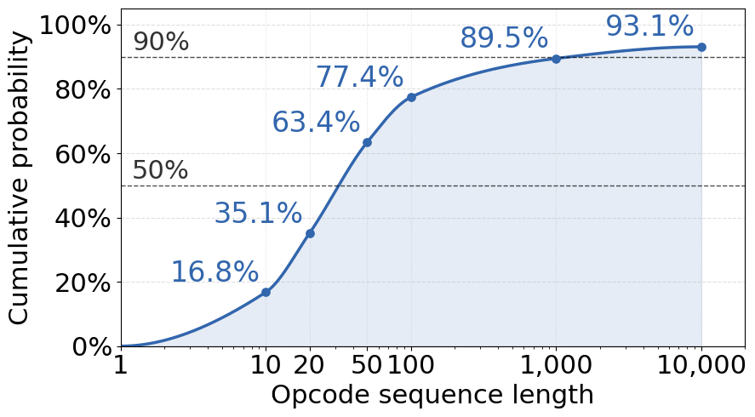
Gas Usage Analysis In On-chain Traces
Storage opcodes account for the majority of gas usage
SSTORE ranks first
19.96% of gas is spent on those initialization operations
The length of most sequence is smaller than 50

Slide 47
Outline
Introduction
Studying Gas Wastes in Solidity Programs
Analyzing On-Chain Transaction Traces
Gas Waste Detection
Conclusions

Slide 48
Methodology
Collecting on-chain traces using the debug API of Geth
The API returns a sequence of opcodes with information about
Gas consumed by each opcode
Contents of the stack and calldata before/after each opcode
Dataset: 10,629,589 transactions
Between Feb 1st, 2024, and Feb 10th, 2024
Consume 768.8 billion gas units and $160 million in gas fees
Focusing on two types of opcode sequences
Frequently executed sequences: more potential optimization gains
Sequences without side effects: likely to be gas wastes

Slide 49
Gas Waste Analysis In On-chain Traces
Identifying 14 distinct gas-wasting opcode sequences
9 are computing a large constant value at runtime
4 are due to pushing values onto stack that are never used
1 is caused by reading a storage value that is never used
runtime gas vs deployment gas
Bugs in the Solidity compiler
Unused Stack Variables
Skippable Storage Read
Runtime Constant Computation
Insight 11: Gas wastes due to compiler bugs exist, and many of them may not be noticed by the programmers.

Slide 50
Research Questions
RQ-1: Where is the data accessed by gas-inefficient code stored?
RQ-2: Why can't the Solidity compiler optimize the wastes?
RQ-3: What strategies are employed to fix the wastes?

Slide 51
Fixing Strategies
Among the 54 Solidity-unique gas wastes
26 are resolved by changing data store areas
9 are fixed by replacing old stack operations with more efficient ones
15 are eliminated with the unnecessary computation
4 are handled using other strategies
Changing Store Areas
Others
Removing Computation
Changing Stack Operations
51

Slide 52
Coverage
using the gas wastes collected in the empirical study to measure coverage
Store Area | Wastes in Study | Techniques
 |  | PeCatch | SL | PO | GS | MM | solc | LLVM
Stack | 24 | 15 | 0 | 0 | 0 | 0 | 0 | 0
Memory | 4 | 3 | 3 | 0 | 0 | 0 | 0 | 3
Storage | 20 | 18 | 0 | 0 | 0 | 0 | 3 | 0
Calldata | 6 | 5 | 5 | 0 | 5 | 0 | 0 | 0
Total | 54 | 41 | 8 | 0 | 5 | 0 | 3 | 3

