Slide 1

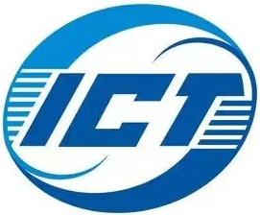



OmniDMA: Scalable RDMA Transport over WAN
Kai Lv, Jinyang Li, Pengyi Zhang, Heng Pan, Luyang Li, Shuihai Hu, Zhenyu Li, Gaogang Xie, Jingbin Zhou, and Kun Tan

Slide 2
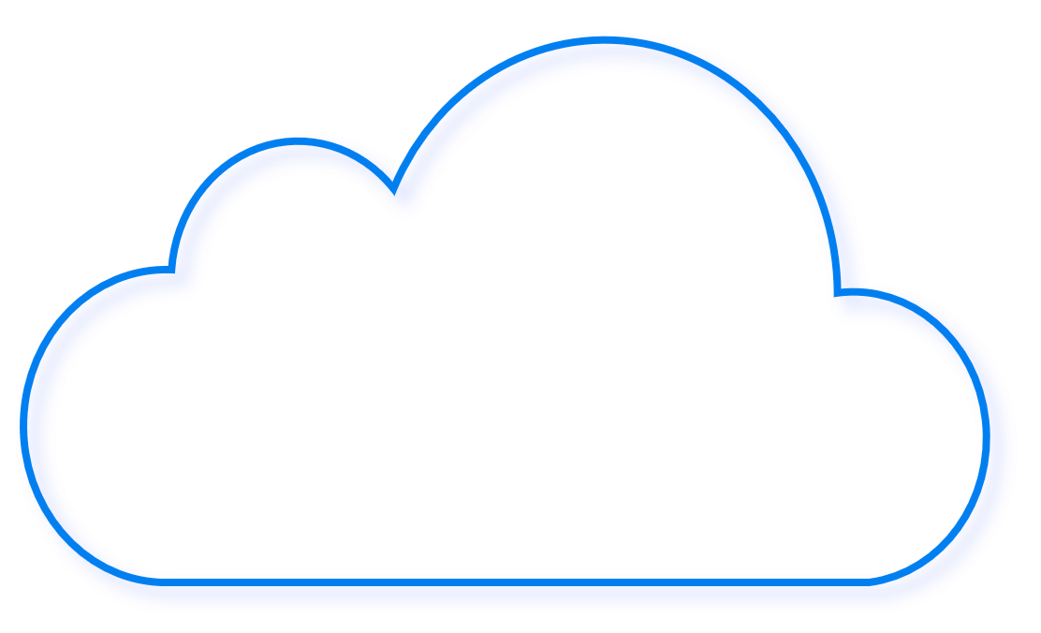
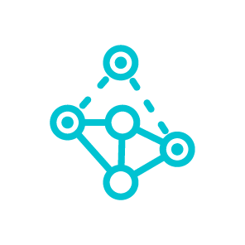



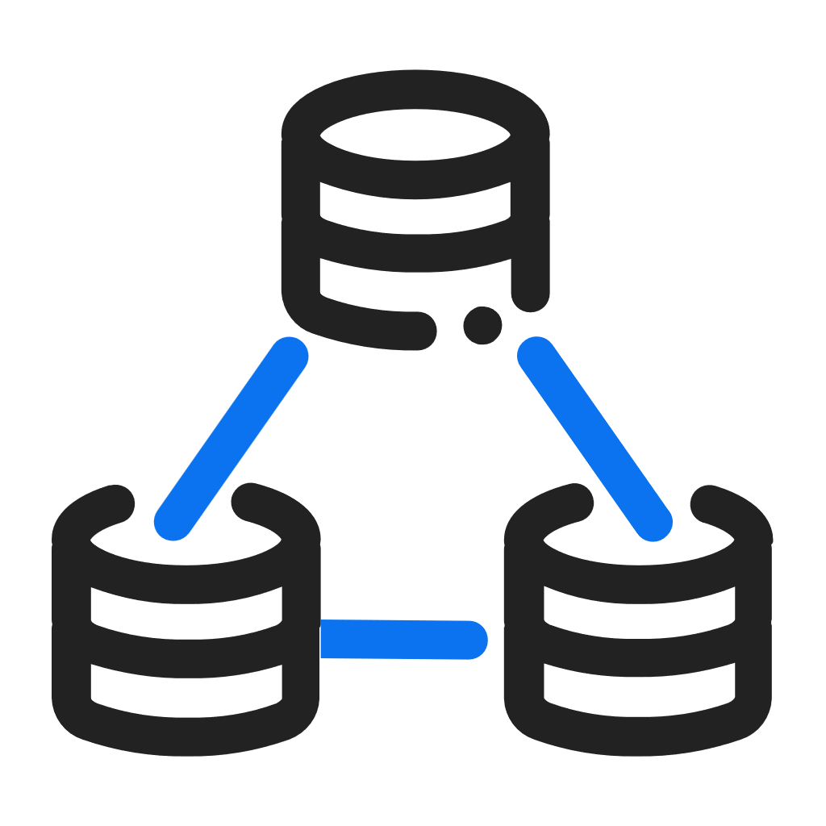







Growing Demand for Cross-Geolocation Transport
Distributed tasks require high-performance geo-distributed transport
For efficient data replication and freshness
Cross DCI / DC-WAN / WAN
Software transport faces bottlenecks
struggles to keep up with growing Ethernet bandwidth
Federated
learning
LLM training
Decentralized
RL
RDMA offers promising performance
High bandwidth, low CPU overhead
Storage
Database
Distributed service
Data
moving
Geo-distributed Cloud Services
Datacenters
Cloud edge
Private Servers
etc.

Slide 3
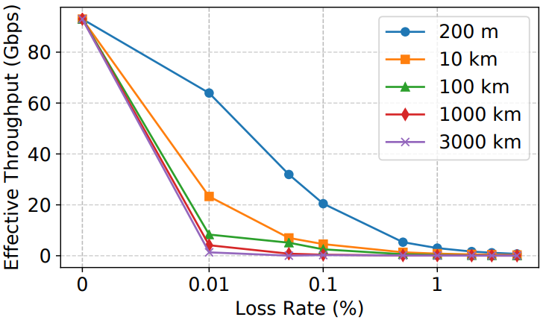
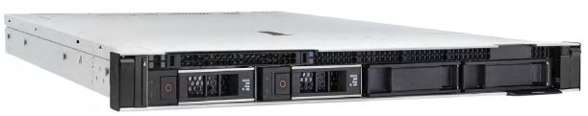
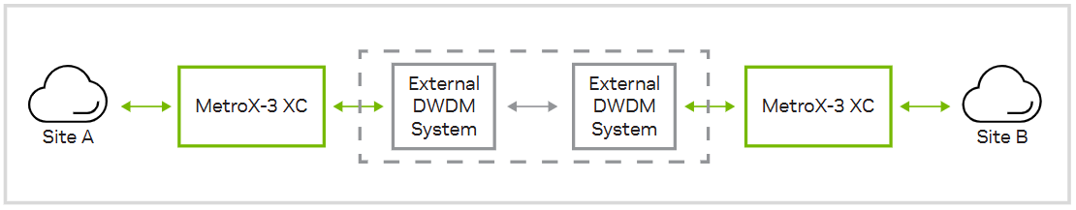
Hard to Deploy RDMA in Wide Area Networks
RDMA is vulnerable to packet loss
while
Hard to maintain a lossless WAN
Packet loss is inevitable in WAN
Congestion loss
Random loss
PFC is unsuitable in WAN
Large headroom required
Need network-wide replacement
Incompatible with CUBIC-like CC
Large RTT (& BDP) worsens go-back-N
Large feedback delay
Excessive spurious retransmissions
Dedicated devices is costly & hard to scale
Need infrastructure updates
Low radix
Reliability can be expensive and exclusive…
Can RDMA support end-to-end loss-tolerant transport?
RoCEv2 goodput over different distance & loss rate
NVIDIA MetroX-3 XC long haul system*
* NVIDIA Metrox-3 XC Long-Haul InfiniBand. https://nvdam.widen.net/s/ggdj8tqdgf/infiniband-datasheet-metrox-3-xc-long-haul-2380143

Slide 4
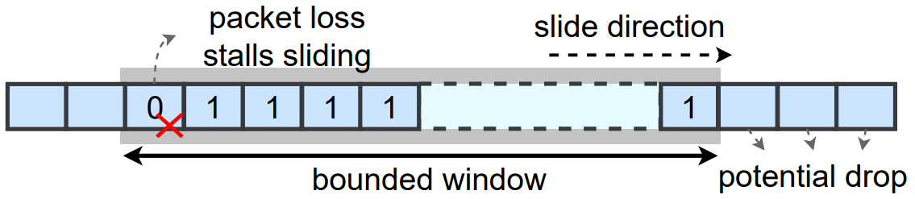


Revisit Selective Retransmission (SR)
SR: RDMA tracks packet arrival with bitmap window
Window size constrains in flight packet count and throughput.
Limitations of existing bitmap designs under large RTT & BDP
Per-QP bitmap: limited by RNIC SRAM capacity; falls back to GBN when exhausted.
Shared bitmap pool: hard to support QP Context swapping, limiting QP scalability.
Host-side bitmap: handle out-of-order (which dominate in WAN) in host; got CPU bottleneck.
How to scale the reorder window without sacrificing scalability?

Slide 5



Observation #1: Concentrated Packet Drops
Large BDP requires scalable loss recording
Tail drop in WAN is bursty and consecutive
Large delay -> untimely rate adjustment -> buffer exhaustion -> bursty (non-uniform) packet drop
For AIMD CCs: periodically packet drop
Loss / ACK / RTT / ECN / …
throughput
Network
capacity
Congestion losses
time
Long feedback delay
Congestion control’s AIMD policy
Record consecutive losses as a block to optimize space utilization

Slide 6
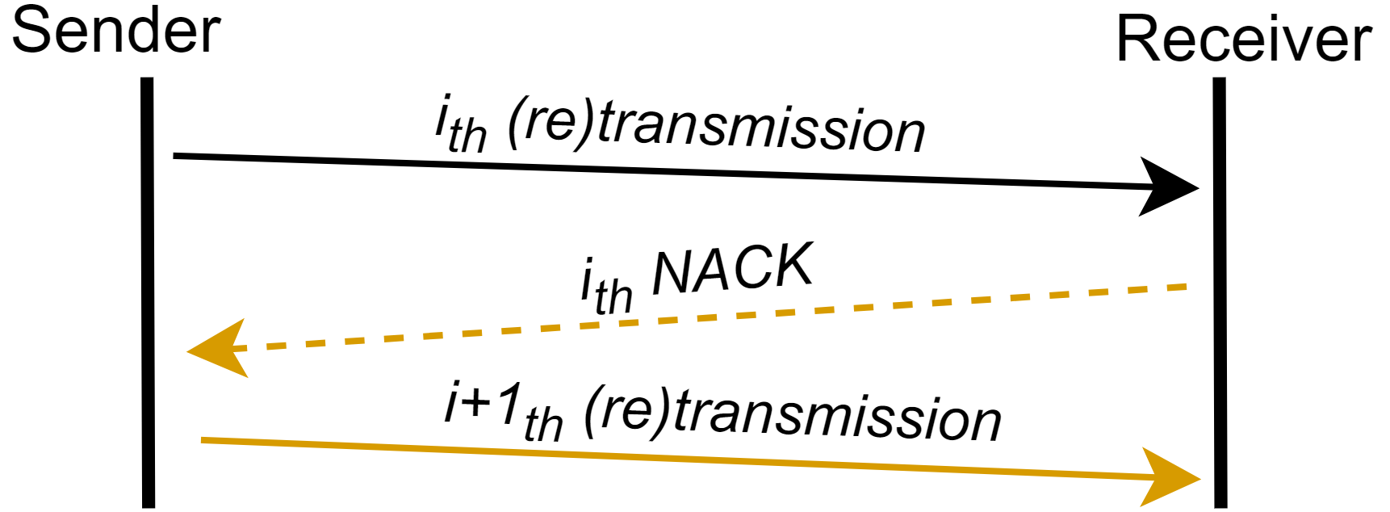
Observation #2: Coupled Transmission and Retransmissions
Reorder window must support random packet arrival efficiently
Coupling Tx and Re-Tx in a unified window requires the bitmap in SRAM
Every single tier of Tx or Re-Tx is sequential
NACKs and retransmitted packets are generated sequentially
Predictable packet arriving pattern
Decouple Tx and each Re-Tx
leverage the predictable arrival pattern for offloading.

Slide 7
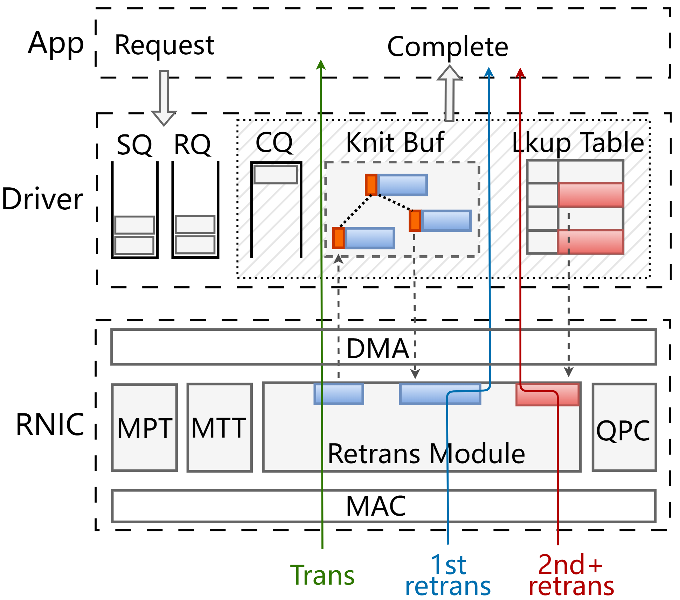
OmniDMA Overview
Design 1: Adamap for loss recording
Record consecutive loss segments
Support both precise and range recording
Fix-size design for easier scheduling
Design 2: 3-tier control path
Decouple transmission and retransmission(s)
Transport-driven context scheduling
Constant (and small) RNIC memory footprint
Design overview

Slide 8
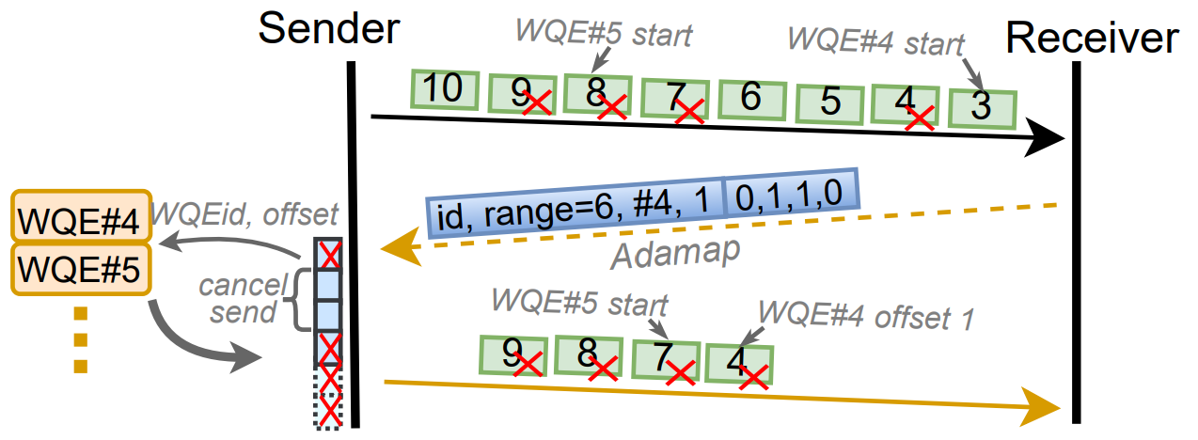
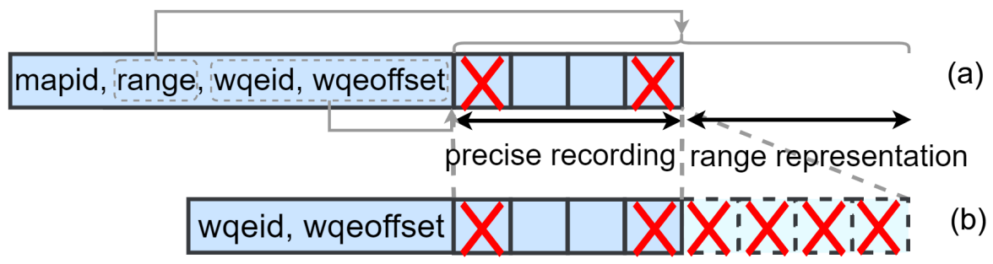
Adamap
Capturing variable loss patterns with fixed-size data structure
Exploits spatial locality of losses
Combine precise and compact range representation
Adamap-driven selective retransmission
Piggybacked in NACK
Retrieve WQEs and generate packets according to Adamap contents

Slide 9
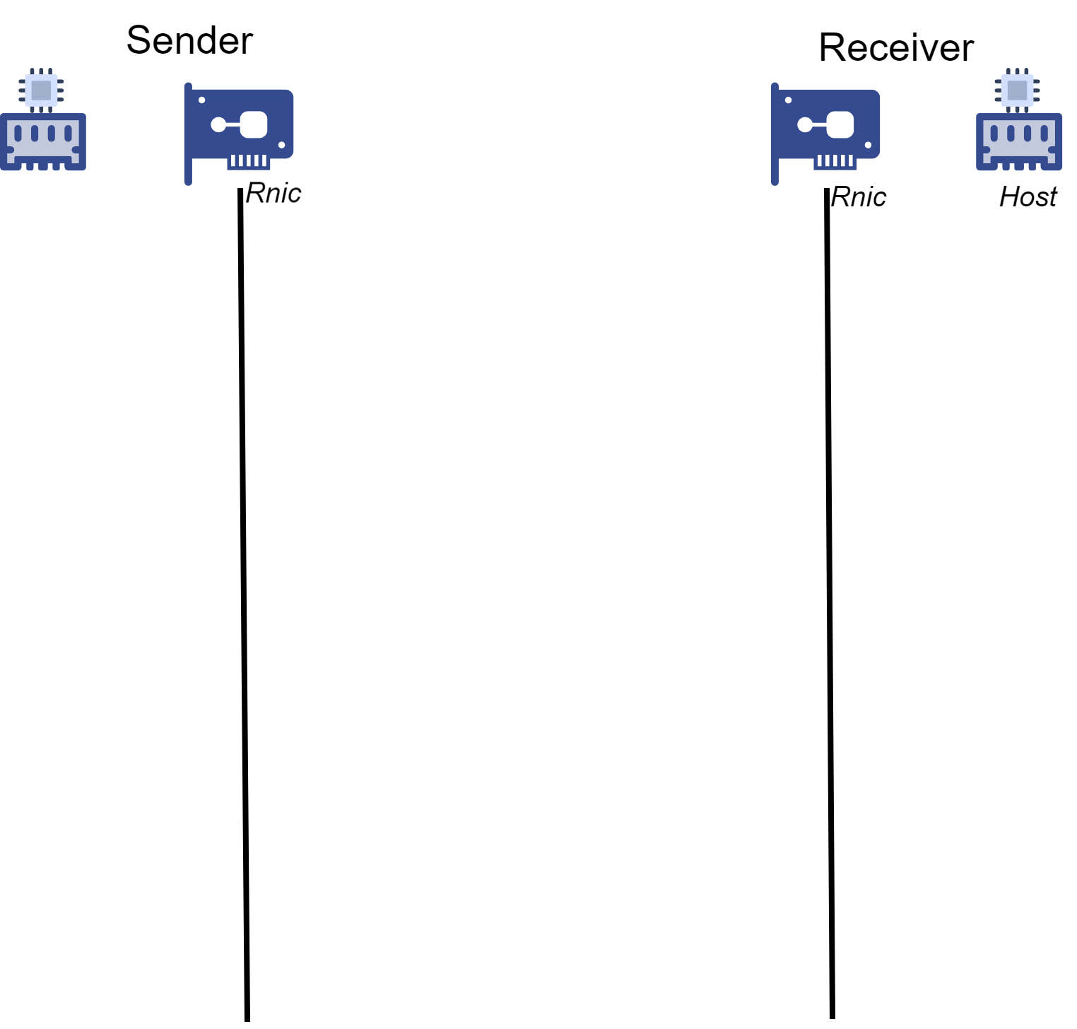
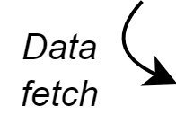
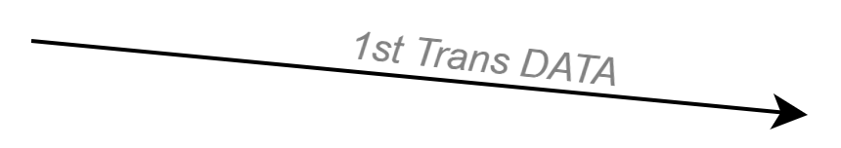
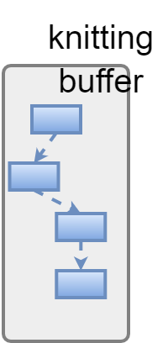
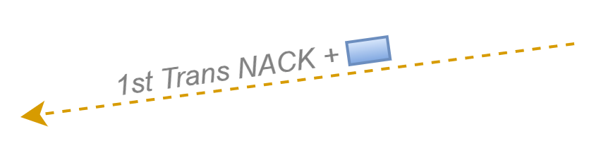


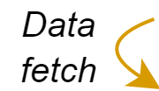
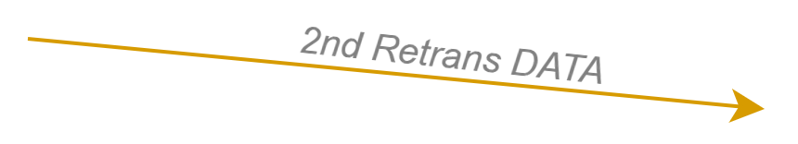


3-tier Control Path
Tier 1: First-Time Transmission Handling
Detect losses
generate Adamap
Processing frequency: ~O(BW)
tail
Tier 2: First-Retransmission Handling
Exploits the sequential pattern
Prefetch for line-rate processing
Processing frequency: ~O(BW × LossRate)
head

Slide 10

3-tier Control Path
Wait… Should we maintain a separate control path for every retransmission tier?
Unpredictable tier of retransmissions
Packets retransmitted > 1 times are rare
It is more cost-effective to manage all high-order retransmissions in a unified manner!

Slide 11
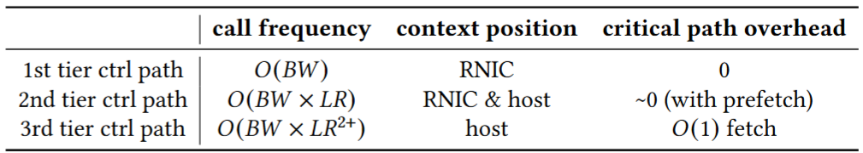
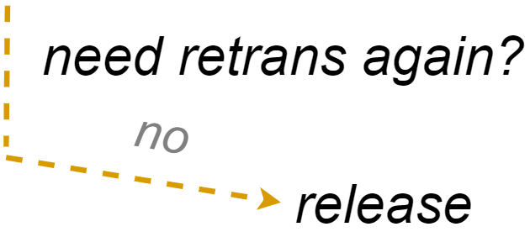
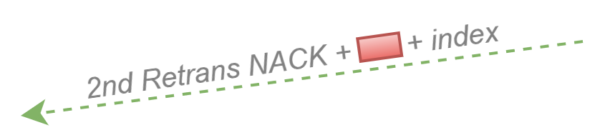
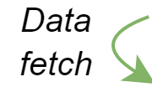


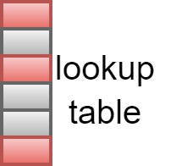
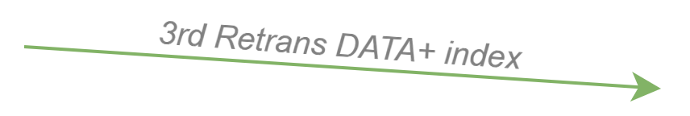
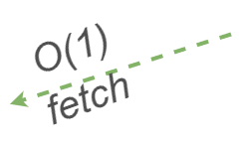
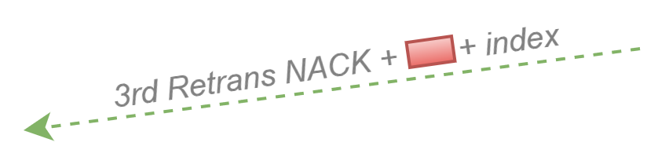

3-tier Control Path
Tier 3: High-order Transmission Handling
Manage Adamap of high-order transmission with a unified lookup table
Lookup index pre-embedded in NACK and returns with retransmitted packets
O(1) Adamap access via direct table lookup
Characteristics of three-tier control path (BW: bandwidth; LR: loss rate)
To further overlap the access cost on critical path:
Intra-QP: dedicated queue
Inter-QP: QP interleaving and pipelining

Slide 12


Evaluation
Setup
NS3 simulation
Topology
P2p connected by a switch
100Gbps, 1KB MTU
1us
Long-haul link
Long-haul link settings
Varied distance: 200m ~ 3000km
Loss rate: 0%, 0.1%, 0.2%, 0.5%, 1%, 2%, 3%
Loss distribution: Amazon Cloud Network^{[1]}
Simulation topology
[1] Measuring and improving the reliability of wide-area cloud paths. (WWW’17)

Slide 13
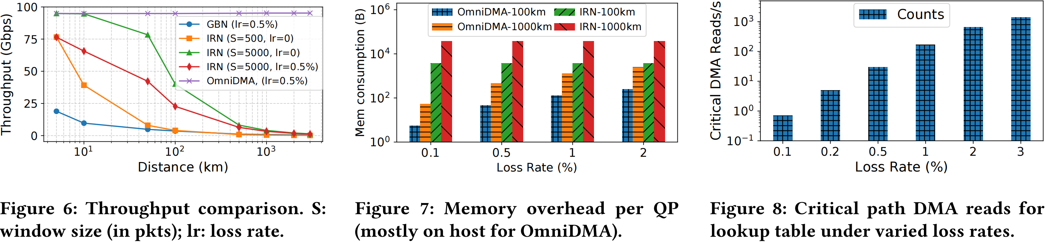
Preliminary Results
Evaluate performance, overhead and efficiency
Distance-independent goodput
  Only affected by loss rate
Small loss-recording overhead
  RNIC mem: small & fixed
  Total mem: less than bitmap-only scheme
Limited critical-path DMA reads
  Can be further mitigated with caching & RNIC’s QP scheduling and pipelining

Slide 14
Summary
To enable scalable RDMA transport over WAN:
Motivation:
Utilize non-uniform packet loss pattern over WAN.
Decouple transmission and retransmission for an “unbounded” window.
Design:
Use Adamap to record loss segments, improving space efficiency.
Enable window scalability through Adamap linked-list offloading.
Manage high-order retransmissions uniformly with O(1) access overhead.

Slide 15
Thank you

Slide 16
Q & A

