Slide 1


Mnemosyne: Lightweight and Fast
Error Recovery for LLM Training in a Just-In-Time Manner
Jinyi Xia¹, Menghao Zhang¹, Jiaxun Huang¹, Yuezheng Liu¹, Xiaohe Hu², Xudong Liu¹, Chunming Hu¹
¹Beihang University ²Infrawaves

Slide 2
Large Language Models (LLMs) Grow Rapidly
Consuming more
computing resources
& training time
thus causing more
frequent failures!
Model sizes are surging.
[1] Maslej N, Fattorini L, Perrault R, et al. Artificial intelligence index report 2024. arXiv preprint arXiv:2405.19522, 2024.

Slide 3

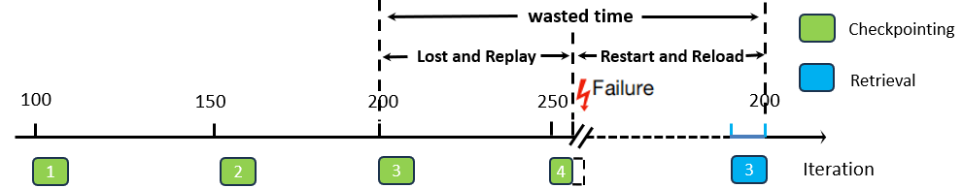

Costly Errors vs. Inefficient Recovery
Meta used 992 NVIDIA A100s to train OPT-175B.
  Encountering about 110 errors in 2 months,
  Wasting 178,000 GPU hours [1].
Common recovery practice: periodic checkpointing.
  Lost iterations need replaying.
  Require global task restarting & checkpoint loading.
  Saving checkpoints interferes with training progress.
[1] Zhang S, Roller S, Goyal N, et al. Opt: Open pre-trained transformer language models. arXiv preprint arXiv:2205.01068, 2022.

Slide 4
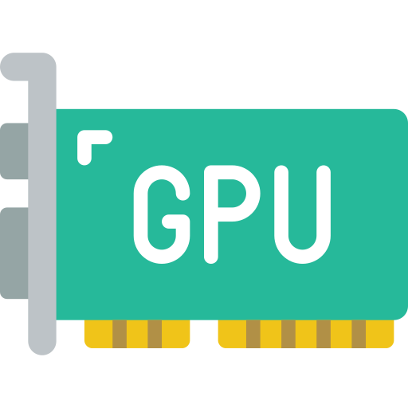
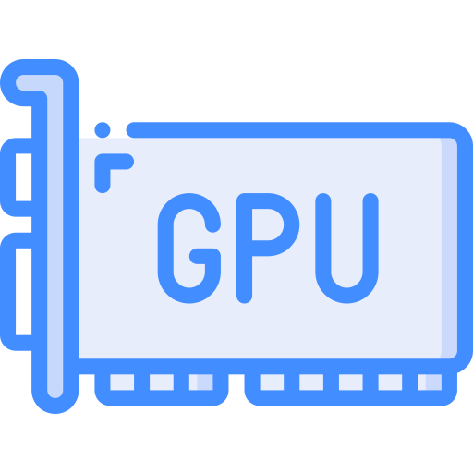

New Solution: Just-In-Time Checkpointing ^{[1]}
Error
Recover
DP Group
Healthy ranks keep alive.
Provide copies
Key insight: data parallelism (DP) naturally provides model copies.
Shortcomings:
  Excessive daily overhead due to heavy mechanisms.
  NCCL object recreations consume a large amount of time (up to 90% of total recovery time) [1].
[1] Gupta T et al. Just-in-time checkpointing: Low cost error recovery from deep learning training failures. EuroSys’24.

Slide 5
Our Solution: Mnemosyne
Transparent and periodic-checkpointing-free recovery.
Mechanisms tailored for error recovery to minimize daily overhead.
Support for runtime adjustment of collective communication groups.
Figure a: Steady state.
Figure b: Recovery with migration.

Slide 6
Workflow #1: Steady-State Work
The training task is splited into two processes, the client and the server, to isolate GPU context for transparent recovery.
All cuda-related API calls in the current iteration are logged for recovery.
Errors are detected and halted by the device proxy to prevent propagation to the upper training framework.
The client process is still alive after errors occurring, while the server process is restarted.

Slide 7
Key Component #1: Device Proxy
GPU context are decoupled via dual-process architecture.
  Client: API interception and forwarding, error interception, daily work (e.g., logging).
  Server: API execution.
Key mechanisms:
  Shared-memory-based IPC.
  Call interception via LD_PRELOAD [1].
  Index-based handle mapping.
[1] Linux manual page. 2024. ld.so. https://man7.org/linux/man-pages/man8/ld.so.8.html

Slide 8
Workflow #2: Recovery
For recoverable errors, recovery happens in place; for hardware errors (rare), recovery needs migration.
In migration, CPU state is saved with CRIU [1] then transferred.
The GPU state (model) is pulled from the same DP group’s replicas.
Flexible CCL helps with fast NCCL object recreations.
[1] CRIU. 2024. Checkpoint/Restore in Userspace. https://criu.org/Main_Page

Slide 9
Key Component #2: Flexible CCL
Capabilities:
  Add or remove ranks from a built NCCL communication group in the runtime.
  Retain most resources (e.g. channels) for efficiency.
Key observations:
  First initialization collects complete global information.
  Adjustments only need incremental data exchange.
Mechanisms:
  Compatibility-preserved APIs.
  Metadata-driven initialization.
  Strategy for runtime communicator modification.
1
3
2
Adjustment steps:
1. Metadata-driven initialization
1. (for newly added ranks)
2. Global metadata update
3. Channel build

Slide 10
Implementation & Evaluation
Implementation:
  Over 17,000 lines of C++ code for device proxy.
  Over 1,700 lines of C++ code for flexible CCL (based on NCCL 2.23).
  Open source at GitHub [1].
Evaluation:
  Reduce daily overhead by up to 58.8% (compared with Microsoft’s Singularity [2]).
  Reduce communication rebuilding time by up to 91.3% (compared with native NCCL).
Figure a: Training iteration time.
Figure b: Communication rebuilding time.
[1] Xia J et al. 2025. Mnemosyne. https://github.com/Networked-System-and-Security-Group/Mnemosyne
[2] Shukla D et al. Singularity: Planet-scale, preemptive and elastic scheduling of AI workloads. arXiv preprint arXiv:2202.07848, 2022.

Slide 11
Conclusion & Future Work
Errors are frequent and costly in LLM training.
  Periodic checkpointing lacks efficiency in both steady state and recovery.
  Microsoft’s just-in-time checkpointing has excessive daily overhead and NCCL object recreation time.
Mnemosyne provides a lightweight and fast error recovery solution.
  Device proxy decouples GPU context in a lightweight and efficient way.
  Flexible CCL supports runtime NCCL communication member adjustment.
  Experiments show our design’s efficiency.
Our work can be adapted for other scenarios like elasticity.
Future work can be done in migration strategies, error location …

Slide 12

Thank You!
Mnemosyne: Lightweight and Fast Error Recovery for LLM Training in a Just-In-Time Manner
Open source:
https://github.com/Networked-System-and-Security-Group/Mnemosyne
Contact me:
Jinyi Xia (he/him)
Ph.D. Student, Beihang University
jinyi.xia@outlook.com

