Slide 1
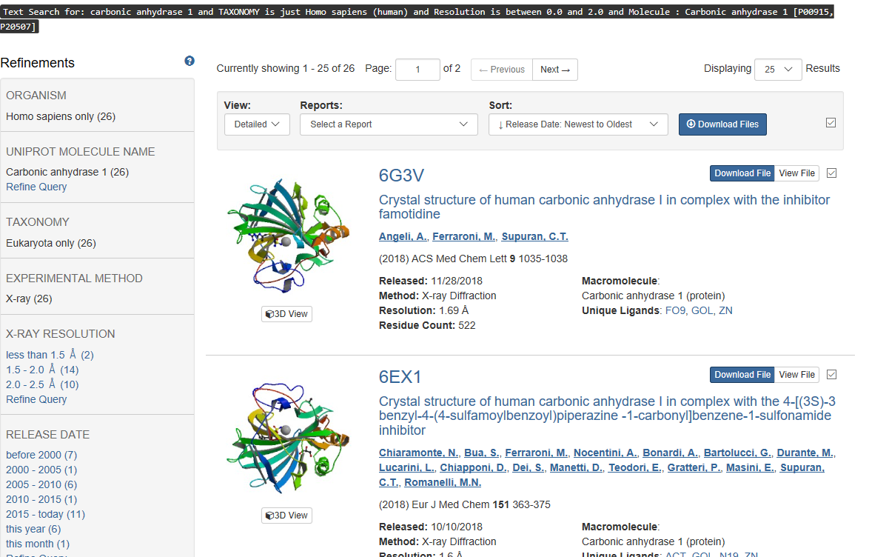
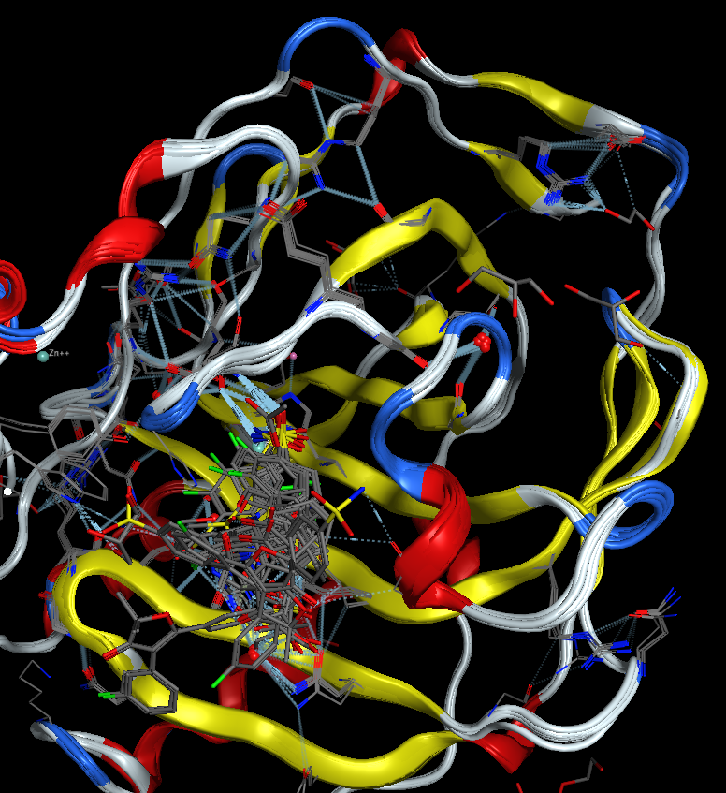
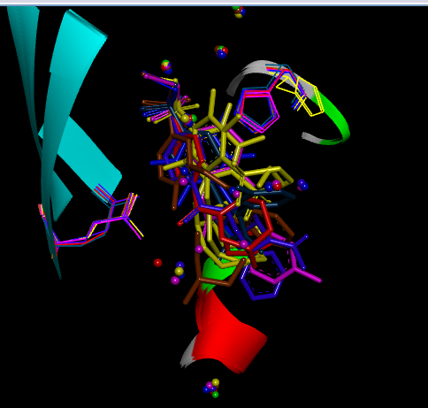
Selection of Protein Structures of Carbonic Anhydrase I for Subsequent Docking
26 structures of Human Carbonic Anhydrase I with high Resolution (<=2Å)
Align structure together to check binding site flexibility & select representative conformation(s) for ensemble docking
only 4wr7, 5e2m, 6evr, 5gmm, 6fag, 6faf, 6f3b, 6ex1 in this study to save time
26 High Resolution of Human Carbonic Anhydrase I Crystal Structures in PDB
Binding Site Flexibility, Mobile Residues,
Structurally conserved waters; Binding water replaced by Ligands in CA1 Monomer
His200, but ambiguous density
Conserved water
Gln92
In this exercise, 6F3B and 5GMM are selected as the conformational Ensemble (with different orientation of Gln92)

Slide 2
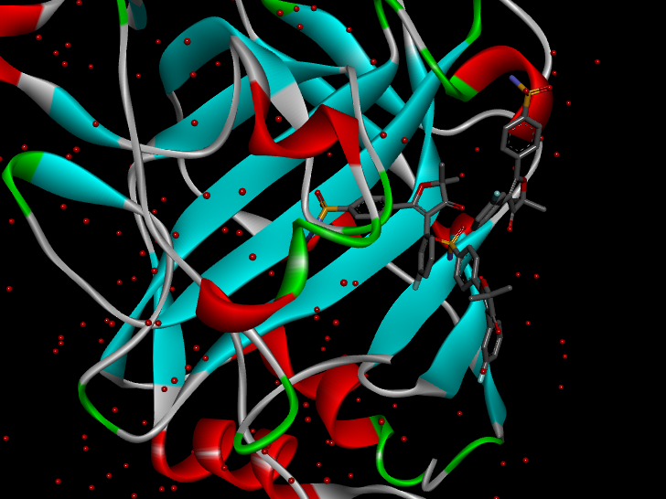
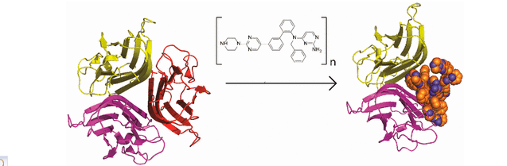
Other Observations that May Affect Future Binding Modes or Affinity Prediction
e.g. some compounds may form aggregation which may interfere the binding measurement
Structural Basis of Small-Molecule Aggregate Induced Inhibition of a Protein-Protein Interaction.
J Med Chem. 2017 Apr 27;60(8):3511-3517

Slide 3
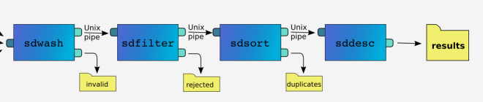
Ligand & Protein Structure Preparation for Doking
119 CA1 inhibitors from Chembl
J. Med. Chem., 2000, 43 (2), pp 292–300
CA1 inhibition assay (k_{i} in the range of 1 - 78500nM)
Typical tools for ligand structure preparation:
Schordinger’s ligprep
MOE’s SDF pre-process
hydrogen correction, salt and solvent removal, chirality and bond type normalization, tautomer generation, adjustment and enumeration of protonation state
Assign force field, atomic charge and conformation minimization/sampling
Protein structure preparation through MOE
Protein protonation

Slide 4
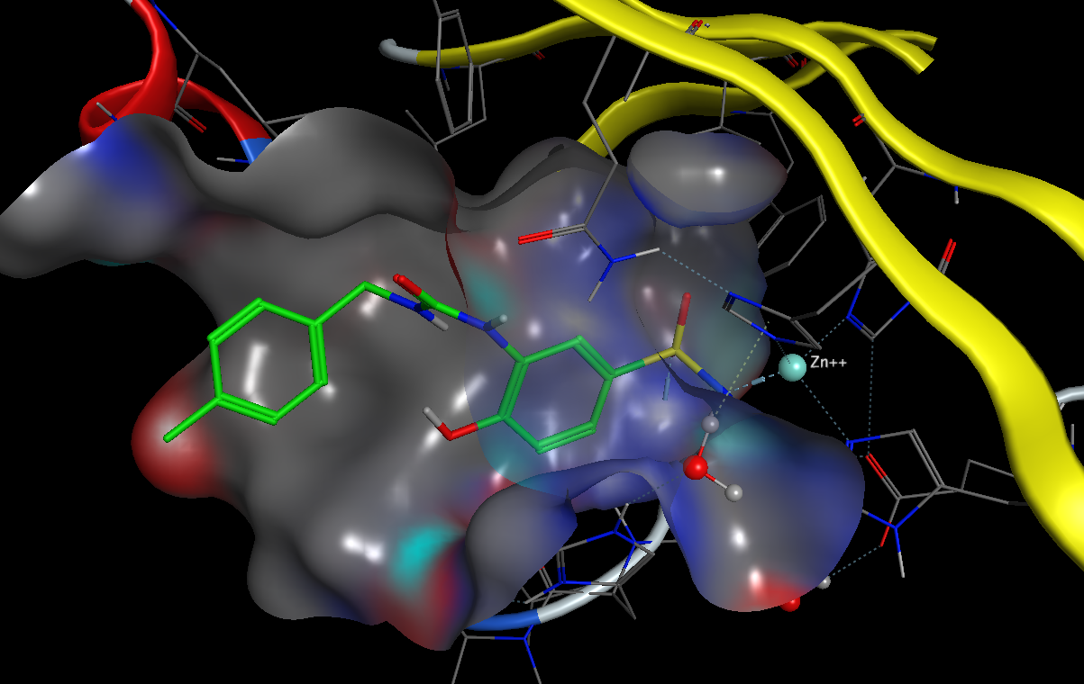
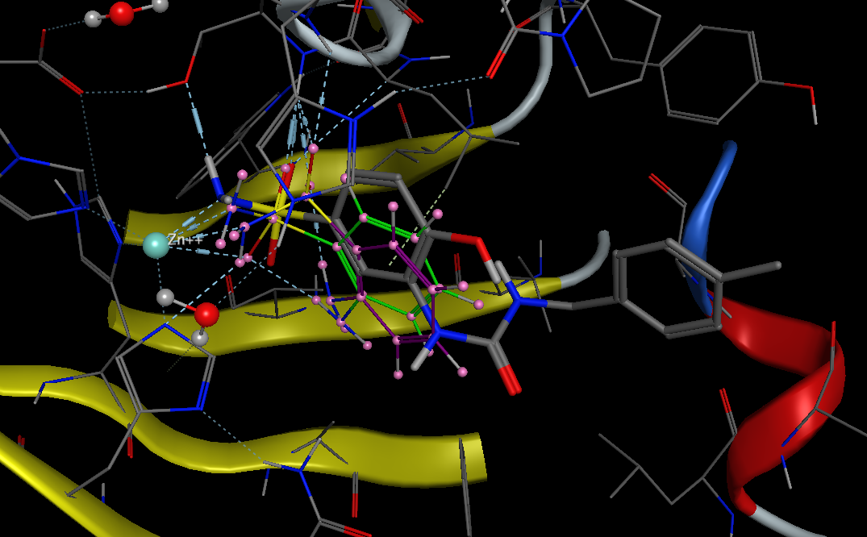
Docking Poses of top 5 ranks from MOE sometimes are not fully
consistent with sulfonamide anchors in cocrystal structures

Slide 5
R2 = 0.278
Pearson Corr.: 0.112
Spearman Corr.: 0.152

