Slide 1
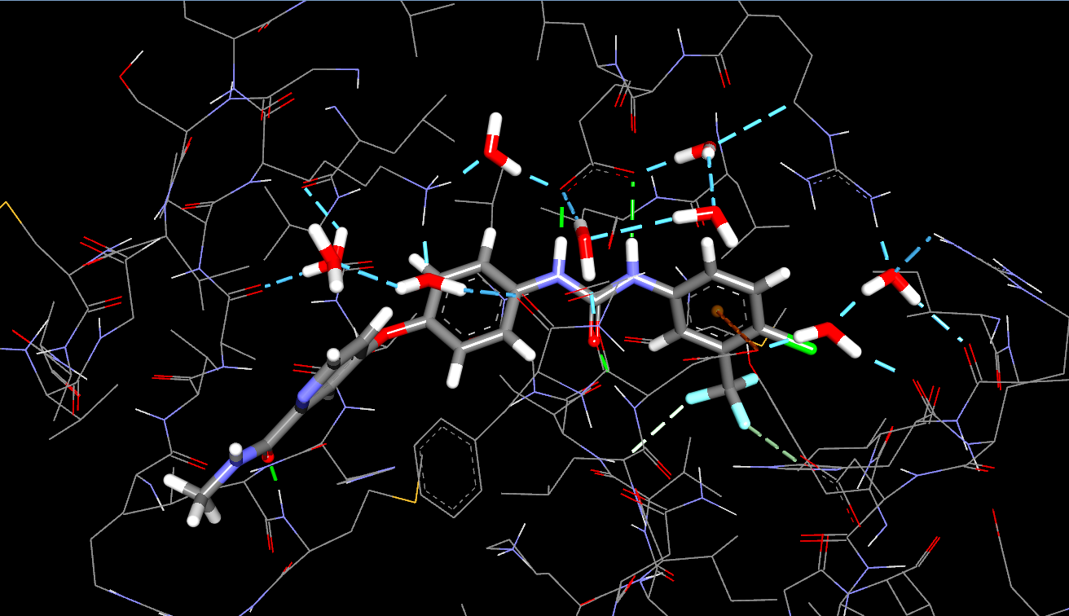
Ligand Binding Pocket of 3GCS

Slide 2
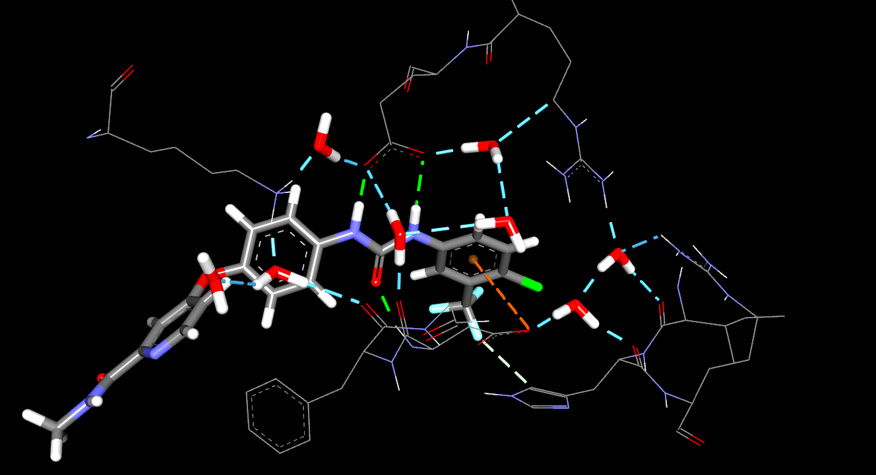
H-bonding Network Example in 3GCS (Zoom-in Figure for later Publish Picture Generation )

Slide 3
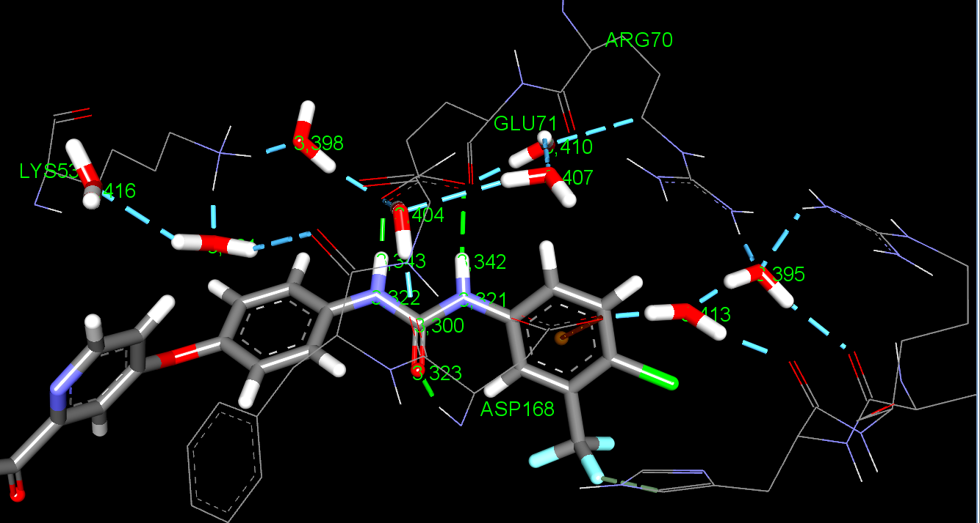
Ligand Atom Label of Some Interacting Atoms (more interactive file is stored in *.dsv file I forwarded )

Slide 4
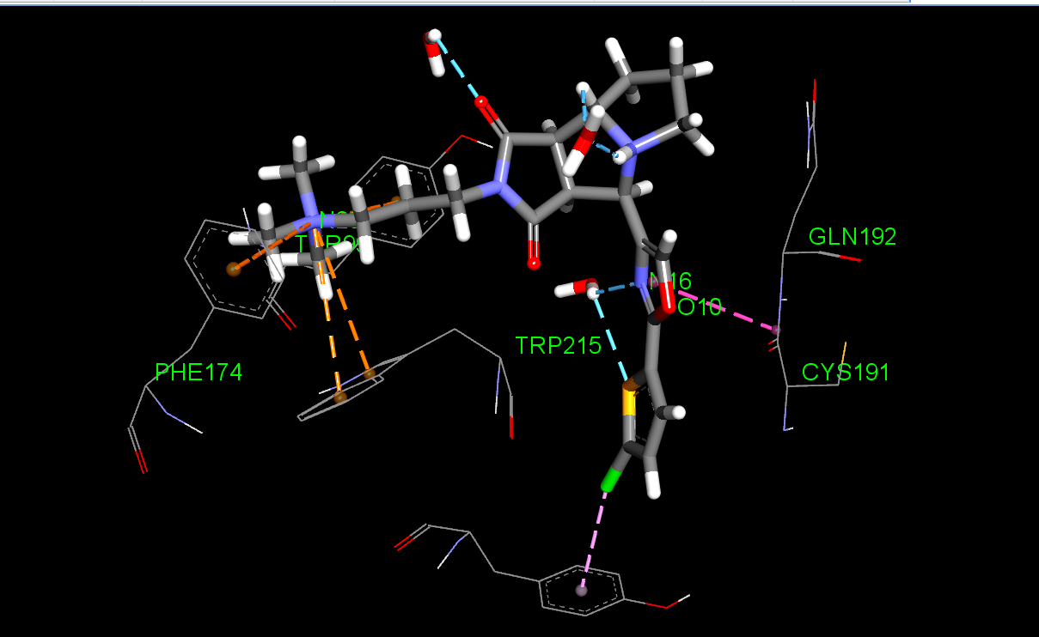
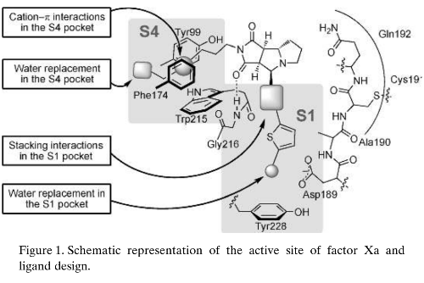
Cation-pi and amide-pi stacking Examples in 2y5h (more interactive file is stored in *.dsv file I forwarded )

