Slide 1

Computations in Option Pricing Engines
Vital Mendonca Filho, Pavee Phongsopa, Nicholas Wotton
Advisors: Yanhua Li, Qingshuo Song, Gu Wang
April 24, 2020

Slide 2
Outline
Traditional Methods in Option Pricing
Exploring Modern Approach
Computations of Option Prices via Neural Network
Applications: Greeks
Conclusion
Notes:
Vital: Greetings all, here’s a few points of our project bam bam bam bam bam, now we continue

Slide 3
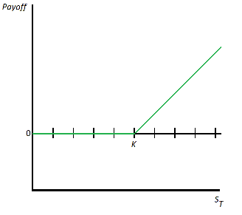
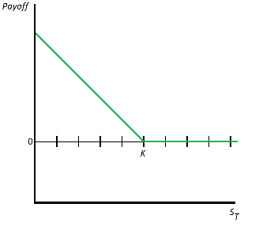
Brief Overview of Options
Call
C(T) = max[0, S_{T} – K]
Put
P(T) = max[0, K – S_{T}]
European vs American
Notes:
Vital: Options are great!

Slide 4

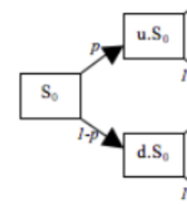
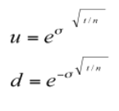

CRR Model
Recursive model prices of options contracts in discrete time
Option price at end of each node (Call or Put)
Uses Binomial Tree
Wikipedia.Binomial Options Pricing Model
Notes:
Pom - bunch trees

Slide 5

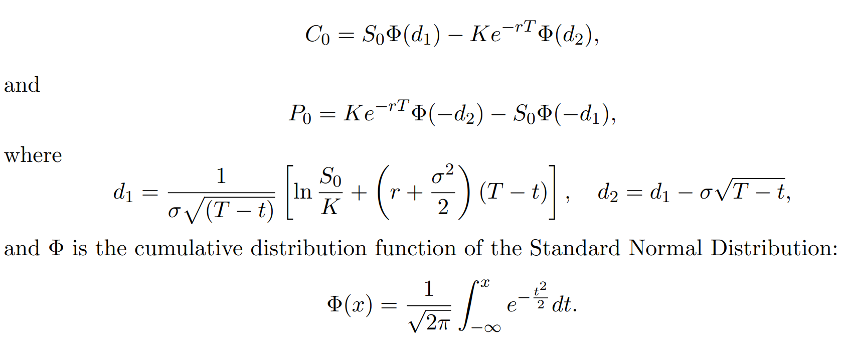
Black-Scholes Model (BSM)
Mathematical model to price options contracts in continuous time
The option prices with maturity T and strike price K
The Model
Steven Shreve. Stochastic Calculus for Finance II: Continuous Time Models. Springer Finance, 2010.
Notes:
Nick

Slide 6
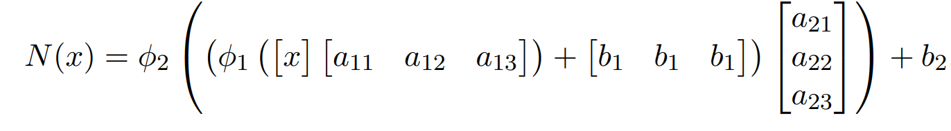
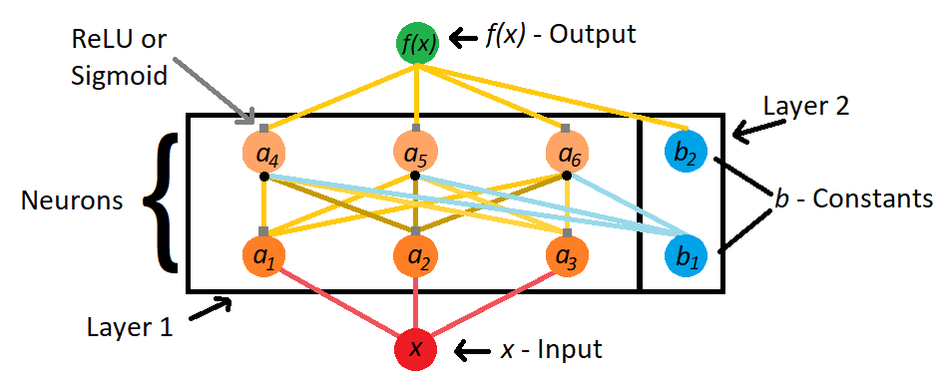
Neural Networks
Approximates Complex Function
Neurons: Simple Functions
Activation Functions
A Simple Neural Network
Notes:
Nick

Slide 7
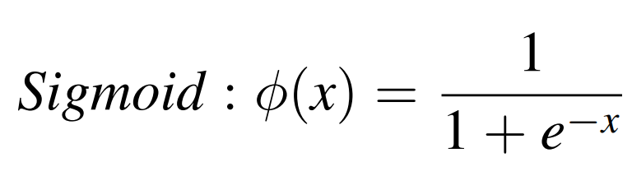
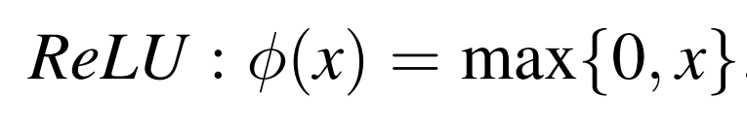
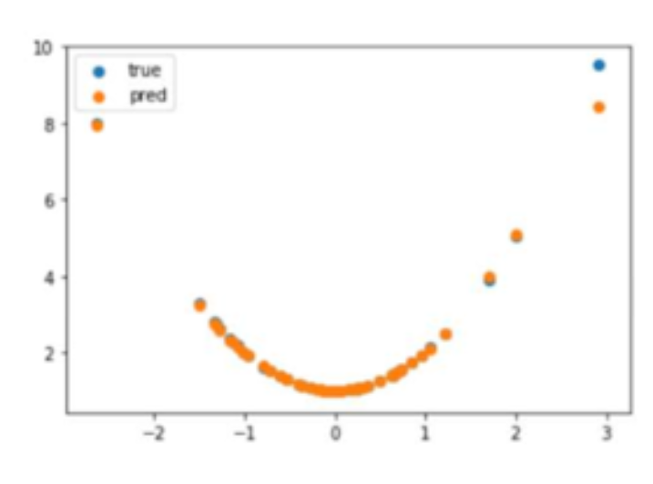
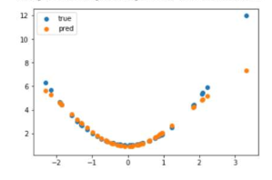
Activation Functions
ReLU
Sigmoid
Notes:
Pom - both gud
optimizer

Slide 8
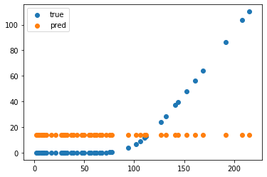
BSM With Neural Network
Underlying Price vs Option Price
Model Malfunction
True vs Predicted Values for a European Call Option
Notes:
Nick

Slide 9
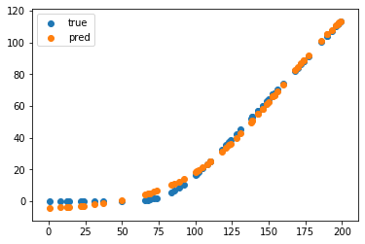
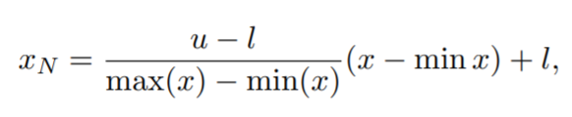
Normalization
Attempt to Fix
u, l - scale parameters
u = 1, l = 0
u = 1, l = -1
True vs Predicted Values for a European Call Option 50 Neurons Layer 1 and 12 Neurons Layer 2
Notes:
Nick

Slide 10
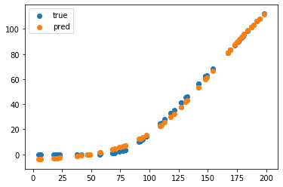
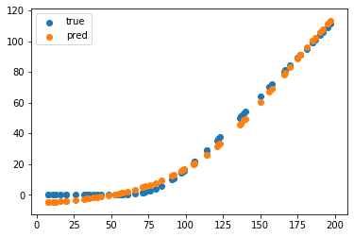
BSM Neural Network - Further Exploration
Varied Neurons
Varied Layers
100 Neurons Layer 1; 100 Neurons Layer 2 Loss: 0.00052513 Time: 4.812922478 Seconds
50 Neurons Layer 1; 50 Neurons Layer 2; 100 Neurons Layer 3
Loss: 0.00111636
Time: 5.457895279 Seconds
Notes:
Nick
More Neurons -> increased computation time but increased accuracy
More Layer -> increased comp time but not always increased accuracy

Slide 11
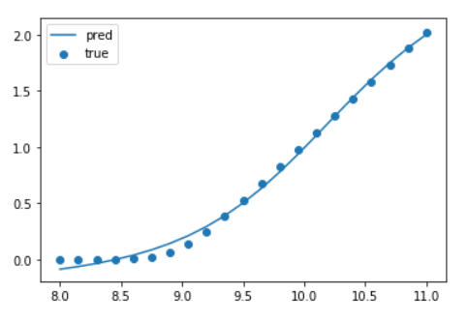
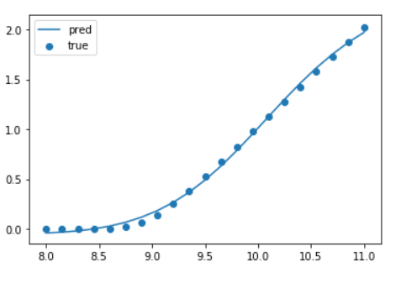
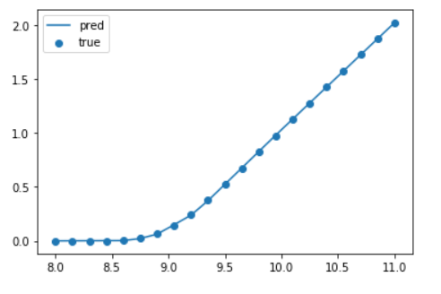
Universal Approximation Theorem
Theorem A feed-forward network with a single hidden layer containing a finite number of neurons can approximate continuous functions on compact subsets of Rn, under mild assumptions on the activation function
Wikipedia.Universal Approximation Theorem
Notes:
Pom more bad one good relu good

Slide 12
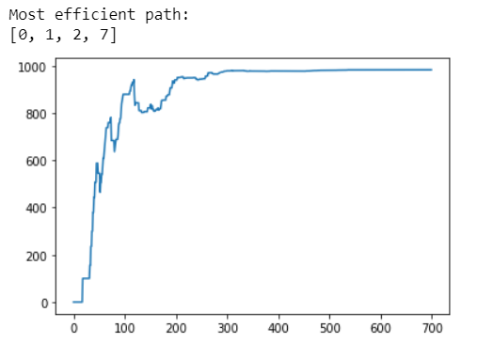
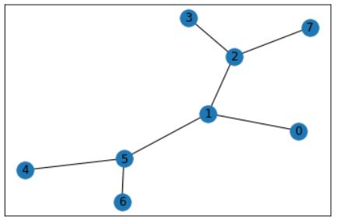
Q-Learning
Model Free Reinforcement Learning
Reward Based Algorithm
Viralml.Reinforcement Learning - A simple python example
Notes:
Pom didnt have time to do but want to explore and talk about the possibility of applying it to our past work.
unlike tranditional model based supervised learning

Slide 13
Greeks
Collection of partial derivatives of the BSM model with respect to:
Delta → price of stock
Theta → time to expiration
Rho → risk-free interest rate
Vega → volatility
Vega does not have a closed form solution
Future work can exploit approximation of vega using machine learning
Notes:
Greece (Greek: Ελλάδα), officially the Hellenic Republic (Greek: Ελληνική Δημοκρατία), historically also known as Hellas, is a country located in Southeast Europe. Its population is approximately 10.7 million as of 2018; Athens, the nation's capital, is its largest city, followed by Thessaloniki.
Situated on the southern tip of the Balkan Peninsula, Greece is located at the crossroads of Europe, Asia, and Africa. It shares land borders with Albania to the northwest, North Macedonia and Bulgaria to the north, and Turkey to the northeast. The Aegean Sea lies to the east of the mainland, the Ionian Sea to the west, the Cretan Sea and the Mediterranean Sea to the south. Greece has the longest coastline on the Mediterranean Basin and the 11th longest coastline in the world at 13,676 km (8,498 mi) in length, featuring many islands, of which 227 are inhabited. Eighty percent of Greece is mountainous, with Mount Olympus being the highest peak at 2,918 metres (9,573 ft). The country consists of nine traditional geographic regions: Macedonia, Central Greece, the Peloponnese, Thessaly, Epirus, the Aegean Islands (including the Dodecanese and Cyclades), Thrace, Crete, and the Ionian Islands.
Greece is considered the cradle of Western civilisation, being the birthplace of democracy, Western philosophy, Western literature, historiography, political science, major scientific and mathematical principles, Western drama and the Olympic Games. From the eighth century B.C., the Greeks were organised into various independent city-states, known as poleis (singular polis), which spanned the entire Mediterranean region and the Black Sea. Philip of Macedon united most of the Greek mainland in the fourth century BC, with his son Alexander the Great rapidly conquering much of the ancient world, from the eastern Mediterranean to India. Greece was annexed by Rome in the second century B.C., becoming an integral part of the Roman Empire and its successor, the Byzantine Empire, which adopted the Greek language and culture. The Greek Orthodox Church, which emerged in the first century A.D., helped shape modern Greek identity and transmitted Greek traditions to the wider Orthodox World. After falling under Ottoman dominion in the mid-15th century, Greece emerged as a modern nation state in 1830 following a war of independence. The country's rich historical legacy is reflected in part by its 18 UNESCO World Heritage Sites.
Greece is a unitary parliamentary republic and developed country with an advanced high-income economy, a high quality of life, and a very high standard of living. Its economy is the largest in the Balkans, where it is an important regional investor. A founding member of the United Nations, Greece was the tenth member to join the European Communities (precursor to the European Union) and has been part of the Eurozone since 2001. It is also a member of numerous other international institutions, including the Council of Europe, the North Atlantic Treaty Organization (NATO), the Organisation for Economic Co-operation and Development (OECD), the World Trade Organization (WTO), the Organization for Security and Co-operation in Europe (OSCE), and the Organisation internationale de la Francophonie (OIF). Greece's unique cultural heritage, large tourism industry, prominent shipping sector and geostrategic importance^{[a]} classify it as a middle power.

Slide 14
Implied Volatility
Market’s expected volatility for an asset during the contract’s duration
Extracted from the market price of the contract
Volatility Smile
Deeper out-the-money and in-the-money contracts have higher implied vol
Traditionally approximated by Newton’s Method

Slide 15
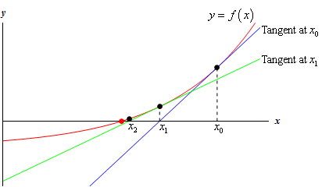
Newton’s Method
Recursive method to approximate the root of a differentiable function
We approximate the implied volatility using BSM and Vega

Slide 16
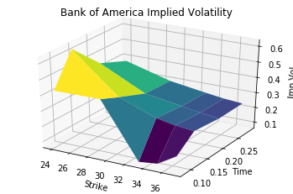
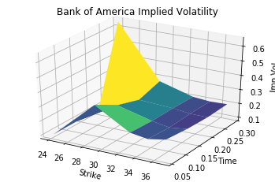
Volatility Surface
Surface generated from comparing Implied Volatility with different times to maturity and strikes

Slide 17
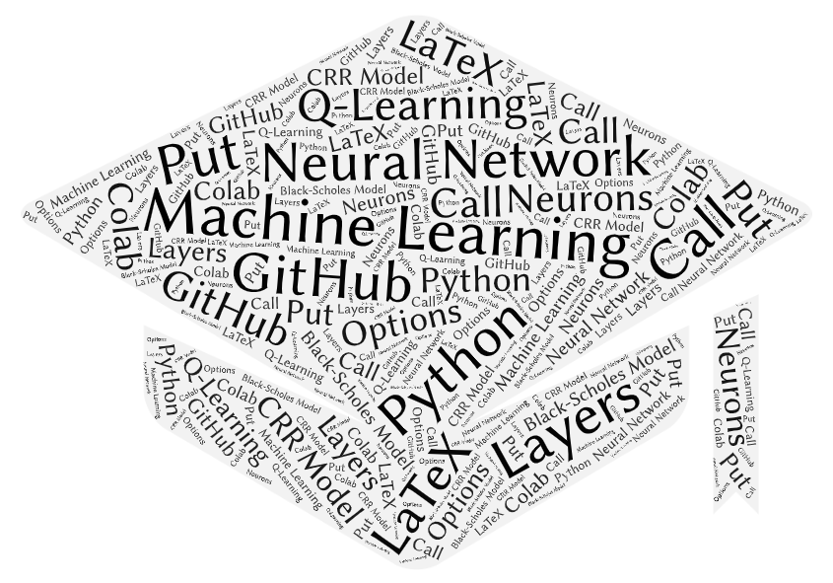


Conclusion
Explored Machine Learning Techniques
Implemented Neural Networks in Financial Models
Notes:
pom - machine good

