Slide 1
COMP 4434 Final Presenstation
JIANG Ruixiang
19079662D

Slide 2
Contents
Introduction
Preprocessing
Model
Result

Slide 3
Background
PolyTube
Large dataset

Slide 4
Project Objective
Task 1 build a regression model
Task 2 build a recommender system

Slide 5
Contents
Introduction
Preprocessing
Model
Result

Slide 6
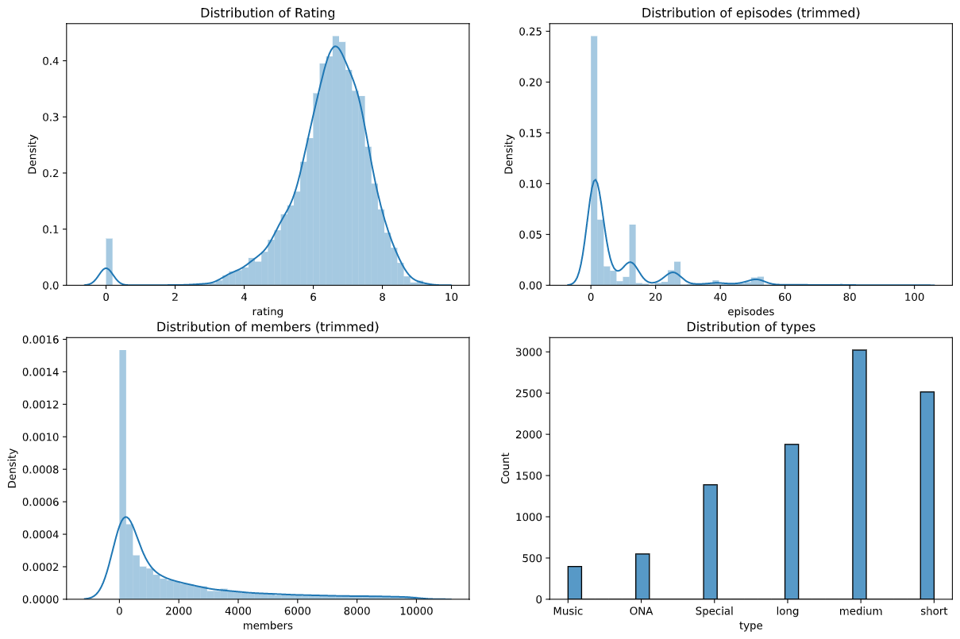
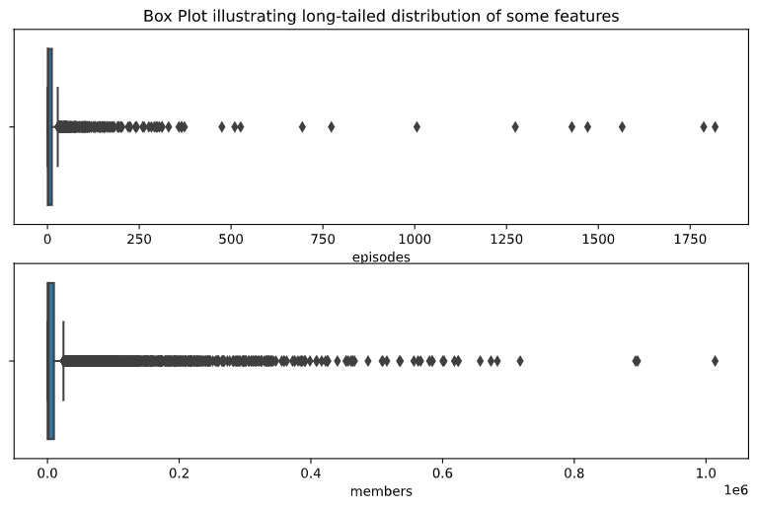
Exploratory data analysis
Long-tail distribution
Outliers

Slide 7
Preprocessing
Null value imputation –mean values
Outliers -clipping
Feature scaling –transformation
Feature encoding -vectorize

Slide 8
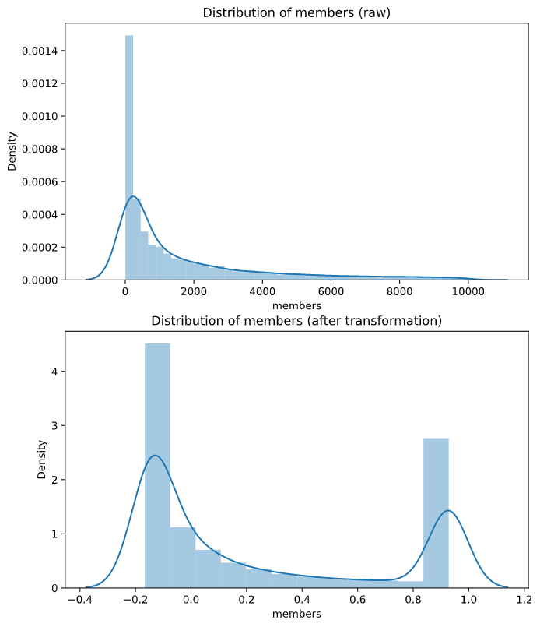
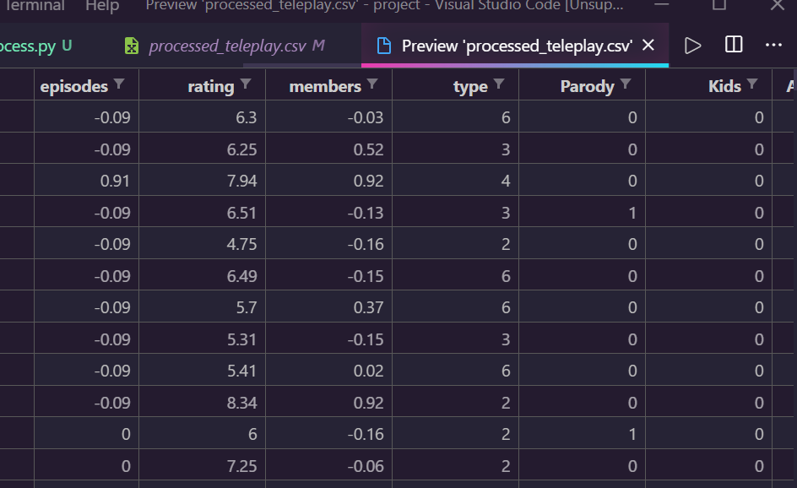
Preprocessing Result

Slide 9
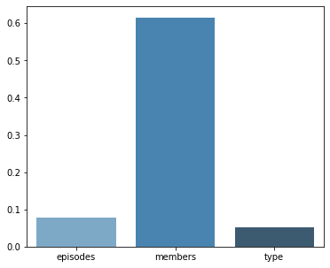
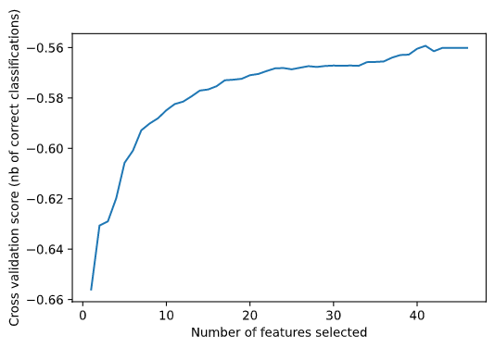
Feature selection
Recursive Feature Elimination
Feature importance

Slide 10
Contents
Introduction
Preprocessing
Model
Result

Slide 11
Model Design (Task 1 )
Baseline -linear regression, neural networks
Ours –Stacked model (ensembling)

Slide 12
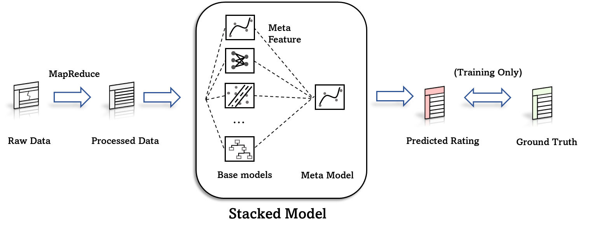
Model Architecture (Task 1 )

Slide 13
Model Design (Task 2)
Content-based recommender system
Many baselines
Final solution: linear regression

Slide 14
Regularizations
L1, L2 norms for LR, MLPs
Dropout
Batchnormalization
Earlystopping
reduceLRonPlatau
Adaptive learning rate scheduler
Gradient Clipping

Slide 15
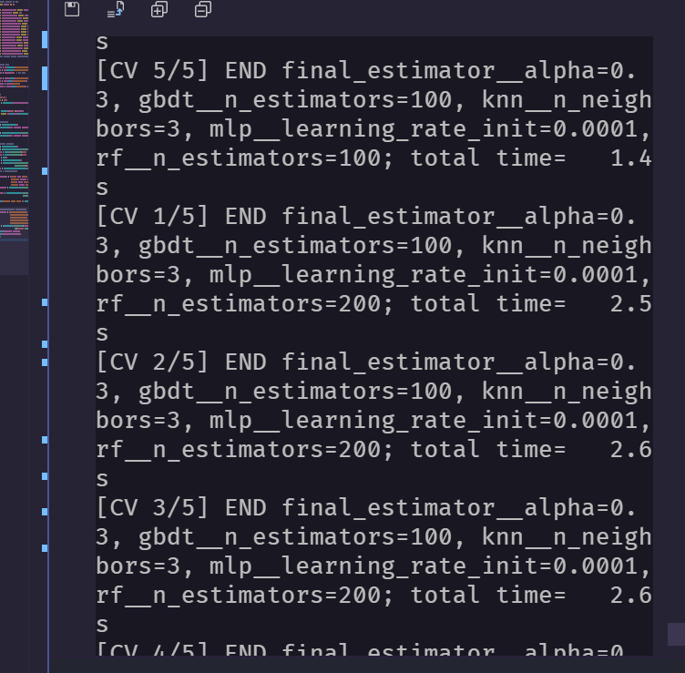
Model Training
Grid Search to optimization hyper-param
9-12 hours on a server to optimize
Singel training round ~10 min

Slide 16
Contents
Introduction
Preprocessing
Model
Result

Slide 17
Model Merics
Baselines : plain linear regression, linear regression with polynomial feature expansion, Lasso regression (λ = 0.01), multilayer perceptron
Metrics: 5-fold RMSE

Slide 18
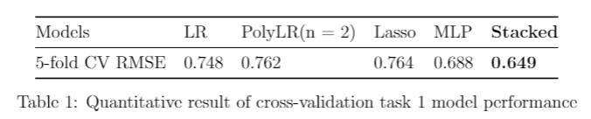
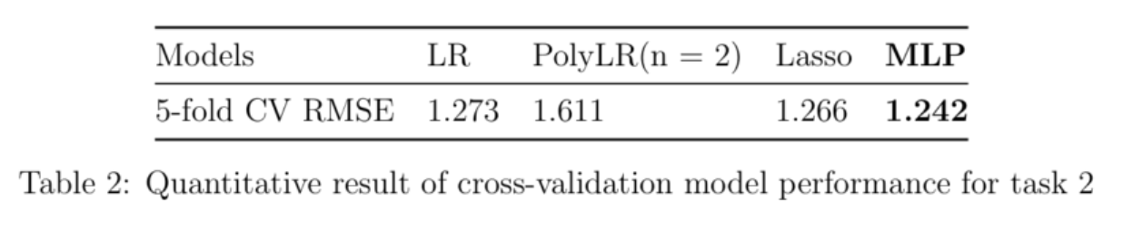
Quantitative Results

Slide 19
Discussion on models
Non-linear model outperform others, but training is hard
Linear model is good for task 2
Conclusion

Slide 20
Thanks

