Slide 1
Comp2411
Database Systems

Slide 2
Teaching Staff’s Information
Prof. Qing LI (Lecturer-in-Charge)
  Email: csqli@comp.polyu.edu.hk
  Phone: 2766-7252
  Office: PQ803a
Mr. Alvin MAK, Dr. Kevin Yuen (Tutoring Staff)
  Emails: alvin.mak@polyu.edu.hk (Mr. MAK), 2766-7731 (PQ732)
  kevin.yuen@polyu.edu.hk (Dr. Yuen), 2766-7876 (PQ732)
There will also be some general teaching assistants (to be announced) to join the team later…

Slide 3
Course Overview
Course Format:
  Regular lectures
    Class timetable:
      Thursday 12:30pm - 3:30PM lectures
  Tutorial and lab classes
      One-hour tutorial or lab class every week
      Patterns:
        w2-3, w7-9, w12-13: tutorial classes;
        w4-6, w10-11: lab classes (@PQ604A/B/C)

Slide 4
Assessment
Coursework -- 70% :
  Tutorial and lab attendance -- 15%
    Proportional to number of attendances
    full mark for at least 10 attendances
  Mid-term -- 25%
  Homework assignments -- 30%
Final examination -- 30%
  in the form of two team-projects (each team consists of 3~4 students)
Notes:
3

Slide 5
Course Materials
Text books
  “Fundamentals of Database Systems”, 7th/6th 5th edition, by R. Elmasri, and S.B. Navathe, Global edition, Pearson.
  “Database System Concepts”, 7th/6th/5th edition, by A. Silberschatz, H. Korth, S. Sudarshan, McGraw-Hill Companies Inc.
Notations may vary in different books. Please stick to the ones used in this lecture notes!

Slide 6
Introduction to DB Systems
Motivations
  Information about a particular enterprise
  File-processing Systems
    permanent records stored in various files
    application programs written to extract & add records
  Disadvantages of traditional file-processing systems
    data redundancy & inconsistency
    difficulty in accessing data
    data isolation & different data formats
    concurrent access anomalies
    security problem
    integrity problem

Slide 7
Motivating Example
Student ID Student name Sex Course Course Name Grade
50000000 Peter Wong M CS3402 Database Systems B+
50000000 Peter Wong M CS2302 Data Structures A
50000000 Peter Wong M …. …. ..
50000001 Mary Tsui F CS3402 Database Systems A-
50000002 Bob Lee M CS3402 Database Systems B
This way of storing data good?
How to improve?

Slide 8
Introduction to DB Systems
What is a Database (DB)?
  A non-redundant, persistent collection of logically related records/files that are structured to support various processing and retrieval needs
Database Management System (DBMS)
  A set of software programs for creating, storing, updating, and accessing the data of a DB.
Software interface
DB
DBMS

Slide 9
Introduction to DB Systems
Difference between DBMS & other programming systems
  the ability to manage persistent data
  primary goal of DBMS: to provide an environment that is convenient, efficient, and robust to use in retrieving & storing data
Other DBMS capabilities
  data modeling
  high-level languages to define, access and manipulate data
  transaction management & concurrency control
  access control
  recovery

Slide 10
Introduction to DB Systems
Data Abstraction
  Abstract view of the data
    simplify interaction with the system
    hide details of how data is stored and manipulated
  Levels of abstraction
    physical/internal level: data structures; how data are actually stored
    conceptual level: schema, what data are actually stored
    view/external level: partial schema

Slide 11

Data Abstraction: 3-level architecture

Slide 12
Data Models
Data Model
  A collection of conceptual tools for describing data, data relationships, operations, and consistency constraints
  the “core” of a database
Categories of data models
  Object-based logical models (conceptual & view levels)
    the Entity-Relationship (ER) model -- mid 70’s
    the Semantic Data Models -- early/mid 80’s
    the Object-Oriented data models -- late 80’s
  Record-based logical models (conceptual & view levels)
    the Network and Hierarchical models -- 60’s
    the Relational model -- early 70’s

Slide 13
Data Models
Categories of data models (cont’d)
  Physical data models (internal level)
    Unifying model
    Frame memory model
  (these will NOT be studied in this course.)
Basic Concepts and Terminologies
  instance
    - the collection of data (information) stored in the DB at a particular moment (ie, a snapshot)
  scheme/schema
    - the overall structure (design) of the DB -- relatively static

Slide 14
Basic Concepts and Terminologies
Data Independence
  the ability to modify a schema definition in one level without affecting a schema in the next higher level
  there are two kinds (a result of the 3-level architecture):
    physical data independence
        -- the ability to modify the physical schema without altering the conceptual schema and thus, without causing the application programs to be rewritten
    logical data independence
        -- the ability to modify the conceptual schema without causing the application programs to be rewritten

Slide 15
Data Abstraction: 3-level architecture

Slide 16
Basic Concepts and Terminologies
Data Definition Language (DDL)
    - a language for defining DB schema
    - DDL statements compile to a data dictionary which is a file containing metadata (data about data), e.g., descriptions about the tables
Data Manipulation Language (DML)
    a language that enables users to manipulate data
    - an important subset for retrieving data is called Query Language
    - two types of DML: procedural (specify “what” & “how”) vs. declarative (just specify “what”)

Slide 17
Basic Concepts and Terminologies
Database Users
  Application Programmers
    Writing embedded DML in a host language
  Interactive Users:
    Using query languages
  Naive Users:
    Running application programs

Slide 18
Basic Concepts and Terminologies
Database Administrator (DBA)
  DBA is the person who has central control over the DB
  Main functions of DBA:
      schema definition
      storage structure and access method definition
      schema and physical organization modification
      granting of authorization for data access
      integrity constraint specification

Slide 19
System Architecture
File Manager
  allocation of space
  operations on files
DB Manager
  interface between stored data and application programs/queries
  translate conceptual level commands into physical level ones
  responsible for
    access control
    concurrency control
    backup & recovery
    integrity

Slide 20
System Architecture
Query Processor
  translate high-level queries into low-level instructions
  query optimization
DML (Pre-)compiler
  translates DML statements embedded in an application program into procedure calls
DDL (Pre-)compiler
  converts DDL statements to data dictionary items (eg, table descriptions)

Slide 21
DB System Architecture
Naïve user
Appl. Prog’er
Interactive user
DBA
Application
interfaces
Application
programs
(SQL) query
DB schema
DML compiler
Query processor
DDL compiler
Application programs object code
Database manager
DBMS
File manager
Data files
disk storage
DB
Data dict.

Slide 22
Course Objectives
ER model: characterize relationships among entities
Relational model: transform from ER diagram to tables
SQL: language for writing queries
Relational Algebra: logical way to represent queries
Normal Forms: how to design good tables
File Organization: provide file level structure to speed up query
Query Optimization: transform queries into more efficient ones
Transactions and Concurrency Control: handle concurrent operations and guarantee correctness of the database

Slide 23
The Entity-Relationship Model
Preliminaries
  Proposed by P. Chen in 1976
  Mainly a design tool for record-based databases
Important Components
  Entity -- a distinguishable object with an independent existence
        Example: John Chan, CityU, HSBC, …
  Entity Set -- a set of entities of the same type
        Example: Student, University, Bank, ...

Slide 24
The Entity-Relationship Model
Attribute(Property) -- a piece of information describing an entity
    Example: Name, ID, Address, DoB are attributes of a student entity
    Each attribute can take a value from a domain
        Example: Name ∈ Character String,
        ID ∈ Integer, ...
    Formally, an attribute A is a function which maps from an entity set E into a domain D:
        A: E → D

Slide 25
The Entity-Relationship Model
Relationship -- an association among several entities
    Example: Patrick and Eva are friends
        Patrick is taking cs3450
Relationship Set -- a set of relationships of the same type
    Example:
    Formally, a relationship set R is a subset of:
  { (e1, e2, …, ek) | e1 ∈ E1, e2 ∈ E2, …, ek ∈ Ek) }
taking
John
mary
may
cs3450
cs2578
ee4532

Slide 26
The Entity-Relationship Model
Relationship vs. Attribute
  an attribute A: E → D is a “simplified” form of a relationship:
    If we allow D to be an Entity Set, then A becomes a relationship
  a relationship can carry attributes
    properties of the relationship
    Example: Patrick takes cs2450 with a grade of B+
        Supplier S supplies item T with a price of P

Slide 27
The Entity-Relationship Model
Entity Set vs. Attribute
  When to use attribute, and when to use entity set?
    Example: Employee and Phone
    1) employee entity set with attribute phone#
    2) empPhn relationship set with entity sets employee and phone#
  No simple answer, depending on
      - what we want to model
      - meaning of attributes

Slide 28
The Entity-Relationship Model
Integrity Constraints
  Mapping Cardinalities
    One - to - One (1:1)
    One - to - Many (1:M) / Many - to - One (N:1)
    Many - to - Many (M:N) ?
a
b
c
1
2
3
a
b
c
1
2

Slide 29
The Entity-Relationship Model
Integrity Constraints (cont’d)
  Keys: to distinguish individual entities or relationships
    superkey -- a set of one or more attributes which, taken together, identify uniquely an entity in an entity set
      Example: {student ID, Name} identify a student
    candidate key -- minimal set of attributes which can identify uniquely an entity in an entity set
      a special case of superkey (for which no proper subset is a superkey)
      Example: student ID identify a student,
        but Name is not a candidate key (WHY?)
    primary key -- a candidate key chosen by the DB designer to identify an entity in an entity set

Slide 30
The Entity-Relationship Model
ER Diagram
  Rectangles: Entity Sets
  Ellipses: Attributes
  Diamonds: Relationship Sets
  Lines: Attributes to Entity/Relationship Sets
        or, Entity Sets to Relationship Sets
m
n
R
m
1
R
1
1
R

Slide 31
The Entity-Relationship Model
Weak Entity Set
  an entity set that does NOT have enough attributes to form a primary/candidate key
Role Indicators
trans. type
date
amount
Acct. no
balance
account
log
transaction
Multi-value attri.
Emp. name
Phone#
manager
employee
Works-for
worker

Slide 32
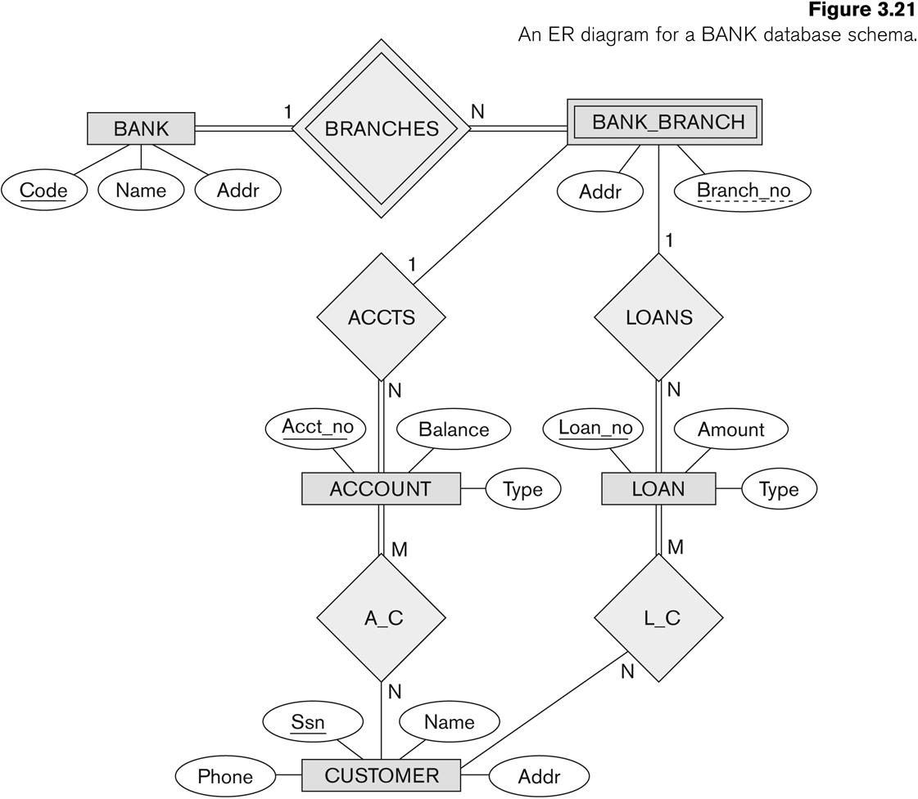
ER Diagram for a Bank Database

Slide 33
Summary of ER-Diagram Notation
Symbol
Meaning
ENTITY TYPE
WEAK ENTITY TYPE
RELATIONSHIP TYPE
IDENTIFYING RELATIONSHIP TYPE
ATTRIBUTE
KEY ATTRIBUTE
MULTIVALUED ATTRIBUTE
COMPOSITE ATTRIBUTE
DERIVED ATTRIBUTE
TOTAL PARTICIPATION OF E₂ IN R
CARDINALITY RATIO 1:N FOR E₁:E₂ IN R
STRUCTURAL CONSTRAINT (min, max) ON PARTICIPATION OF E IN R
E₁
R
E₂
N
E₁
R
N
E₂
R
(min,max)
E

Slide 34

ER Diagram with Role Names and Mini-Max Constraints

Slide 35
Summary
  The ER Model is regarded as the 1st “conceptual/semantic” model centered around relationships, not attributes
  It combines successfully the best features of the previous data models
  simple and easy to understand
  can be mapped to tables (relational model) in a straightforward manner
    (to be studied in the coming lecture series)

