Slide 1
Tips to Get Started

Slide 2
Font Test
Make sure the correct font, NVIDIA Sans, is loaded/displayed on your screen before proceeding
Does the live text in the right box look exactly like the text on the left that is an image?
If it matches…great!
If it does NOT, please see next slide on how to install fonts
All employees must have NVIDIA Sans installed on their machines
IMAGE FOR COMPARISON
LIVE TEXT
Introducing NVIDIA Sans.
Our new font for everything NVIDIA.

Slide 3
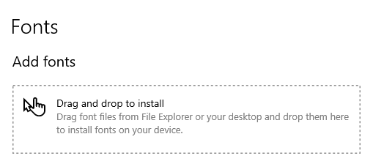



How to Install NVIDIA Sans Fonts
Go to search tool and type in “fonts”
Select the option for “Font Settings” App
Follow the instructions for installing
After “drag and drop” of font folder is complete; restart MS Office PPT and then check the drop-down menu to see if fonts are loaded
NOTE: For NVIDIA employees, you can download the font folders to your desktop from here: https://nvidia.sharepoint.com/sites/nvinfo/brand/Pages/font.aspx
For non-employees, please reach out to your NVIDIA contact to provide
Install Instructions for PC
Install Instructions for Mac

Slide 4
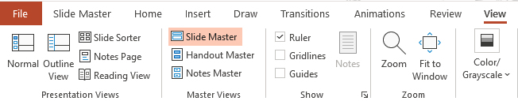
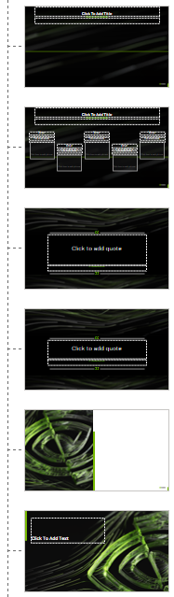
Ways to Reduce File Size
Click the “View” tab on the top tool bar
Then click on “Slide Master” tab
Slide types: “Timeline”, “Quote”, “Agenda” and/or “Transition” not being used in deck? Delete from Slide Master section
Images and videos can increase file size; limit usage if smaller file size is needed
Check the Slide Master section for multiple templates
Only this template should be included
Delete any templates that may have transferred over from copying & pasting other slide decks
Slide types that can be deleted if not used in the deck

Slide 5
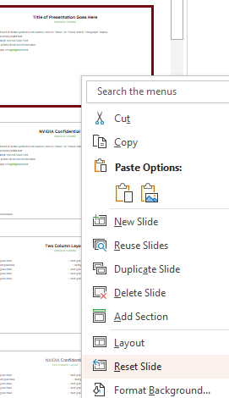
Reset Slide
Restore slide to template layout
Fixes placement of text boxes
Adjusts font size/designation
For “image” (slides 23-34), it restores the outline, gradient, and text box after deleting an inserted image
Right click on the slide to reset
From the drop down, select “Reset Slide”

Slide 6
Title of Presentation Goes Here
Speaker Name, Title | Event/Date

Slide 7
Title of Presentation Goes Here
Optional subtitle
Bullet text (if bullet symbol is not needed, turn to “None” on “Home” tab in “Paragraph” styles)
Secondary bullet text 40 pt.
Use 44 pt. NVIDIA Sans font
Keep points short and informative
Example of highlighted text

Slide 8
NVIDIA Confidential Slide
Optional subtitle
Bullet text (if bullet symbol is not needed, turn to “None” on “Home” tab in “Paragraph” styles)
Secondary bullet text 40 pt.
Use 44 pt. NVIDIA Sans font
Keep points short and informative
Example of highlighted text

Slide 9
Titles Are “Title Case”
Subtitles are “sentence case”
Title Case: All major words are capitalized, while minor words are lowercase in AP style
Helpful casing tool: https://headlinecapitalization.com
Sentence case: Only the first word of a sentence and proper nouns are capitalized, with the rest of the words in lowercase

Slide 10
Two Column Layout
Optional subtitle
Text goes here
Text goes here
Text goes here
Text goes here
Text goes here
Text goes here
Text goes here
Text goes here
Text goes here
Text goes here

Slide 11
NVIDIA Confidential
Two column layout
Text goes here
Text goes here
Text goes here
Text goes here
Text goes here
Text goes here
Text goes here
Text goes here
Text goes here
Text goes here

Slide 12
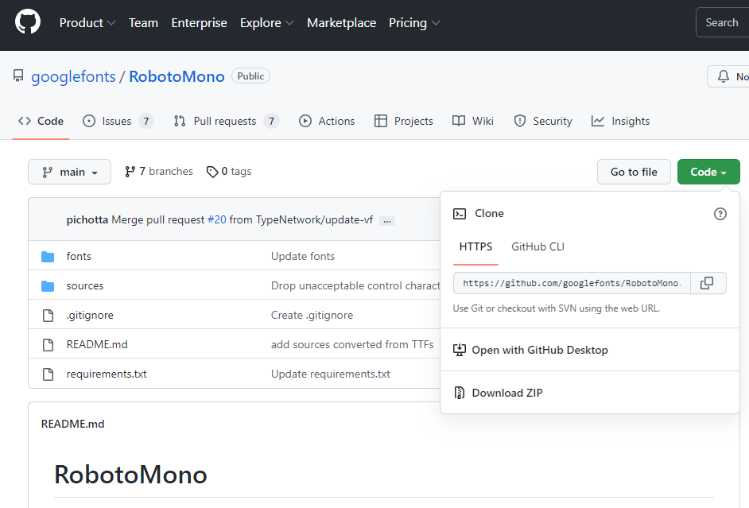
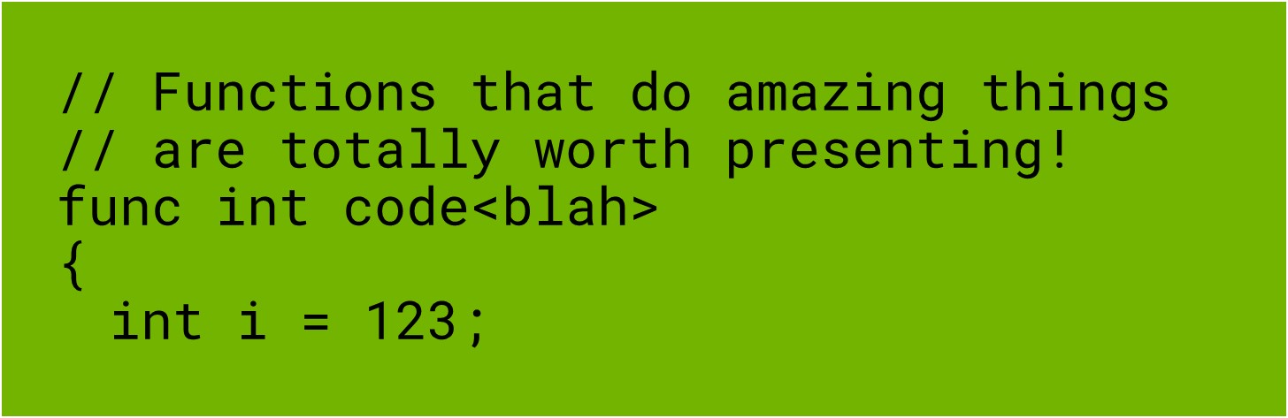
Coding Font
Coding subtitle
Use 44 pt. RobotoMono font
Download the RobotoMono font folder: https://github.com/googlefonts/RobotoMono
Text should look like this after install
IMAGE FOR COMPARISON
LIVE TEXT
// Functions that do amazing things
// are totally worth presenting!
func int code<blah>
{
int i = 123;
NOTE: Download ZIP, Install TTF fonts, Restart PPT

Slide 13
NVIDIA Confidential Slide
Example code slide
<!DOCTYPE html> <html> <head> <title>Example</title> <link rel=“stylesheet” href=“stylesheet” </head> <body> <h1> <nav> <a href=“one/”>One</a> <a href=“two/”>Two</a> <a href=“three/”>Three</a>

Slide 14
Agenda
• | Text goes here; can be more than one line
• | Text goes here; can be more than one line
• | Text goes here; can be more than one line
• | Text goes here; can be more than one line
• | Text goes here; can be more than one line

Slide 15
Long quote example. NVIDIA Sans Light 120 pt. Use sentence case and avoid using all caps.
— Quote Source, NVIDIA Sans Italic 44 pt.

Slide 16
Short quote example. Can go up to two lines of text.
— Quote Source, NVIDIA Sans Italic 44 pt.

Slide 17
Color Palette
Primary and Neutral Colors
Light Gray
205 / 205 / 205
Medium Gray
140 / 140 / 140
Secondary Colors
Dark Gray
94 / 94 / 94
White
255 / 255 / 255
Black
0 / 0 / 0
Amethyst
93 / 22 / 130
Emerald
0 / 133 / 100
CPU Blue
0 / 113 / 197
NVIDIA Green
RGB: 118 / 185 / 0
Fluorite
250 / 194 / 0
Garnet
137 / 12 / 88

Slide 18
Pie Chart
Source: Source information is 24 pt. italic

Slide 19
Bar Chart
Y-axis text goes here
X-axis text goes here
Source: Source information is 24 pt. italic

Slide 20
Line Chart
NOTE: Link all original data for charts
Y-axis text goes here
X-axis text goes here
Source: Source information is 24 pt. italic

Slide 21
Table Sample
 | Title Goes Here | Title Goes Here | Title Goes Here
Text Goes Here | Text | Text | Text
Text Goes Here
Text Goes Here
Text Goes Here
Text Goes Here

Slide 22
Table Sample
 | Title Goes Here | Title Goes Here | Title Goes Here
Text Goes Here | Text | Text | Text
Text Goes Here
Text Goes Here
Text Goes Here
Text Goes Here

Slide 23
Transition Slide or Section Divider

Slide 24
Slide Title for Single Image Layout
Optional subtitle

Slide 25
Slide Title for Image With Text Layout
Optional subtitle
Add supporting text here if a lot of bullets points are necessary to explain the image
Text goes here
Text goes here
Text goes here
Text goes here
Text goes here
Text goes here

Slide 26
Slide Title for 2 Image Layout
Optional subtitle

Slide 27
Slide Title for 2 Image Layout With Text Layout
Optional subtitle
Text goes here
Text goes here
Text goes here
Text goes here
Text goes here
Text goes here
Text goes here
Text goes here
Text goes here
Text goes here
Text goes here
Text goes here

Slide 28
Slide Title for 3 Image Layout
Optional subtitle

Slide 29
Slide Title for 4 Image Layout
Optional subtitle

Slide 30
Slide Title for 5 Image Layout
Optional subtitle

Slide 31
Slide Title for 6 Image Layout
Optional subtitle

Slide 32
Slide Title for 7 Image Layout
Optional subtitle

Slide 33
Slide Title for 8 Image Layout
Optional subtitle

Slide 34
Slide Title for 9 Image Layout
Optional subtitle

Slide 35
Slide Title for 10 Image Layout
Optional subtitle

Slide 36
Title Goes Here
Subtitle
Text goes here
Text goes here
Text goes here
Text goes here
Text goes here
Text goes here
Text goes here
Text goes here
Text goes here
Text goes here
Text goes here

Slide 37
Title Goes Here
Text goes here
Text goes here
Text goes here
Text goes here
Text goes here
Text goes here
Text goes here
Text goes here
Text goes here
Text goes here
Text goes here

Slide 38
Title Goes Here
Subtitle
Text goes here
Text goes here
Text goes here
Text goes here
Text goes here
Text goes here
Text goes here
Text goes here
Text goes here
Text goes here
Text goes here

Slide 39
Title Goes Here
Text goes here
Text goes here
Text goes here
Text goes here
Text goes here
Text goes here
Text goes here
Text goes here
Text goes here
Text goes here
Text goes here

Slide 40
Title Goes Here
Subtitle goes here

Slide 41
Title Only

Slide 42
Title Goes Here
Subtitle
// Functions that do amazing things
// are totally worth presenting!
func int code<blah>
{
int i = 123;
for (n=1; n<x; n++)
{
doSomethingCool(n,x);
}
return 0;
}
Text goes here
Text goes here
Text goes here
Text goes here
Text goes here
Text goes here
Text goes here
Text goes here
Text goes here
Text goes here
Text goes here

Slide 43
Publication Links
https://www.nvidia.com/en-us/geforce/gaming-laptops/?nvid=nv-int-csfg-288505#cid=_nv-int-csfg_en-us
https://www.nvidia.com/en-us/geforce/news/
https://www.nvidia.com/en-us/research/ai-playground/?nvid=nv-int-cwmfg-884255#cid=nrz_nv-int-cwmfg_en-us
https://www.nvidia.com/en-us/research/
https://store.nvidia.com/en-us/shield/
https://store.nvidia.com/en-us/jetson/store/?page=1&limit=9&locale=en-us
https://www.nvidia.com/en-us/networking/products/data-processing-unit/
https://catalog.ngc.nvidia.com/orgs/nvidia/collections/languagemodelling
https://catalog.ngc.nvidia.com/orgs/nvidia/collections/automaticspeechrecognition
https://www.nvidia.com/en-us/geforce/technologies/dlss/?nvid=nv-int-csfg-616647#cid=gf7_nv-int-csfg_en-us
Example layout of hyperlinks

Slide 44

Use Case Examples: How to Include an Image
After adding image to placeholder box, click on the image and then: right click → “send to back”
Partner Logo Here

Slide 45
EMBARGO
This presentation is embargoed until [month, day], 20xx at xx:xx [time zone]

Slide 46
Example Slides

Slide 47

Logo Treatment
Logos are full color & alphabetized

Slide 48

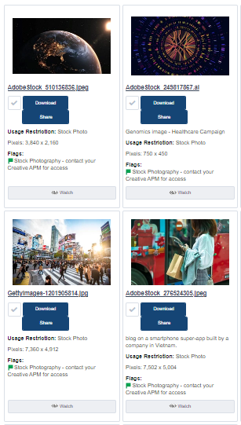
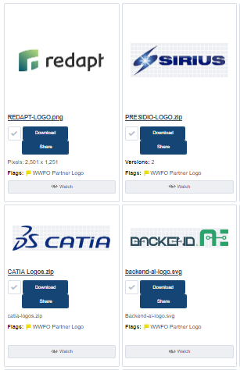

Available Assets
Images / Campaigns / Events / Videos / Partner Logos: Download from NVDAM
Icon Library: Download from NVDAM Icon Library

Slide 49
Arrowhead and Diagram Design Styles
Text goes here
Text goes here
Text goes here
Text goes here
Arrowhead line weight 1.0pt., black
Text goes here
Dashed line weight 1.5pt., black
Text goes here
Line weight 1.0pt., black
Text goes here
Text goes here

Slide 50
Stack Design Sample
NOTE: On NVIDIA Green Boxes, Light and Medium Gray; text is BLACK
On all other colored boxes; text is WHITE
Text
Text
Text
Text
Text
Text
Text
Text
Text
Text
Text
Text
Text
Text
Text
Text
Text
Text
Text
Text
Text
Text
Text
Text

Slide 51
Stack Design Sample
NOTE: On NVIDIA Green Boxes, Light and Medium Gray; text is BLACK
On all other colored boxes; text is WHITE
NVIDIA highlighted
Text
Text
Text
Text
Text
Text
Text
Text
Text
Text
Text
Text
Text
Text
Text
Text
Text
Text
Text
Text
Text
Text
Text
Text

Slide 52

Use Case Examples or Single Image Partner Slide
Supporting text goes here
Partner Logo Here

Slide 53
Timeline
With text
2022 – Aug.
2023 – Jan.
2023 – Sept.
Title Goes Here
Title Goes Here
Title Goes Here
Supporting text here
Supporting text here
Supporting text here
2022 – Oct.
2023 – May
2024 – Feb.
Title Goes Here
Title Goes Here
Title Goes Here
Supporting text here
Supporting text here
Supporting text here

Slide 54
Timeline
With images
2022 – Aug.
2023 – Jan.
2023 – Sept.
Title Goes Here
Title Goes Here
Title Goes Here
Supporting text goes here
Supporting text goes here
Supporting text goes here
2022 – Oct.
2023 – May
Title Goes Here
Title Goes Here
Supporting text goes here
Supporting text goes here

Slide 55
Complex Timeline
With text
 | Title Goes Here | Title Goes Here | Title Goes Here | Title Goes Here |  | Title Goes Here | Title Goes Here | Title Goes Here
Text Goes Here | Text | Text | Text |  |  | Text | Text
Text Goes Here
Text Goes Here |  | Text |  |  |  | Text | Text
Text Goes Here |  |  |  | Text |  |  |  | Text
Text Goes Here |  |  |  | Text |  |  | Text
September
October
November
December
January
February
March
2022
2023

Slide 56
Video/Demo Title
Subtitle option

Slide 57
Video/Demo Title
Subtitle option

Slide 58

World Map
Adjust locations to areas needed
Helsinki
Santa Clara
Tokyo

Slide 59
World Map Slide With Additional Text
Helsinki
Santa Clara
Tokyo
Include supporting text here for labels
Text goes here
Text goes here

