Slide 1
Progress Presentation
Team Indigo
송수민, 염재후, 임경빈

Slide 2
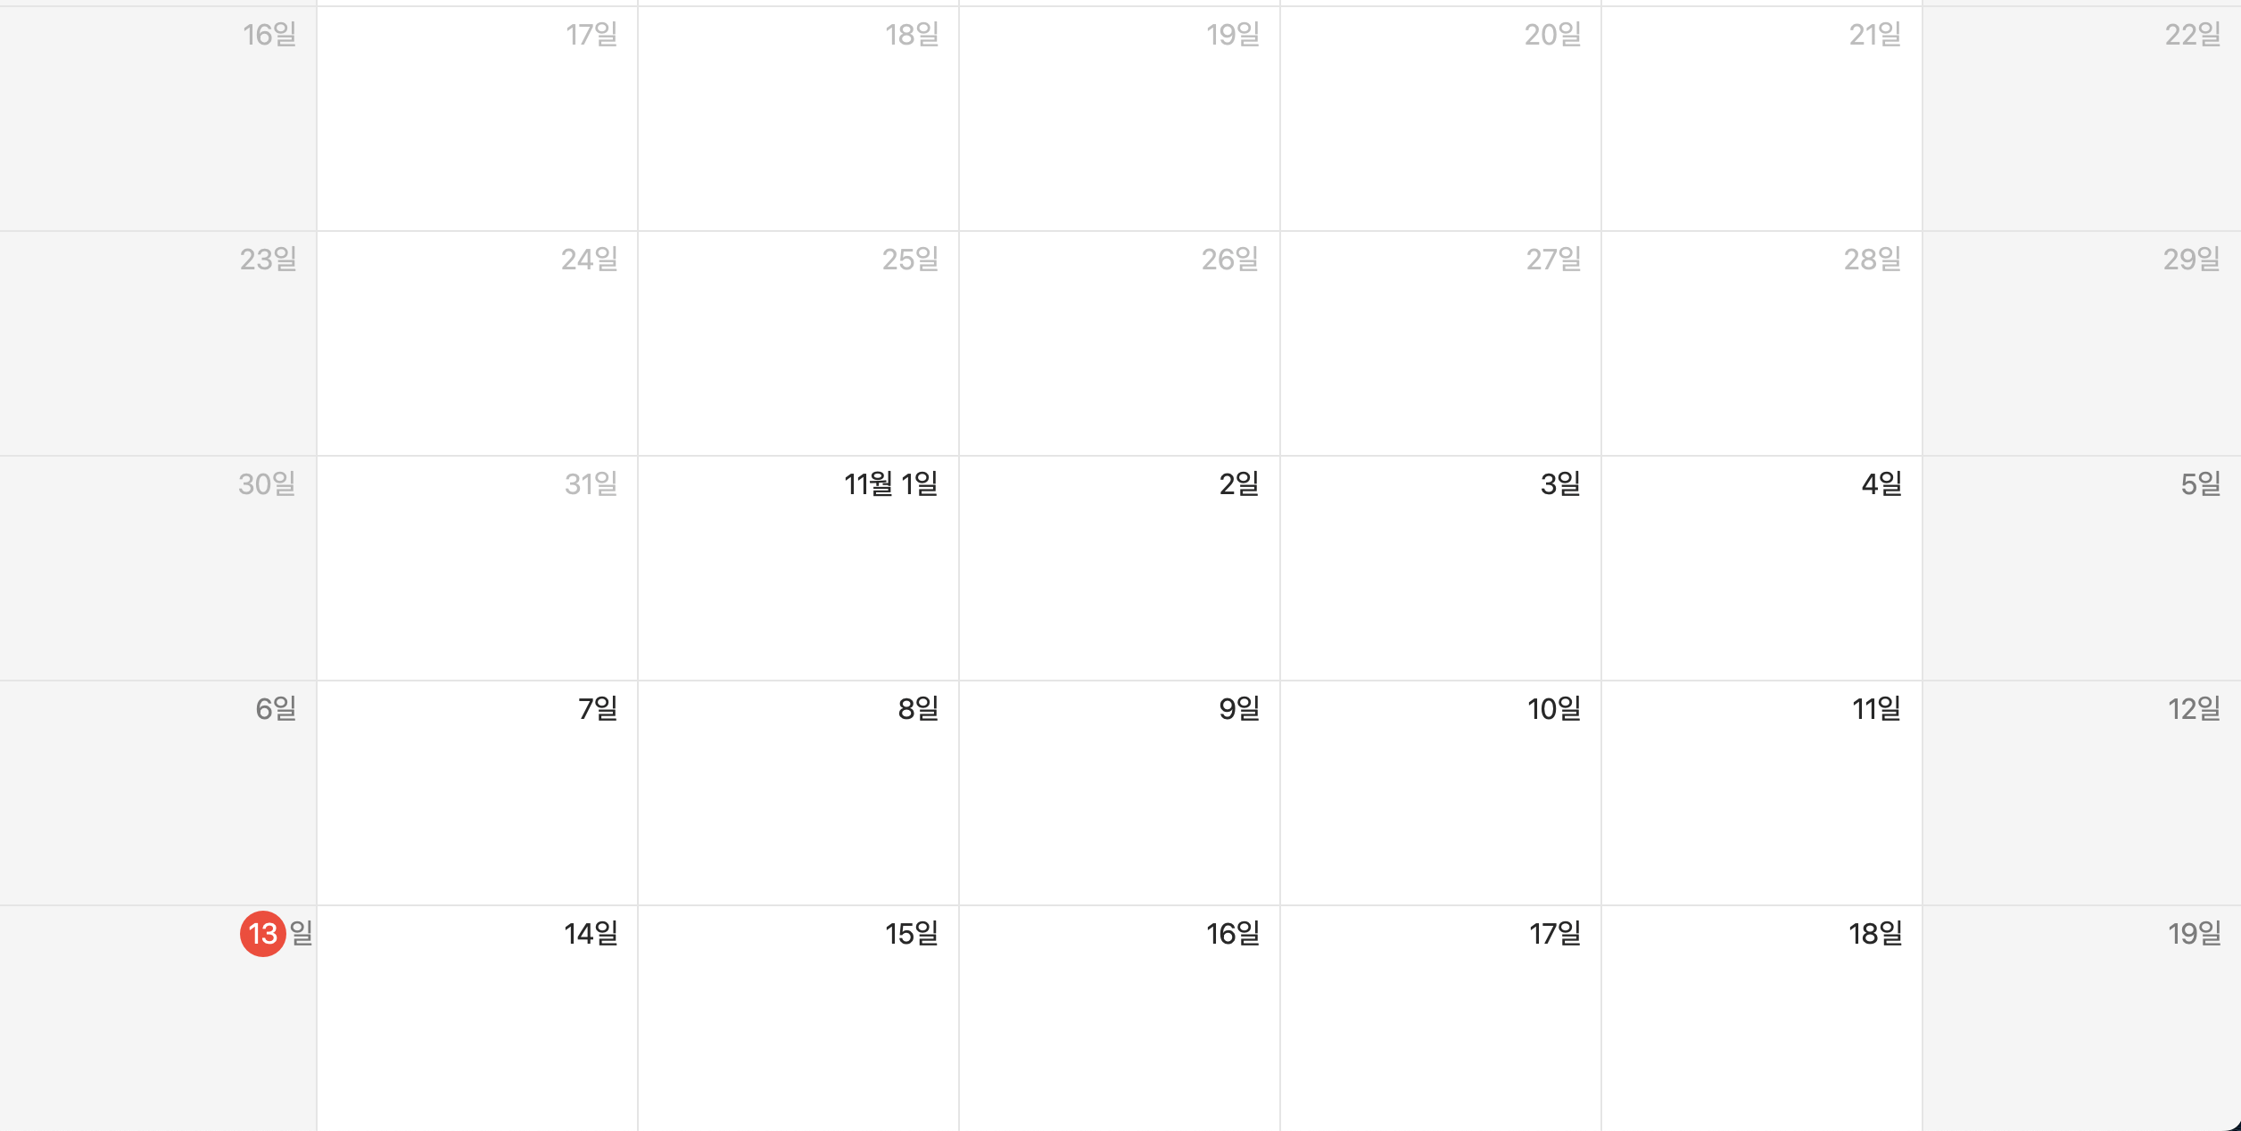
Review Our Weekly Progress
Week 1 : Set milestone & Create Git repository
Week 2: Exam Period (No Progress Until Exam End) / Study Project (Algorithm, gRPC)
Week 3: Study Project (Algorithm, gRPC) & Sketch Project with Discussion
Week 4: gRPC Example Code & Build Detailed Class Design

Slide 3
Communication
Prepare
Share
Attack
Revise
Recognize Supplementary Point
Repetition for Next Topic
Topic A
Topic B
Topic C
Notes:
프로젝트 계획 수립 단계에서 쓰는 Communication에서 쓰이는 과정이라고 설명 (만약 교수님이 코딩 할 때도 저 프로세스를 따를 것이냐고 물어보면)
코딩 프로세스에서는 Attack -> Revise 단계를 써도 무방할듯.

Slide 4
Details
Programming Environment
OS: Canonical Ubuntu 22.04 LTS
Java Version : JDK 11 / Scala Version : Scala 2.13.0
Library : protobuf3, gRPC, Java Concurrent Programming… TBD
Logging : log4j, print()…
• Input Data : Windows (O), MacOS (X) → Ubuntu 22.04 (O)

Slide 5
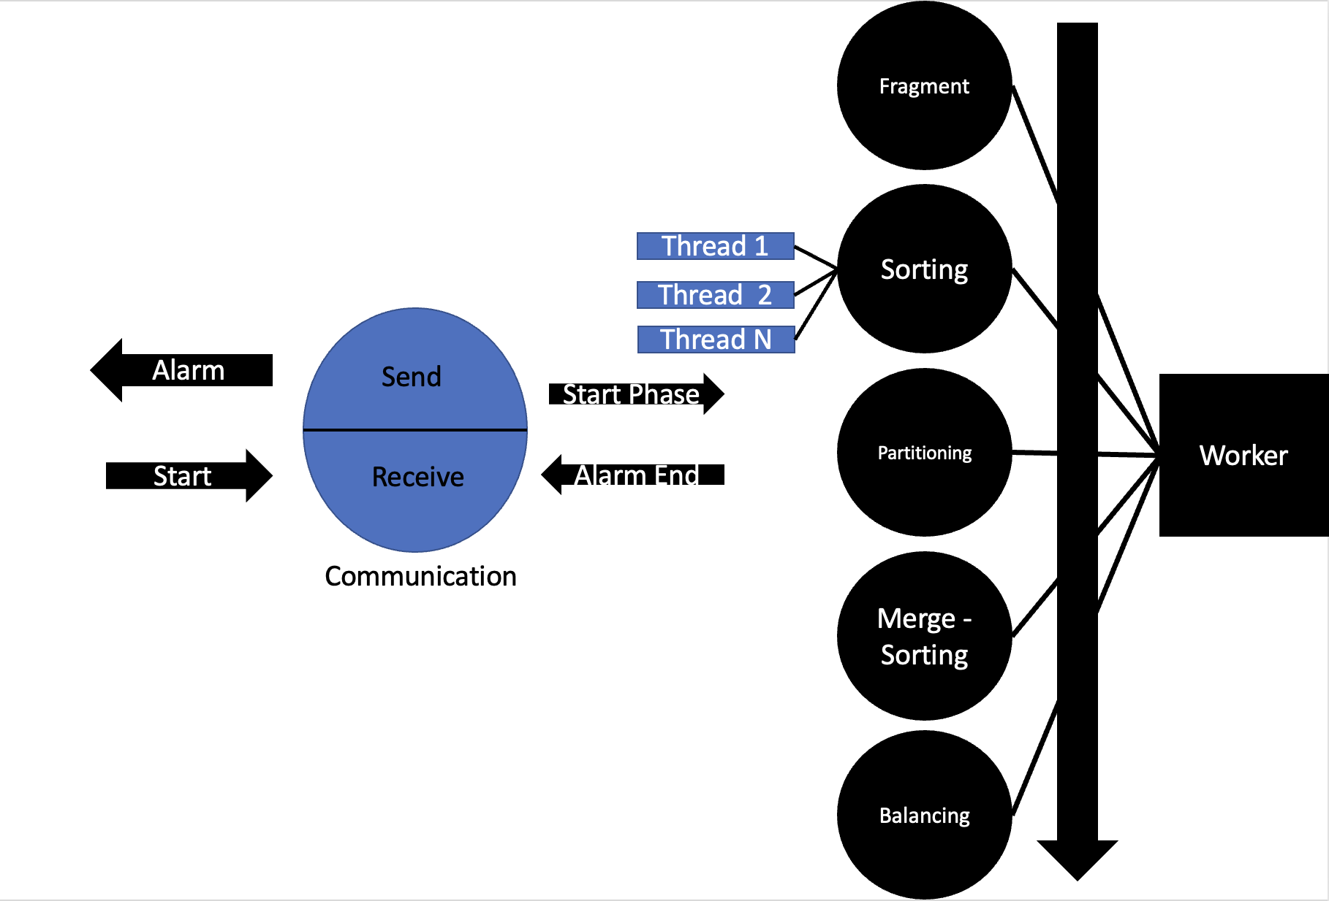
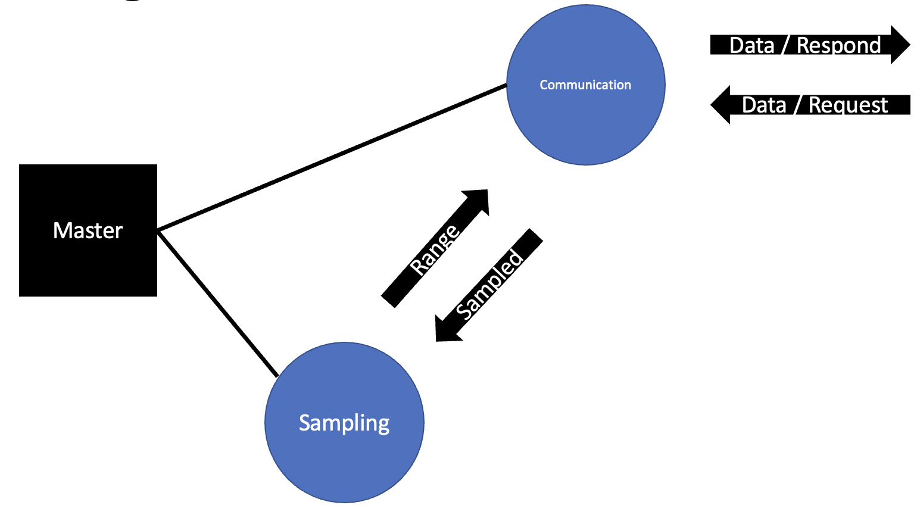
Design – Entire
gRPC
Protocol
...

Slide 6
Design - Master
Communication
Data / Respond
Data / Request
Master
Master Key Task
- Control overall process
→ Check worker’s request
- Make range based on Sampling
→ Each machine’s range of data
- Sending Data / Message to Worker
→ Notify to worker to start next phase
Range
Sampled
Sampling

Slide 7
Design - Worker
Fragment
Sorting
Thread 1
Thread 2
Alarm
Thread N
Send
Partitioning
Start Phase
Worker
Start
Receive
Alarm End
Communication
Merge -Sorting
Worker Key Task
- Process 5 phase
→ Project’s key function
- Alarm to Master
→ Alarm : Each phase is done
Balancing

Slide 8
Progress
Set 10 milestones.
Therefore, finished 2 milestones, working on 2 milestones
gRPC, multi-threads example code finished. Start project’s code by this week.
Development Environment trouble found & solved.
Keep traking with shared document
FileIO, Fragmentation prototype implemented.

