Slide 1
FEDWAGG: Federated Learning based on Weighted Aggregation
Deep Learning (AIGS538)
20180590 Junsoo Jang
20180085 Sumin Song
20200811 Chanyoung Maeng

Slide 2
About Federated Learning
Non-I.I.D Issue in FL
Our Solution
Experimental Results
Conclusion
Reference

Slide 3
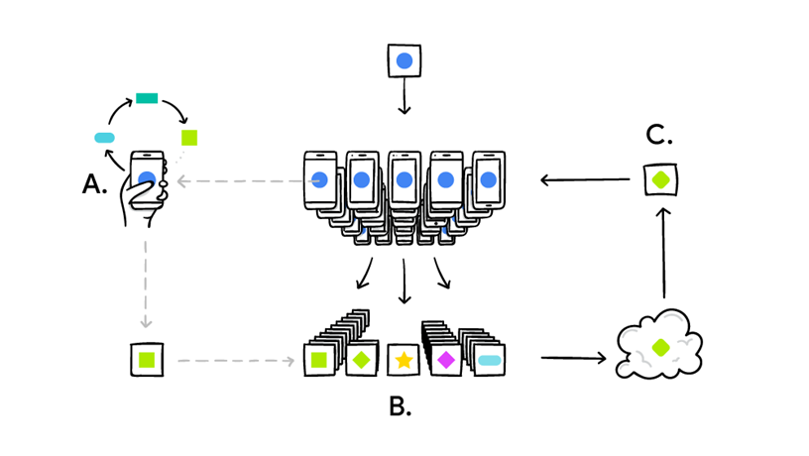
About Federated Learning
Technology that builds centralized model via decentralized data on many clients but not using them directly
Notes:
사진 변경 -> 구글 ai 블로그에 다른 그 핸드폰 많은 이미지로
일반적으로 Federated Learning이 어떻게 진행되는지 설명하는 슬라이드가 추가로 필요. 이 과정에서 자연스럽게 일반적으로 FL할때 FedAVG라는 게 사용된다고 말하며 FedAvg를 설명해야 함. 수식

Slide 4


General FL: FedAvg
Global
Model
$$FedAvg\left(\left[w1:w_{n}\right]\right)=\sum_{k=1}^{n}{\frac{m_{k}}{M}w_{k}}$$
$$w^{′}←FedAvg([w1:w9])$$
1
2
3
4
5
6
7
8
9

Slide 5
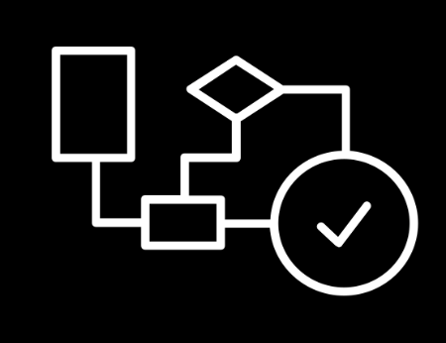
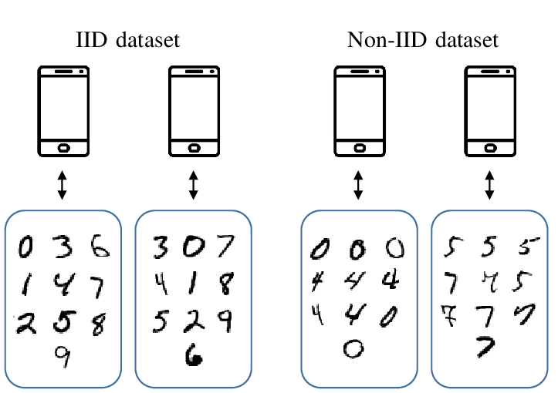

Non – I.I.D Issue in Federated Learning
1. Data
2. Algorithm
Solve
Based on
3. System

Slide 6
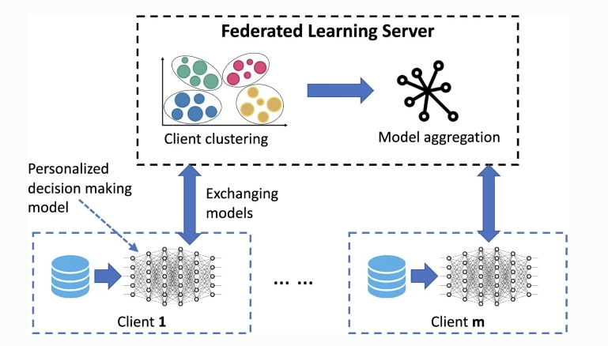
Our solution
Weighted aggregation
using
Client Clustering
Notes:
For -> using
Our Solution 시작부분에 우리 솔루션을 제안하는 이유 (우리의 가설) -> fedavg에서는 negative information이 positive information과 동일한 비율로 global 모델에 반영된다. 우리는 negative information이 더 적게 반영되도록 할 것이다. FedWagg에서는 클러스터링을 함으로써 negative information끼리, positive information들끼리 각 클러스터로 모으고, 이를 타 클라이언트들에 테스트하여 generalization error를 판별한다. 이를 통해 어떤 정보(weight, parameter)가 positive, negative인지 파악한 후 그 비율대로 글로벌 모델에 반영한다.

Slide 7
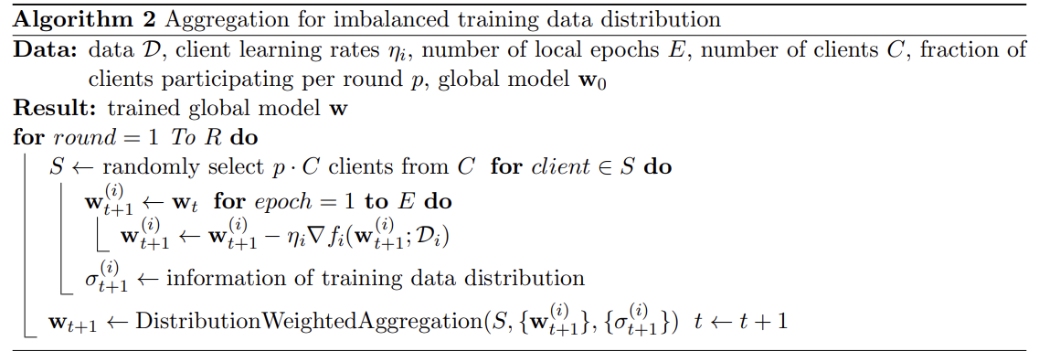
Our solution
Weighted aggregation
using
Client Clustering
Notes:
For -> using
Our Solution 시작부분에 우리 솔루션을 제안하는 이유 (우리의 가설) -> fedavg에서는 negative information이 positive information과 동일한 비율로 global 모델에 반영된다. 우리는 negative information이 더 적게 반영되도록 할 것이다. FedWagg에서는 클러스터링을 함으로써 negative information끼리, positive information들끼리 각 클러스터로 모으고, 이를 타 클라이언트들에 테스트하여 generalization error를 판별한다. 이를 통해 어떤 정보(weight, parameter)가 positive, negative인지 파악한 후 그 비율대로 글로벌 모델에 반영한다.

Slide 8
Cluster 1
Cluster 2
Cluster 3
1
2
3
4
5
6
7
8
9
Usually, Traditional clustering method operates multiple cluster models.
No one global model.

Slide 9
Global
Model
Cluster 1
Cluster 2
Cluster 3
1
2
3
4
5
6
7
8
9
weighted aggregation method of the cluster models
for one global model

Slide 10
Training process : Step 1
Global
Model
Initialize all clients
with global model
Cluster 1
Cluster 2
Cluster 3
1
2
3
4
5
6
7
8
9
Notes:
1. 사진을 3 layer 도표로 바꾸기.

Slide 11
Training process : Step 2
Global
Model
Proceed with
model update
in each client
Cluster 1
Cluster 2
Cluster 3
1
2
3
4
5
6
7
8
9
Notes:
1. 사진을 3 layer 도표로 바꾸기.

Slide 12



Training process : Step 3
Global
Model
clustering
the m most similar clients to form
a cluster
$$w2, w5,w9$$
$$w1, w4,w7$$
$$w3, w6,w8$$
Cluster 1
Cluster 2
Cluster 3
1
2
3
4
5
6
7
8
9
Notes:
1. 사진을 3 layer 도표로 바꾸기.

Slide 13
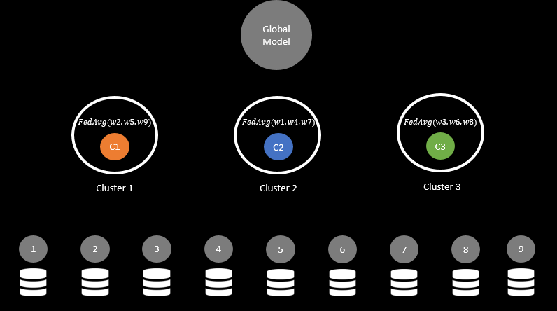
Training process : Step 3
clustering
the m most similar clients to form
a cluster
Notes:
1. 사진을 3 layer 도표로 바꾸기.

Slide 14
Training process : Step 4
For each cluster,
sample m clients
to test
the performance of
the cluster model.
(obtain averaged accuracy)
Notes:
1. 사진을 3 layer 도표로 바꾸기.

Slide 15
Training process : Step 4
Global
Model
For each cluster,
sample m clients
to test
the performance of
the cluster model.
(obtain averaged accuracy)
$$FedAvg(w2, w5,w9)$$
$$FedAvg(w1, w4,w7)$$
$$FedAvg(w3, w6,w8)$$
C1
C2
C3
Cluster 1
Cluster 2
Cluster 3
Test
Result
1
2
C1
C1
3
4
9
C1
5
6
C1
7
C1
8
C1
Notes:
1. 사진을 3 layer 도표로 바꾸기.

Slide 16
Training process : Step 4
Global
Model
For each cluster,
sample m clients
to test
the performance of
the cluster model.
(obtain averaged accuracy)
$$FedAvg(w2, w5,w9)$$
$$FedAvg(w1, w4,w7)$$
$$FedAvg(w3, w6,w8)$$
C1
C2
C3
Cluster 1
Cluster 2
Cluster 3
Test
Result
C2
1
2
C2
C2
3
4
C2
5
C2
C2
9
6
7
8
Notes:
1. 사진을 3 layer 도표로 바꾸기.

Slide 17
Training process : Step 4
Global
Model
For each cluster,
sample m clients
to test
the performance of
the cluster model.
(obtain averaged accuracy)
$$FedAvg(w2, w5,w9)$$
$$FedAvg(w1, w4,w7)$$
$$FedAvg(w3, w6,w8)$$
C1
C2
C3
Cluster 1
Cluster 2
Cluster 3
Test
Result
1
2
C3
3
4
C3
C3
C3
C3
9
5
6
7
8
C3
Notes:
1. 사진을 3 layer 도표로 바꾸기.

Slide 18
Training process : Step 5
Global
Model
Update
Using the accuracy obtained at step 4,
weighted sum
cluster models
to update
the global model.
Aggregation
based on result
1
2
3
4
5
6
7
8
9
Notes:
1. 사진을 3 layer 도표로 바꾸기.

Slide 19
Training process : Step 6
Global
Model
Repeat step 1~5.
Until the global model converges.
Cluster 1
Cluster 2
Cluster 3
1
2
3
4
5
6
7
8
9
Notes:
1. 사진을 3 layer 도표로 바꾸기.

Slide 20
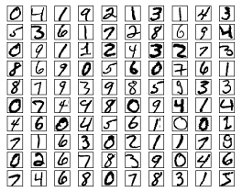
Test FEDWAGG for MNIST classification task
Notes:
Now, let's apply the FedWagg algorithm to the MNIST classification task and analyze its performance.

Slide 21
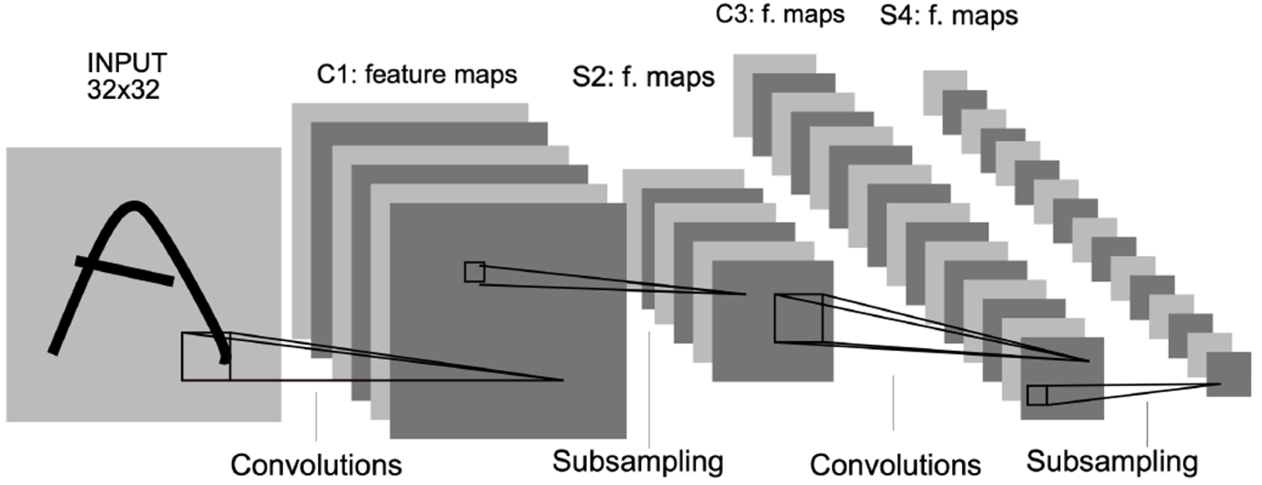
Experimental Results
Experiment Setting
Compare FedWagg and FedAvg
MNIST Classification with 2-layer CNN
# clients = 9
# clusters = 3
# clients per cluster = 3
Round = 20
Client Data Distribution: Non-I.I.D.
Evaluate
Loss & Accuracy of the global model per round
Average Loss & Accuracy of the global model
2-Layer CNN model
Notes:
We proceeded Federated Learning by using FedWagg and FedAvg method to the MNIST Classification task. This is our Experiment Setting. For both, we use same 2-layer CNN architecture model with same initial parameter. Number of clients is 9, for FedWagg, number of clusters is 3, number of clients per cluster is 3. We did Federated Learning with Round 20, and client data distribution is Non-I.I.D. We will evaluate Loss and accuracy of the global model per round, and its average value.

Slide 22
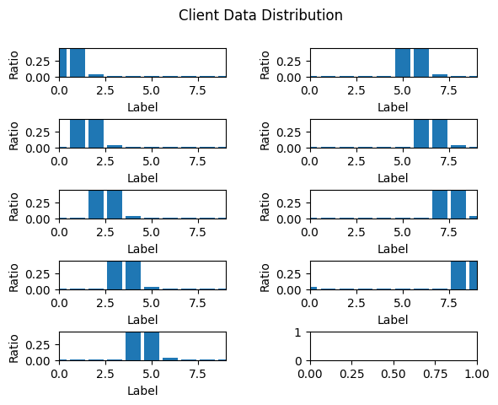
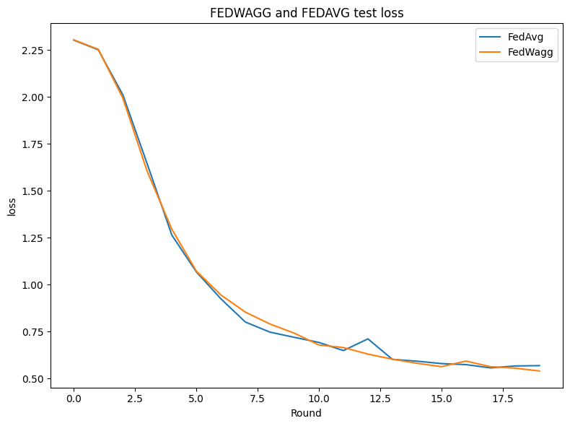
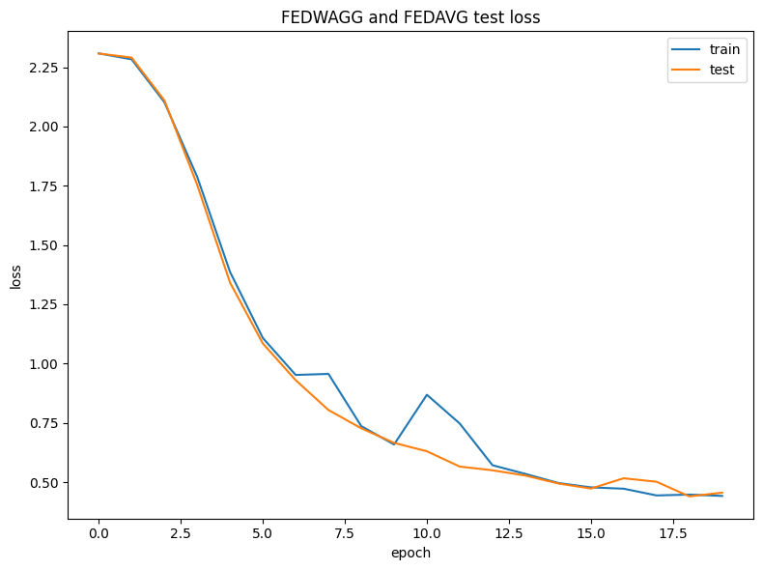
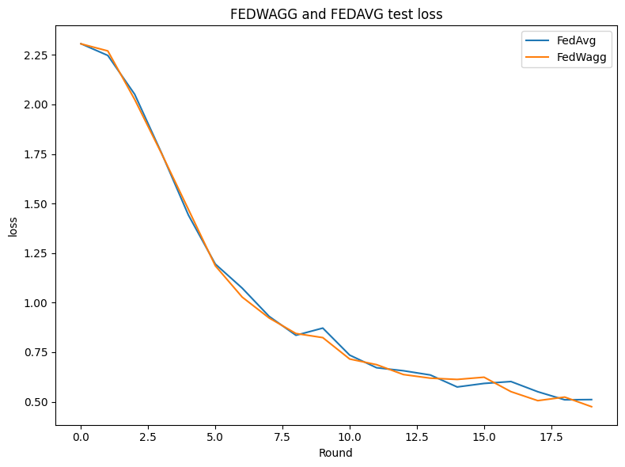
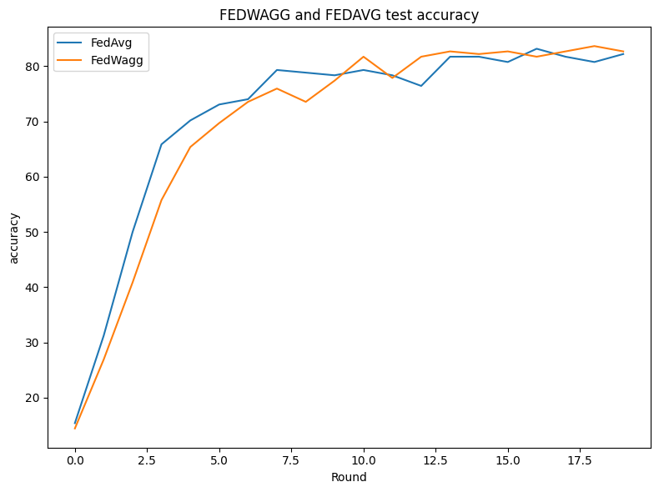
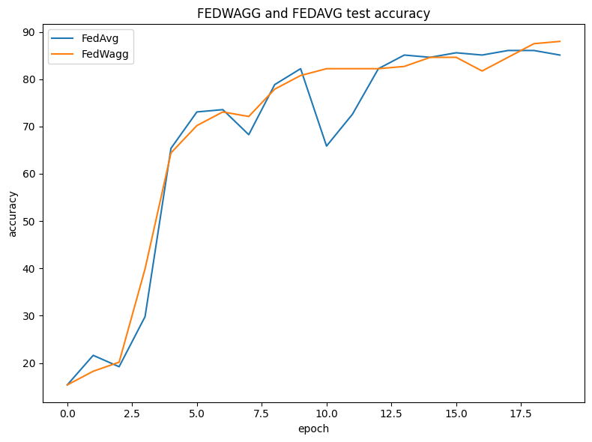
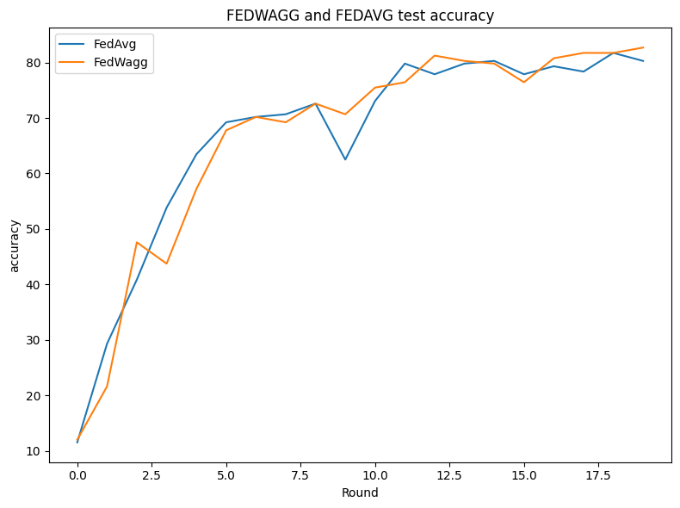
Experimental Results
Compare FedWagg and FedAvg
# Total Trainset: 1500 (166 per clients)
Client epochs=5, batch_size=16, lr=0.01
Round 20
Stabilize!
Test 1
Test 2
Test 3
FEDWAGG FEDAVG
Test acc: 86.54
Test acc: 87.97
Test acc: 87.02
Test acc: 83.17
Test acc: 83.93
Test acc: 81.83
Notes:
Above settings are applied for our experiment. First experiment’s client data distribution is like below. For each client, two of labels have 0.45 ratio and others have 0.2, 0.1.
In our test result graph on the right, the orange color is for FedWagg, and the blue color is for FedAvg. Each graph shows the loss and accuracy of global model per every rounds. We can see that there was no significant performance difference between FedWagg and FedAvg. However, the learning graph in the case of FedWagg was learned stably without peaks rather than FedAvg.

Slide 23
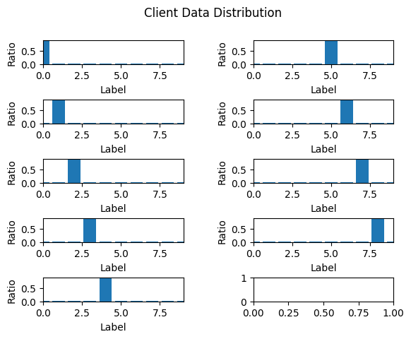
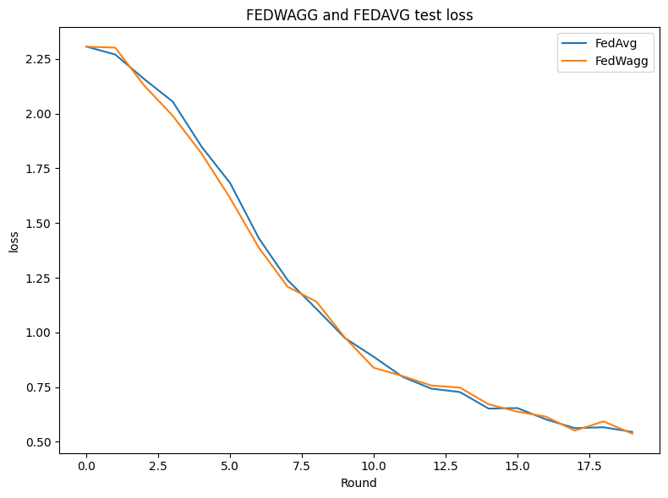
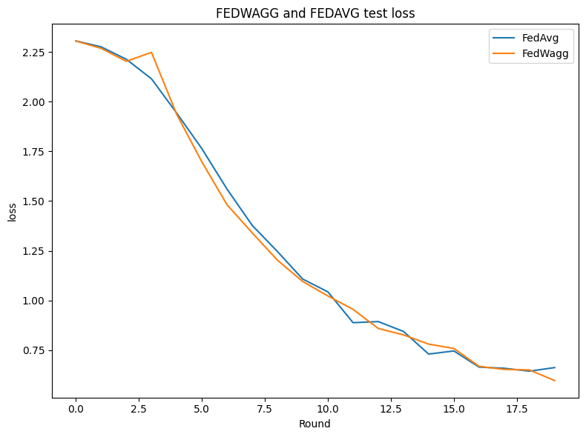
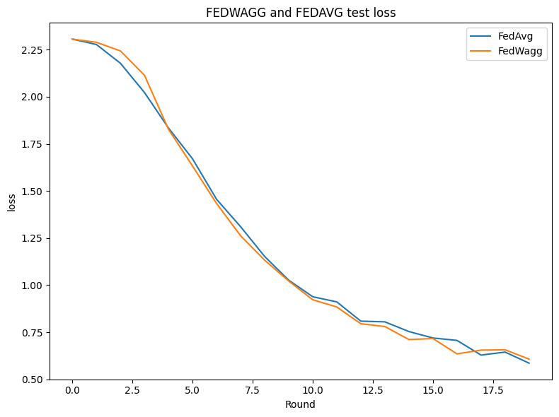
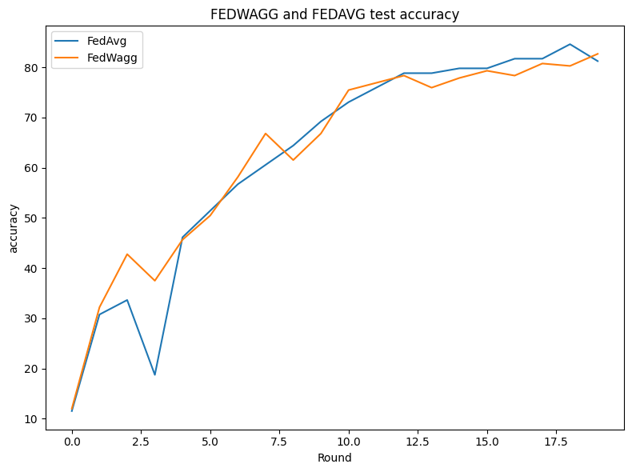
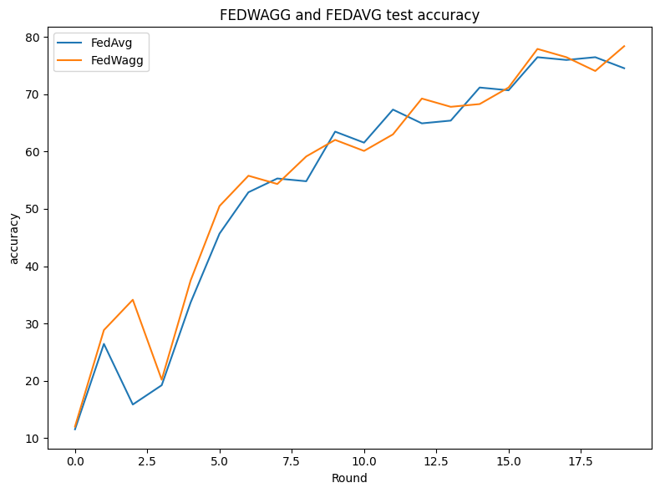
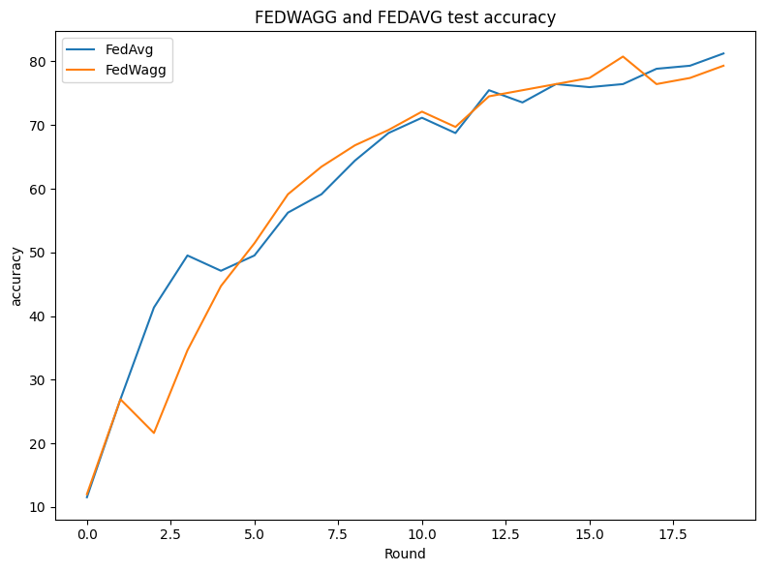
Experimental Results
Compare FedWagg and FedAvg
# Total Trainset: 1500 (166 per clients)
Client epochs=5, batch_size=16, lr=0.01
Round 20
Test 1
Test 2
Test 3
FEDWAGG FEDAVG
Test acc: 82.42
Test acc: 76.21
Test acc: 77.40
Test acc: 76.92
Test acc: 81.25
Test acc: 83.17
Notes:
Second experiment’s client data distribution is like below. For each client, one of labels has 0.9 ratio and others have 0.2, 0.1. Like before experiment, there is no significant performance improvement for FedWagg. Also there occured weakly Stabilizing Effect in FedWagg than first experiment.

Slide 24
Conclusion
Results
FedWagg stabilize the learning of the global model by preventing unstable loss and accuraccy peak.
FedWagg doesn’t have performance improvement of the global model in terms of overall accuracy and loss for Non-I.I.D.
Discussion
Why stabilizing effect occurs in FedWagg?
In FedWagg, we can control bad parameters to be reflected with less weight to a global model. A cluster model contains bad client model will get less weight when testing generalizing error step.
Why stabilizing effect occurs weakly in FedWagg for second Non-I.I.D. dataset?
Because clustering doesn’t work meaningfully. Unlike the first, the second client dataset has a completely different each other. So they might not construct cluster with similar ones.
Why no performance improvement in FedWagg?
Client models rapidly converged as round repeated. After round 3, similarities between client models was higher than 0.97, round 5, almost converged to 0.99.
So after the initial few rounds, clustering may not worked meaningfully.
Notes:
Summarizing our experimental results, FedWagg had the effect of stabilizing global model learning. However, there was no significant performance improvement in FedWagg compared to FedAvg for Non-I.I.D dataset.
This is our discussion.
First, Why stabilizing effect occurs in FedWagg?
Its because in FedWagg, we can control bad parameters to be reflected with less weight to a global model. So the weight of the unique parameter that has an bad effect is reduced. This leads to a stabilizing the accuracy and loss.
Second, Why stabilizing effect occurs weakly in FedWagg for second Non-I.I.D. dataset?
Its because clustering doesn’t work meaningfully. Unlike the first, second client dataset has a completely different each other. So they might not construct cluster with similar ones.
Why no performance improvement in FedWagg?
Its because Client models rapidly converged as round repeated. Each client model’s parameter converged rapidly as round repeated, So after round 5, similarities between each client model’s parameter are 0.99. So after the initial few rounds, clustering may not worked meaningfully. We think this is why FedWagg doesn’t outperform FedAvg meaningfully overall view of Federated Learning.
고찰 추가
Stabilize에 대하여
왜 stabilize가 되는지
첫번째 데이터셋에서는 되고, 두번째에서는 안되었던 이유 -> 겹치는 데이터셋이 없으니 애초에 클러스터링이 유의미하게 작용하지 않았을 것이다.
왜 성능향상이 예상과 달리 잘 안일어났는가?
테스트해보니 round가 5 정도 지나면서부터 clients간의 similarity가 0.99에 수렴했다. 따라서 클러스터링이 유의미하게 진행되지 않았을 것이다.

Slide 25
Reference
Brendan Mcmahan and Dainiel Ramage. 2017. Federated Learning: Collaborative Machine Learning without Centralized Training Data. Google Research
Zhu, H., Xu, J., Liu, S., Jin Y., (2021). Federated Learning on Non-IID Data: A Survey. Department of Computer Science, University of Surrey. East China University of Science of Technology.
Zhao, Y., Li, M., Lai, L., Suda, N., Civin, D., and Chandra, V. (2018). Federated learning with non-iid data. arXiv preprint arXiv:1806.00582.
Notes:
Summarizing our experimental results, FedWagg had the effect of stabilizing global model learning. However, there was no significant performance improvement in FedWagg compared to FedAvg for Non-I.I.D dataset.
This is our discussion.
First, Why stabilizing effect occurs in FedWagg?
Its because in FedWagg, we can control bad parameters to be reflected with less weight to a global model. So the weight of the unique parameter that has an bad effect is reduced. This leads to a stabilizing the accuracy and loss.
Second, Why stabilizing effect occurs weakly in FedWagg for second Non-I.I.D. dataset?
Its because clustering doesn’t work meaningfully. Unlike the first, second client dataset has a completely different each other. So they might not construct cluster with similar ones.
Why no performance improvement in FedWagg?
Its because Client models rapidly converged as round repeated. Each client model’s parameter converged rapidly as round repeated, So after round 5, similarities between each client model’s parameter are 0.99. So after the initial few rounds, clustering may not worked meaningfully. We think this is why FedWagg doesn’t outperform FedAvg meaningfully overall view of Federated Learning.
고찰 추가
Stabilize에 대하여
왜 stabilize가 되는지
첫번째 데이터셋에서는 되고, 두번째에서는 안되었던 이유 -> 겹치는 데이터셋이 없으니 애초에 클러스터링이 유의미하게 작용하지 않았을 것이다.
왜 성능향상이 예상과 달리 잘 안일어났는가?
테스트해보니 round가 5 정도 지나면서부터 clients간의 similarity가 0.99에 수렴했다. 따라서 클러스터링이 유의미하게 진행되지 않았을 것이다.

