Slide 1
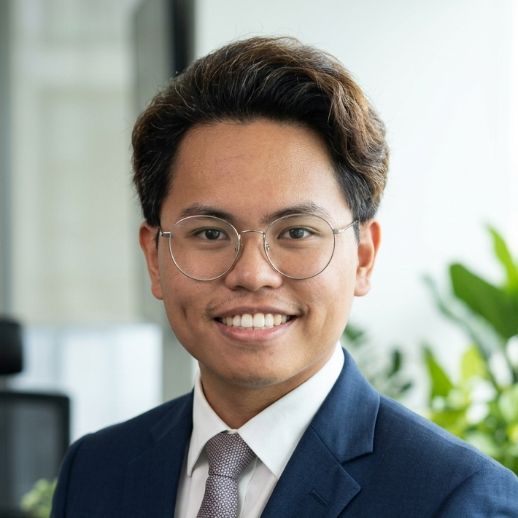
Adam Zailani
Software AI Engineer
+6018-310-9742 | adamzikrizailani@protonmail.com | Bangi, Malaysia
SUMMARY
A young tech enthusiast on a mission to make an impact wherever I go. With a knack for problem-solving and a passion for innovation, I bring a fresh perspective and a hunger for learning to every project I tackle. From coding complex algorithms to diving into the latest advancements in AI, I thrive on challenges and love turning ideas into reality.
EDUCATION
PROFESSIONAL EXPERIENCE
Bachelor of Computer Science (Hons.)
Freelance Developer
Bangi, Malaysia | 06/2025 - Present
Universiti Teknologi Mara, Jasin
Leveraged Agentic coding frameworks to streamline the software development life cycle (SDLC), utilizing autonomous agents for debugging, documentation, and initial prototyping.
Evaluated and integrated emerging AI architectures, including RAG (Retrieval-Augmented Generation) and Agentic reasoning loops, to build smarter, more intuitive applications for diverse clients.
Conducted continuous technical research into Transformer models and fine-tuning techniques to ensure client projects utilized the most cost-effective and performant models available.
Engineered and maintained Linux-based server environments using Docker for service isolation and custom Bash automation to streamline the deployment of AI-integrated application
10/2020 - 06/2023
3.78 CGPA
Vice Chancellor Award Receiver
SKILLS
Tools:
• Java • C++ • Python • OpenCode • LM Studio • LATE • openClaw
• Docker • ComfyUI •
Associate AI Researcher
MIMOS Berhad
Kuala Lumpur, Malaysia | 09/2024 - 02/2025
AI Specialization
Engineered high-impact Computer Vision Proof of Concepts (PoCs), transitioning cutting-edge research into functional prototypes for industrial applications.
Developed robotic software systems within the ROS framework, utilizing a polyglot approach (C# and Python) to bridge hardware-software communication.
Architected a proprietary image generation pipeline by fine-tuning foundational models, optimizing the model for specific in-house use cases and data requirements.
Spearheaded on-premise LLM deployments using DeepSeek R1, ensuring 100% data sovereignty and security by hosting inference on internal hardware.
Managed technical partnerships with external engineering firms to ruggedize lab prototypes, facilitating the transition from fragile concepts to field-deployable units.
Closed the feedback loop between stakeholders and engineering teams, using field data to iteratively refine POCs for mass-scale adoption.
• LLM Deployment • Prompt Engineering • Agentic Coding • RAG • ROS (Robot Operating System)
Operating Systems:
• Linux • Windows • MacOS
Interests
Geopolitics & Macroeconomics
Emerging AI Architectures
Self-Hosted Infrastructure
Modding/Reverse Engineering
Badminton
Pickle Ball
Gym
IT Applications Intern
Edwards Lifesciences APAC
Kuala Lumpur, Malaysia | 09/2023 - 02/2024
JDE & Android Integration: Developed and maintained global EnterpriseOne (JDE) systems and mobile applications, ensuring seamless data flow across the enterprise.
Legacy Migration: Successfully migrated unsupported MAF applications to Native Android, leveraging MVP architecture and REST APIs for modern performance standards.
Global Support: Resolved complex, real-world JDE tickets, deploying technical fixes and features to a worldwide production environment.
QA & Project Management: Managed development tasks via Jira and executed comprehensive quality audits through TestRails to maintain enterprise-level standards.

