Slide 1

Accidents happened in Seattle

Slide 2
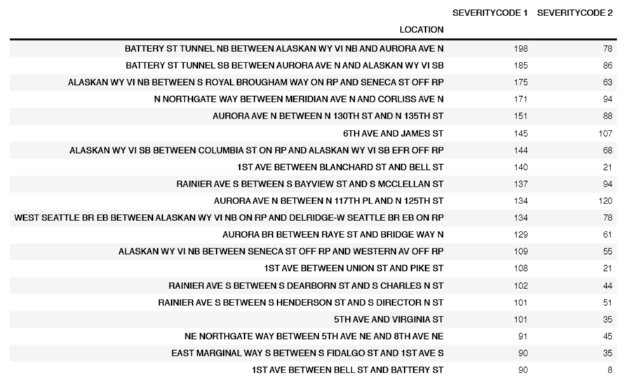
Data analysis
Top 20 locations of most accidents happened in Seattle

Slide 3
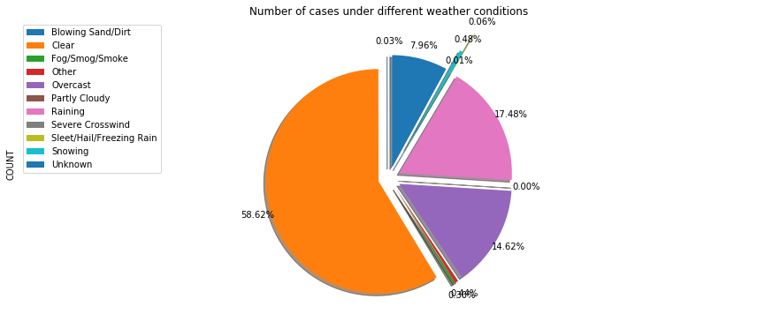
Data analysis
Number of Cases under different Weather Conditions

Slide 4
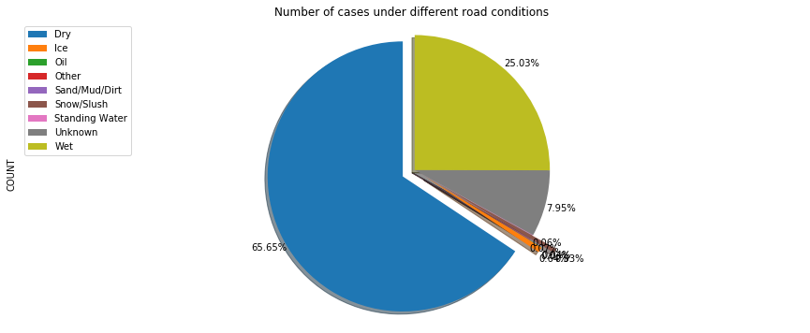
Data analysis
Number of Cases under different Road Conditions

Slide 5
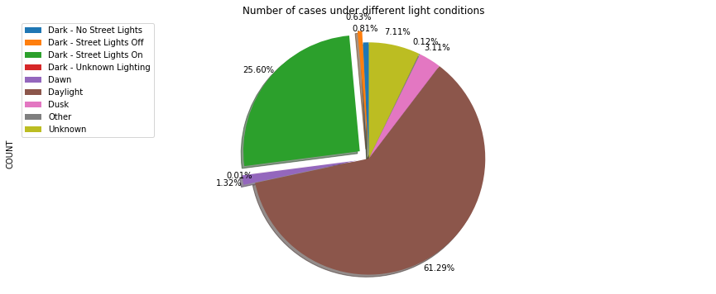
Data analysis
Number of Cases under different Light Conditions

Slide 6
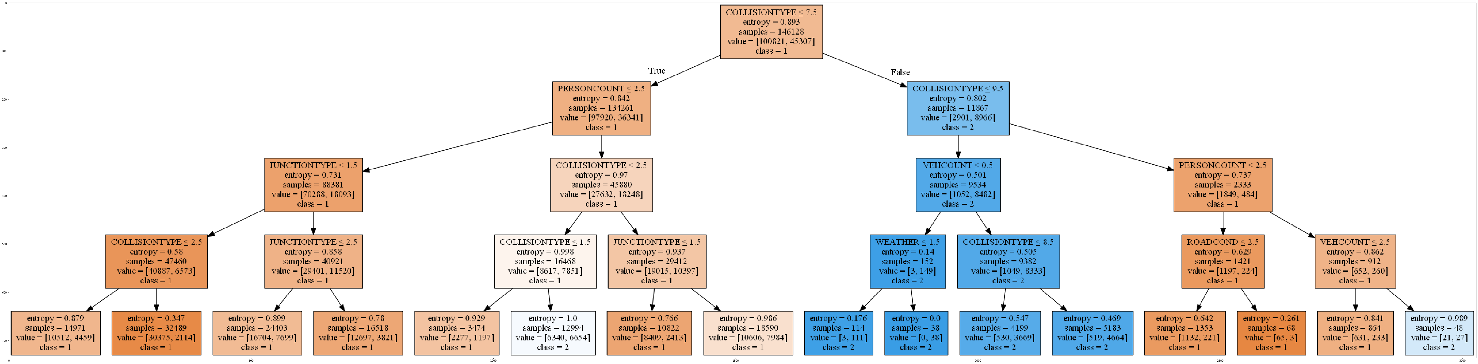
Decision tree

