Slide 1
Please log into katana and request an interactive job
Log into katana:
ssh z1234567@katana.restech.unsw.edu.au -o "ServerAliveInterval 10"
Request an interactive job:
qsub -I -l nodes=1:ppn=4,mem=60gb,walltime=02:59:00
Commands are here:
https://github.com/songweizhi/BioSAK/tree/master/BioSAK_tutorial

Slide 2
Functional annotation in a stand-alone and batch manner on Katana --- with BioSAK
Notes:
Today, I am going to talk about how to do functional annotations on Katana.
Before I start, please log into katana and submit an interactive job. If you want to go through the commands later,
Because it takes some time to start a job, depends on how busy katana is.
The code for this can be found from the website I sent you. Please request 4 cores and at least 30 gbp memory. 60 is better.
It’s not hard to do this when you have only a few files , like with IMG, BlastKoala, and some other annotation website.
But having hundreds of files on hand is a little bit difficult to do it online.
The tool I am going to use is BioSAK, which is just a collection of my frequently used scripts for handling large amount data.

Slide 3


Databases
COG
Notes:
The three databases I am going to cover today are COG, KEGG and CAZy.
First, I’ll briefly talk about their structure

Slide 4
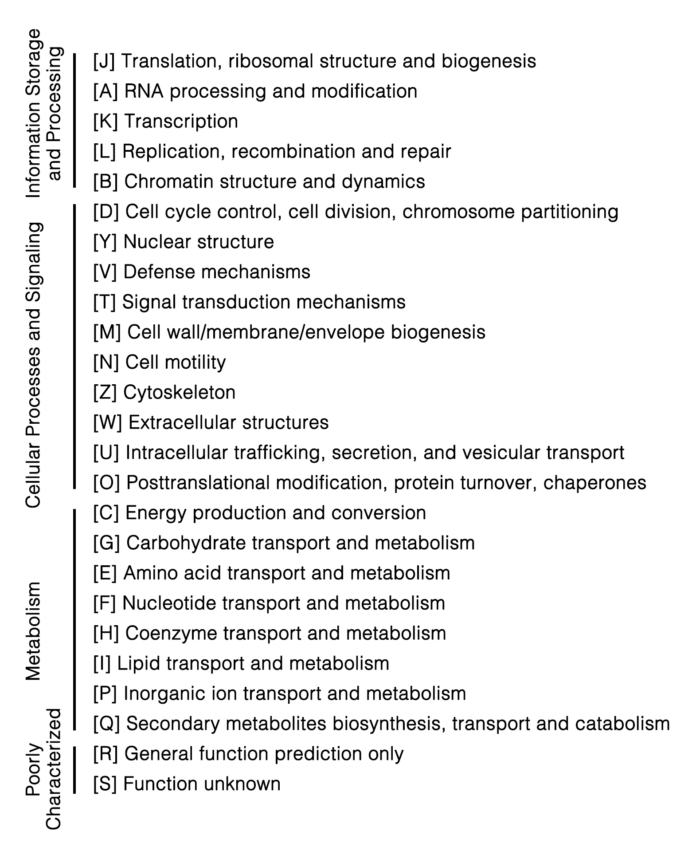
COG
Clusters of Orthologous Groups
Notes:
The word COG refers to the Clusters of Orthologous Groups.
All these groups in COG database were organized at three levels:
On the top are the three main functional categories which include …
Then followed by about 30 sub-classes: like …
At the bottom level are individual proteins from each of these functional categories.
This is COG database, very brief introduction.

Slide 5
Level A:
A09160 Human Diseases
A09100 Metabolism
A09150 Organismal Systems
A09190 Not Included in Pathway or Brite
A09120 Genetic Information Processing
A09180 Brite Hierarchies
A09130 Environmental Information Processing
A09140 Cellular Processe
A Metabolism
B Carbohydrate metabolism
B Nucleotide metabolism
B Amino acid metabolism
C Lysine biosynthesis [PATH:ko00300]
C Lysine degradation [PATH:ko00310]
C Tyrosine metabolism [PATH:ko00350]
Notes:
Similar to COG database,
KEGG database was also organized at different levels. There are four levels here.
On the top level are 8 main categories. Including Metabolism, human diseases organismal systems etc. (Et Cetera)
Let’s take Metabolism as an example. One level down would be the metabolism of different kind of substance, like Carbohydrate, nucleotide and amino acid.
And, one level down the amino acid metabolism would be the pathways for biosynthesis or degradation of specific amino acid.
The lowest level (D) are the individual enzymes belong to these pathways.

Slide 6
The families of enzymes that degrade, modify, or create glycosidic bonds.
Enzyme Classes currently covered
Glycoside Hydrolases (GHs) Hydrolysis and/or rearrangement of glycosidic bonds
GlycosylTransferases (GTs) Formation of glycosidic bonds
Polysaccharide Lyases (PLs) Non-hydrolytic cleavage of glycosidic bonds
Carbohydrate Esterases (CEs) Hydrolysis of carbohydrate esters
Auxiliary Activities (AAs) Redox enzymes that act in conjunction with CAZymes.
Notes:
The CAZy database describes the families of enzymes that degrade, modify, or create glycosidic bonds.
These enzymes were also grouped into different categories according to their functions.
For example, the hydrolysis, rearrangement and formation of glycosidic bonds

Slide 7
How BioSAK works:
COG and KEGG databases
Use Blast+/Diamond to get the best hits of query proteins from the database with user defined e-value cut-off (default 0.001).
CAZy database (using dbCAN)
http://bcb.unl.edu/dbCAN2/download/Databases/dbCAN-old@UGA/readme.txt
Notes:
For COG and KEGG databases:
For CAZy database, there is a ready-for-use tool which is called dbCAN. But the steps for running it’s a little bit tedious.
I just made it easy to run, especially when you have large amount of files. Also made the results bit easier to interpret.

Slide 8
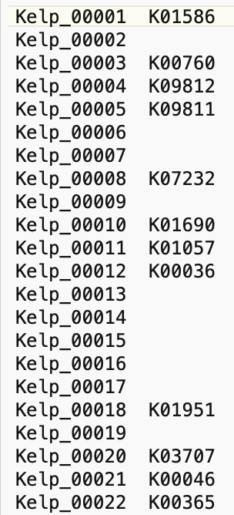
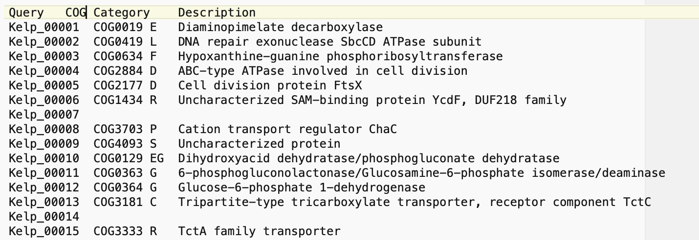
Output files 1
The assignment of query gene to the COG/KEGG/CAZY protein families.
Notes:
Now let’s see what kind of output we can get.
E.g. the number/percentage of genes been annotated to each COG/KEGG/CAZy protein family.
Support for depth information
Provide data matrix which combine annotation results for multiple query genomes
Total depth of a COG/KO/CAZy family is calculated by summing up the depth of all genes assigned to it.
The percentage of GeneNumber/TotalDepth of genes assigned to a COG/KO/CAZy family is calculated by dividing them by the total number/depth of all genes in the query file.

Slide 9
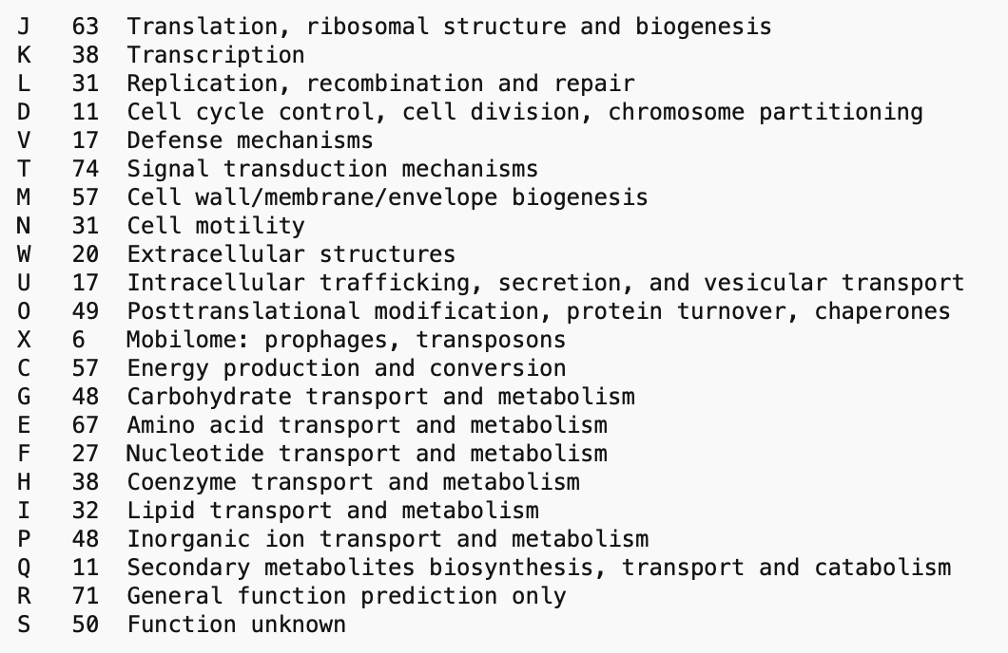
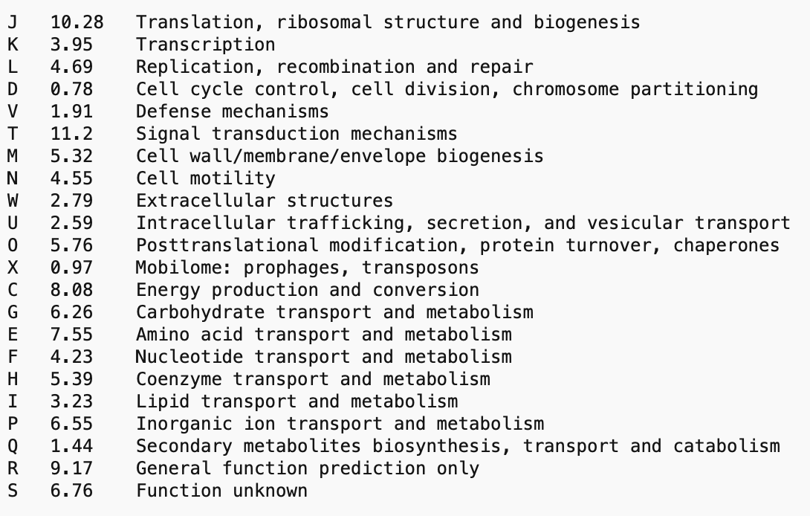
Output files 2
Summary of the annotation results for each query file
The number/percentage of genes annotated to each protein family
The total depth of genes annotated to each protein family
The number/percentage of genes annotated to each COG category

Slide 10
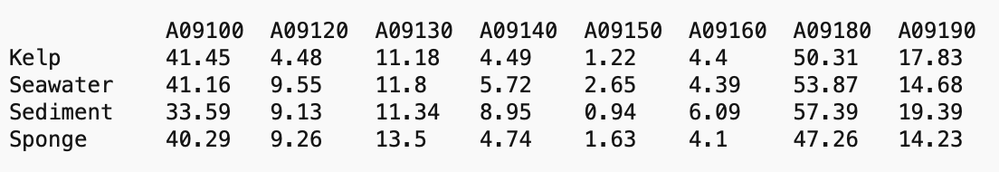
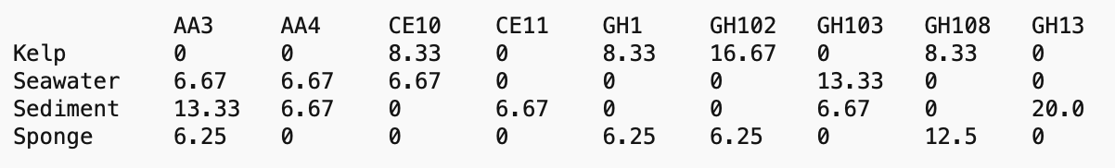
Output files 3
Data frames which combine the annotations for all query files
KEGG, level A
CAZy
The percentage of of for all query files.
Notes:
Suppose you have 100 genes to annotate and only 50 of them been annotated to certain gene families.
For COG category “V”, you have 5 genes assigned to it. In this case, the percentage of genes assigned to this COG category is 5/50 = 10%, but not 5%.
So you can use these files to do some kind of multivariant analysis.

Slide 11
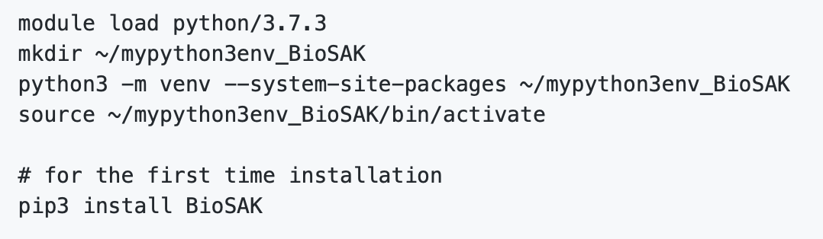
How to run
Download database files
Install BioSAK on Katana with Python virtual environment
On your own Mac/Linux (Windows not supported yet ☹️ )
Notes:
Python virtual environment allows you to install python packages for yourself on Katana
We will go through all the steps later

Slide 12
Slides Backup

Slide 13
All these modules support multiprocessing. Which means you can run annotation for multiple files at the same time if you requested more than one cores on Katana.

Slide 14
First, let check what in this folder. There are three folders here, CtgSeq, CtgDepth and OtherFiles. In the CtgSeq folder are four sequence files assembled from metagenomic data of bacterial communities isolated from different locations. Actually they are not complete sets of metagenomic assemblies. I just kept 10 contigs for each of the four files for a quick demo. Anyway, let’s pretend they are complete sets of metagenomic assemblies.
In the CtgDepth folder are the depth information of all sequences in CtgSeq. The higher the ctg depth, the more abundant of the organism in a community that contig come from. These info was obtained by mapping sequencing reads back to the assemblies. I will not cover this today, but you can check out all the commands I used to get this from the “Commands for getting contig depth” section.
The otherfiles folder contains some files which I can used to show a few other utilities of BioSAK, if we have some time left.

Slide 15
What we need to do first is to predict all genes encoded by these sequences, we’ll do this with Prokka. And the commands can be found here. You can now copy and paste them to you terminal.
There are a bunch of output files from Prokka, what we need are the two file with extension .faa and gff.
The faa file contains the protein sequences of all predicted genes from the contig file. And the gff file tells us the correlations between the protein sequences and contigs. That is which protein comes from which contig.
If we open it, let ignore lines started with #. The first column are contig ids, and the 9th column tells gene ids, together with some descriptions. Because we know the depth of the contigs, with this file, we can get the depth for each predicted genes.
Let’s move them to separate folders now. and the commands are here.

Slide 16
Now let get gene depth with contig depth and the gff file. The commands can be found from section 4. it will produce
After you have done this, we’ll now create a new folder called CtgSeq_faa_depth, and copy all gene depth file into it.
Now, we are ready for running annotation now.
Let load diamond and hmmer first, and assign your zid to the zID variable. In this case, you don’t need to change the $zID in the command line.
When you run COG annotation , you just type BioSAK followed with COG2014,

Slide 17
Community-level comparison --- abundance matters
Sponge 1 Sponge 2
99 : 1
1 : 99
Sponge 1 Sponge 2
Copy number: 1 : 1
Abundance: 99 : 1

Slide 18
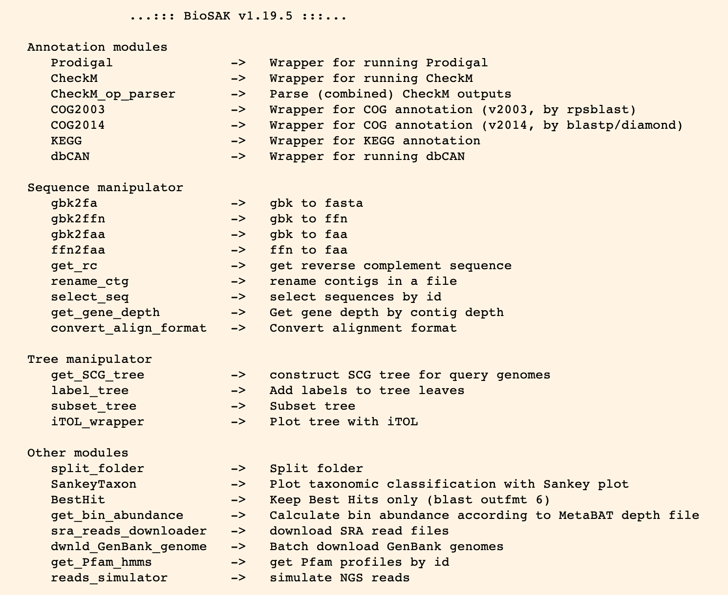
Other modules and New features
Notes:
If there are any other features you think is great for handling large amount of data of tables, just let me know and I can incorporate it into BioSAK.
dwnld_GenBank_genome: Alteromonas
label_tree
SankeyTaxon
BestHit
subset_tree

Slide 19
Comparison between BioSAK (Diamond), BioSAK (Blast+) and GhostKOALA for KEGG
GhostKOALA BioSAK (Diamond)
BioSAK (Blast+) BioSAK (Diamond)
6
1
BH_ER_050417_11
BH_ER_050417_13
BH_ER_050417_18
20 333 38
6 370 15
4
1
23 238 42
4 279 3
2
1
20 190 33
4 270 4
Notes:
o

Slide 20
Comparison between WebMGA, BioSAK (Blast+) and BioSAK (Diamond) for COG2014
WebMGA BioSAK (Diamond)
BioSAK (Blast+) BioSAK (Diamond)
58
19
BH_ER_050417_11
BH_ER_050417_13
BH_ER_050417_18
28 567 48
62 653 1
54
24
26 447 60
79 537 0
33
14
25 375 52
34 445 1

Slide 21
Comparison between BioSAK (Diamond), BlastKOALA and GhostKOALA
 | BH_ER_050417_Refined_11 | BH_ER_050417_Refined_13 | BH_ER_050417_Refined_18
Query sequences | 899 | 853 | 785
Both NA | 512 | 574 | 556
Same | 348 | 252 | 200
Different | 0 | 0 | 0
BlastKOALA only | 28 | 14 | 17
GhostKOALA only | 11 | 13 | 12

Slide 22
Comparison between WebMGA, BioSAK (Blast+) and BioSAK (Diamond) for COG2014
 | BH_ER_050417_Refined_11 | BH_ER_050417_Refined_13 | BH_ER_050417_Refined_18
Query sequences | 899 | 853 | 785
Both NA | 198 | 266 | 300
Same COG | 567 | 447 | 375
Different COG | 58 | 54 | 33
WebMGA only | 28 | 26 | 25
BioSAK (Diamond) only | 48 | 60 | 52
 | BH_ER_050417_Refined_11 | BH_ER_050417_Refined_13 | BH_ER_050417_Refined_18
Query sequences | 899 | 853 | 785
Both NA | 164 | 213 | 291
Same COG | 653 | 537 | 445
Different COG | 19 | 24 | 14
BioSAK (Diamond) only | 1 | 0 | 1
BioSAK (Blast+) only | 62 | 79 | 34

Slide 23
Comparison between BioSAK (Diamond), BioSAK (Blast+) and GhostKOALA for KEGG
 | BH_ER_050417_Refined_11 | BH_ER_050417_Refined_13 | BH_ER_050417_Refined_18
Query sequences | 899 | 853 | 785
Both NA | 502 | 546 | 540
Same ko | 333 | 238 | 190
Different ko | 6 | 4 | 2
BioSAK (Diamond) only | 38 | 42 | 33
GhostKOALA only | 20 | 23 | 20
 | BH_ER_050417_Refined_11 | BH_ER_050417_Refined_13 | BH_ER_050417_Refined_18
Query sequences | 899 | 853 | 785
Both NA | 507 | 566 | 556
Same ko | 370 | 279 | 220
Different ko | 1 | 1 | 1
BioSAK (Diamond) only | 15 | 3 | 4
BioSAK (Blast+) only | 6 | 4 | 4

