Slide 1
PyDeBruijn: a novel Python library to construct deBruijn Graphs and analyse the Effect of Sequence Error Correction on DeBruijn Graph properties
Stuti Agrawal, Yajing Tang

Slide 2
Introduction
De-Brujin Graph: graph of edges as k-mers used for De-Novo genome assembly
Problem: Computationally intensive, error-prone dataset- result in wrong assembly, also increase the size of graph

Slide 3
Introduction
Error correction tools: help to enhance the accuracy of the reads sequencing
Problem: No evaluation on how it effects the De-novo genome assembly
Our solution: Evaluate the effect of error correction before sequence assembly, by creating the De-Brujin graph first and analysis the quality of De-Brujin graph

Slide 4
Method
1.Constructing De-Brujin Graph
a. Construct k-mer table
-- used for analysis k-mer coverage
b. Construct succinct De-Brujin Graph
c. Construct classic De-Brujin Graph

Slide 5
Method
2. Evaluate De-Brujin Graph
A. Graph size -- indicating required computation
B. k-mer coverage – indicating the effect of error-correction
C. Number of self-loop – indicating the complexity of graph

Slide 6
Result
Seecer – HMM based error correction tool.
We ran our program for both original data and corrected data, and we ran the program for different size of dataset.

Slide 7
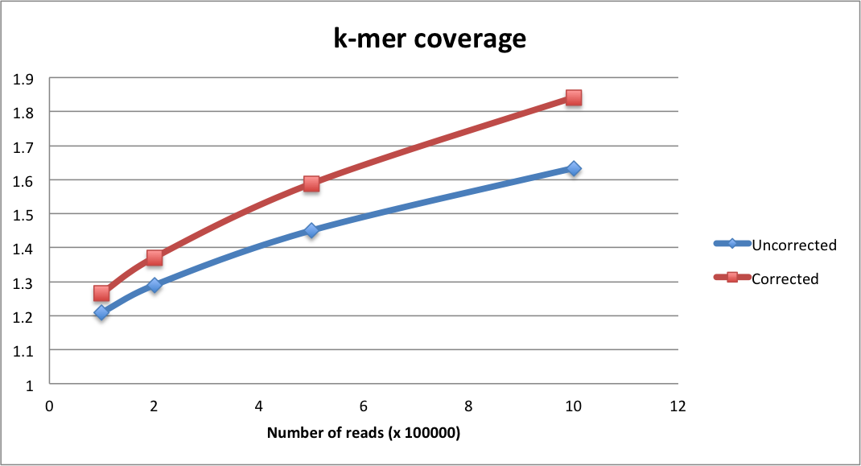
Result

Slide 8
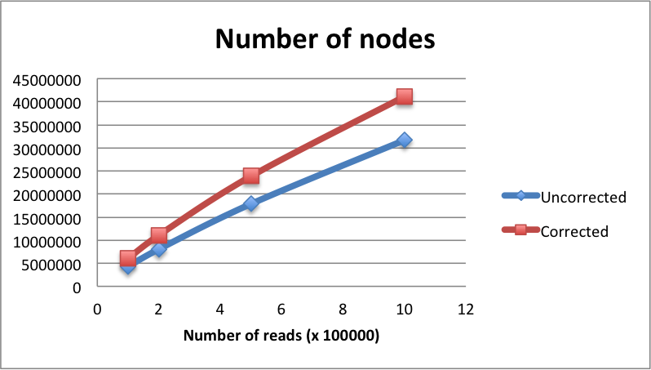
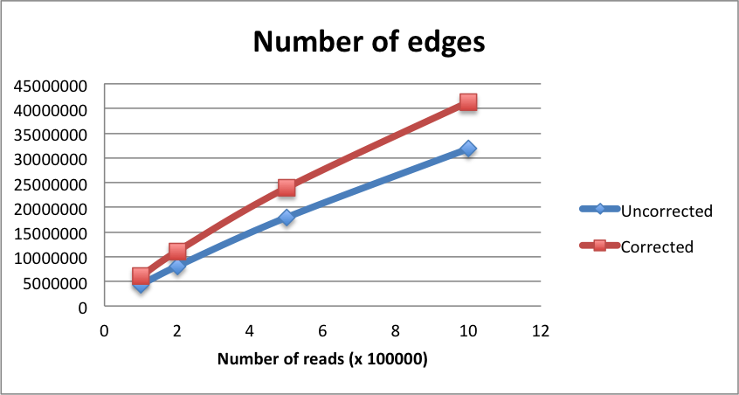
Result

Slide 9
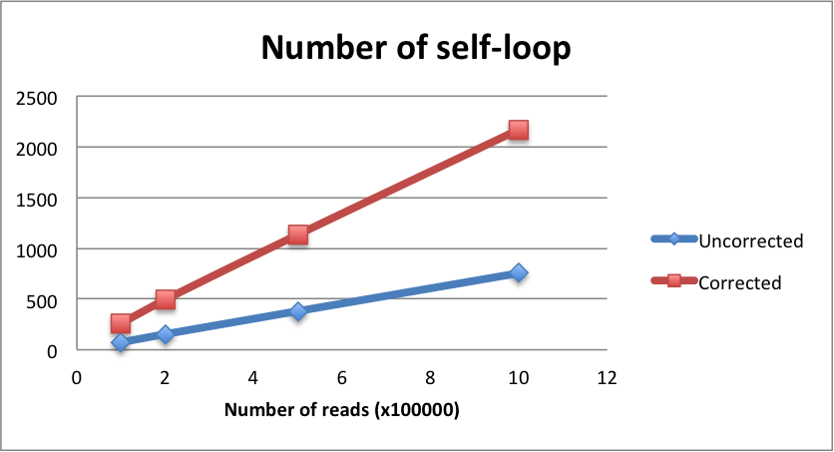
Result

Slide 10
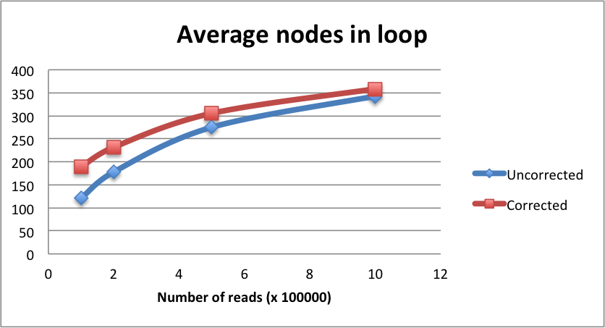
Result

Slide 11
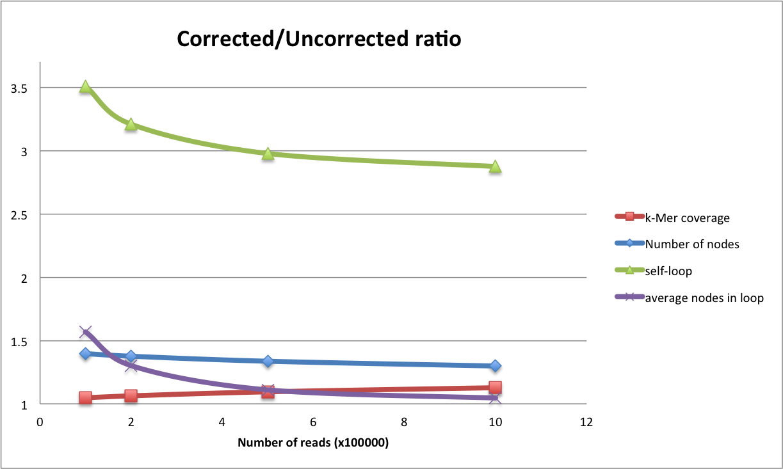
Result

Slide 12
Discussion
K-mer coverage – Increased. Indicating that it has effect on error correction.
Graph size – Increased. It generates more nodes and edges.
Graph complexity – Increased. It generates more self-loops in the graph.

Slide 13
Discussion
The trend of increasing graph size and complexity is going down.
Should be further tested the effect on genome dataset.

