Slide 1
How to use DP
SONG Xianming
2019.12.10

Slide 2
Basic Functions
1 data interface
1.1 function introduction
1.2 more input or output parameters
1.3 function for more channels
2 GUI
2.1 find the channel and browser
2.2 more channels
2.3 draw
2.4 zoom in and zoom out
2.5 oscilloscope
2.6 group configuration
2.7 update

Slide 3
Basic Functions
2.8 data save and load
2.9 default channel show
2.10 shot compare
2.11 data from workspace
2.12 shotcut
3 FAQ
3.1 interface to put data
4 Data into the mds+ Database
4.1 Why DP command doesn’t work?
4.2 Why exl50 server doesn’t work?
4.3 Why some channels doesn’t work?
5 Future plan

Slide 4

data interface
1.1 function introduction:
for experienced users only
addpath(‘C\DataProc’) : only one time
or cd to C\DataProc : every time when use DP
2) pmds; %set path first. Mandatory for MDSplus
3) For check the data: vb(1); % turn on verbose mode for view. vb(0) turn off.
4) Get data y and t. Lower and upper case is ok.

Slide 5
data interface
1.1 function introduction:
for experienced users only
For example:
>[y,t]=hl2adb(iShot, strChannel);
>help hl2adb
>[y,t]=exl50db(iShot, strChannel);
>[y,t]=exl50db(417, ‘ip’);
>[y,t,unit]= exl50db(20001, ‘axuv001’);
% time context: start, end and frequency control.
TIPS: eastdb instead of exl50db for east data.
[y,t,u]=eastdb(33038,'pcrl01',’1000:4000:1’); % ms

Slide 6
data interface
1.2 more input or output parameters
>[y, t, varargout] =
hl2adb(CurrentShot,CurrentChannel,varargin)
>[y, t, varargout] =
eastdb(CurrentShot,CurrentChannel,varargin)
>[y, t, varargout] =
exl50db(CurrentShot,CurrentChannel,varargin)
Mandatory input:
1) CurrentShot: int, double.
2) CurrentChannel: string.
Optional input:
timeWindow: string, ‘start:end:step’, e.g. ‘0:10:0.001’

Slide 7
data interface
1.2 more input or output parameters
[y, t, varargout] =
hl2adb(CurrentShot,CurrentChannel,varargin)
Mandatory output:
1) y: data, double array.
2) t: time, double array.
Optional output:
Unit: string, e.g. ‘kA’
treeName: string, e.g. ‘exl50’

Slide 8
data interface
1.3 function for more channels
>[ys,t]=hl2adb(shot,’_channels_’);
>[Ys, t, varargout] =
exl50dbN(CurrentShot,CurrentChannels,varargin)
Similar as the single channel function but with the CurrentChannels instead of CurrentChannel. Ys are matrix.
CurrentChannels is string with regexp
CurrentChannels is cell array of character vectors
TIPS: eastdbN for east data.

Slide 9
data interface
1.3 function for more channels
Regular express (strongly recommended)
[y, t] =hl2adb(20000,'_ref_\d_’);
[y, t] =xl50dbN(417,’ipf\d’);
cell array of character vectors
[y, t] =xl50dbN(417,{’ipf1’, ’ipf2’, ’ipf3’});
For EAST data
[y, t] =eastdbN(33038,{’pcpf1’, ’pcpf2’, ’pcpf3’});
TIPS：
All channels should be in the same tree.

Slide 10
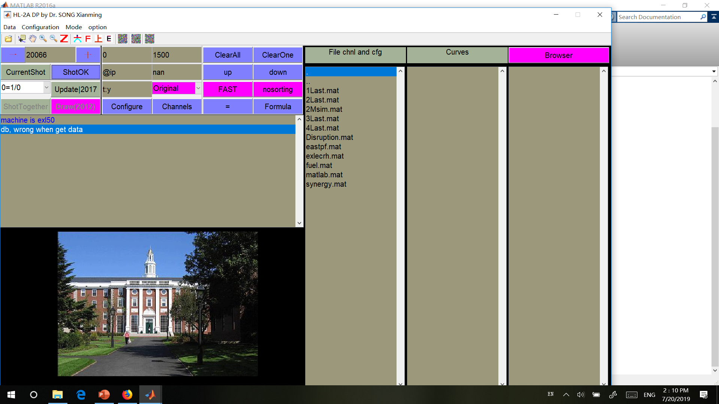
GUI (easy to use)

Slide 11
GUI(recommended)
GUI is easier to use, suitable for beginners.
TIPs：
1) Set the system display configuration before launching the matlab.
2) The GUI set DP GUI according to the screen, if you change display configuration after you launch the matlab, the GUI size may confuse you.

Slide 12
GUI
2.1 use regular expression for channel pattern for search the channels.
2.2 click the upper right magenta Browser button to switch to Broswer+ add mode for adding more channel data to for later drawing.
2.3 click the upper left magenta Draw button to draw more channels in a new figure.

Slide 13
GUI
2.4 use gesture to manipulate the figure.
Up to zoom in and down return.
Right to zoom in and Left to return.
zoom in zoom out
2.5 press the F5 key to turn on the oscilloscope mode and press the escape key to return to normal mode.
2.6 choose the layout mode for curve layout.

Slide 14
GUI
2.7 Click the update button to update the curves for the same channels
2.8 In the menu, click the savedata save the data for the curves into a file; click the load data to load the data from a file (the format you save before)into the curves.
2.9 you can define a default channel to show when you come into a new shot. (Press f6, click a channel in curve list, and select the number 2
2.10 click the shottogether button to compare the data for more shot.

Slide 15
GUI
2.11 prepare data in (t:y) then press enter
2.12 shotcut for graph

Slide 16
shotcut
1 图片位置调整
C：right
V：down
B：left
N：up
2 高采样率数据分片浏览
Right：向右浏览
Down：减小移动步长
Left：向左浏览
Up：增加移动步长

Slide 17
shotcut
3 属性控制
Z: 交换图像元素层次
X：修改图形属性
T：详细设置图形属性
S：修改尺寸大小
M：toggle menu
R ：toggle resizable
K: toggle y tick number (3,5)
L: toggle Label, legend and text
W: toggle y range style
U: update y range
P: toggle publish style
O: add a Line to indicate a value
A/E : adding column/row shadow(menu add shadow)
Z: exchange layer

Slide 18
shotcut
4 功能
F5：详细分析曲线
F6：获取两条曲线的零漂
F7：标定两条曲线的比例系数

Slide 19
GUI
ask the experienced user for learning more functions, more drawing skills not present here.
Most functions are in the dropdown menu.

Slide 20
Data into the mds+ Database
exl50Upload(t,y,ShotNum,channelName,varargin)
Mandatory input:
t: time series, int or double.
y: data series, int or double.
ShotNum : int or double
4) channelName : string.
Optional input:
Data Unit: string, e.g. ‘kA’
Time Unit: string, e.g. ‘s’
TIPS: can not change the order of the inputs

Slide 21
FAQ
4.1 Why DP command doesn’t work?
No path for DP command.
Action:
save the DataProc path in matlab,
or cd to DataProc root path.

Slide 22
FAQ
4.2 Why exl50 server doesn’t work?
No internet connection to server
Action:
ask the internet manager for help.
192.168.20.11 is the server ip, for some reason you may use other server such as
192.168.10.11
192.168. 0.11

Slide 23
FAQ
4.3 Why some channels doesn’t work?
Channels are added to server from time to time, your channels may not be in the index table.
Action:
Scan the tree for new shot to add all channel names in the index table.
sct(‘exl50’, 417)

Slide 24
Future plan
5.1 implementation of more functions in 2A DP
5.2 Web application
5.3 Domain Account and authentication

Slide 25
Application Structure
HL-2A Database
Html+Jquery
php
matlab
dpmatlab.php
phpmatlab.m
Php:
$myport=$_SESSION['Localport'];
$myclient=fsockopen("127.0.0.1", $myport);
dpmatlab.php
Matlab:
phpString=phpmatlab(receivedmessage);
output_stream = output_socket.getOutputStream;
d_output_stream = DataOutputStream(output_stream);
phpmatlab.m

Slide 26
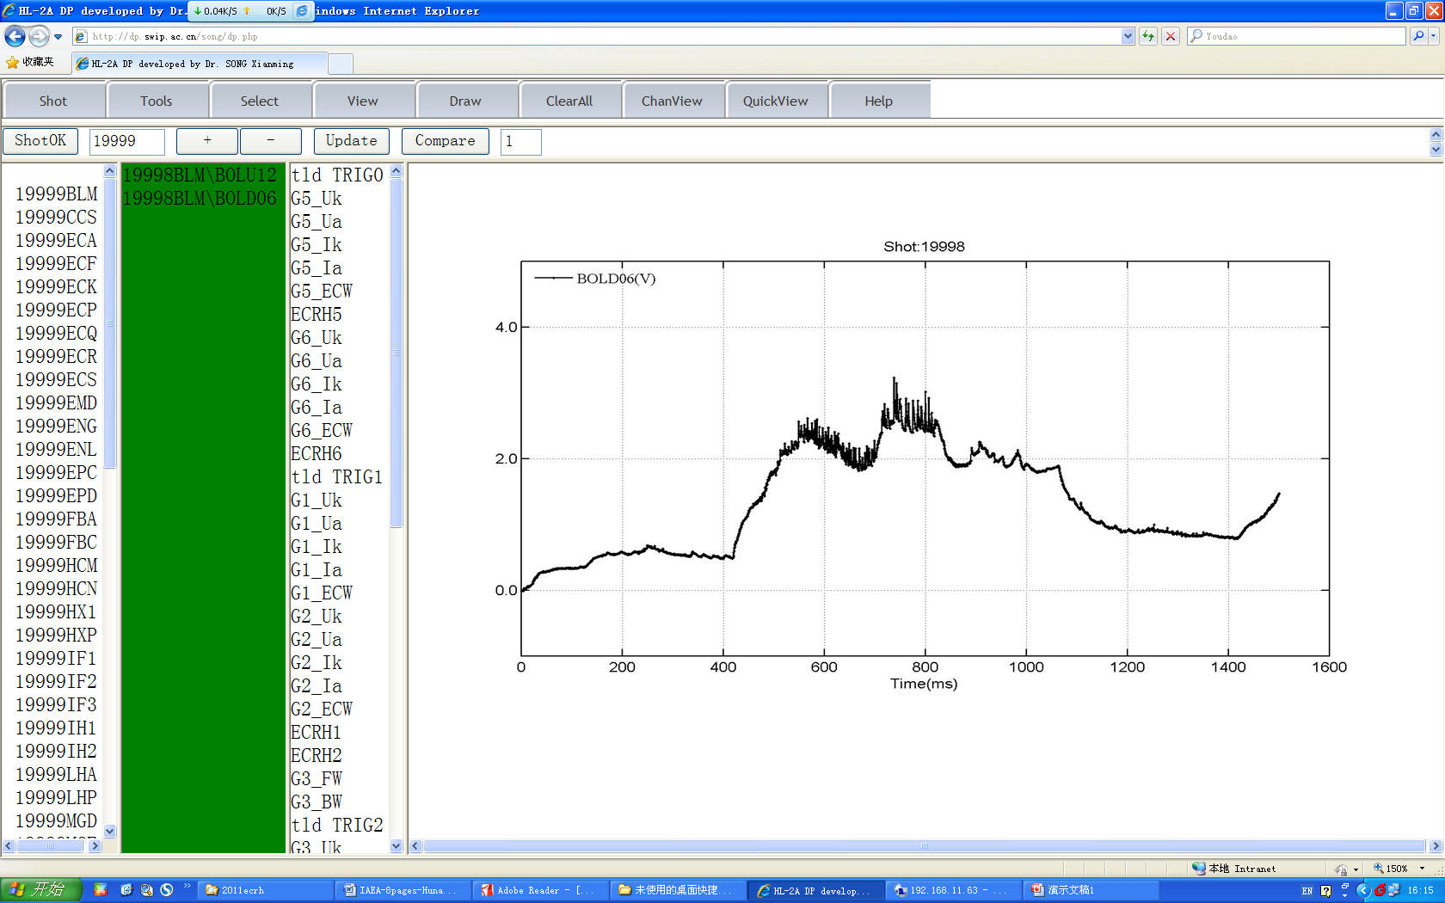
UI and functions

Slide 27
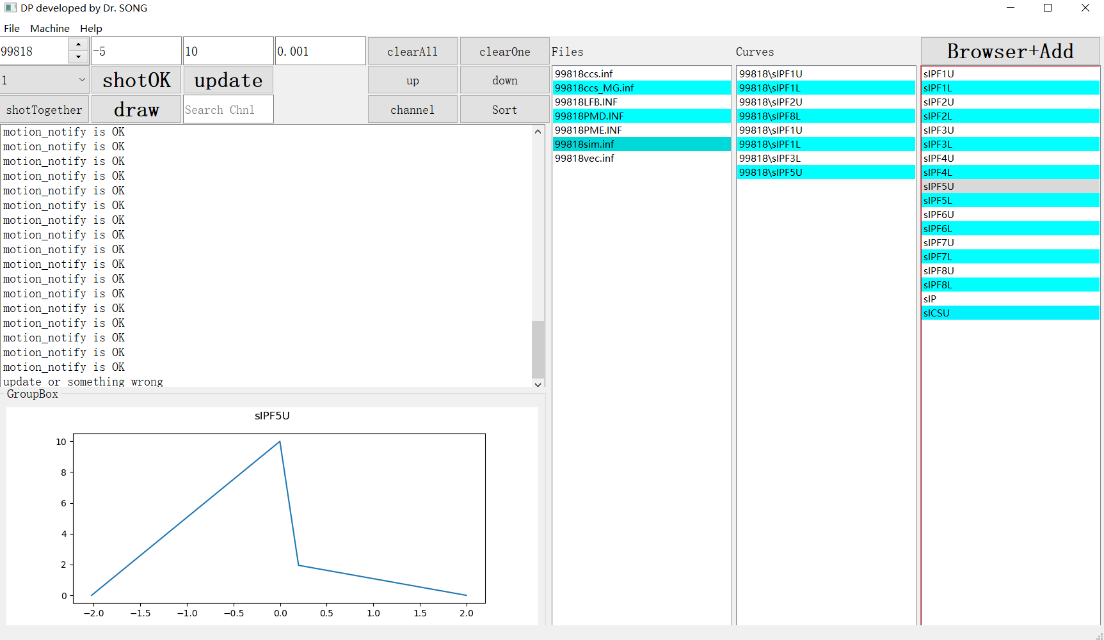
Python version

