Slide 1

Analysis of City Similarities

Slide 2
Top 10 largest US cities by populations
1. New York City, NY
2. Los Angeles, CA
3. Chicago, IL
4. Houston, TX
5. Phoenix, AZ
6. Philadelphia, PA
7. San Antonio, TX
8. San Diego, CA
9. Dallas, TX
10. San Jose, CA

Slide 3
How similar are they from one to another?
I'm curious about the similarity among them and going to cluster them using venue-based similarity measurement.
It will be useful for movers from those 10 cities to find the one that they are already familiar with and like to live.

Slide 4
Data Description and Processing workflow
Cities | Latitude | Longitude
0 | New York City, NY | 40.712728 | -74.006015
1 | Los Angeles, CA | 34.053691 | -118.242766
2 | Chicago, IL | 41.875562 | -87.624421
3 | Houston, TX | 29.758938 | -95.367697
4 | Phoenix, AZ | 33.448437 | -112.074142
5 | Philadelphia, PA | 39.952724 | -75.163526
6 | San Antonio, TX | 29.424600 | -98.495141
7 | San Diego, CA | 32.717420 | -117.162773
8 | Dallas, TX | 32.776272 | -96.796856
9 | San Jose, CA | 37.336191 | -121.890583
- The geograpical coordinate of the 10 cities
- Get the top 100 venues that are within a radius of 500 meters of each city. (Foursquare API)
Transform the venue categories to hot code for analysis convenience
Normalize the data
Calculate the Euclidean distances to show how different the 10 cities are from each other.

Slide 5
One column example from Distance Matrix
 | Cities | Difference
4 | New York City, NY | 0.000000
1 | Dallas, TX | 6.836431
7 | San Antonio, TX | 6.843296
2 | Houston, TX | 7.042819
6 | Phoenix, AZ | 7.059759
3 | Los Angeles, CA | 7.160766
0 | Chicago, IL | 7.287910
5 | Philadelphia, PA | 7.643115
9 | San Jose, CA | 7.736015
8 | San Diego, CA | 7.758686
The most similar city to New York is Dallas, TX

Slide 6
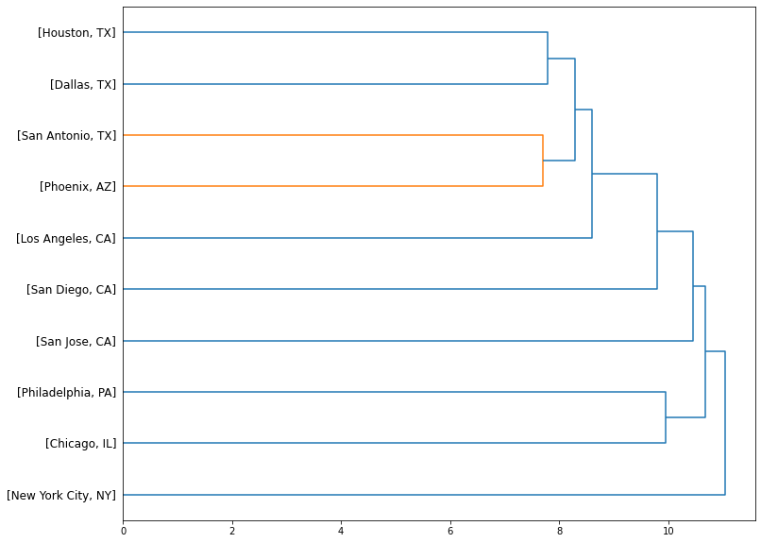
Clustering the cities using scikit-learn

Slide 7
Conclusion
The Hierarchical Clustering of the top 10 cities show us the similarities among cities.
It will be useful for movers from those 10 cities to find the one that they are already familiar with and like to live. For example, I’m now living in Houston, TX. I find that Dallas, TX is very similar to Houston, TX. If I can find a better job in Dallas, I won’t hesitate to move there.

