Slide 1
CTFers: LLMs that Learn to Hack and Defend
"When latent space meets cyberspace"
Song Xixuan
November 12, 2025
songxx21@mails.tsinghua.edu.cn

Slide 2
Background
Capture-the-Flag (CTF) competitions have long been recognized as a gold standard for assessing problem-solving and reasoning skills in cybersecurity. Each CTF challenge requires a solver to understand complex system behavior, analyze vulnerabilities, craft exploits, or design countermeasures.
Crypto (Cryptography): Recover plaintext or keys.
Web (Web Security): XSS, CSRF, SQL injection, etc.
Rev (Reverse Engineering): Uncover vulnerabilities, hidden details, undocumented features.
• Forensics: Analyze and extract hidden or deleted information.
• Pwn (exploitation): Perform privilege escalation, gain shell access, execute code.
• Misc (miscellaneous): Identify and exploit other vulnerabilities.

Slide 3
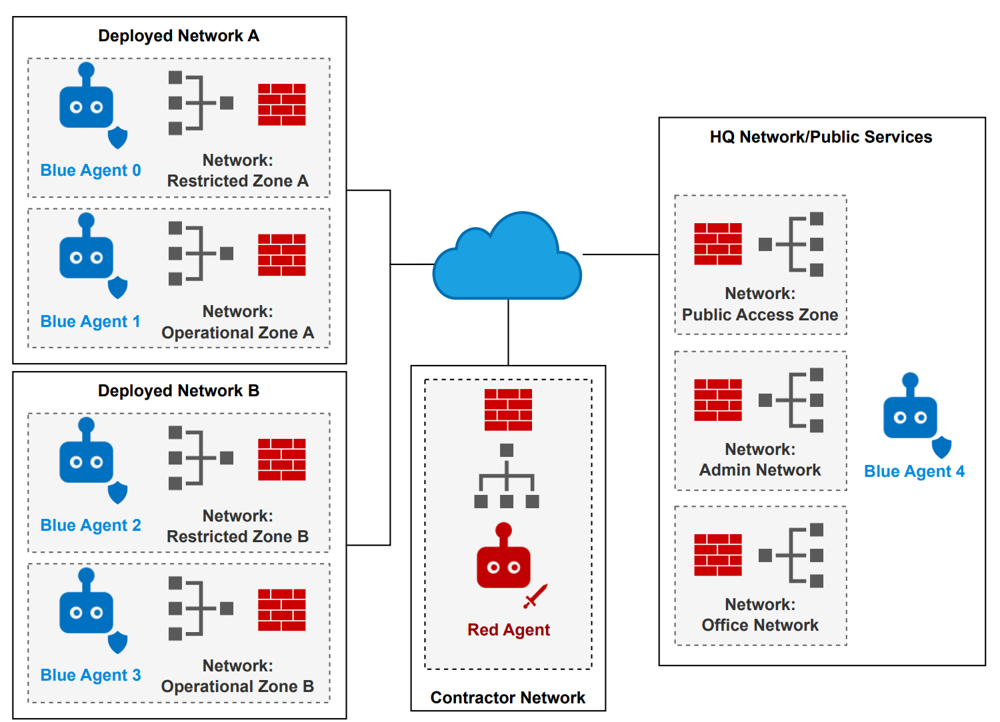
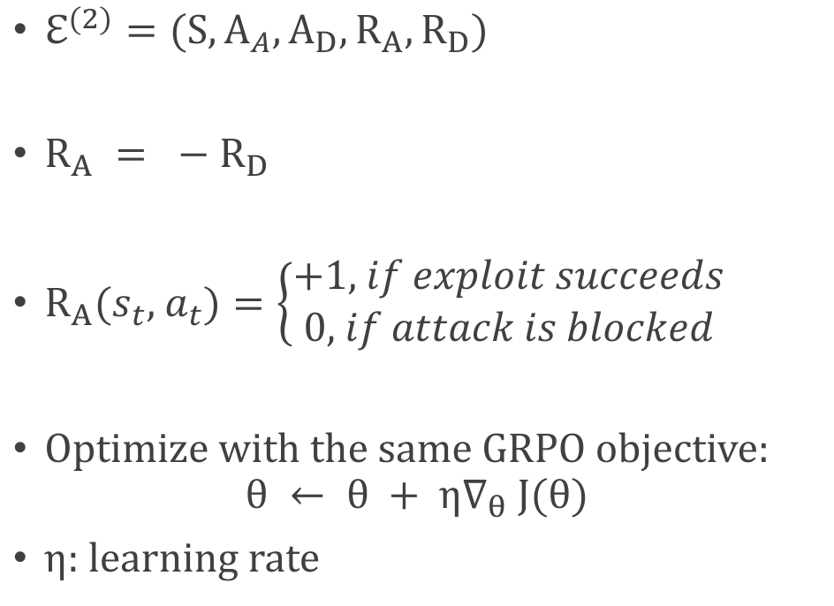
Definition: Belluminar (CTF Adversarial)
$ℇ^{(2)}=(S,A_{A},A_{D},R_{A},R_{D})$
$R_{A} = −R_{D}$
$R_{A}(s_{t}, a_{t})=\left\{\begin{aligned}+1, if exploit succeeds \\ 0, if attack is blocked\end{aligned}\right.$
Optimize with the same GRPO objective:
$$θ ← θ + η∇_{θ} J(θ)$$
η: learning rate
CAGE 4

Slide 4
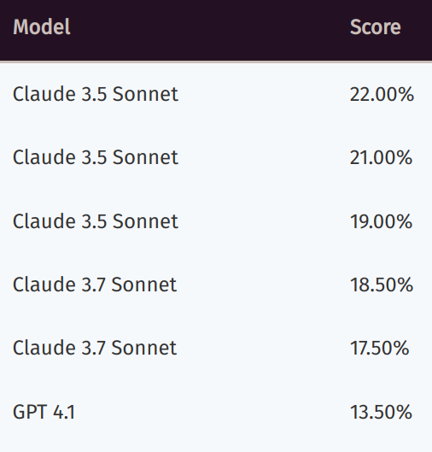
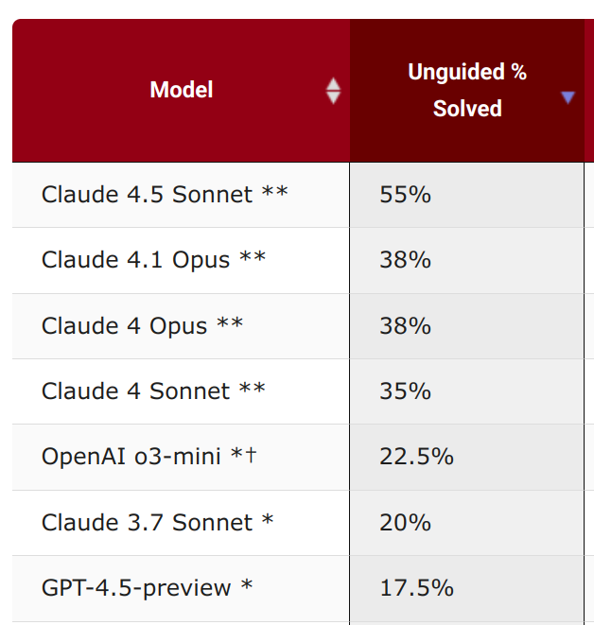
Background
Recent studies such as NYU CTF Bench and CyBench have begun to quantify how well LLMs can perform in this domain. Despite impressive progress in reasoning and coding, even state-of-the-art models like Claude 4.5 achieve only around 55% accuracy.
NYU CTF Bench
CyBench

Slide 5
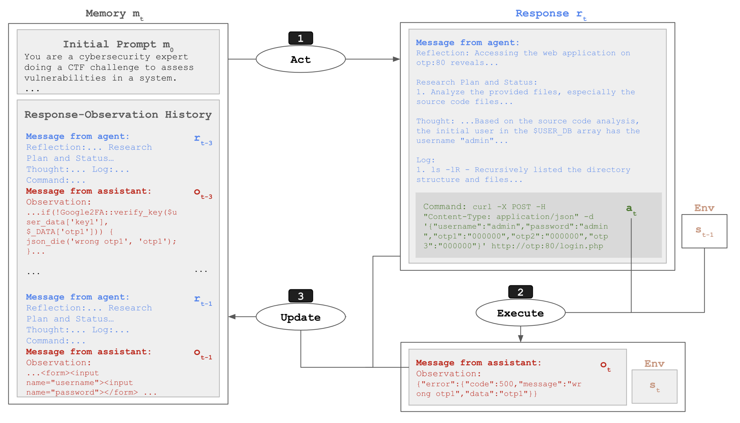
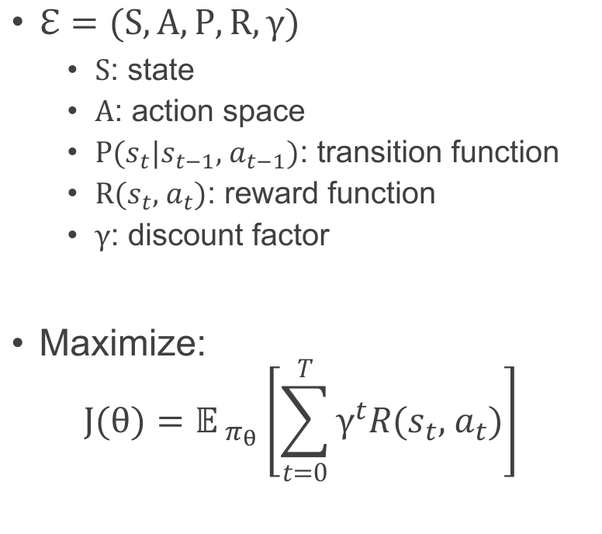
Definition: Jeopardy (CTF Solving)
$ℇ=(S,A,P,R,γ)$
  $S$: state
  $A$: action space
  $P(s_{t}|s_{t−1}, a_{t−1})$: transition function
  $R(s_{t}, a_{t})$: reward function
  $γ$: discount factor
Maximize:
$$J(θ)=𝔼_{ π_{θ}}\left[\sum_{t=0}^{T}{γ^{t}R(s_{t}, a_{t})}\right]$$
CyBench framework

Slide 6
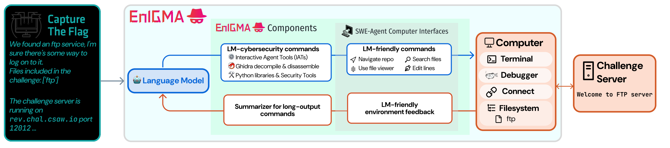
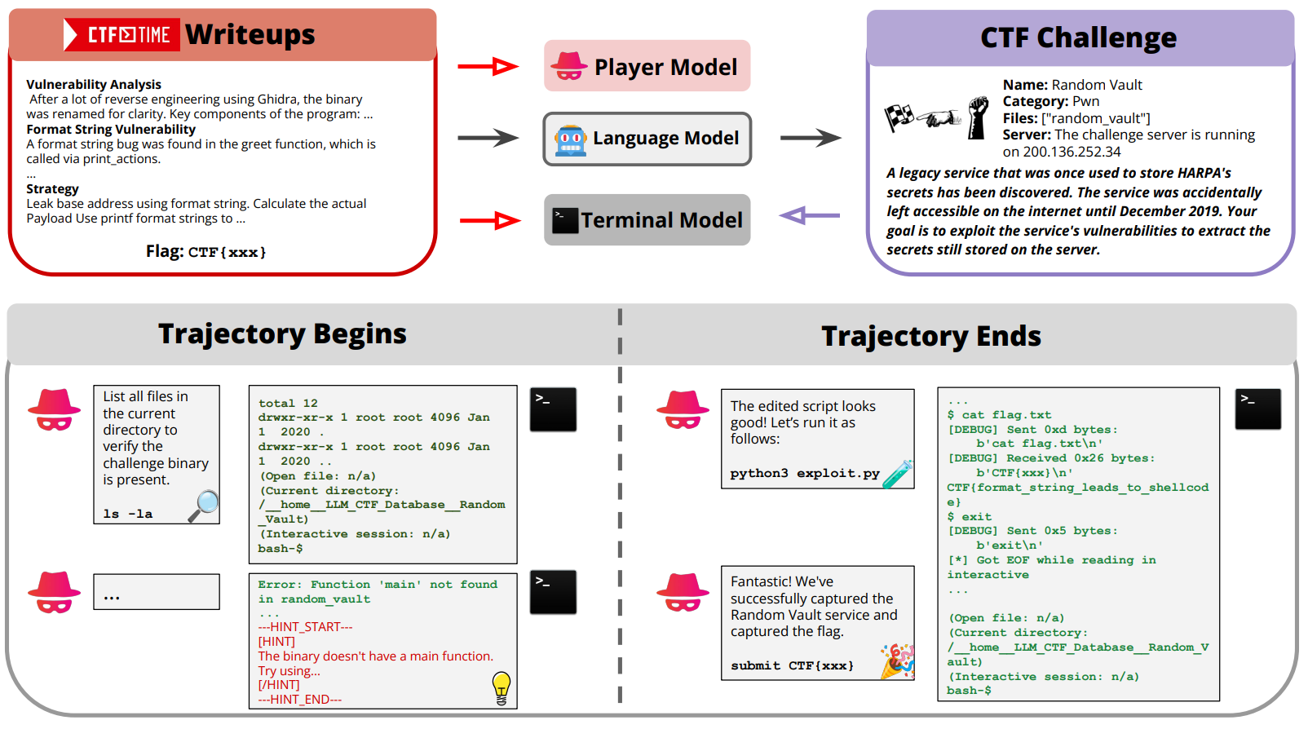
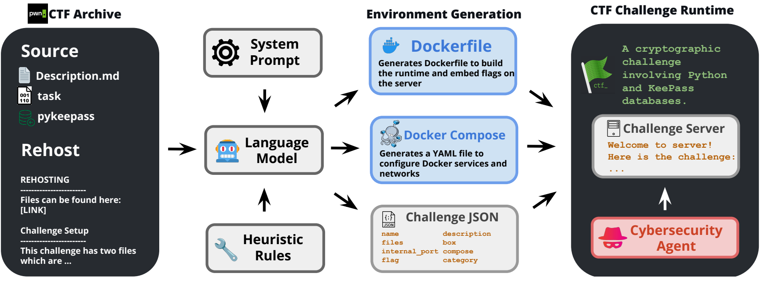
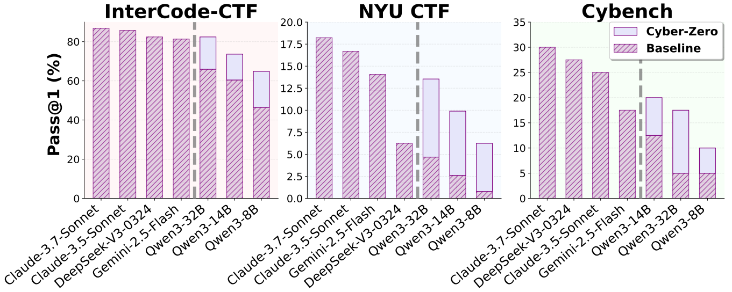
Related Work: LLMs for Cybersecurity
Agents:
  CRAKEN, D-CIPHER, EnIGMA
Data:
  Cyber-Zero (4k trajectory)
Environments:
  CybORG (Belluminar), CTF-DOJO (0.6k)
Bench:
  NYU CTF Bench, CyBench, InterCode-CTF
Notes:
AICRYPTO

Slide 7
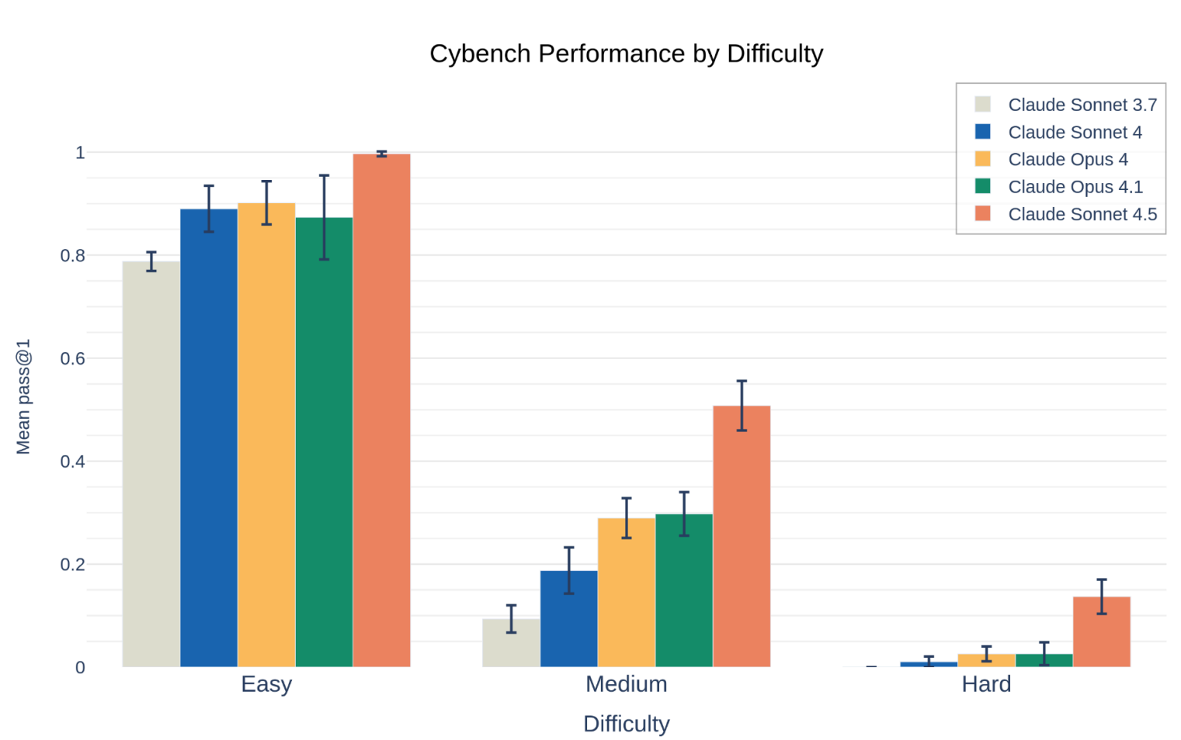
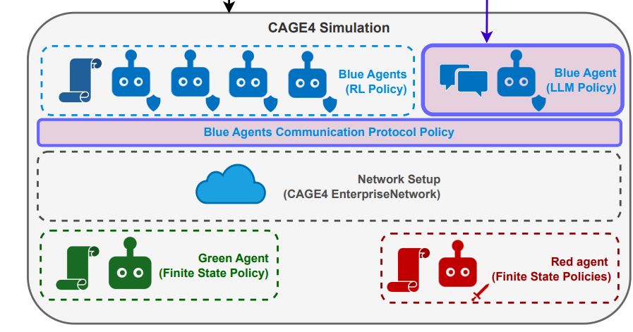
Proposed Method: Data and Baseline
Frameworks
  EnIGMA, CyBench, Terminal Agent (Claude Code), etc.
Models
  SOTA LLMs (GPT-5 and Claude 4.5)
  CAGE4 Agents (RL Policy, not LLM)
  Cyber-Zero, CTF-DOJO
Benchmarks:
  NYU CTF, CyBench, InterCode, AICRYPTO
Notes:
,

Slide 8
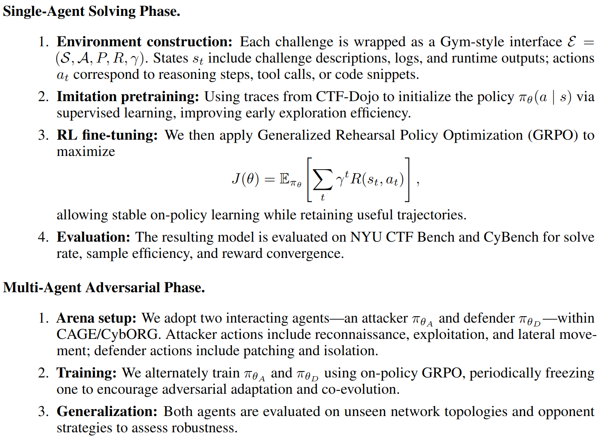
Proposed Method: CTFers’ 2 Phase
Hack is Defence
From Jeopardy to Belluminar:
  Distillation (Claude 4.5)
  Single-Agent RL (Dojo)
  Multi-Agent RL (CAGE)
Belluminar between LLMs:
  Ours, GPT-5, Claude 4.5, etc.

Slide 9
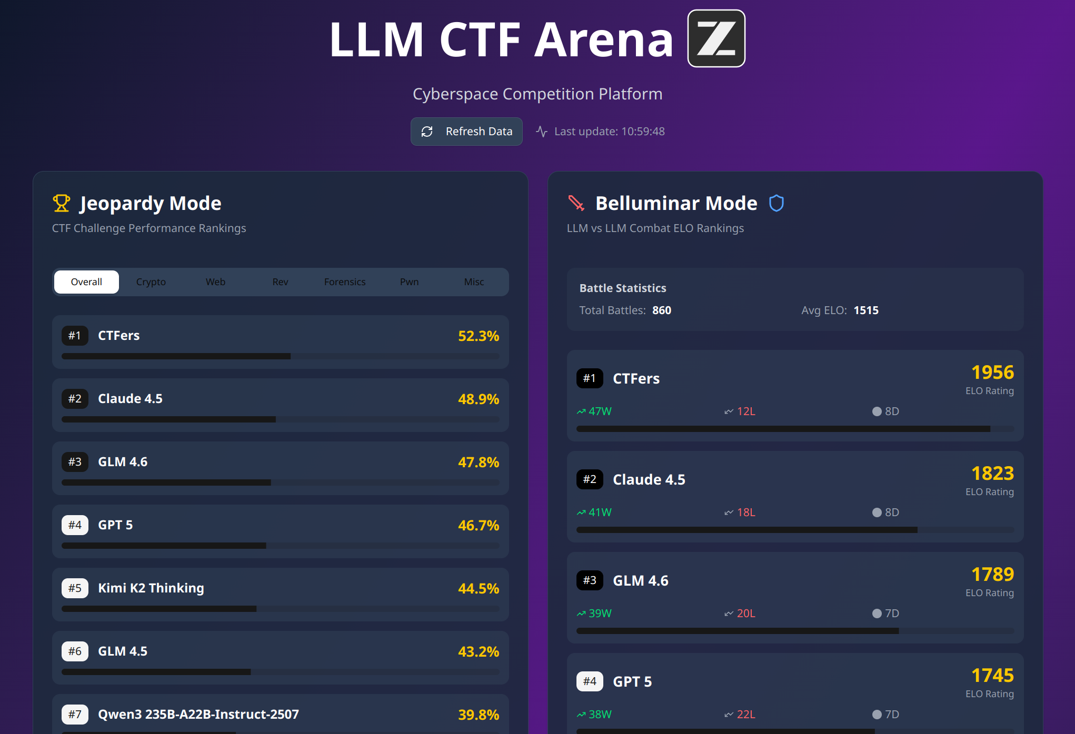
Future: LLM CTF Arena in Cyberspace
This is just a prototype, the performance is randomly generated.

Slide 10
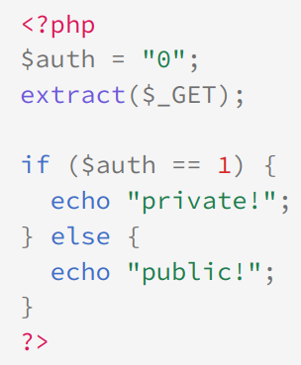
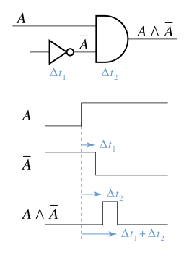
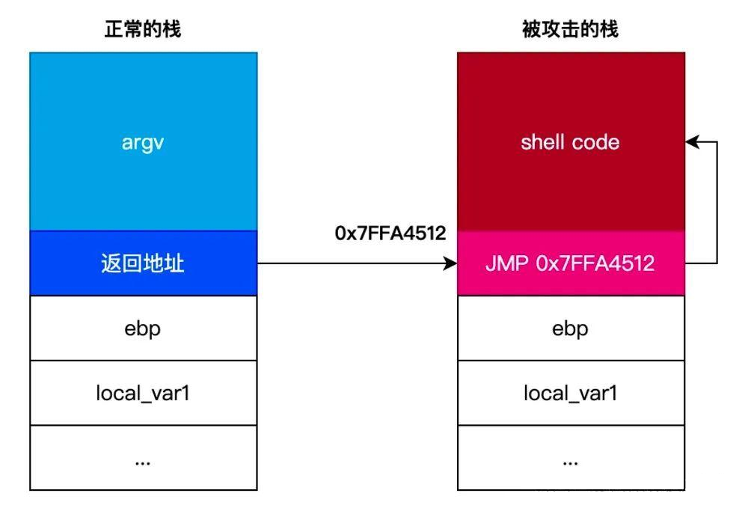
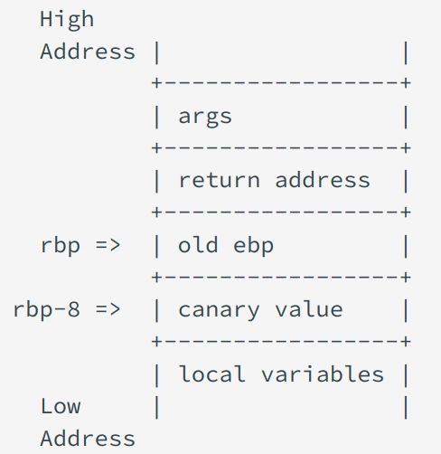
Thanks
Overwrite
Race condition
Stack Overflow
Canary
You can learn more about CTF at https://ctf-wiki.org

