Slide 1
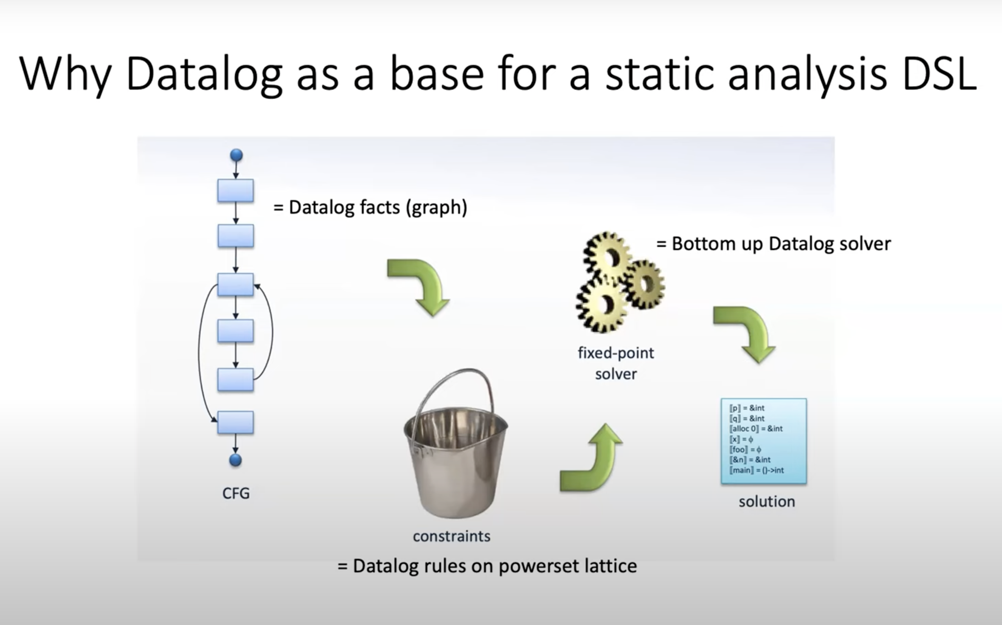
Notes:
https://www.youtube.com/watch?v=mHVIdHLp9ZQ

Slide 2
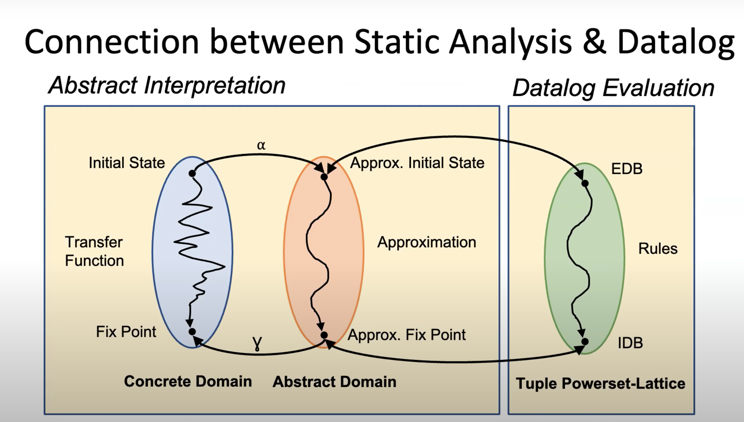

Slide 3
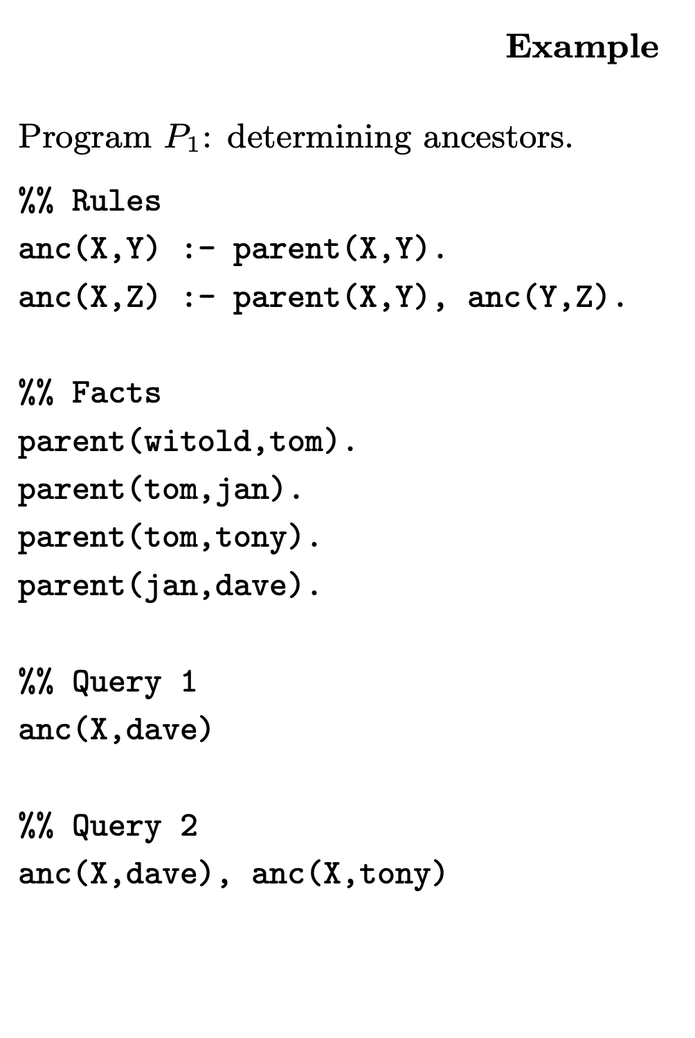
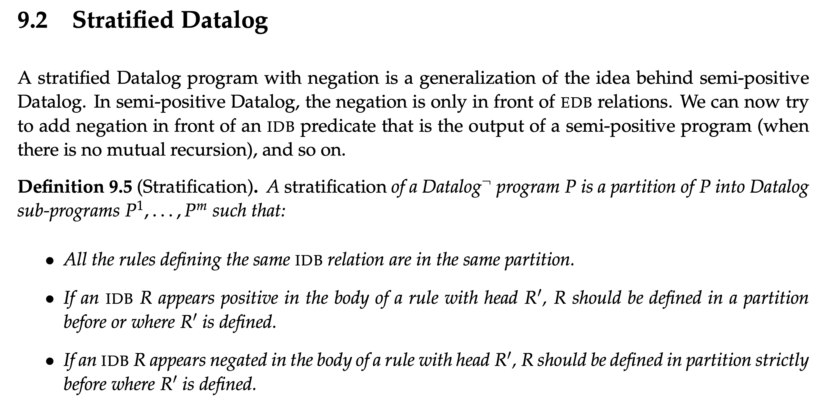
Notes:
https://cse.buffalo.edu/~chomicki/636/datalog-h.pdf
https://pages.cs.wisc.edu/~paris/cs784-s17/lectures/lecture9.pdf

Slide 4
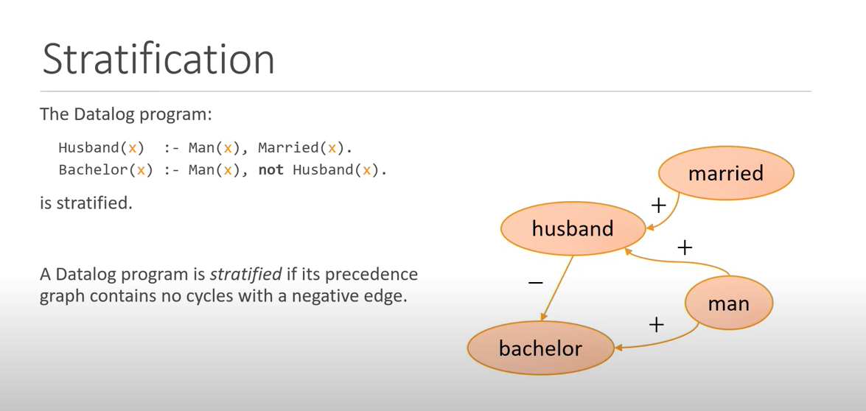
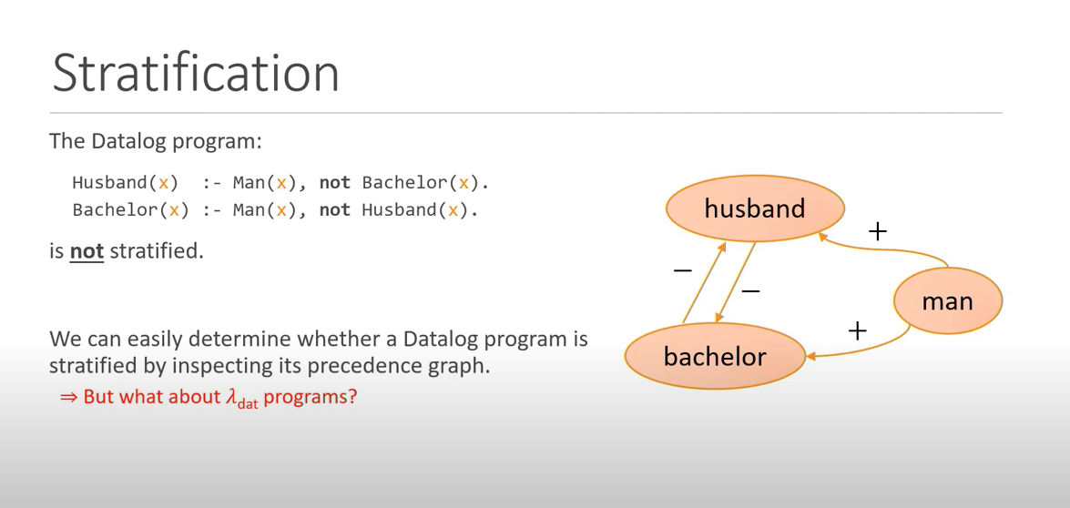
Notes:
Fixpoints for the Masses: Programming with First-Class Datalog Constraints
https://www.youtube.com/watch?v=ikVZrivln8c

Slide 5
branching time temporal logic property AGEFp
The fixed-point semantics of this property will be: gfp X. ( lfp Y.( p OR <-> Y) AND [-] X) agefp(S) :- not n_agefp(S). n_agefp(S) :- not efp(S). n_agefp(S) :- transition(S, T), n_agefp(T). efp(S) :- p(S). efp(S) :- transition(S, T), efp(T).
Forall p = not exist (not p)
agefp(S) :- not n_gefp(S). n_gefp(S) :- n_fp(S). efp(S) :- p(S). efp(S) :- transition(S, T), efp(T).
Notes:
where <-> means there exists an action and [-] means for all actions. In Datalog stratified, you can encode via predicates like
// for all path globally Efp
// exists a path which NOT globally Efp
AGEF -> Recovery problem.
Non starvation

Slide 6
Possible framework
Have user-defined rules for generating propositions as facts
we define a set of rules, as a Datalog library.
Different queries have different repair strategy:
EF(p_bad): to fix till it does not return and results.
What is the difficulty to deal with the stratified negation?

Slide 7
char* strcpy(char* destination, const char* source);
Note: When you use strcpy(), the size of the destination string should be large enough to store the copied string. Otherwise, it may result in undefined behavior.

Slide 8
Summary
Follow up work for the Datalog-based repair, Liu Yu, Sergey.
Currently: for NPE (in Java) and data leak (In python), the rules are negation free.
Final Goal: targeting on CTL bugs, which can be described using stratified negation, targeting temporal bugs or bugs which can be described using temporal properties.
Difficulties/novelty: constraint generating with rules using negation, and the facts generation for precise and lightweight temporal analysis.
Possible App: user-after-free, memory leak, buffer overflow, data race, protocol propositions.
Next step: user-defined fact generation schema, and the rules for detecting bugs.

