Slide 1
Datalog – CTL properties Analysis & Repair
-- A blueprint of this project
For the meeting on 14th July 2023

Slide 2
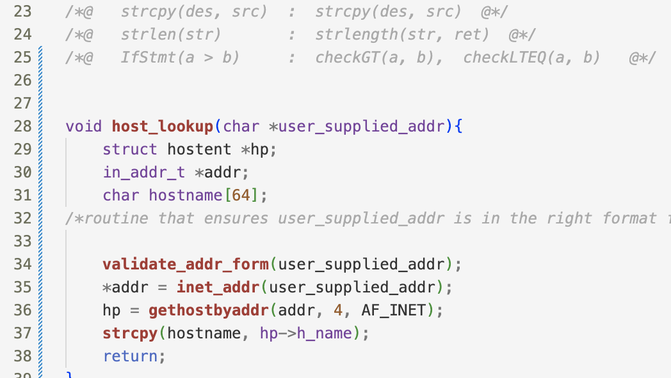
CWE-121: Stack-based Buffer Overflow
https://cwe.mitre.org/data/definitions/121.html
Facts Generation Schema
Possible Buggy Code

Slide 3
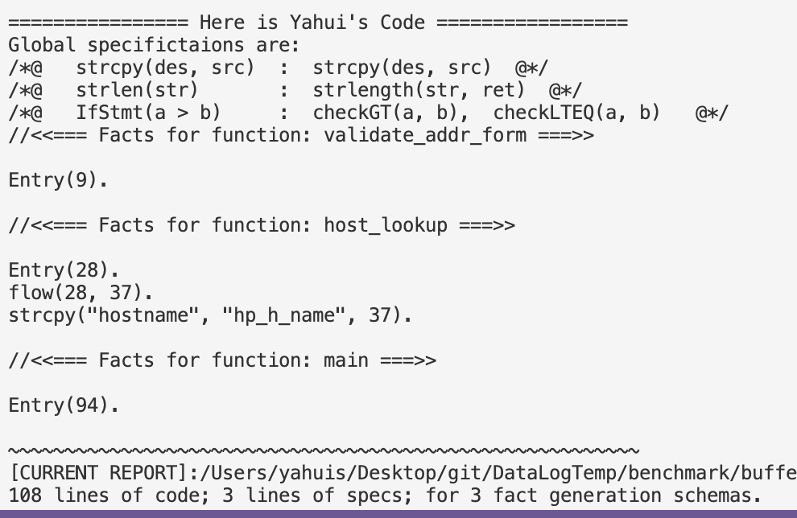

CWE-121: Stack-based Buffer Overflow
https://cwe.mitre.org/data/definitions/121.html

Slide 4
Datalog Rules for Buffer Overflow
NotBuffer_Overflow(des, src, l3) :- strcpy(des, src, l3),
transFlow(l2, l3), checkGT(a, b, l2), strlength(des, a, _),strlength(src, b, _),
transFlow(l1, l2), Entry (l1).
Buffer_Overflow (des, src, l) :- strcpy(des, src, l), ! NotBuffer_Overflow(des, src, l).
FinallyBuffer_Overflow (x) :- Buffer_Overflow (_, _, x).
FinallyBuffer_Overflow (x) :- transFlow(x, loc), Buffer_Overflow (_, _, loc).
AG_NotBuffer_Overflow(x) :- Entry(x), ! FinallyBuffer_Overflow(x).
Rules with Temporal Operators can
be generated automatically !
Query: AG(NotBuffer_Overflow)

Slide 5
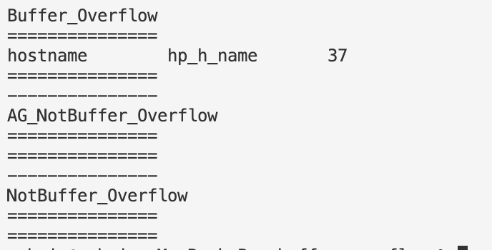
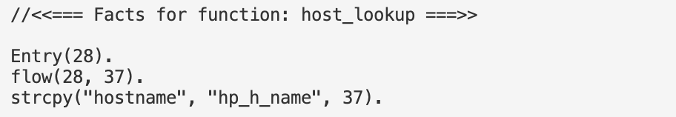
Test it out!

Slide 6
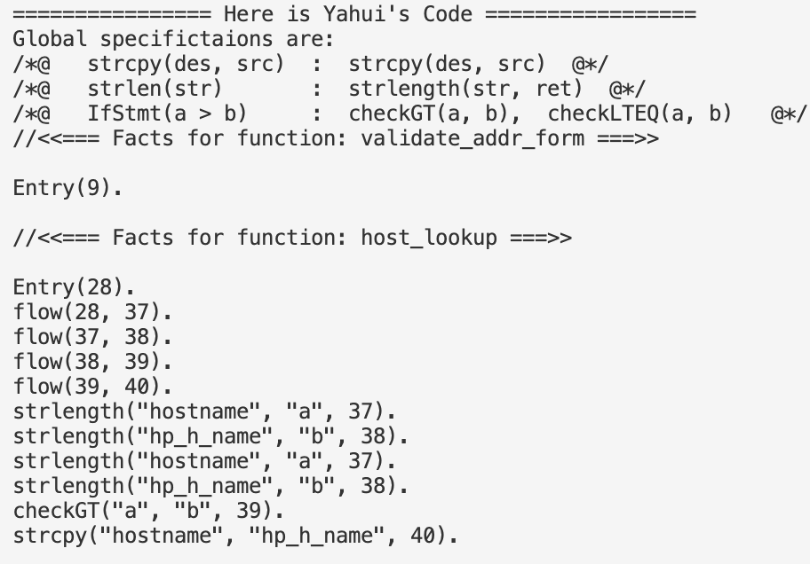
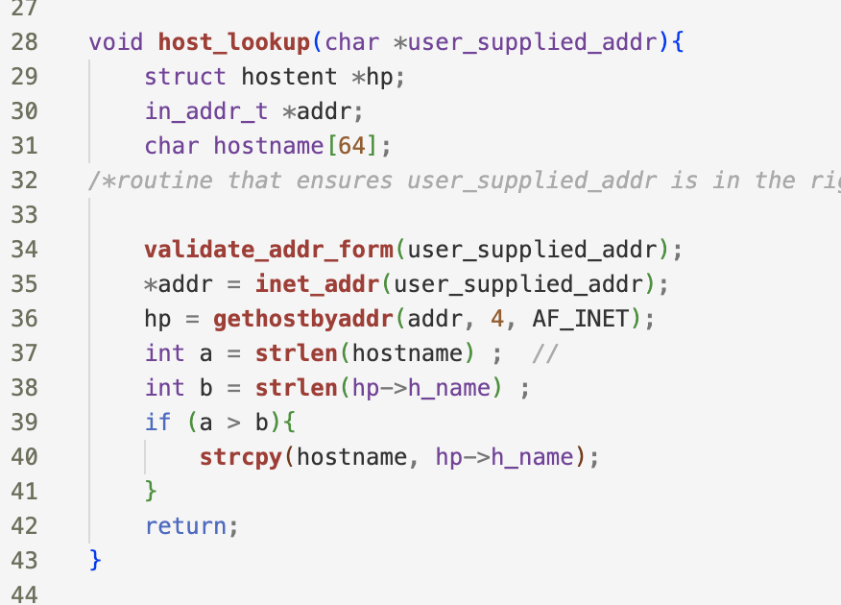
Correct Case

Slide 7
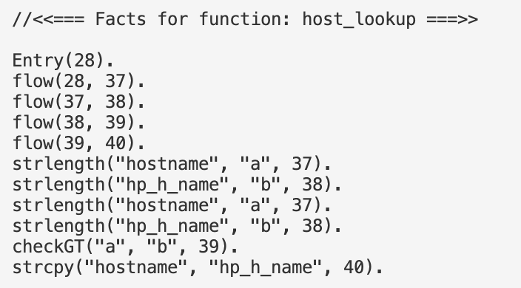
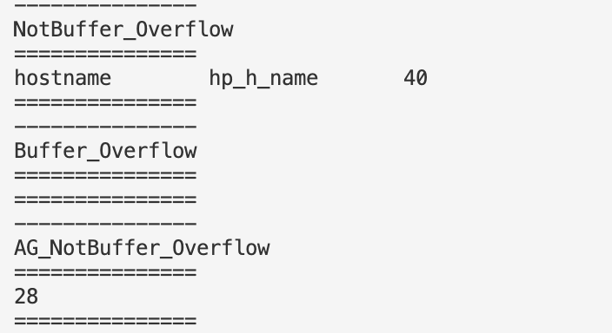
Test it out!

Slide 8
Test it out!
The repair work

Slide 9
The repair work
NotBuffer_Overflow(des, src, l3) :- strcpy(des, src, l3),
transFlow(l2, l3), checkGT(a, b, l2), strlength(des, a, _),strlength(src, b, _),
transFlow(l1, l2), Entry (l1).
Buffer_Overflow (des, src, l) :- strcpy(des, src, l), ! NotBuffer_Overflow(des, src, l).
FinallyBuffer_Overflow (x) :- Buffer_Overflow (_, _, x).
FinallyBuffer_Overflow (x) :- transFlow(x, loc), Buffer_Overflow (_, _, loc).
AG_NotBuffer_Overflow(x) :- Entry(x), ! FinallyBuffer_Overflow(x).
Target is + AG_NotBuffer_Overflow(28)
➔ - FinallyBuffer_Overflow(28)

Slide 10
The repair work
NotBuffer_Overflow(des, src, l3) :- strcpy(des, src, l3),
transFlow(l2, l3), checkGT(a, b, l2), strlength(des, a, _),strlength(src, b, _),
transFlow(l1, l2), Entry (l1).
Buffer_Overflow (des, src, l) :- strcpy(des, src, l), ! NotBuffer_Overflow(des, src, l).
FinallyBuffer_Overflow (x) :- Buffer_Overflow (_, _, x).
FinallyBuffer_Overflow (x) :- transFlow(x, loc), Buffer_Overflow (_, _, loc).
AG_NotBuffer_Overflow(x) :- Entry(x), ! FinallyBuffer_Overflow(x).
Target is + AG_NotBuffer_Overflow(28)
- FinallyBuffer_Overflow(28)
➔ - Buffer_Overflow (_, _, 37)

Slide 11
The repair work
NotBuffer_Overflow(des, src, l3) :- strcpy(des, src, l3),
transFlow(l2, l3), checkGT(a, b, l2), strlength(des, a, _),strlength(src, b, _),
transFlow(l1, l2), Entry (l1).
Buffer_Overflow (des, src, l) :- strcpy(des, src, l), ! NotBuffer_Overflow(des, src, l).
FinallyBuffer_Overflow (x) :- Buffer_Overflow (_, _, x).
FinallyBuffer_Overflow (x) :- transFlow(x, loc), Buffer_Overflow (_, _, loc).
AG_NotBuffer_Overflow(x) :- Entry(x), ! FinallyBuffer_Overflow(x).
Target is + AG_NotBuffer_Overflow(28)
- FinallyBuffer_Overflow(28)
- Buffer_Overflow (_, _, 37)
➔ + NotBuffer_Overflow(_, _, 37)

Slide 12
The repair work
Will this be able to be handled by the existing work?
NotBuffer_Overflow(des, src, l3) :- strcpy(des, src, l3),
transFlow(l2, l3), checkGT(a, b, l2), strlength(des, a, _),strlength(src, b, _),
transFlow(l1, l2), Entry (l1).
Buffer_Overflow (des, src, l) :- strcpy(des, src, l), ! NotBuffer_Overflow(des, src, l).
FinallyBuffer_Overflow (x) :- Buffer_Overflow (_, _, x).
FinallyBuffer_Overflow (x) :- transFlow(x, loc), Buffer_Overflow (_, _, loc).
AG_NotBuffer_Overflow(x) :- Entry(x), ! FinallyBuffer_Overflow(x).
Target is + AG_NotBuffer_Overflow(28)
- FinallyBuffer_Overflow(28)
- Buffer_Overflow (_, _, 37)
➔ + NotBuffer_Overflow(_, _, 37)

Slide 13
Overview and Workload
User inputs:
F = Fact generation schema
R = Specific reasoning rules
T = Temporal properties queries upon R
E.g., F (R), G (R), AF (R), R1 U R2, AGEF (R) ….
If T failed to hold: Use symbolic execution for Datalog to +/- facts to make T hold.
0. IDB rules propagation to deal with the negations.
1. Translating to meta-program
2. Generate symbolic formulae
3. Constraints generation use delta-debugging
Run Souffle

Slide 14
Overview and Workload
User inputs:
F = Fact generation schema
R = Specific reasoning rules
T = Temporal properties queries upon R
E.g., F (R), G (R), AF (R), R1 U R2, AGEF (R) ….
If T failed to hold: Use symbolic execution for Datalog to +/- facts to make T hold.
0. IDB rules propagation to deal with the negations.
1. Translating to meta-program
2. Generate symbolic formulae
3. Constraints generation use delta-debugging
Run Souffle
Questions:
Related work: Doop, Datalog-based analysis (?), model checking …
Why is that so important to generate facts by ourselves? Less hard-coded complication and more efficient.
<< The last slide >>

Slide 16
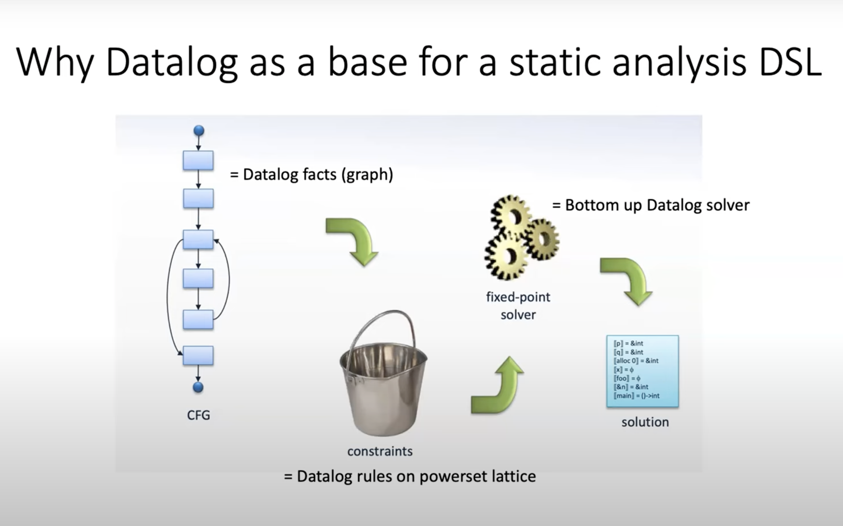
Notes:
https://www.youtube.com/watch?v=mHVIdHLp9ZQ

Slide 17
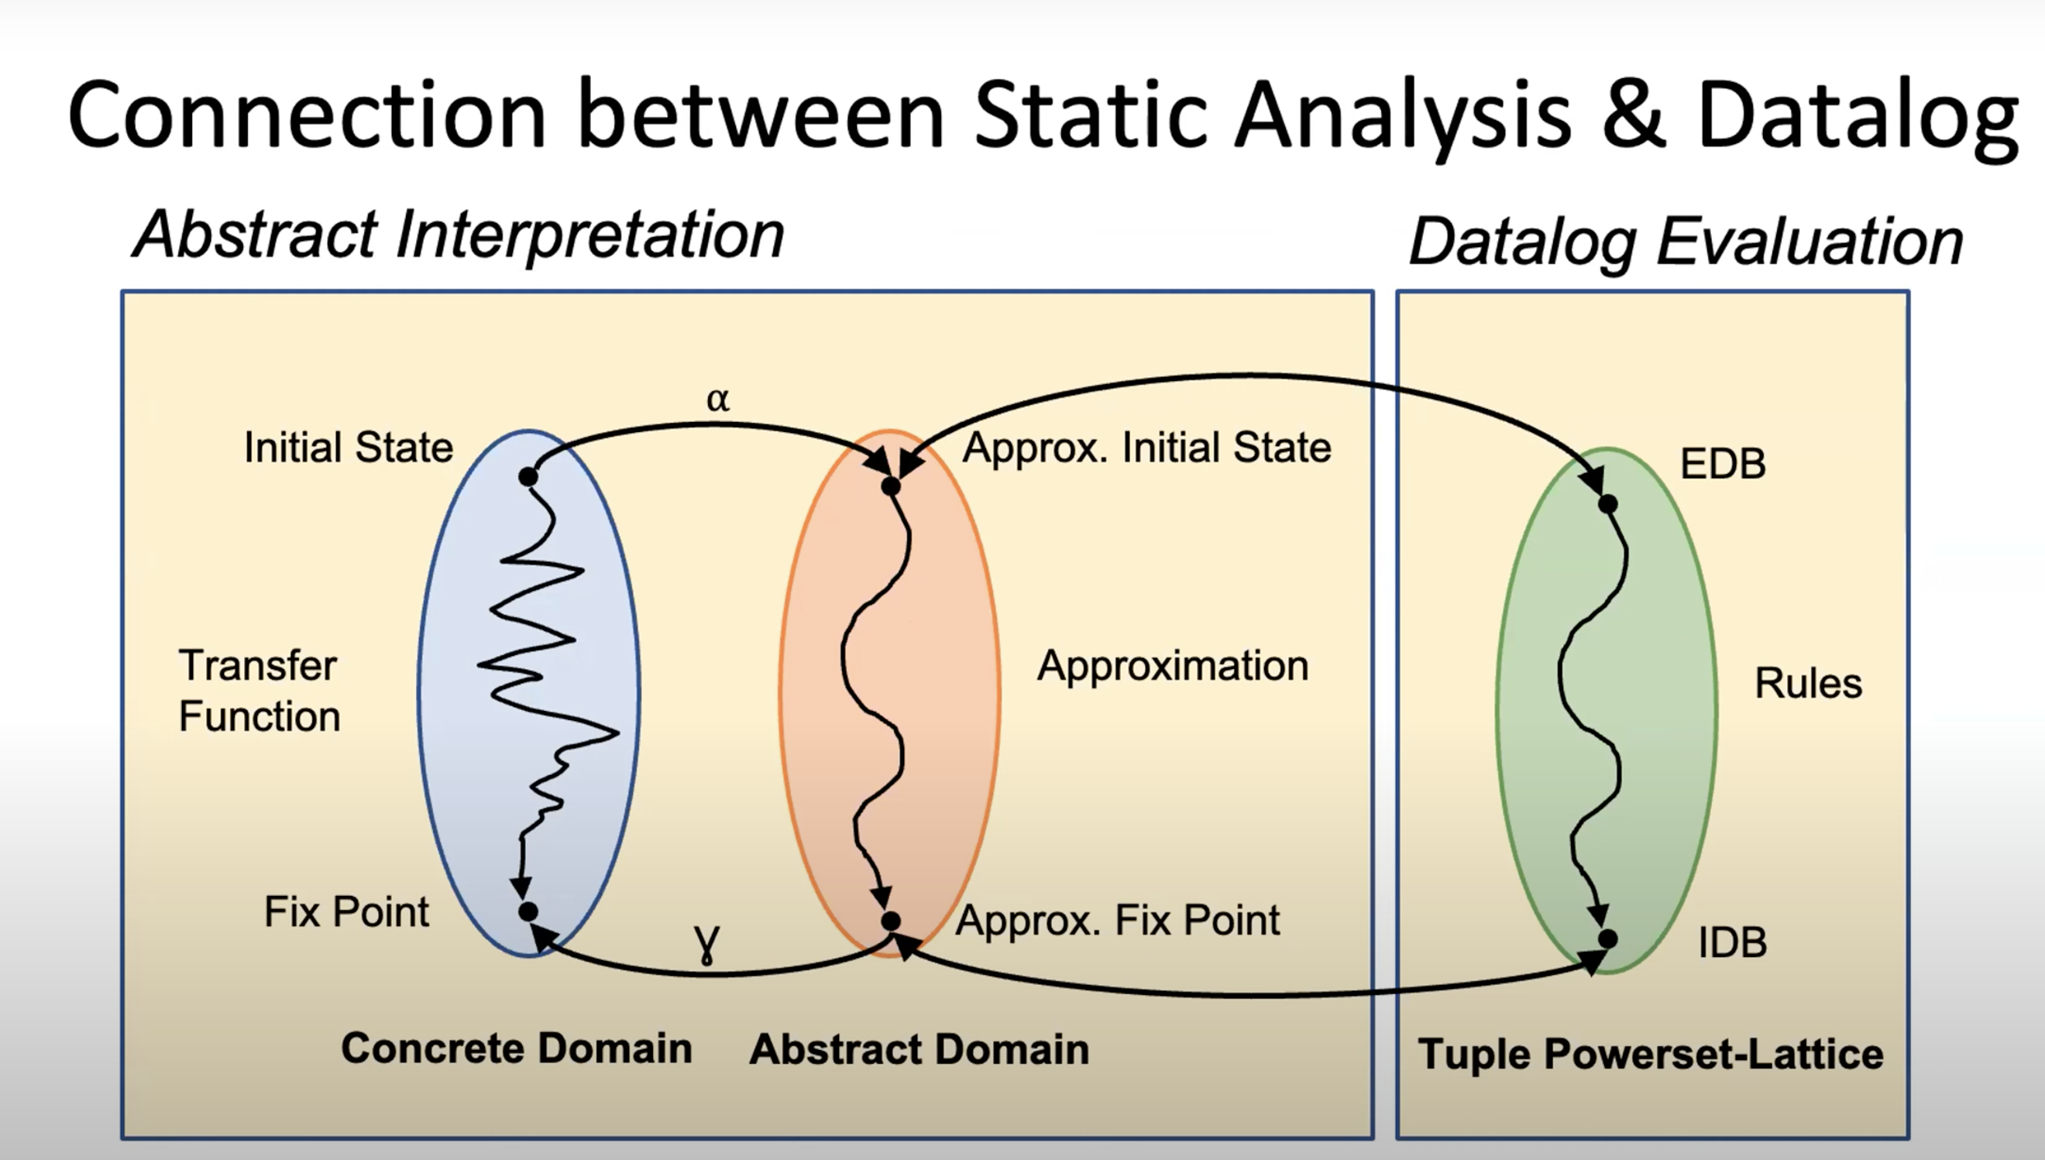

Slide 18
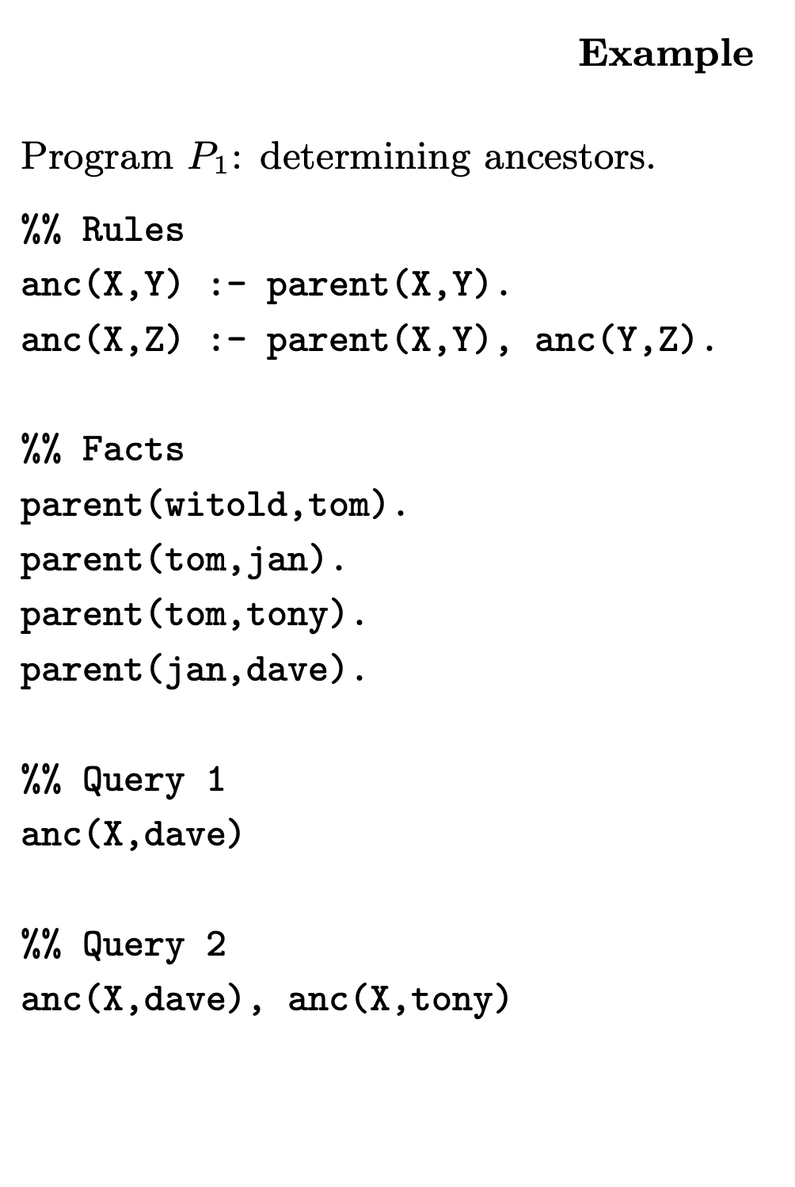
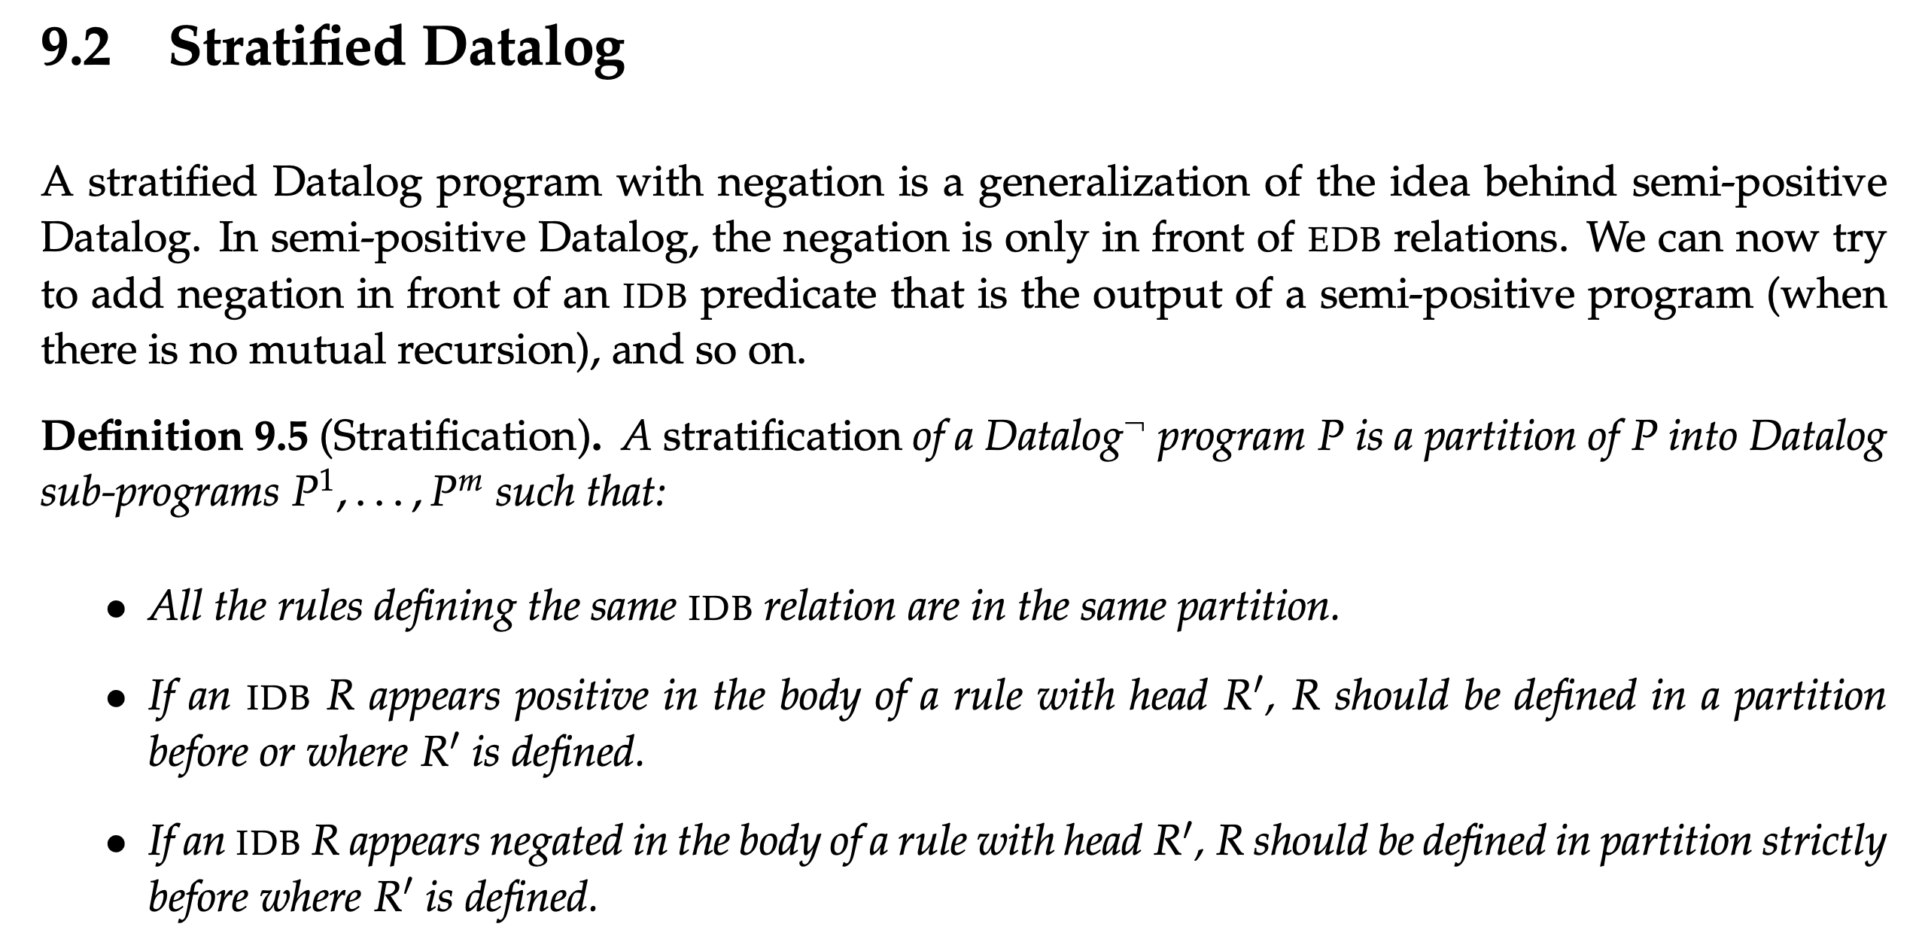
Notes:
https://cse.buffalo.edu/~chomicki/636/datalog-h.pdf
https://pages.cs.wisc.edu/~paris/cs784-s17/lectures/lecture9.pdf

Slide 19
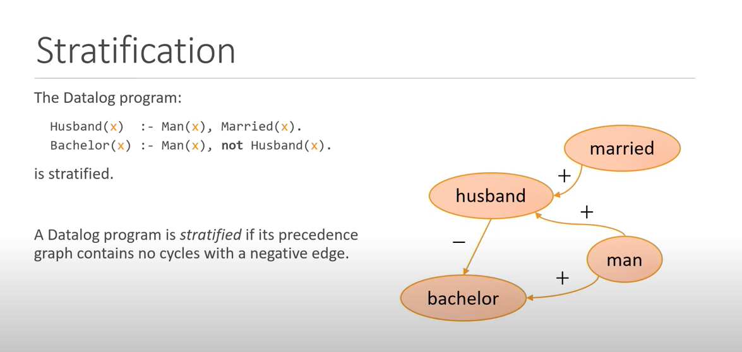
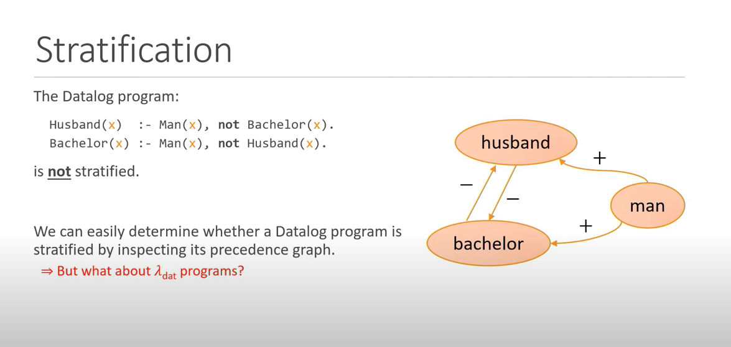
Notes:
Fixpoints for the Masses: Programming with First-Class Datalog Constraints
https://www.youtube.com/watch?v=ikVZrivln8c

Slide 20
branching time temporal logic property AGEFp
The fixed-point semantics of this property will be: gfp X. ( lfp Y.( p OR <-> Y) AND [-] X) agefp(S) :- not n_agefp(S). n_agefp(S) :- not efp(S). n_agefp(S) :- transition(S, T), n_agefp(T). efp(S) :- p(S). efp(S) :- transition(S, T), efp(T).
Forall p = not exist (not p)
agefp(S) :- not n_gefp(S). n_gefp(S) :- n_fp(S). efp(S) :- p(S). efp(S) :- transition(S, T), efp(T).
Notes:
where <-> means there exists an action and [-] means for all actions. In Datalog stratified, you can encode via predicates like
// for all path globally Efp
// exists a path which NOT globally Efp
AGEF -> Recovery problem.
Non starvation

Slide 21
Possible framework
Have user-defined rules for generating propositions as facts
we define a set of rules, as a Datalog library.
Different queries have different repair strategy:
EF(p_bad): to fix till it does not return and results.
What is the difficulty to deal with the stratified negation?

Slide 22
char* strcpy(char* destination, const char* source);
Note: When you use strcpy(), the size of the destination string should be large enough to store the copied string. Otherwise, it may result in undefined behavior.

Slide 23
User inputs:
F = Fact generation schema
R = Specific reasoning rules
T = Temporal properties Queries upon R
E.g., F (R), G (R), AF (R), R1 U R2, AGEF (R) ….
Yahui
If T failed to hold:
Use symbolic execution for Datalog to insert/delete facts to make T hold.
1. Translating to meta-program
2. Generate symbolic formulae
3. Constraints generation use delta-debugging
Liu Yu
Current TODO:
Find bug types (also benchmark) which can be encoded as R and T.
Fixe the current constraint generation process to support negations. (delta-debugging?)
Engineer: generate runnable .dl files from the user input
Supporting difference statement patterns, type check, libraries, etc.

Slide 24
Summary
Follow up work for the Datalog-based repair, Liu Yu, Sergey.
Currently: for NPE (in Java) and data leak (In python), the rules are negation free.
Final Goal: targeting on CTL bugs, which can be described using stratified negation, targeting temporal bugs or bugs which can be described using temporal properties.
Difficulties/novelty: constraint generating with rules using negation, and the facts generation for precise and lightweight temporal analysis.
Possible App: user-after-free, memory leak, buffer overflow, data race, protocol propositions.
Next step: user-defined fact generation schema, and the rules for detecting bugs.

