Slide 1



Automated Timed Temporal Verification for a Mixed Sync-Async Concurrency Paradigm
Yahui Song and Wei-Ngan Chin
School of Computing, NUS
@Computing Research Week 2021
Notes:
Hello, everyone, my name is Yahui Song, I am soon becoming a 4th year PhD students. I am generally interested in program verification and temporal logics. Before I get started, I need to thank my fellow students for their efforts and time this research week, I am happy to present my ongoing project, which is also a joint work with my supervisor, Prof. Chin Wei Ngan.

Slide 2
Automated Timed Temporal Verification for a Mixed Sync-Async Concurrency Paradigm
Yahui Song and Wei-Ngan Chin
School of Computing, NUS
@Computing Research Week 2021
Hiphop.js = Esterel + JS
Notes:
Alright, as it highlighted, we are trying to do some automated temporal verification, not only about properties of the execution sequences, but also include the real-time awareness into the analysis. That’s why we call it “timed temporal verification”.
Then our target programs are based on this mixed synchronous and asynchronous concurrency model.
Well, I think the most interesting contribution of our work is a novel logic called “timed effects”. We use this logic to capture the temporal behaviors from the target programs and to wirte specifications, which are the temporal properties we want to guarantee.
Our implementation is in written in Ocaml, during this presentation, we can scan this QE code to get into our web page to paly around with some examples.

Slide 3

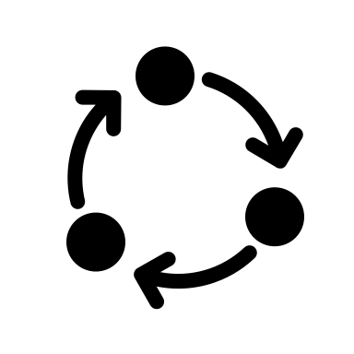
Verification Overview
Source code, P
Specification, S
Notes:
In a typical verification framework, or rather the kind of verification I am interested in. we are expected to be given a source program P, and some specification S of the desired functionalities of the program.

Slide 4
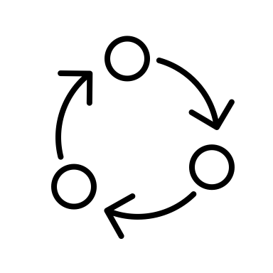
Verification Overview
Source code, P
Specification, S
Inference
Actual behaviors, B
Notes:
Then we infer the program behaviors based on the semantics model of the target language,

Slide 5
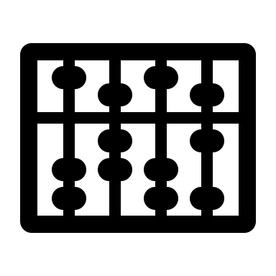
Verification Overview
Source code, P
Specification, S
Inference
Actual behaviors, B
Prover, B ⊆ S
Notes:
And we need a back-end prover to decide the inclusion relation between B and S.
In a typical verification context, checking the inclusion/entailment between the program effects B and the
valid traces S proves that: the program P will never lead to unsafe traces which violate S.

Slide 6



Verification Overview
Source code, P
Specification, S
Inference
True
Unknown
Actual behaviors, B
Prover, B ⊆ S
False
Notes:
The decision procedure are expected to have three output, True means the program is safe, False means there exists unsafe states, unknown means it is undecidable upon the power of the current prover.

Slide 7
Automated Verification Overview
Input
Source code, P
Specification, S
Output
Inference
True
Unknown
Actual behaviors, B
Prover, B ⊆ S
False
Notes:
As in the automated verification, we take source program and the specification as the input and the feed back from the back-end prover, indicating the given program is safe or not.

Slide 8

Our Work & Contributions
Input
2.
Hiphop.js, P
1.
Timed Effects, S
Output
axiomatic
semantics
True
3.
Unknown
4.
Actual behaviors, B
Term writing system, B ⊆ S
False
Notes:
Based on this framework, we highlight our contributions using the orange stars. In our work: the specification S and the inferred program behaviors are written in the novel logic, “timed effects”. Then our target language is called “hiphop.js”, which is a combination of JS and synchronous language esterel. Lastly, we propose and implement the automated back-end solver to decide the inclusion programs between timed effects. In particular, our algorithm is theoretically sound and complete, therefore, the output from the TRS is either true or false.
Next, we will get into some the details following the marked indexes.

Slide 9

1. Timed Synchronous Effects
"The event will be triggered no later than 1000 milliseconds"
Notes:
Intuitively, if traditional timed automata [Larsen et al. 1997] define an exact transition
68 system, our timed effects define a set (possibly infinite) of exact transition systems.

Slide 10
1. Timed Synchronous Effects
"The event will be triggered no later than 1000 or t milliseconds"
Notes:
Intuitively, if traditional timed automata [Larsen et al. 1997] define an exact transition
68 system, our timed effects define a set (possibly infinite) of exact transition systems.

Slide 11
1. Timed Synchronous Effects
"The event will be triggered no later than 1000 or t milliseconds"
Extends Synchronous Kleene Algebra with the operator #.
Defines a set of exact timed transition systems.
Notes:
Intuitively, if traditional timed automata [Larsen et al. 1997] define an exact transition
68 system, our timed effects define a set (possibly infinite) of exact transition systems.

Slide 12
2. Computation Models
Transformational programs compute output values from input values. This is the domain of classical sequential programming languages.
Asynchronous concurrent programs perform interactions between their components using typically network-based communication.
Synchronous reactive programs react to external events in a conceptually instantaneous and deterministic way.
Notes:
with comparatively simple interaction with their environment.
with uncontrollable timing.

Slide 13
2. Hiphop.js = Esterel + JS
Transformational programs compute output values from input values. This is the domain of classical sequential programming languages.
Asynchronous concurrent programs perform interactions between their components using typically network-based communication. (JS)
Synchronous reactive programs react to external events in a conceptually instantaneous and deterministic way. (Esterel)
Hiphop.js
Notes:
with comparatively simple interaction with their environment.
with uncontrollable timing.

Slide 14
2. Hiphop.js = Esterel + JS
“Mixed Sync-Async Concurrency Paradigm”
{A} · {B} · {C} || {W} · {X} · {Y} · {Z} -> {A,W} · {B,X} · {C,Y} · {Z}
{A} · {B} · {C} · {D} || {E} · C? · {F} -> {A, E} · {B} · {C} · {D, F}
{A} · {B} · {D} || {E} · C? · {F} -> {A, E} · {B} · {D} · C? · {F}
Notes:
with comparatively simple interaction with their environment.
with uncontrollable timing.

Slide 15
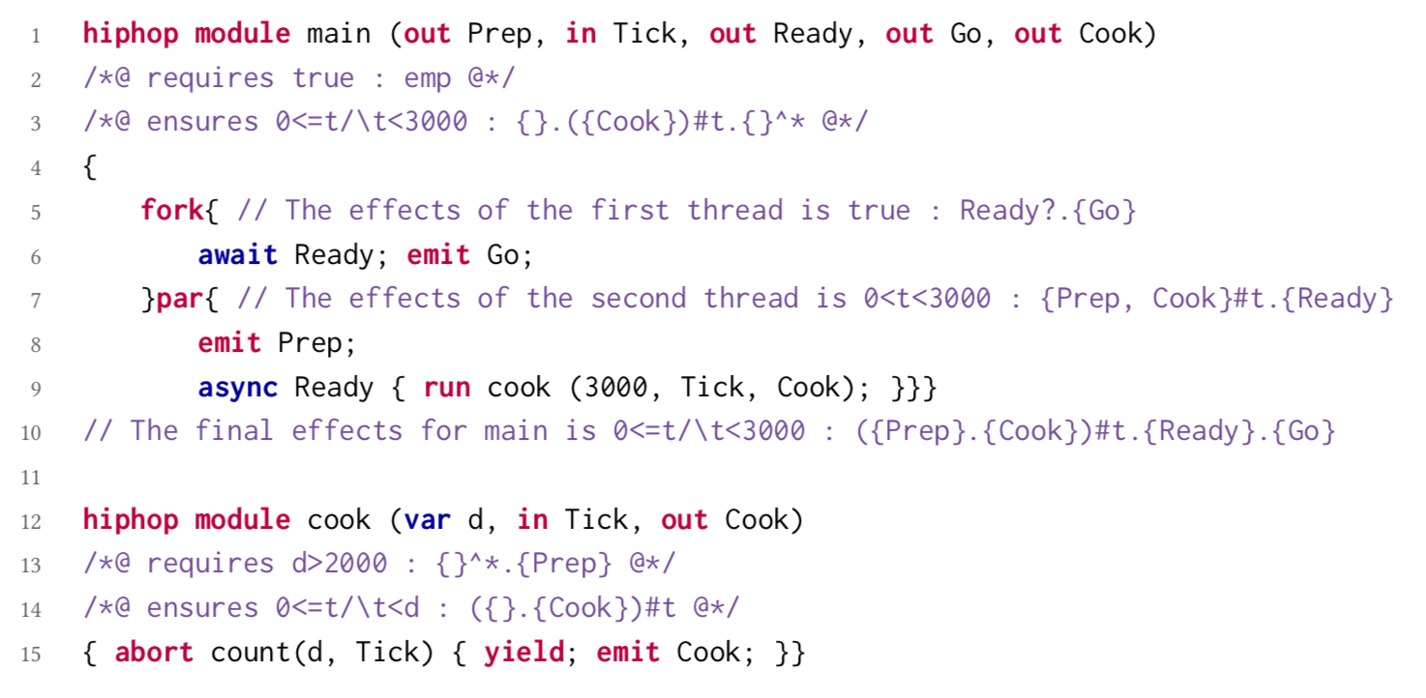
3. Effects Inference

Slide 16
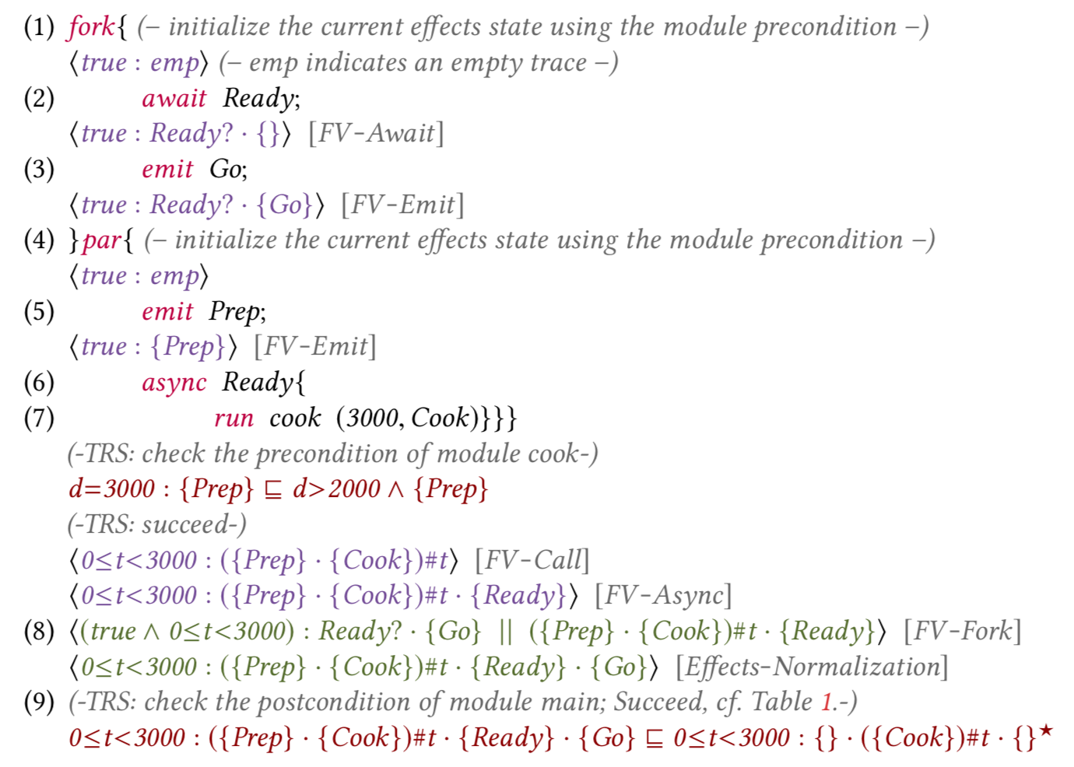
3. Effects Inference
Add the events
into the effect state

Slide 17
3. Effects Inference
Add the events
into the effect state
Check if the current effect
satisfies the callee’s precondition

Slide 18
3. Effects Inference
Add the events
into the effect state
Check if the current effect
satisfies the callee’s precondition
Checks if the final effects satisfy the
Program’s postcondition

Slide 19
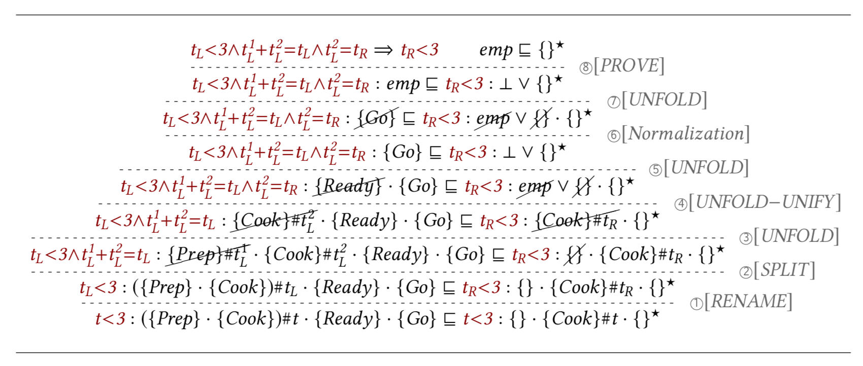
4. Language Inclusion (TRS)

Slide 20
4. Language Inclusion (TRS)

Slide 21
4. Language Inclusion (TRS)

Slide 22
4. Language Inclusion (TRS)

Slide 23
Implementation and Evaluation
An open-sourced prototype system using Ocaml.
Benchmarks, 155 programs (10~300 lines) with manually annotated specs:
CEC: It is an open-source compiler which provides Esterel programs for testing.
Hiphop.js: It is a DSL for JavaScript.
Proven the back-end solver (inclusion checker) sound and complete.
Notes:
CEC: It is an open-source compiler designed for research in both hardware and software generation from the Esterel synchronous language to C, Verilog or BLIF circuit description. It currently supports a subset of Esterel V5 [5], and provides pure Esterel programs for testing.
– Hiphop.js: It is a DSL for JavaScript, to facilitate the design of complex web applications by smoothly integrating Esterel and JavaScript. To enrich our test suite, we take a subset of Hiphop.js programs (as our verifier does not accept JavaScript code), and translate them into our target language.

Slide 24
Our Work & Contributions
Input
2.
Hiphop.js, P
1.
Timed Effects, S
Output
axiomatic
semantics
True
3.
Unknown
4.
Actual behaviors, B
Inclusion Checker, B ⊆ S
False

Slide 25
Summary
Timed Synchronous Effects (TSE): goes beyond timed automata;
Automated Forward Verifier: an axiomatic semantics for HipHop.js;
An Efficient Term Rewriting System (TRS): the back-end prover for TSE language inclusions, proven sound and complete;
Implementation and Evaluation;
Thanks a lot for your attention!

