Slide 1





Friot: Functional Reactive Abstraction for IoT Programming
The 31st symposium on Implementation and Application of Functional Languages
@ NUS Soc, Singapore
Yahui Song Andreea Costea Wei-Ngan Chin
Notes:
Hi everyone, thanks for being here, my name is Yahui Song, I am a second year PhD student here in NUS. Today I am going to present my undergoing project, this is a joint work with A and my supervisor Prof Chin, this is actually a draft paper for presentation. So if you have any questions or suggestions, that would be very helpful.
Simply speaking I am designing a new language for IoT control systems. Of course this is a functional language. So far it is called Friot. Referring to functional reactive IoT programming. I think we are all comfortable to say that there are many benefits of using functional language for many reasons. So besides that, I will explain what is reactive programming in a short while. But for the time being now. I want to mention that our ultimate goals of this work are 1. will be easier for users, IoT developers to write their applications in the sense that the code would be more concise, more readable, maintainable. 2. will be easier for people who are doing program analyses to use formal methods such as model checking, type checking, separation logic verification and so on.
More specifically, Friot is a domain specific language embedded in Haskell. It will be eventually translated into C code and be executed in Linux OS, our experiments are based on Raspberry pi model B+, which is roughly a Linux system.
So let’s get started.

Slide 2

Internet of Things (IoT)
Notes:
There are lots of devices interconnected with each other. And They are expected to smartly control themselves automatically.

Slide 3
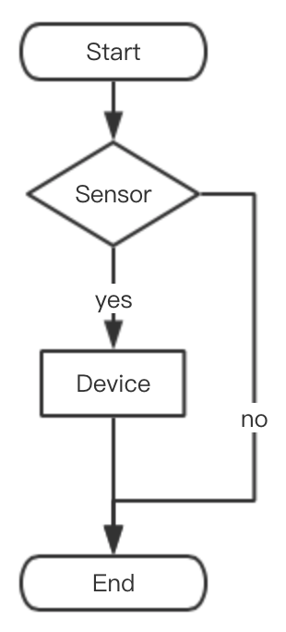
Internet of Things (IoT)

Slide 4
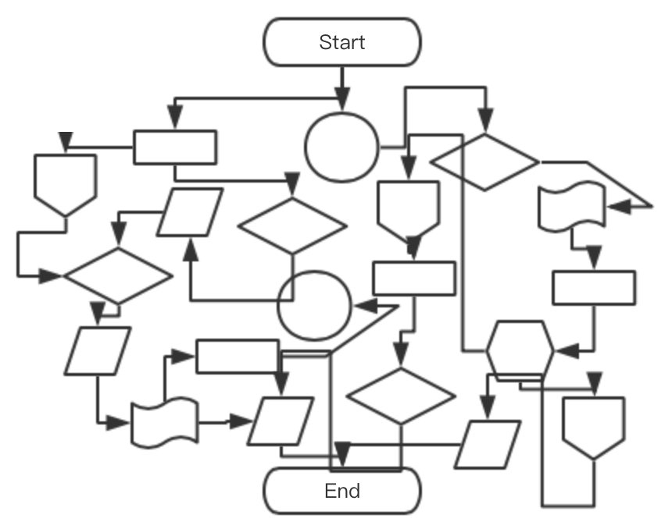
Internet of Things (IoT)
Notes:
Very often you will get this spaghetti code, caused by the long running data flow of mutable values and callback functions. It is not very pleasant to either scale up/ down such a system.

Slide 5
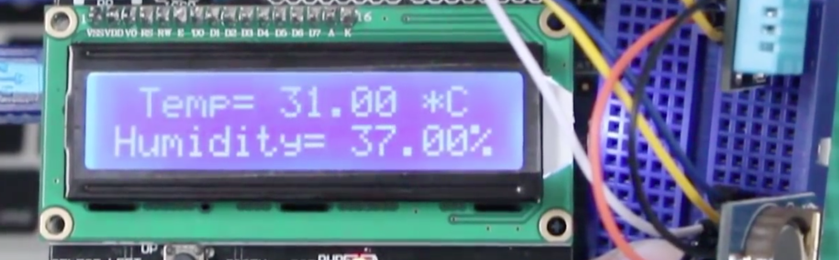
Motivation Example — LCD
Requirement: to show the current temperature and a clock.

Slide 6
Motivation Example
Requirement: to show the current temperature and a clock.
#include <wiringPi.h>
#include <time.h>
#include <string.h>
int main() {
if (wiringPiSetup() == -1) {
return -1;
}
setup();
while(1) loop();
return 0;
}
GPIO library
(General-purpose input/output )
Notes:
Here is a typical framework of the IoT C programs for RESPBERRY PI.
This C library is use to access to the hardware, called GPIO,
In the main function, you firstly need to call the Wiring Pi function to make sure all the hardware are all set to use.
After that you need to define your own setup function to set some necessarily used global values.
Then you will get into a forever loop. Which defines the logical relations of the devices.
Note that, the functions are marked as green are coming from the library. And functions marked as orange will be provided by the programmer.

Slide 7
Motivation Example
Requirement: to show the current temperature and a clock.
#include <wiringPi.h>
#include <time.h>
#include <string.h>
int main() {
if (wiringPiSetup() == -1) {
return -1;
}
setup();
while(1) loop();
return 0;
}
#define TempSensor 0
#define LCD 1
void setup() {
pinMode(TempSensor, INPUT);
pinMode(LCD, OUTPUT); // actually needs more parameters
}
void loop() {
int temp = digitalRead(TempSensor);
// … initialize the timer …
tm_info = localtime(&timer);
strftime(buffer_time, 26, "Time: %H:%M:%S", tm_info);
string data = strcat(to_string (temp), buffer_time);
lcdPuts(LCD, data);
}
To initialize GPIO
1. Read temperature
2. Get current time
3. Show on the lcd

Slide 8
Motivation Example
Requirement: to show the current temperature and a clock.
#include <wiringPi.h>
#include <time.h>
#include <string.h>
int main() {
if (wiringPiSetup() == -1) {
return -1;
}
setup();
while(1) loop();
return 0;
}
#define TempSensor 0
#define LCD 1
void setup() {
pinMode(TempSensor, INPUT);
pinMode(LCD, OUTPUT); // actually needs more parameters
}
void loop() {
int temp = digitalRead(TempSensor);
// … initialize the timer …
tm_info = localtime(&timer);
strftime(buffer_time, 26, "Time: %H:%M:%S", tm_info);
string data = strcat(to_string (temp), buffer_time);
lcdPuts(LCD, data);
}
High reliance on mutable values
Global delay
Long running data flow (callbacks)
Notes:
This comes from the nature of using imperative language.
If there is an http request or database query.
You may have A controls B, B controls C and D, D and E controls F G H.

Slide 9
Motivation Example
Requirement: to show the current temperature and a clock.
#include <wiringPi.h>
#include <time.h>
#include <string.h>
int main() {
if (wiringPiSetup() == -1) {
return -1;
}
setup();
while(1) loop();
return 0;
}
#define TempSensor 0
#define LCD 1
void setup() {
pinMode(TempSensor, INPUT);
pinMode(LCD, OUTPUT); // actually needs more parameters
}
void loop() {
int temp = digitalRead(TempSensor);
// … initialize the timer …
tm_info = localtime(&timer);
strftime(buffer_time, 26, "Time: %H:%M:%S", tm_info);
string data = strcat(to_string (temp), buffer_time);
lcdPuts(LCD, data);
}
Functional Reactive IoT Programming !
High reliance on mutable values
Global delay
Long running data flow (callbacks)

Slide 10



Functional Reactive IoT Programming
If the temperature rose too high,
the air conditioner (AC) would be turned on automatically.
IF
High
AC ON
Sensor Module
AC Module

Slide 11
Functional Reactive IoT Programming
Passive
Reactive
Sensor owns the Update method
Remote setters and updates
AC has no awareness on the dependence
AC owns the Update method
Observers and self-updates
Easy to track/add dependencies on AC module

Slide 12
Functional Reactive IoT Programming
Passive
Reactive
Sensor owns the Update method
Remote setters and updates
AC has no awareness on the dependence
AC owns the Update method
Observers and self-updates
Easy to track/add dependencies on AC module
“How does this module work?"

Slide 13
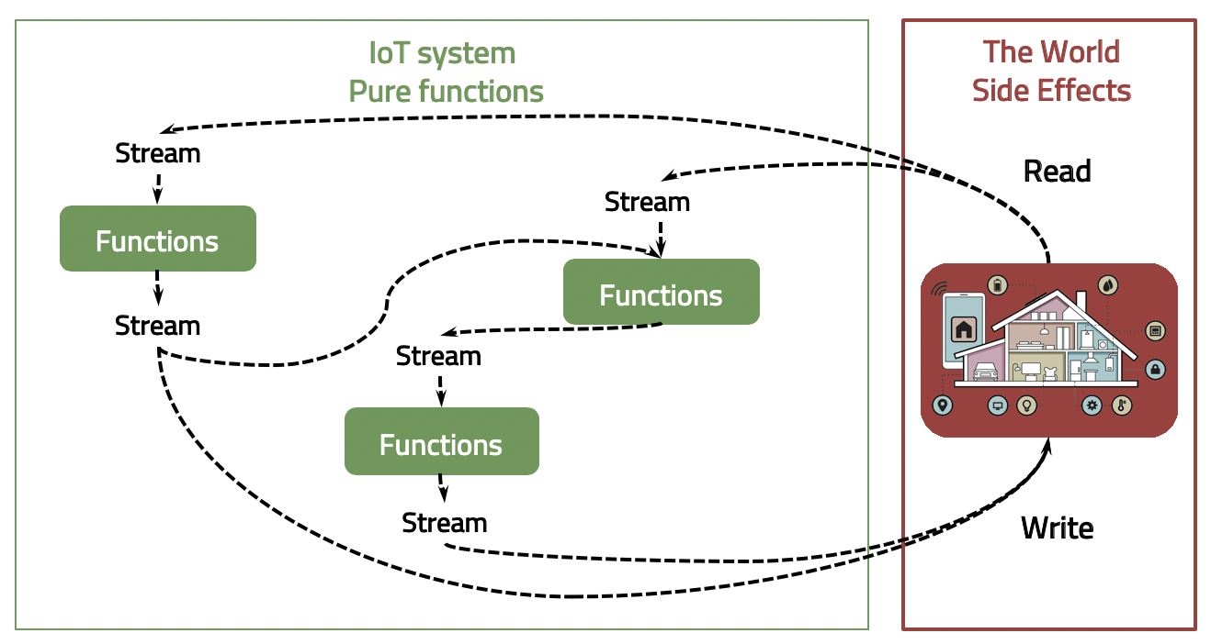
Signal Stream Graphs — Core Design
Signals:
Continuously changing
Connect to the world
Infinite
Signals graphs:
Static
Multi-threaded
Asynchronous by default
Pushing the side effect to the edge of the system !

Slide 14


Input / Output are Signals
port number
Env.temperature :: Int -> Signal Float
clock :: Signal (Int, Int, Int)
lcd :: Int -> Signal String -> IO ()
Day : Hour : Second

Slide 15
Input / Output are Signals
port number
Env.temperature :: Int -> Signal Float
clock :: Signal (Int, Int, Int)
lcd :: Int -> Signal String -> IO ()
Day : Hour : Second
Higher-order functions !

Slide 16
High-order functions — Transformation
lift :: (a -> b) -> Signal a -> Signal b
data :: Signal String
data = lift floatToStr (Env.temperature 0)
port number

Slide 17
High-order functions — Transformation
lift :: (a -> b) -> Signal a -> Signal b
lift_2 :: (a -> b -> c) -> Signal a -> Signal b -> Signal c
lift_n …
Merge
data :: Signal String
data = lift floatToStr (Env.temperature 0)
port number

Slide 18

High-order functions — State
Flod from the past
foldP :: (a -> b -> b) -> b -> Signal a -> Signal b
port number
totalStep :: Siganl Int
totalStep = foldP (\step count -> count + 1) 0 (Env.motion 0)
Initialization of the count accumulator

Slide 19
Revisit: Requirement:
to show the current temperature and a clock. Use Friot!
import Rpi
import Env
import Time
show :: Signal String show = lift_2 (,) (Env.temprature 0) Time.everySec
main :: IO ()
main = Rpi.bPlus [(lcd 2 show)
]
More concise code (LOC: 40 VS 9)
easy to read and easy to write
lift_2 :: (a -> b -> c) -> Signal a -> Signal b -> Signal c
(,) :: a -> b -> String
data Signal a = Signal a
data Time = HMS (Int, Int, Int)
temprature :: Int -> Signal Int
everySec :: Signal Time
lcd :: Int -> Signal String -> IO()
bPlus :: [IO()] -> IO()

Slide 20
Revisit: Requirement:
to show the current temperature and a clock. Use Friot!
import Rpi
import Env
import Time
show :: Signal String show = lift_2 (,) (Env.temprature 0) Time.everySec
blink :: Signal Bool
blink = foldP (\a state -> not state) False Time.everySec
main :: IO ()
main = Rpi.bPlus [(lcd 2 show)
,(led 3 blink)
]
Adding a new device:
A blinking LED
More concise code (LOC: 40 (+12) VS 9 (+3))
easy to read and easy to write
lift_2 :: (a -> b -> c) -> Signal a -> Signal b -> Signal c
(,) :: a -> b -> String
data Signal a = Signal a
data Time = HMS (Int, Int, Int)
temprature :: Int -> Signal Int
everySec :: Signal Time
lcd :: Int -> Signal String -> IO()
bPlus :: [IO()] -> IO()

Slide 21
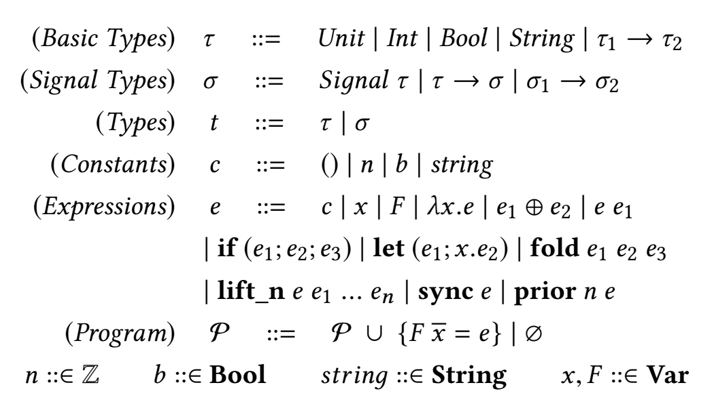
ML-like syntax for Friot
Type guided program transformation
Notes:
A thread's priority shows how frequently a thread gains the access to CPU resources.
The prio argument is a value in the range -20 to 19 (but see NOTES below). with -20 being the highest priority and 19 being the lowest priority. Attempts to set a priority outside this range are silently clamped to the range. The default priority is 0; lower values give a process a higher scheduling priority.
If depen1 changed then
while (depen 2 not changed)
Else -→

Slide 22

Signal Graph Transformation — multithreads
import Rpi
import Env
helper :: Bool -> Bool
helper a = if a then True else False isPeopleIn :: Signal Bool
isPeopleIn = lift helper (Env.motion 0)
mode_LCD :: Signal Bool
mode_LCD = lift helper isPeopleIn
lcd_show :: Signal String
lcd_show = lift_2 (\a b -> if a then toStr b else "null")
mode_LCD (Env.temprature 1)
main :: IO ()
main = Rpi.bPlus [ (lcd 2 lcd_show)
,(led 3 isPeopleIn) ]
Input signals
isPeopleIn
mode_LCD
lcd_show
Output signals
lift_2 :: (a -> b -> c) -> Signal a -> Signal b -> Signal c
(,) :: a -> b -> String
data Signal a = Signal a
data Time = HMS (Int, Int, Int)
temprature :: Int -> Signal Int
everySec :: Signal Time
lcd :: Int -> Signal String -> IO()
bPlus :: [IO()] -> IO()

Slide 23
Signal Graph Transformation — multithreads
Input signals
Global Model
isPeopleIn
mode_LCD
lcd_show
Output signals
Notes:
To add…

Slide 24
Signal Graph Transformation — multithreads
Input signals
Global Model
isPeopleIn
mode_LCD
lcd_show
isPeopleIn
Output signals

Slide 25
Signal Graph Transformation — multithreads
Input signals
Global Model
isPeopleIn
isPeopleIn
mode_LCD
lcd_show
isPeopleIn
mode_LCD
Output signals

Slide 26
Signal Graph Transformation — multithreads
Input signals
Global Model
isPeopleIn
isPeopleIn
mode_LCD
mode_LCD
lcd_show
lcd_show
isPeopleIn
mode_LCD
Output signals

Slide 27
Signal Graph Transformation — multithreads
single-writer multi-reader lock
Input signals
Global Model
isPeopleIn
isPeopleIn
mode_LCD
mode_LCD
lcd_show
lcd_show
isPeopleIn
mode_LCD
Output signals
Notes:
a reader could read while a writer is writing,
When writer is writing, reader can not access,
But when reader is reading, other readers are allowed to access.
write-starvation. -> Priority policies. or prevent more readers to enter when reached to a bound.

Slide 28
Signal Stream Graphs — Benefits
High reliance on mutable values
Global delay
Long running data flow (callbacks), passive
Immutability of functional language
Efficient (Asynchronous and multithreads)
Reactive programming style
Concise (LOC 40 vs. 9)
Easy to read and write
Efficient no global delay
Pure functions for formal verification (No side effect)

Slide 29
Conclusion
Friot is a new FRP language designed for IoT control systems
Has many functional programming features
Embedded in Haskell Compiles to C (multithreads)
Shows clear benefits for logic re-use; time dependent behaviors, being able to be formal verified.
Efficient (explicit synchronous, Asynchronous by default)
Notes:
to be run on small

Slide 30

Conclusion
Friot is a new FRP language designed for IoT control systems
Has many functional programming features
Embedded in Haskell Compiles to C (multithreads)
Shows clear benefits for logic re-use; time dependent behaviors, being able to be formal verified.
Efficient (explicit synchronous, Asynchronous by default)
Thanks a lot for your attention!
https://www.comp.nus.edu.sg/~yahuis/
Notes:
to be run on small

