Slide 1




Automated Temporal Verification of Integrated Dependent Effects
Presented by Yahui Song
26th Feb 2020
Notes:
Hello everyone, my name is Yahui. I am a PhD student working with Prof Chin.
Today I am going to present this paper, which has just been submitted to CAV 2020. If you have any suggestions, that would be very nice.
Last week, Ilya presented this nice paper about the incorrectness logic to better catch bugs and find the bug traces, while this paper is still stick
to the standard correctness logic, which is to prove the absence of the bugs.

Slide 2
Automated Temporal Verification of Integrated Dependent Effects
Presented by Yahui Song
26th Feb 2020
Notes:
Simply speaking, we are trying to prove the temporal properties based on the specification language. We call it integrated dependent effects.

Slide 3
Integrated Dependent Effects
send n =
if n == 0 then event [Done];
else event [Send];
send (n - 1);
Notes:
Integrated Dependent Effects is extended from regular expressions.

Slide 4
Integrated Dependent Effects
send n =
if n == 0 then event [Done];
else event [Send];
send (n - 1);
𝚽’ = (Send* ・ Done, Send^{ω} ) [Martain 2014]
Notes:
Integrated Dependent Effects is extended from regular expressions.

Slide 5
Integrated Dependent Effects
send n =
if n == 0 then event [Done];
else event [Send];
send (n - 1);
𝚽’ = (Send* ・ Done, Send^{ω} ) [Martain 2014]
𝚽’’ = (Send^{n} ・ Done, Send^{ω} ) [Yoji 2018]
Notes:
Integrated Dependent Effects is extended from regular expressions.

Slide 6
Integrated Dependent Effects
send n =
if n == 0 then event [Done];
else event [Send];
send (n - 1);
𝚽’ = (Send* ・ Done, Send^{ω} ) [Martain 2014]
𝚽’’ = (Send^{n} ・ Done, Send^{ω} ) [Yoji 2018]
𝚽_{pre} = True ∧ Ready ・ _*
𝚽_{post}(n) = n ≥ 0 ∧ (Send^{n} ・ Done) ∨ n < 0 ∧ (Send^{ω})
Notes:
Integrated Dependent Effects is extended from regular expressions.

Slide 7
Integrated Dependent Effects
send n =
if n == 0 then event [Done];
else event [Send];
send (n - 1);
server n =
event [Ready];
send (n);
server (n);
𝚽’ = (Send* ・ Done, Send^{ω} ) [Martain 2014]
𝚽’’ = (Send^{n} ・ Done, Send^{ω} ) [Yoji 2018]
𝚽_{pre} = True ∧ Ready ・ _*
𝚽_{post}(n) = n ≥ 0 ∧ (Send^{n} ・ Done) ∨ n < 0 ∧ (Send^{ω})
𝚽_{pre} = n ≥ 0 ∧ 𝜖
𝚽_{post}(n) = n ≥ 0 ∧ (Ready・ Send^{n} ・ Done)^{ω}
Notes:
Integrated Dependent Effects is extended from regular expressions.

Slide 8
Integrated Dependent Effects
send n =
if n == 0 then event [Done];
else event [Send];
send (n - 1);
server n =
event [Ready];
send (n);
server (n);
𝚽’ = (Send* ・ Done, Send^{ω} ) [Martain 2014]
𝚽’’ = (Send^{n} ・ Done, Send^{ω} ) [Yoji 2018]
𝚽_{pre} = True ∧ Ready ・ _*
𝚽_{post}(n) = n ≥ 0 ∧ (Send^{n} ・ Done) ∨ n < 0 ∧ (Send^{ω})
𝚽_{pre} = n ≥ 0 ∧ 𝜖
𝚽_{post}(n) = n ≥ 0 ∧ (Ready・ Send^{n} ・ Done)^{ω}
𝚽_{pre} = True ∧ 𝜖
𝚽_{post}(n) = n ≥ 0 ∧ (Ready・ Send^{n} ・ Done)^{ω}
∨ n < 0 ∧ (Ready・ Send^{ω})
Notes:
Integrated Dependent Effects is extended from regular expressions.
we are aware of (i) termination proper- ties: server must not terminate, while send may not terminate; (ii) branching properties: different arithmetic conditions on the input parameters lead to different temporal effects; and (iii) use of prior effects in precondition. Although these examples are simple, they already show that our integrated effects provide more detail information than classical LTL or μ-calculus, and in fact, it cannot be fully captured by any prior works

Slide 9
Integrated Dependent Effects – Summary
send n =
if ( . . . ) then event [Done];
else event [Send];
send (n - 1);
Aware of termination (mixed definition)
(n ≥ 0 ∧ Send^{n} ・ Done) ∨ (n < 0 ∧ Send^{ω})
Beyond the context-free grammar
a^{n} · b^{n} · c^{n}
Effects in precondition is new
𝚽_{pre} = True ∧ Ready ・ _*
Undetermined termination (Kleene Star)
True ∧ Send* ・ Done

Slide 10
Forward Verifier
𝚽_{pre} = True ∧ Ready ・ _*
𝚽_{post}(n) = (n ≥ 0 ∧ Send^{n} ・ Done) ∨ (n < 0 ∧ Send^{ω})
send n =
if n == 0 then event [Done];
else event [Send];
send (n - 1);

Slide 11
Forward Verifier
𝚽_{pre} = True ∧ Ready ・ _*
𝚽_{post}(n) = (n ≥ 0 ∧ Send^{n} ・ Done) ∨ (n < 0 ∧ Send^{ω})
send n =
{True ∧ Ready ・ _*}
if n == 0 then event [Done];
{n=0 ∧ Ready ・ _* ・ Done}
else event [Send];
send (n - 1);

Slide 12
Forward Verifier
𝚽_{pre} = True ∧ Ready ・ _*
𝚽_{post}(n) = (n ≥ 0 ∧ Send^{n} ・ Done) ∨ (n < 0 ∧ Send^{ω})
send n =
{True ∧ Ready ・ _*}
if n == 0 then event [Done];
{n=0 ∧ Ready ・ _* ・ Done}
else event [Send];
{n!=0 ∧ Ready ・ _* ・ Send}
send (n - 1);
{n!=0 ∧ Ready ・ _* ・ Send ・((n > 0 ∧ Send^{n-1} ・ Done) ∨ (n < 0 ∧ Send^{ω}))}
n!=0 ∧ Ready ・ _* ・ Send
⊑
True ∧ Ready ・ _*

Slide 13
Forward Verifier
𝚽_{pre} = True ∧ Ready ・ _*
𝚽_{post}(n) = (n ≥ 0 ∧ Send^{n} ・ Done) ∨ (n < 0 ∧ Send^{ω})
send n =
{True ∧ Ready ・ _*}
if n == 0 then event [Done];
{n=0 ∧ Ready ・ _* ・ Done}
else event [Send];
{n!=0 ∧ Ready ・ _* ・ Send}
send (n - 1);
{n!=0 ∧ Ready ・ _* ・ Send ・((n > 0 ∧ Send^{n-1} ・ Done) ∨ (n < 0 ∧ Send^{ω}))}
{Ready ・ _* ・ ((n=0 ∧ Done) ∨ (n > 0 ∧ Send ・ Send^{n-1} ・ Done) ∨ (n < 0 ∧ Send ・ Send^{ω}))}
Goal: 𝚽_{body} ⊑ 𝚽_{post}(n)
Mix Finite & Infinite traces
Branching Properties

Slide 14

Regular Expressions Containment Problem
Translation of r, s into DFAs/NFAs
(gives rise to an exponential blow-up)
A : a finite set of alphabet, Σ
E = 𝝓 | emp | a (a ∈ Σ) | E ∨ E | E・E
For r, s ∊ E, to check if r ≤ s is valid
Symbolic decision procedure
- a term rewriting system (t.r.s)
PSPACE-
complete

Slide 15

Regular Expressions Containment Problem
Translation of r, s into DFAs/NFAs
(gives rise to an exponential blow-up)
A : a finite set of alphabet, Σ
E = 𝝓 | emp | a (a ∈ Σ) | E ∨ E | E・E
For r, s ∊ E, to check if r ≤ s is valid
Symbolic decision procedure
- a term rewriting system (t.r.s)
(The worse-case complexity
is still exponential)
PSPACE-
complete

Slide 16
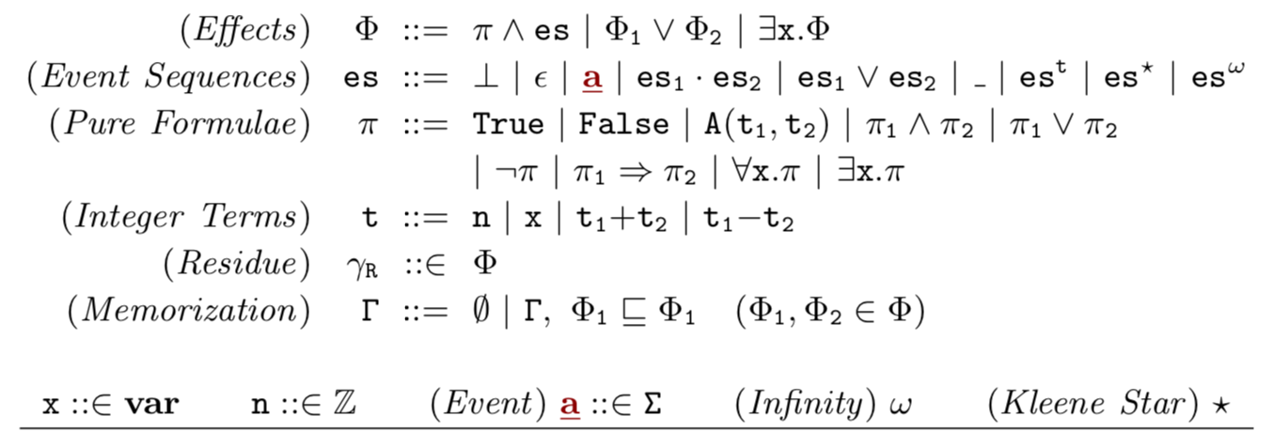
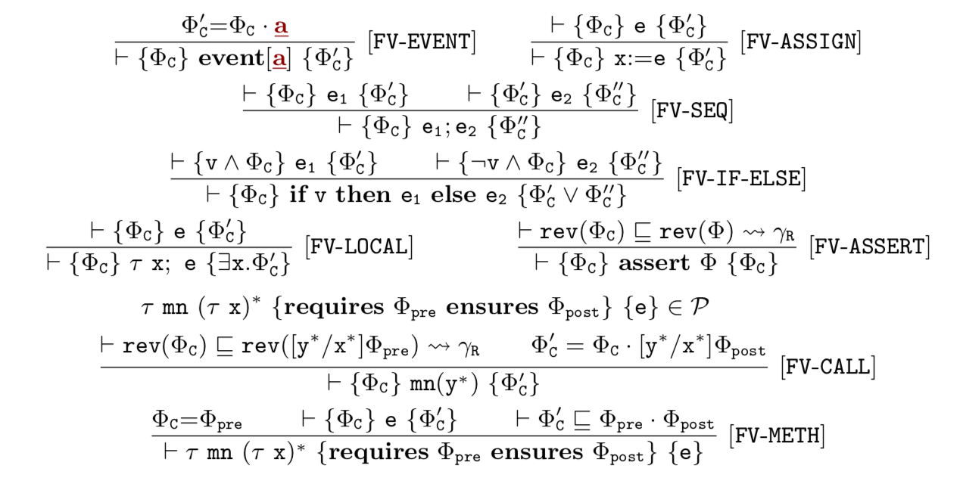
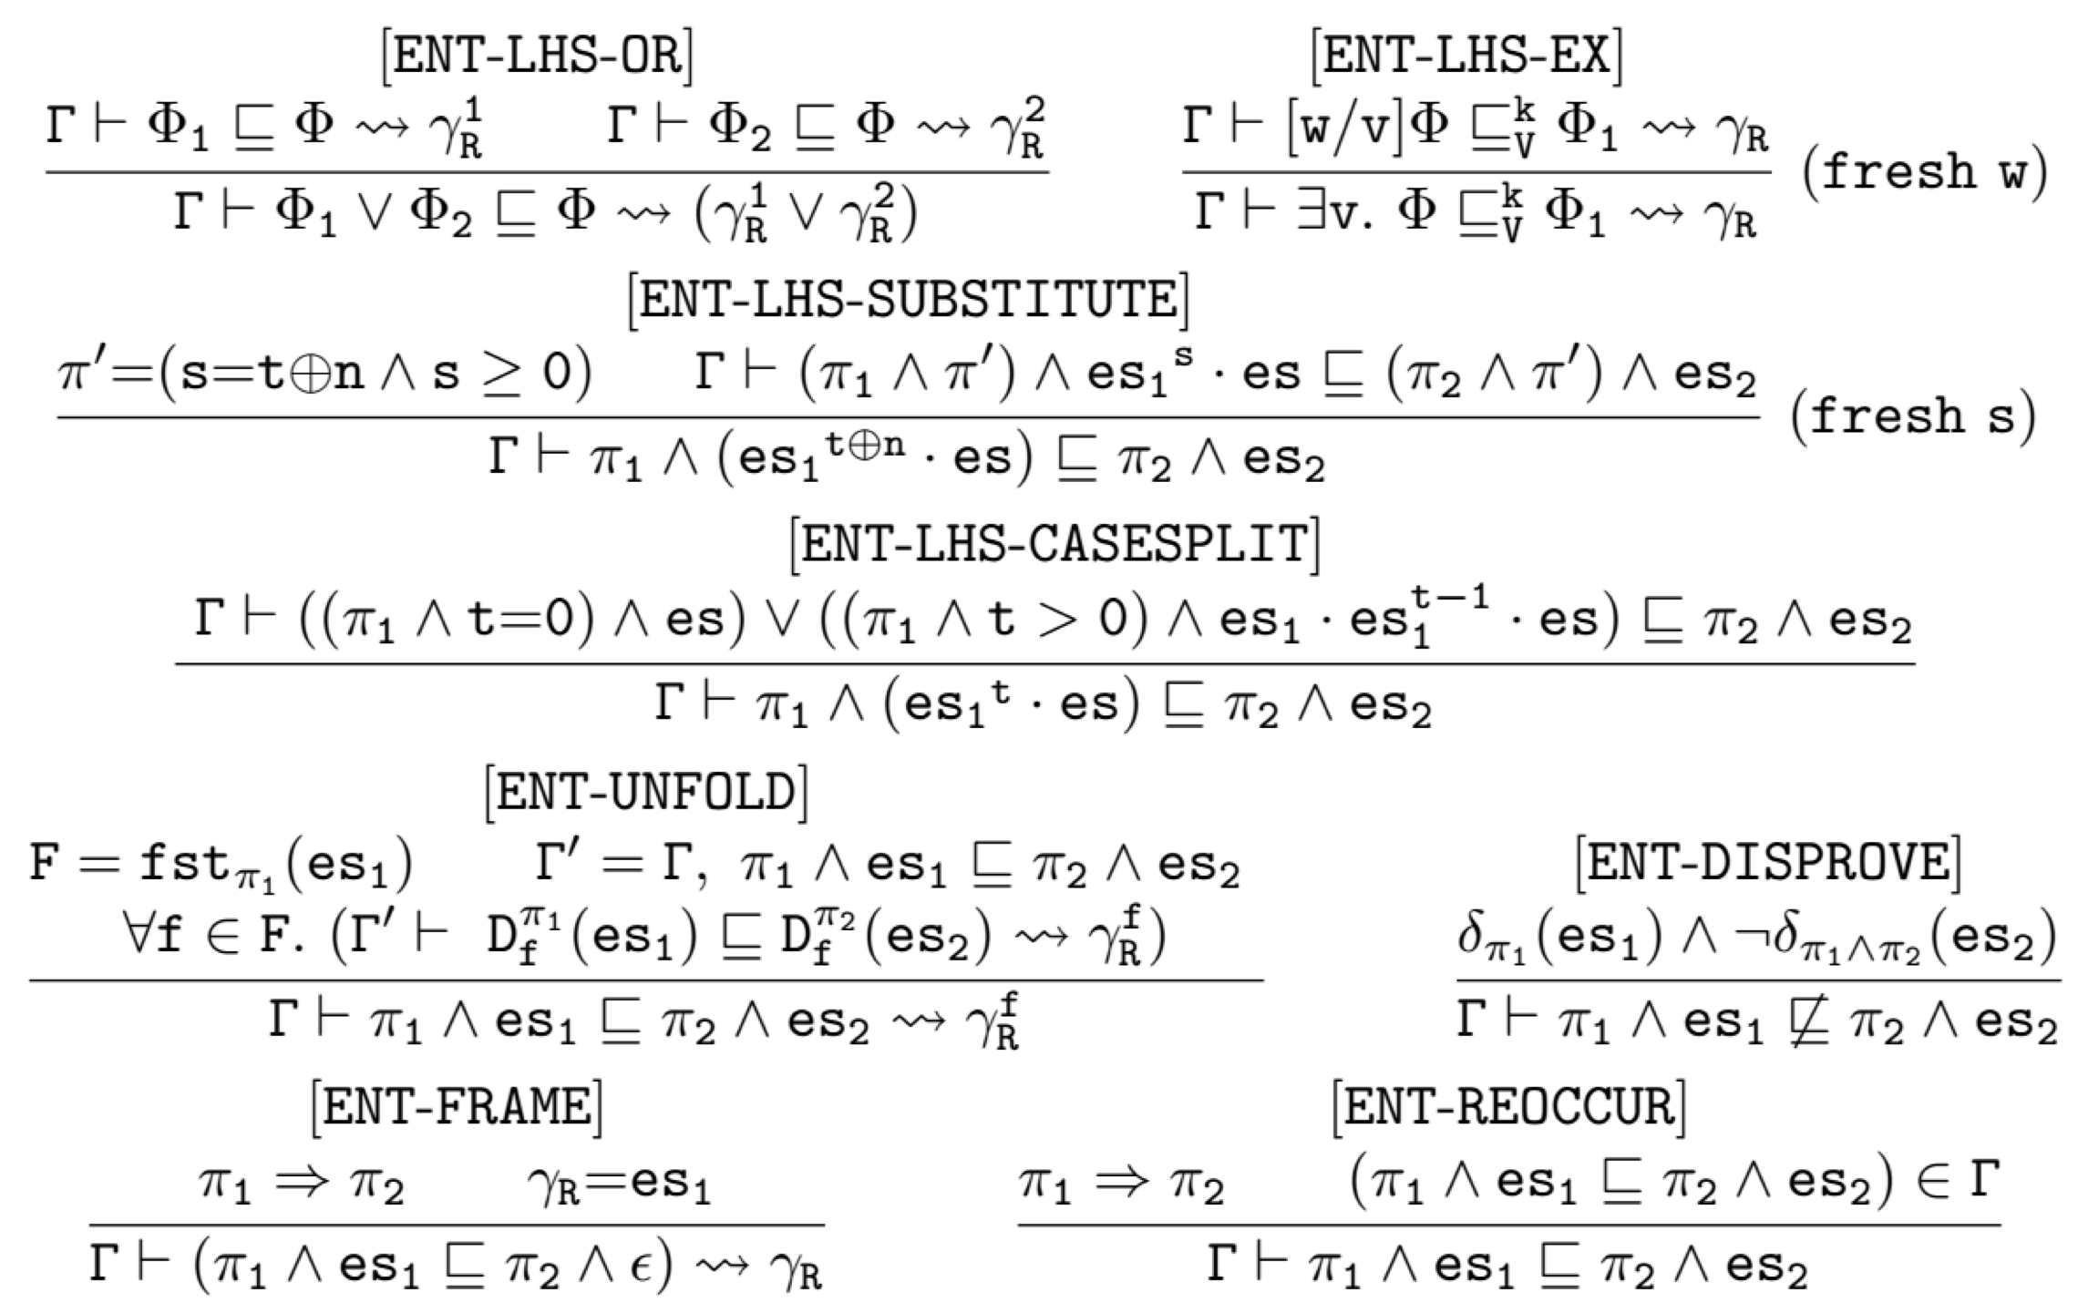

Formal Specification & Entailment Rules

Slide 17
Goal: 𝚽_{body} ⊑ 𝚽_{post}(n)
Mix Finite & Infinite traces
Branching Properties
(n=0 ∧ Done) ∨ (n > 0 ∧ Send ・ Send^{n-1} ・ Done) ∨ (n < 0 ∧ Send ・ Send^{ω})
⊑
𝚽_{post}(n) = (n ≥ 0 ∧ Send^{n} ・ Done) ∨ (n < 0 ∧ Send^{ω})

Slide 18
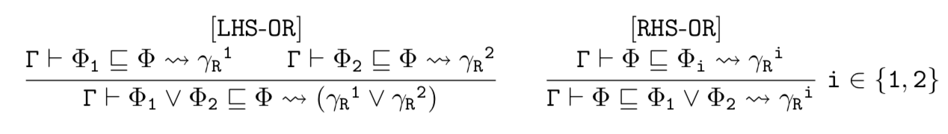
Goal: 𝚽_{body} ⊑ 𝚽_{post}(n)
Mix Finite & Infinite traces
Branching Properties
(n=0 ∧ Done) ∨ (n > 0 ∧ Send ・ Send^{n-1} ・ Done) ∨ (n < 0 ∧ Send ・ Send^{ω})
⊑
𝚽_{post}(n) = (n ≥ 0 ∧ Send^{n} ・ Done) ∨ (n < 0 ∧ Send^{ω})

Slide 19
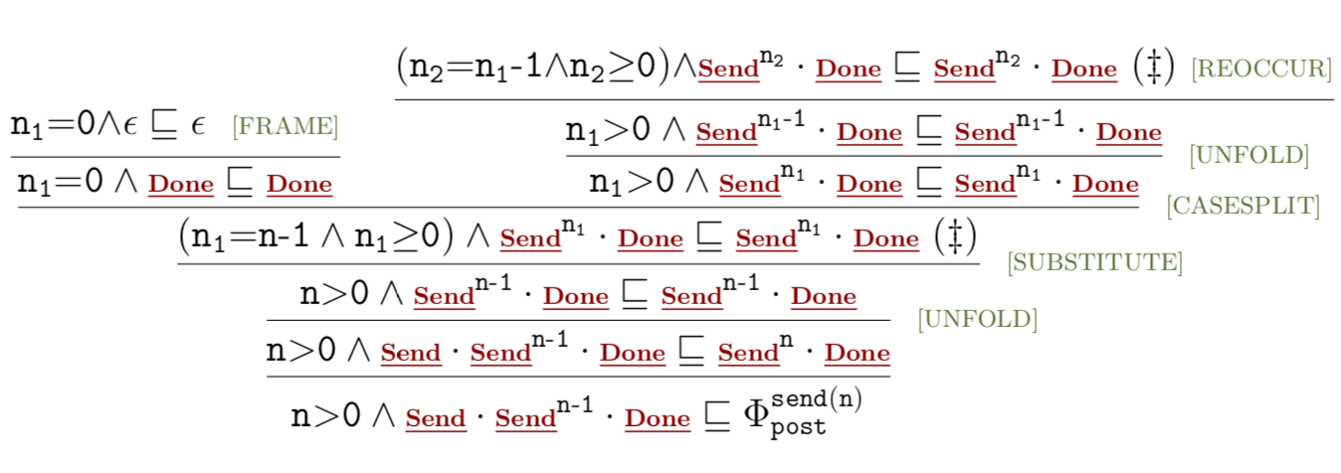
Term Rewriting System - Example
Online Demo

Slide 20
Term Rewriting System - Example
Online Demo

Slide 21
Term Rewriting System - Example
Online Demo

Slide 22
Term Rewriting System - Example
Online Demo

Slide 23
Term Rewriting System - Example
Online Demo

Slide 24
Term Rewriting System - Example
Online Demo

Slide 25
Evaluation (T.r.s vs. NFA + efficient Antichain)
REs Generation:
Fix the input alphabet Σ to {a,b}
Randomly and recursively generate REs of a certain height.
NFA Construction:
Glushkov’s algorithm (without any ε-transitions)
Inclusion Pairs Generation:
33.3% valid, 33.3% invalid, and leave the rest 33.3% unsure.
Generate two Res: re₁ re₂, build their union re₃=re₁ ∨ re₂ and test re₁ ≤ re₃
Notes:
, we randomly draw an operator from concat, union and Kleene star, to- gether with their child REs with height-1.

Slide 26
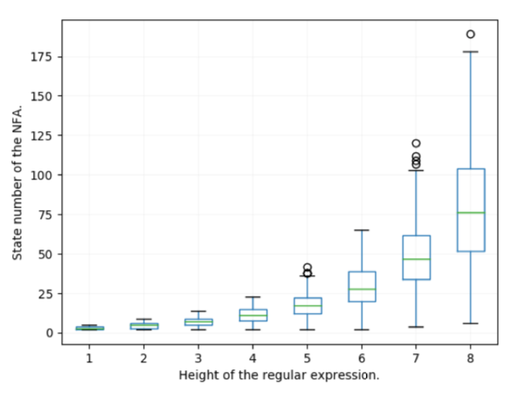
Evaluation (T.r.s vs. NFA + efficient Antichain)
REs Generation:
Fix the input alphabet Σ to {a,b}
Randomly and recursively generate REs of a certain height.
NFA Construction:
Glushkov’s algorithm (without any ε-transitions)
Inclusion Pairs Generation:
33.3% valid, 33.3% invalid, and leave the rest 33.3% unsure.
Generate two Res: re₁ re₂, build their union re₃=re₁ ∨ re₂ and test re₁ ≤ re₃
Notes:
, we randomly draw an operator from concat, union and Kleene star, to- gether with their child REs with height-1.

Slide 27
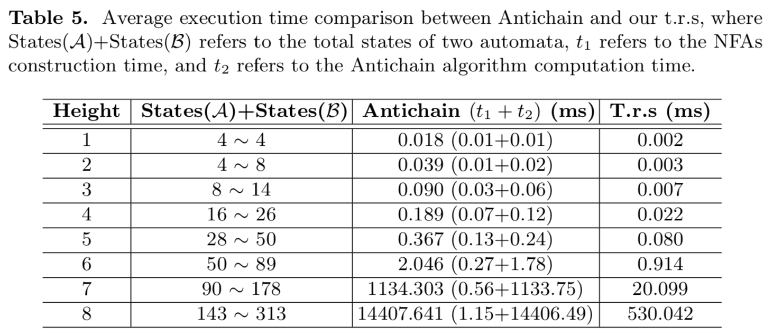
Evaluation (T.r.s vs. NFA + efficient Antichain)

Slide 28
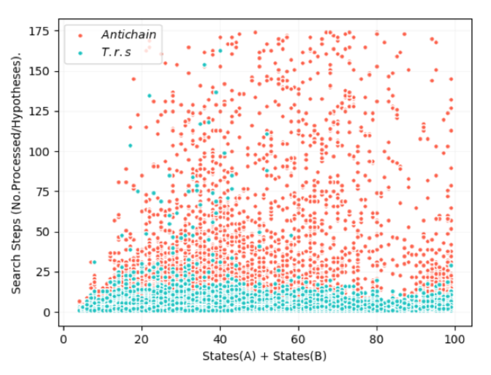
Evaluation (T.r.s vs. NFA + efficient Antichain)
Notes:
When the total states are smaller than 50, the average execution time spends by the t.r.s is actually even less than the NFAs construction time, which means it is not necessary to construct the NFAs when a t.r.s solves it faster.
For the invalid cases, the t.r.s disproves them earlier without constructing the whole NFAs. Therefore, we summarize that we take more advantages of using a t.r.s when the verification contains more invalid cases.

Slide 29
Evaluation (T.r.s vs. NFA + efficient Antichain)
For the invalid cases, the t.r.s disproves them
earlier without constructing the whole NFAs.
Notes:
When the total states are smaller than 50, the average execution time spends by the t.r.s is actually even less than the NFAs construction time, which means it is not necessary to construct the NFAs when a t.r.s solves it faster.
For the invalid cases, the t.r.s disproves them earlier without constructing the whole NFAs. Therefore, we summarize that we take more advantages of using a t.r.s when the verification contains more invalid cases.

Slide 30
Summary & Contributions
Thank you for your attention!
Enhance the expressiveness of temporal effects
Define the syntax and semantics of the integrated dependent effects
Automate the modular local verification
Front-end: Hoare-style forward verifier
Back-end: effects inclusion checking procedure (the proven sound t.r.s)
Implementation and Evaluation
Prototype system; and experimental results
Notes:
Escapes classical LTL and prior effects

