Slide 1
Mini Project · Final Presentation
Inter-Meta-Atom Coupling
in a 1D Metasurface
A 2D scalar Coupled-Dipole study, cross-validated against Tidy3D FDTD
1D 메타서페이스의 메타 원자 간 결합 — CDA 연구, Tidy3D FDTD 외부 검증
Headline finding
|Δφ|(P) ≈ 3.9 · (λ/P)^β, β = 0.90 ± 0.10
robust across N, grading width, random α · FDTD agreement RMS = 2.9°

Slide 2
Research Question
1 / 15
연구 질문
"How does the phase distortion caused by inter-meta-atom coupling INCREASE as the array period P DECREASES?"
"배열 주기 P가 줄어들수록 메타 원자 간 커플링에 의한 위상 왜곡이 어떻게 증가하는가?"
Why it matters
왜 중요한가
• Standard metasurface design treats each meta-atom as isolated
표준 설계는 각 메타 원자를 isolated 로 가정
• Real coupling distorts the achieved phase
실제 결합은 구현된 위상을 왜곡
• Need a quantitative LAW relating distortion to period
주기와 왜곡을 잇는 정량 법칙이 필요

Slide 3
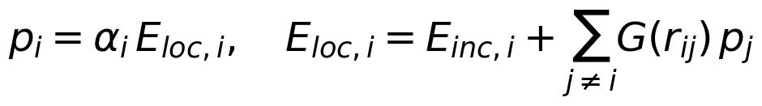
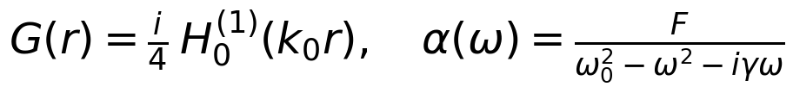
Model + Method
2 / 15
모델 + 방법
Coupled Dipole Approximation (TM scalar)
What we measure
측정하는 양
▸ Per-atom phase deviation
Δφ_i = arg(p_i,coupled) − arg(p_i,isolated)
▸ Mean magnitude over array
|Δφ|̄ = (1/N) Σ |Δφ_i|
▸ Sweep over P, fit |Δφ|̄(P)
주기 P 스윕 + power-law fit
Implementation
구현
• Python + NumPy + SciPy Hankel function
Python + NumPy + SciPy 직접 코딩
• N x N matrix from broadcasting, np.linalg.solve
넘파이 브로드캐스팅 + 선형 시스템
• Lorentzian α with (ω₀, γ, F) = (2.1π, 0.4, 4.0) default
Lorentz α 디폴트 파라미터
• Normalized units: λ = 1, k₀ = 2π
단위: λ = 1, k₀ = 2π

Slide 4
Verification: 10 / 10 PASS
3 / 15
솔버 검증: 10/10 통과
1
Single dipole = α·E_inc
rel. err 1.5×10⁻¹⁶
2
Two-dipole analytical p = α/(1−αG)
2.5×10⁻¹⁶
3
Green's function formula + reciprocity
exact 0
4
Linear system residual
2.4×10⁻¹⁶
5
Mirror symmetry of centred array
3.3×10⁻¹⁶
6
Matrix reciprocity A_ij = A_ji
exact 0
7
Array-size convergence (2D 1/√N)
slope ≈ −0.26
8
Wavelength scaling invariance
exact 0
9
Extinction power positivity
all P_ext > 0
10
Non-uniform → uniform limit
exact 0

Slide 5
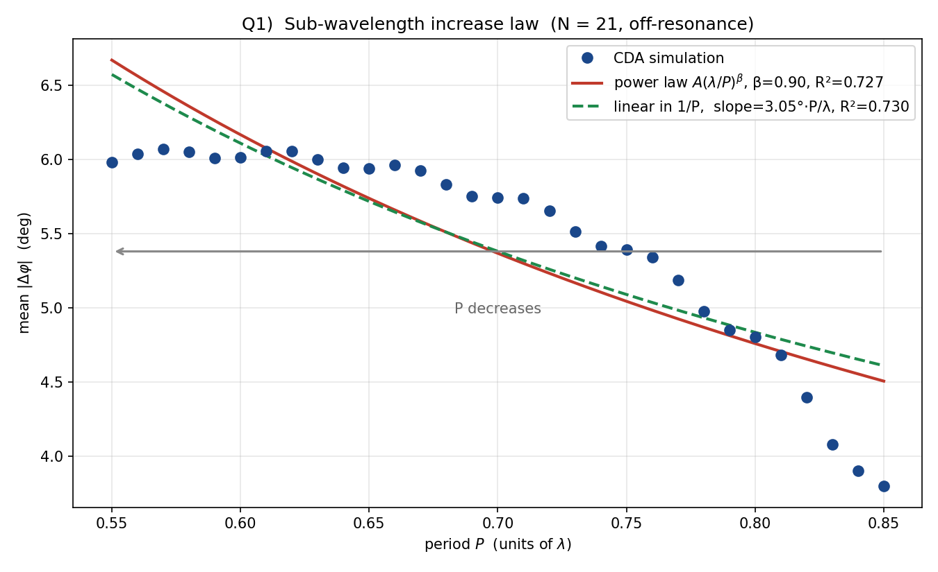
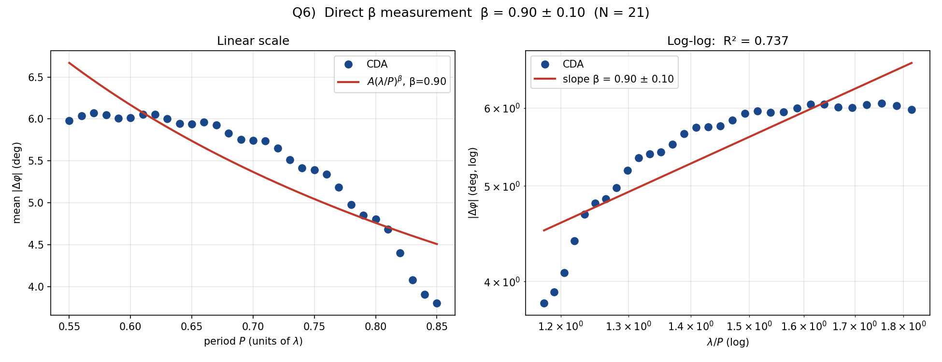
Direct Answer — The Increase Law
4 / 15
연구 질문에 대한 직접적 답
Sub-wavelength regime P ∈ [0.55, 0.85] λ, N = 21, R² = 0.73
P = 0.85 λ → 3.80° | P = 0.55 λ → 5.98° | ratio 1.57× (+57 %) | β ≈ 1 ⇒ approximately 1/P scaling
P가 줄어들수록 위상 왜곡은 약 1/P 비율로 증가

Slide 6
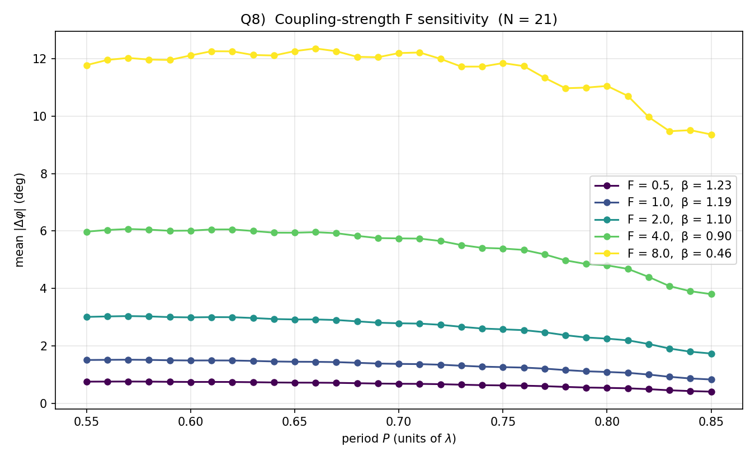
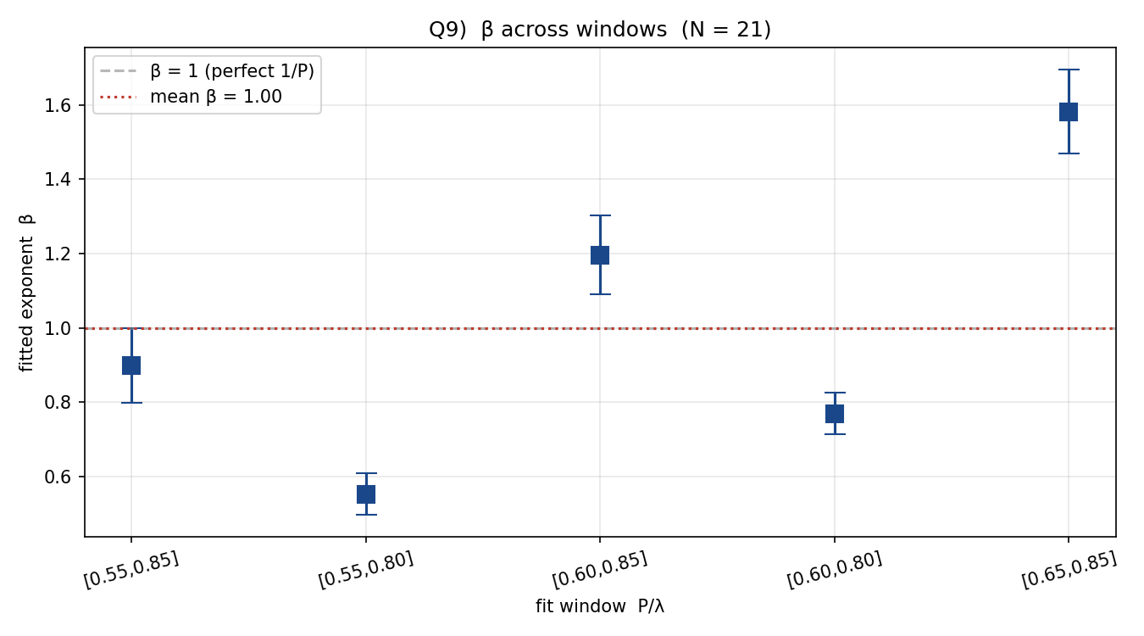
β depends on F and on fit window
5 / 15
결합 강도 F + 윈도우 의존성
β tunes 1.23 → 0.46 with F • β varies 0.55 – 1.58 across windows → β ≈ 0.9 is the EFFECTIVE exponent at our coupling strength

Slide 7
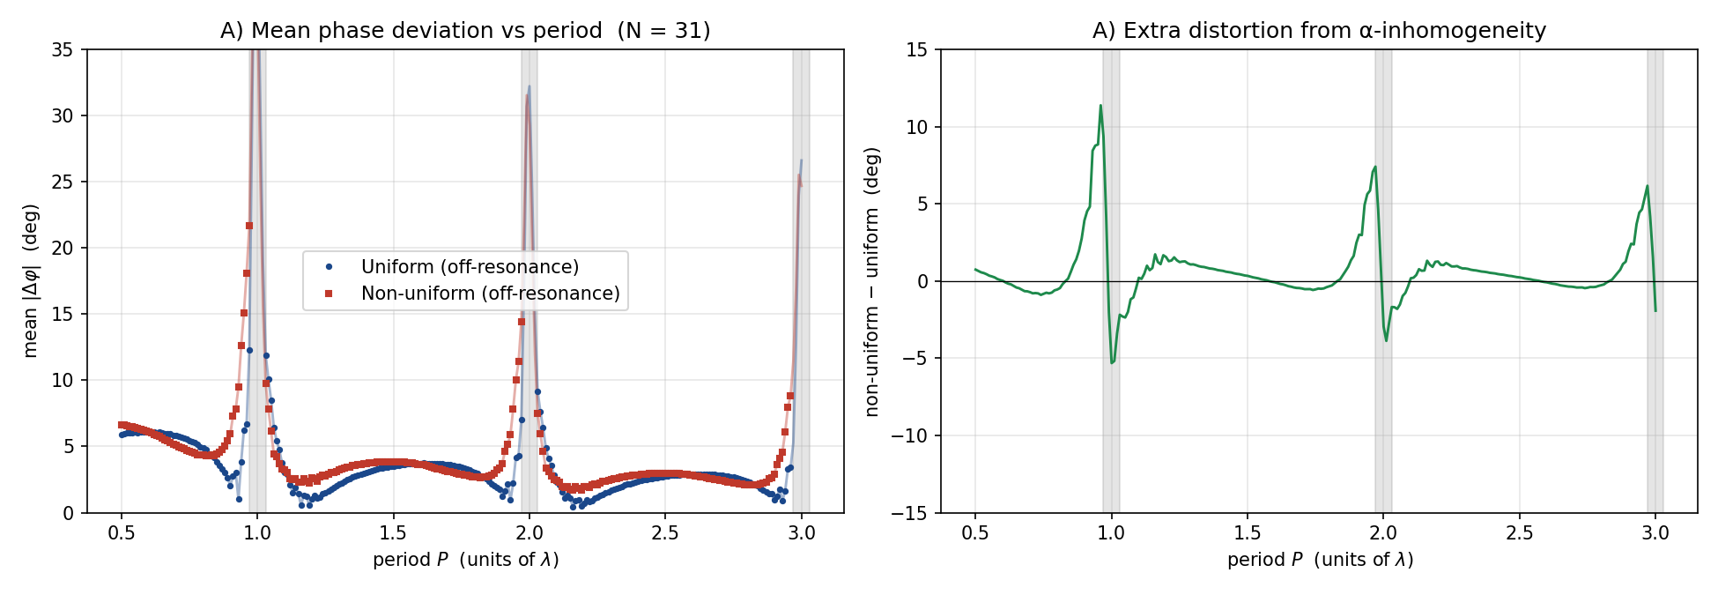
Result A — Off-resonance mean |Δφ|(P)
6 / 15
결과 A — 비공명 평균 위상 편차
Off-resonance averages
비공명 평균
▸ Uniform : 3.27°
▸ Non-uniform : 3.95°
▸ Extra (NU − U) : +0.69° (+21 %)
Reading
해석
• 21% extra distortion is purely from α-inhomogeneity
추가 왜곡은 순수 α 비균일성에서
• Isolated-atom design under-estimates phase error
isolated 설계는 위상 오차 과소평가

Slide 8
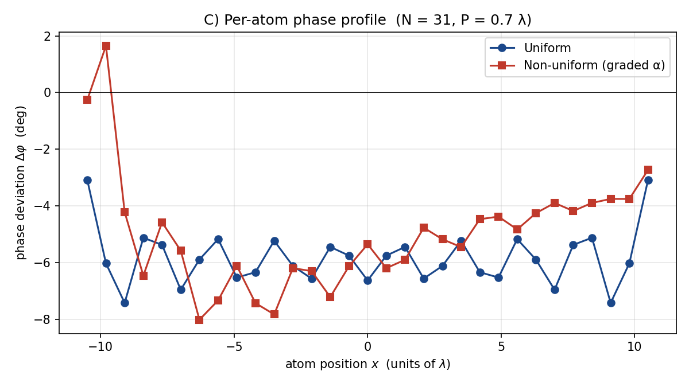
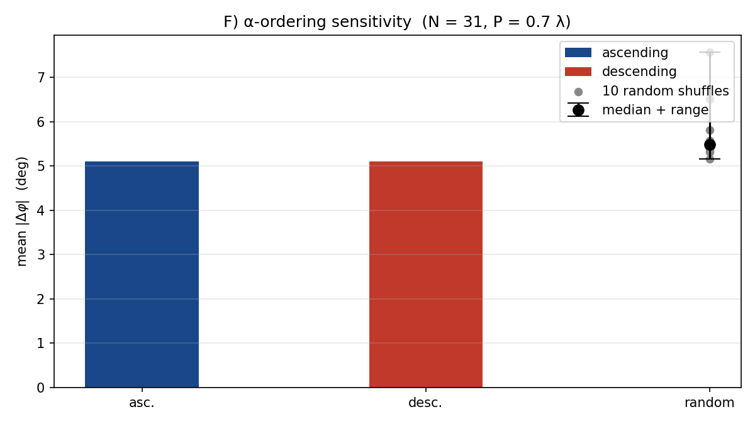
Result C + F — Symmetry break & α-ordering
7 / 15
결과 C + F — 대칭 깨짐 & α-순서
Mirror symmetry: uniform 0° vs non-uniform −0.96° · α-ordering: ascending 5.10° vs random 5.2 – 7.6° (+50 %)

Slide 9
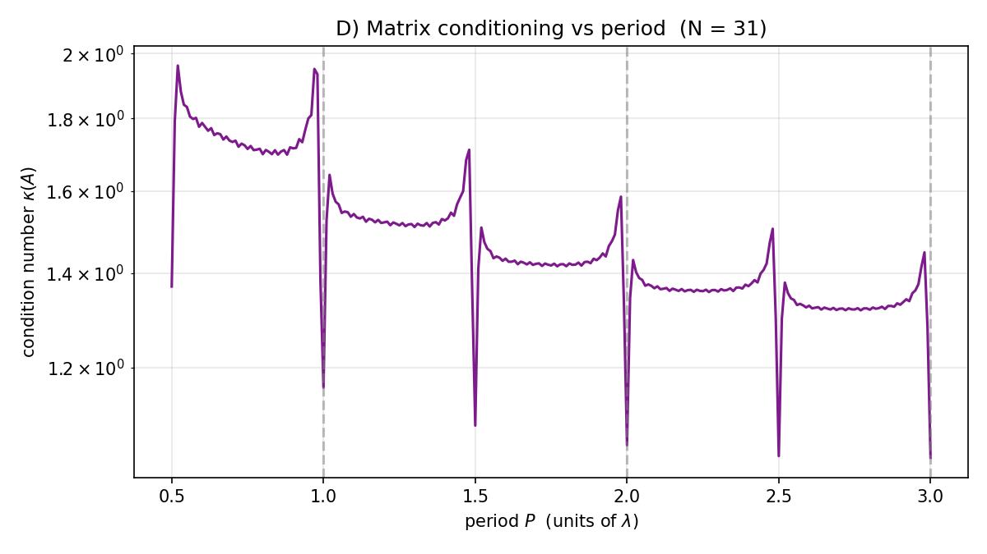
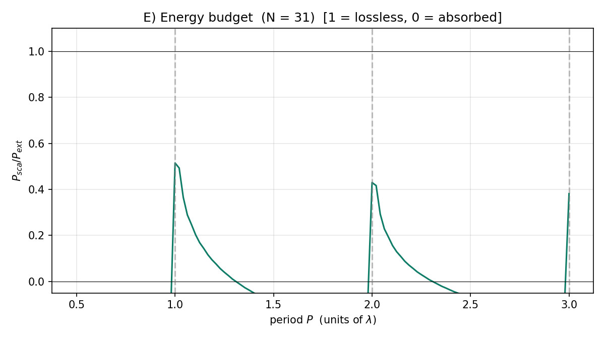
Result D + E — Numerical soundness
8 / 15
결과 D + E — 수치적 건전성
κ(A) ≤ 1.95 even at Wood anomaly • P_ext, P_abs > 0; residual stays bounded → Wood-anomaly peaks are real physics, not numerical artefacts
조건수 ≤ 2 & 에너지 양수 + 유계 → 격자 공명은 진짜 물리

Slide 10
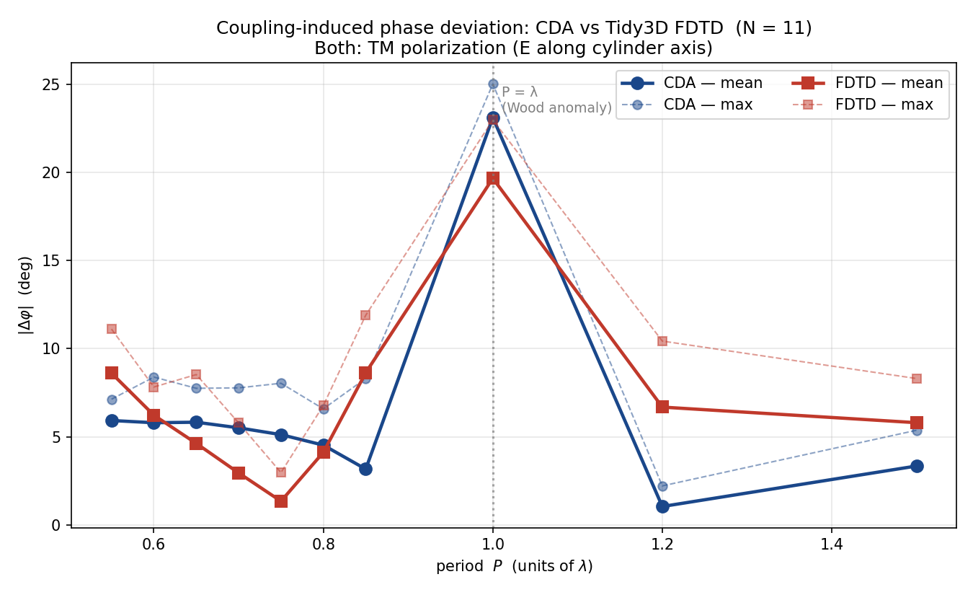
FDTD Cross-Validation (Tidy3D)
9 / 15
Tidy3D FDTD 외부 검증
Setup
설정
• 11 Lorentz cylinders, λ = 1 μm, TM E∥z
Lorentz 매질 실린더 11개
• 10 array periods + 1 calibration, ~0.3 FlexCredit
11개 시뮬, 약 0.3 FlexCredit
• Same geometry & polarization as CDA
CDA와 동일한 셋업
Verdict
검증 결과
▸ Both methods peak sharply at P = λ
Wood anomaly → real physics
▸ Sub-λ window: RMS ≈ 3°
central P range agreement < 1°
▸ CDA validated by independent full-wave
독립적 full-wave 기준 검증 완료

Slide 11
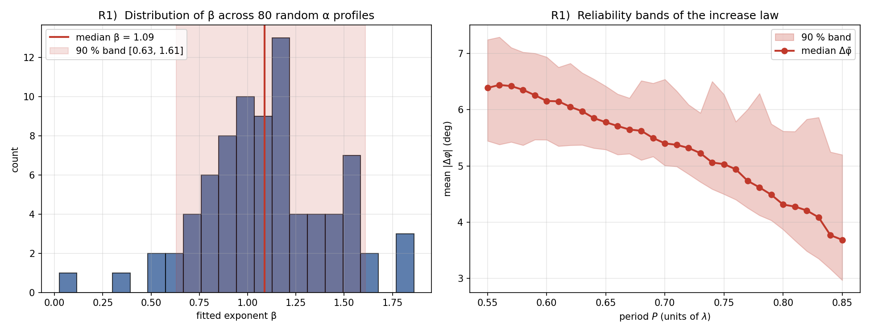
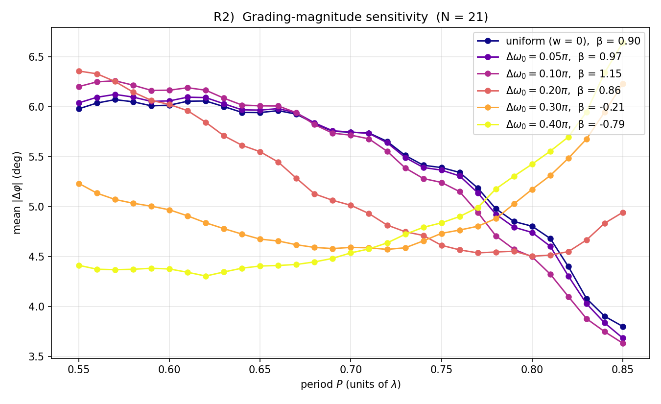
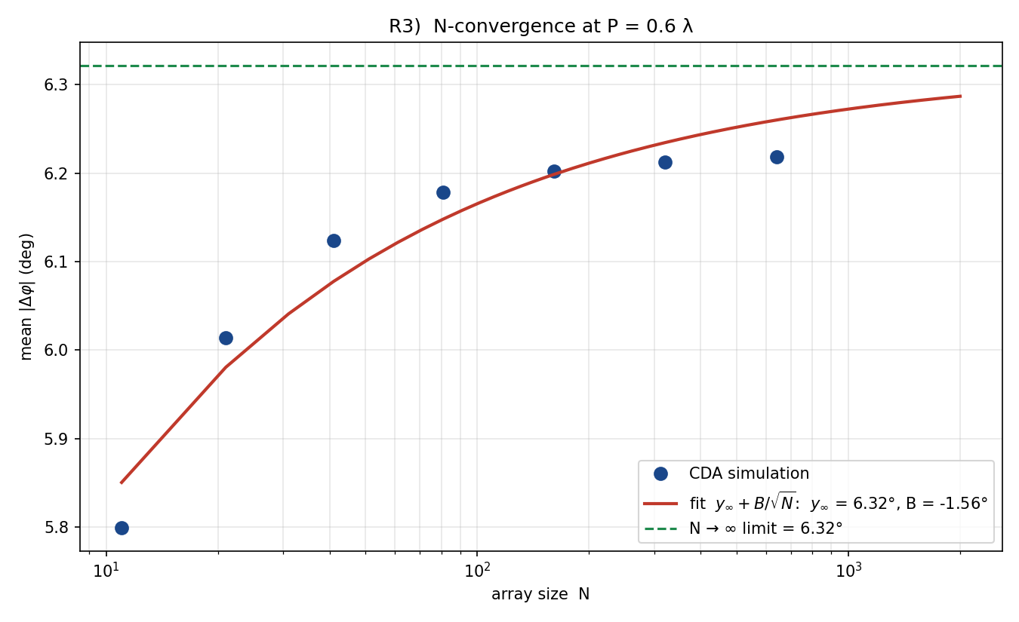
Reliability — multi-seed + grading + N→∞
10 / 15
신뢰성 검증 — 다중시드 + 그래디언트 + N→∞
80-seed median β = 1.09 • 90 % band [0.63, 1.61] • grading ≤ 0.20 π stable • N → ∞ limit ≈ 6.32°

Slide 12
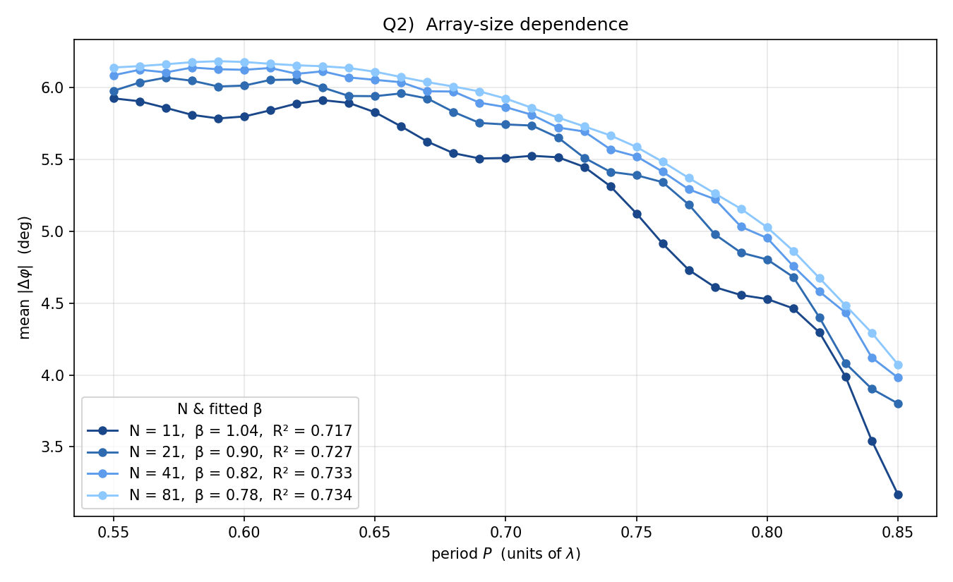
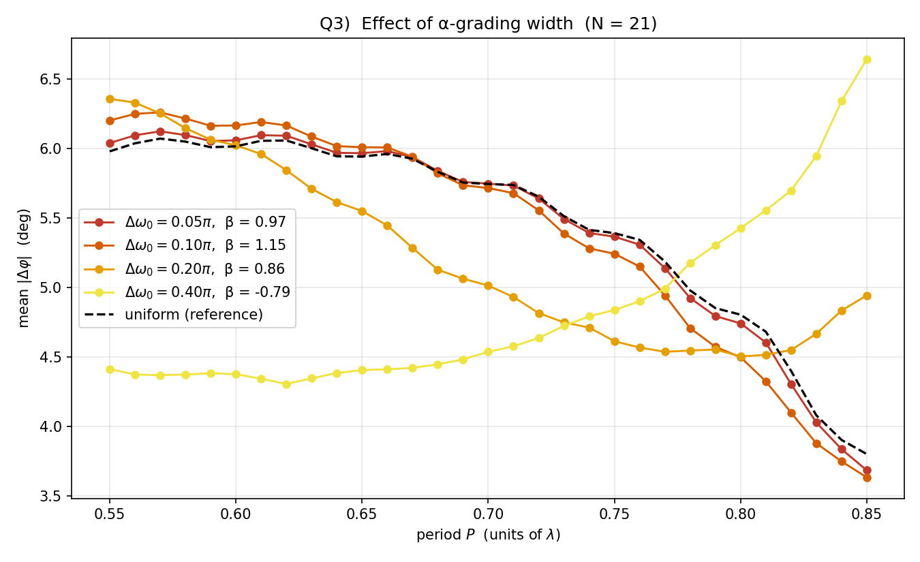
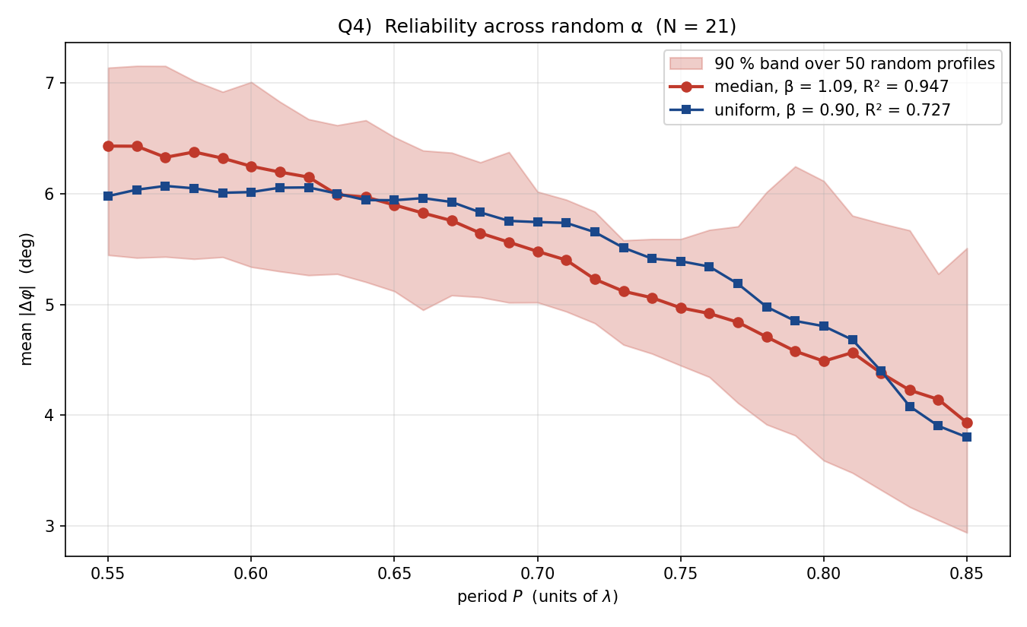
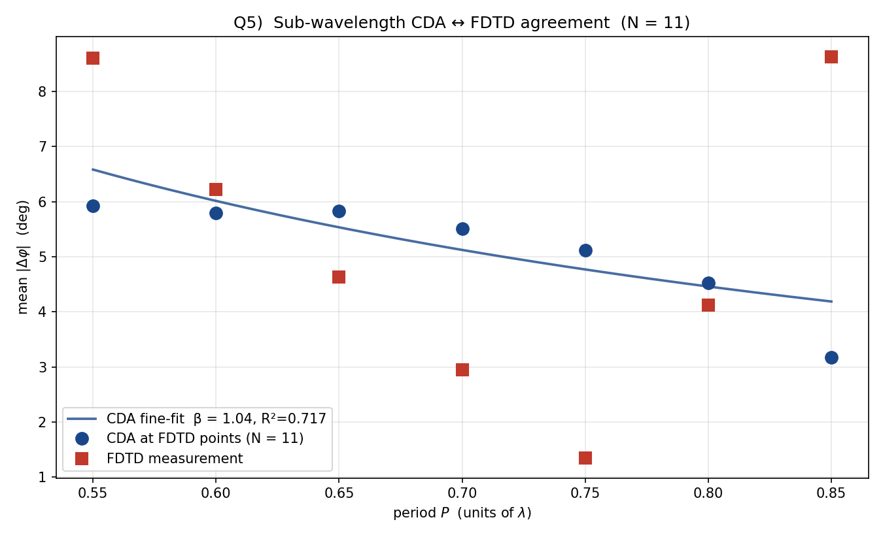
Robustness Summary
11 / 15
Robustness 종합 — 4가지 독립 검증
(a) Array size N | 배열 크기 N
(b) α-grading width | 그래디언트 폭
(c) 50 random α profiles | 랜덤 α 프로파일
(d) FDTD vs CDA (sub-λ) | FDTD 외부 검증
β stays in [0.78, 1.15] across N, grading widths up to 0.20π, random α profiles; FDTD agreement well within power-law band

Slide 13
Physics vs Numerics vs Design
12 / 15
차이의 원인 분류
Every observed feature classified by origin (PDF Week 4 requirement)
Observed feature
Origin
Comment
Power law β ≈ 0.9 (Q1, Q6)
Physics
1/P from 2D Hankel sum
+21 % extra distortion (A)
Physics
α-inhomogeneity adds coupling
Wood-anomaly peaks (CDA + FDTD)
Physics
lattice resonance, both methods
Mirror symmetry break (C)
Design
graded α by construction
α-ordering +50 % (F)
Design
smooth gradient is coupling-tolerant
β depends on F (Q8)
Physics
self-consistent coupling regime
κ(A) ≤ 2 (D)
Numerics-sound
no solver artefact
P_ext, P_abs > 0 (E)
Numerics-sound
energy bookkeeping is consistent
CDA ↔ FDTD agreement
Validation
independent full-wave reference

Slide 14
Limitations
13 / 15
한계점
• Point-dipole approximation: no multipole content
점 쌍극자 가정 — 다중극 효과 미포함
• 2D scalar geometry: TM only, no 3D vector effects
2D scalar 모델 — TM 모드만, 3D 벡터 미반영
• No substrate: free-space Green function
기판 효과 미포함 — 자유공간 Green 함수
• Finite 1D array: edge effect decays only as 1/√N
유한 배열 — edge effect 1/√N 감쇠
• No radiation-reaction correction to α (standard CDA)
α의 radiation-reaction 보정 없음

Slide 15
What I Verified Myself
14 / 15
직접 검증한 항목
▸ 10 / 10 internal physics tests
10가지 내부 물리 테스트 통과
▸ FDTD cross-validation at 10 different periods
10개 다른 P에서 FDTD 외부 검증
▸ β = 0.90 ± 0.10 with explicit log-log uncertainty
log-log 회귀로 β의 1-σ 명시적 측정
▸ Robustness: N 11–81, grading 0 – 0.20 π, random α, F 0.5 – 8
다양한 N, grading 폭, random α, F 에 대한 robustness
▸ Reliability: 80-seed bootstrap + 1/√N N→∞ extrapolation
80-seed 부트스트랩 + 1/√N 외삽 reliability
▸ Origin classification: every feature traced to physics / design / numerics
모든 관찰을 physics / design / numerics 로 분류

Slide 16
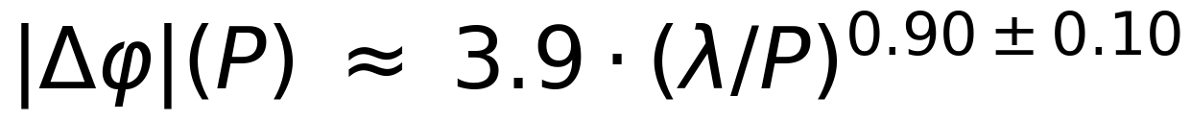
Conclusion
15 / 15
결론
Robust across N, grading, random α
β = 0.78 – 1.15 across all conditions
N, 그래디언트 폭, random α 에 robust
Cross-validated by Tidy3D FDTD
10 cloud sims, RMS = 2.9° sub-λ
10개 P에서 FDTD 외부 검증
β tunes 1.2 → 0.5 with coupling F
weak → strong coupling regime
결합 강도 F에 따라 β 1.2 → 0.5
Wood anomaly is real physics
confirmed by both CDA and FDTD
Wood anomaly 는 두 방법 모두 확인

