Slide 1
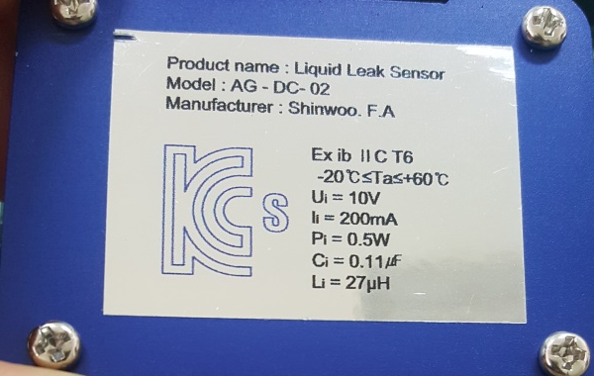


글꼴 : Arial, Size : 5.5
KC mark 는 검은 부분을 실선으로
44mm
3mm
Product name : Liquid Leak Sensor
Model : AG – DC – 02
Manufacturer : Shinwoo. F.A
6mm
Product name : Liquid Leak Sensor
Model : AG – DC – 02
Manufacturer : Shinwoo. F.A
8mm
Ex ib II C T6
-20℃≤Ta≤+60℃
Ui = 10V
Ii = 200mA
Pi = 0.5W
Ci = 0.11㎌
Li = 27μH
Ex ib II C T6
-20℃≤Ta≤+60℃
Ui = 10V
Ii = 200mA
Pi = 0.5W
Ci = 0.11㎌
Li = 27μH
8mm
32mm
6mm
3mm

