Slide 1
Lecture 4 – Network Flow Programming
Topics
Terminology and Notation
Network diagrams
Generic problems (TP, AP, SPP, STP, MF)
LP formulations
Finding solutions with Excel add-in

Slide 2
Network Optimization
Network flow programming (NFP) is a special case of linear programming
Important to identify problems that can be modeled as networks because:
Network representations make optimization models easier to visualize and explain
Very efficient algorithms are available

Slide 3
Example of (Distribution) Network

Slide 4
Terminology
Nodes and arcs
Arc flow (variables)
Upper and lower bounds
Cost
Gains (and losses)
External flow (supply an demand)
Optimal flow

Slide 5
Network Flow Problems

Slide 6
Transportation Problem
We wish to ship goods (a single commodity) from
m warehouses to n destinations at minimum cost.
Warehouse i has s_{i} units available i = 1,…,m and destination
j has a demand of d_{j}, j = 1,…,n .
Goal: Ship the goods from warehouses to destinations
at minimum cost.
Example:
Warehouse
Supply
Markets
Demand
San Francisco
350
New York
325
Los Angeles
600
Chicago
300
Austin
275
Unit Shipping Costs
From/To
NY
Chicago
Austin
SF
2.5
1.7
1.8
LA
--
1.8
1.4

Slide 7
The min-cost flow network for this transportation problem is given by
(2.5)
NY
[-325]
[350]
SF
(1.7)
(1.8)
(0)
CHI
[-300]
(M)
(1.8)
(1.4)
AUS
[-275]
[600]
LA
(0)
DUM
[-50]
Total supply = 950, total demand = 900
Transportation problem is defined on a bipartite network
Arcs only go from supply nodes to destination nodes; to handle excess supply we can create a dummy destination with a demand of 50 and 0 shipment cost

Slide 8
Modeling Issues
•
Costs on arcs to dummy destination = 0
(In some settings it would be necessary
to include a nonzero warehousing cost.)
•
The objective coefficient on the LA → NY arc is M.
This denotes a large value and effectively prohibits
use of this arc (could eliminate arc).
•
We are assured of integer solutions because
technological matrix A is totally unimodular.
(important in some applications)
•Decision variables: x_{ij} = amount shipped from warehouse i to destination j

Slide 9
The LP formulation of the transportation problem with m
sources and n destinations is given by:
m
n
Min
∑
∑
c_{ij}x_{ij}
i =1
j =1
n
s.t.
∑
x_{ij} ≤ s_{i} , i = 1,…,m (no dummy node)
j =1
m
∑
x_{ij} = d_{j} , j = 1,…,n
i =1
0 ≤ x_{ij} ≤ u_{ij} , i = 1,…,m, j = 1,…,n

Slide 10
Solution to Transportation Problem

Slide 11
Assignment Problem
Special case of transportation problem:
• same number of sources and destinations
• all supplies and demands = 1
Example
4 ships to transport 4 loads from single port
to 4 separate ports;
Each ship will carry exactly 1 load;
Associated shipping costs as shown.
Port/load
1
2
3
4
1
5
4
6
7
Ship
2
6
6
7
5
3
7
5
7
6
4
5
4
6
6

Slide 12
Problem: Find a one-to-one matching between ships and ports in such a way as to minimize the total shipping cost.
(5)
[1]
1
(4)
1
[-1]
(6)
(7)
(6)
[1]
2
(6)
2
[-1]
(7)
(5)
(7)
(5)
[1]
3
(7)
3
[-1]
(6)
(5)
(4)
(6)
[1]
4
4
[-1]
(6)
{
1, if ship i goes to port j
0, otherwise
Decision variables are x_{ij} =

Slide 13
Characteristics of Assignment Problem
Note that from a feasibility perspective it could be possible to have x₁₁ = x₁₂ = x₁₃ = x₁₄ = ¼. But we know that a pure network flow problem guarantees that the simplex method will yield an integer solution. In this case we know that each x_{ij} will either take on 0 or 1.
If a particular ship cannot carry a particular load then we can use M as in the transportation problem.
Other types of assignments:
  a. workers to jobs
  b. tasks to machines
  c. swimmers to events (in a relay)
  d. students to internships

Slide 14
Shortest Path Problem
Given a network with “distances” on the arcs, our goal is to find the shortest path from the origin to the destination.
These distances might be length, time, cost, etc, and the values can be positive or negative. (A negative c_{ij} can arise if we earn revenue by traversing an arc.)
The shortest path problem may be formulated as a special case of the pure min-cost flow problem.

Slide 15
Example
(c_{ij}) = cost/length
2
(2)
4
(4)
(3)
(2)
(1)
(1)
[1]
1
6
[-1]
(6)
(7)
3
(2)
5
We wish to find the shortest path from node 1 to node 6.
To do so we place one unit of supply at node 1 and push it through the network to node 6 where there is one unit of demand.
All other nodes in the network have external flows of zero.
← SP Tree Solution

Slide 16
Shortest Path Problem Solution
x
∗
= 1,
x
∗
= 1,
x
∗
= 1,
x
∗
= 0 for all other arcs
12
24
46
ij
Total length (objective value) = 9

Slide 17
Network Notation
A = set of Arcs, N = set of nodes
Forward Star for node i : FS(i ) = { (i, j ) : (i, j ) ∈ A }
Reverse Star for node i : RS(i ) = { (j,i ) : (j,i ) ∈ A }
FS(i )
RS(i )
i
i

Slide 18
Shortest Path Model
In general, if node s is the source node and node t is the termination node then the shortest path problem may be written as follows.
Min
∑
c_{ij}x_{ij}
(i, j )∈A
{
1, i = s
–1, i = t
0, i ∈ N \ {s, t}
s
.t.
∑
x_{ij}
−
∑
x_{ji}
=
(i, j )∈FS(i )
(j, i )∈RS(i )
x_{ij} ≥ 0, ∀ (i, j ) ∈ A

Slide 19
General Solution to Shortest Path Problem
{
1, if (i,j) is on the shortest path
0, otherwise
In general,
x*
=
ij
As in the assignment problem, the integer nature of the solution is key to this shortest path formulation.
Examples of shortest path problems:
a. airline scheduling
b. equipment replacement
c. routing in telecommunications networks
d. reliability problems
e. traffic routing

Slide 20
Shortest Path Tree Problem
It is sometimes useful to find the shortest path from node s to all other m − 1 nodes in the network.
We could do this by solving a collection of shortest path problems, but it is simpler to use a single min-cost flow formulation:
Min
∑
c_{ij}x_{ij}
(i,j )∈A
{
m – 1, i = s
–1, i ∈ N \ {s}
s.t.
∑
x_{ij}
−
∑
x_{ji} =
(i, j )∈FS(i )
(j, i )∈RS(i )
x_{ij} ≥ 0, ∀ (i, j ) ∈ A
where m = |N| = number of nodes

Slide 21
In our example, the shortest path tree is
4
(2)
6
2
4
(4)
(3)
(1)
1
9
6
(6)
3
5
6
5
Each node is labeled with its shortest-path distance to node 1.

Slide 22
Application: Network Reliability
Consider a communications network in which the probability that arc (i, j ) is “up” is p_{ij}.
If the arcs fail independently then the probability that all arcs on a path from the origin s to the termination node t are “up” is the product of the individual arc probabilities.
Routing a message/call from origin to destination so that the probability it arrives is maximized is equivalent to picking P from the set Path so that we have:
where “Path ” is the set of feasible paths through the network.

Slide 23
Equivalent Formulation
We can turn a “Max” into a “Min” via
Now we must introduce network variables x_{ij} and constraints.

Slide 24
Another Application: Knapsack Problem
A hiker must choose among n items to place in a knapsack for a trip.
Each item has a weight of w_{i} (in pounds) and value of v_{i}.
The goal is to maximize the total value of the items in the knapsack subject to the total weight of the knapsack not exceeding W pounds.
Problem can be formulated as a shortest (or longest) path problem.
Example:
i
1
2
3
4
v_{i}
.
40
15
20
10
Four items with their
weights and values
w_{i}
4
2
3
1

Slide 25
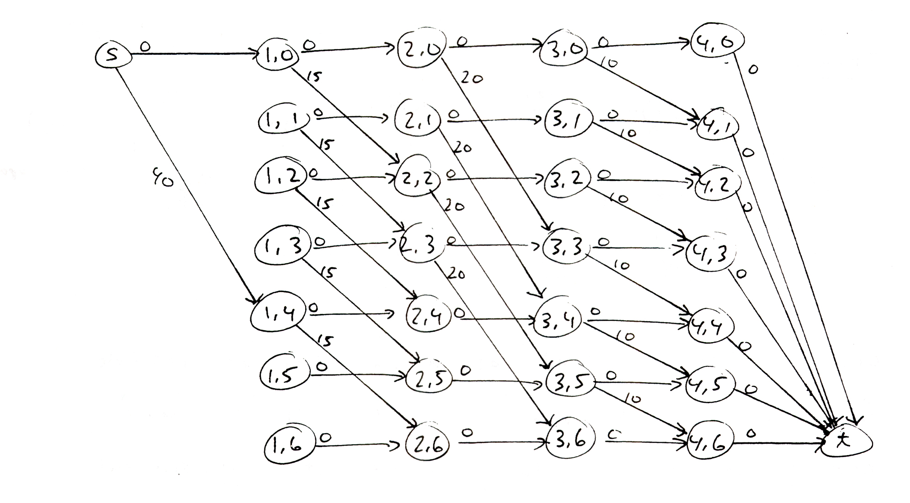
Network for Knapsack Example
Our knapsack has a weight limit of W = 6
Stage 0
Stage 1
Stage 2
Stage 3
Stage 4
Stage 5

Slide 26
Notation for Knapsack Network
The nodes have the form (stage, state) where
stage
corresponds to the item # just
selected or rejected (except for
artificial stages s and t )
state
corresponds to the weight capacity
consumed so far.
We solve the knapsack problem by finding the longest path from s to t. (This can be converted into a shortest path problem by multiplying all costs by –1).
This is an example of a dynamic programming problem.

Slide 27
Maximum Flow Problem
In the maximum flow problem our goal is to send the largest amount of flow possible from a specified origin node to a specified destination node subject to arc capacities.
This is a pure network flow problem (i.e., g_{ij} = 1) in which all the (real) arc costs are zero (c_{ij} = 0) and at least some of the arc capacities are finite.
Example
2
(2)
(4)
4
(3)
(1)
(u_{ij}) = arc capacity
(2)
(1)
6
1
(6)
(2)
(7)
3
5
← Max-cut

Slide 28
Max Flow Example
Our goal is to send as much flow as possible from node 1 to node 6. (This is the same network we used in the shortest path discussion but now the arc labels represent capacities not costs.)
Solution
[2] (2)
[3] (4)
2
4
[2] (3)
[x_{ij}] (u_{ij})
flow capacity
[1] (1)
1
[0] (1)
6
[0] (2)
[2] (6)
3
5
[3] (7)
[2] (2)
[5] (∞)
Maximum flow = 5
MF Excel Solution →

Slide 29
Max Flow Problem Formulation
There are several different linear programming formulations.
The one we will use is based on the idea of a “circulation.”
We suppose an artificial return arc from the destination to the origin with u_{ts} = +∞ and c_{ts} = 1.
External flows (supplies and demands) are zero at all nodes.
s
t

Slide 30
Max Flow LP Model
Max x_{ts}
s.t.
∑
x_{ij}
−
∑
x_{ji} = 0, ∀ i ∈ N
(i,j )∈FS(i )
(j,i )∈RS(i )
0 ≤ x_{ij} ≤ u_{ij}
∀ (i,j ) ∈ A
where x_{ts} is the flow on the circulation arc (t,s).

Slide 31
Min-Cut Problem
Cut: A partition of the nodes into two sets S and T. The origin node must be in S and the destination node must be in T.
Examples of cuts in the network above are:
S₁
= {1}
T₁
=
{2,3,4,5,6}
S₂
= {1,2,3}
T₂
=
{4,5,6}
S₃
= {1,3,5}
T₃
=
{2,4,6}
The value of a cut V(S,T) is the sum of all the arc capacities that have their tails in S and their heads in T.
V(S₁,T₁) = 10
V(S₂,T₂) = 5
V(S₃,T₃) = 14

Slide 32
Max-Flow Min-Cut Theorem
The value of the maximum flow = value of the minimum cut.
In our problem, S = {1,2,3} / T = {4,5,6} is a minimum cut.
The arcs that go from S to T are (2,4), (2,5) and (3,5).
Note that the flow on each of these arcs is at its capacity. As such, they may be viewed as the bottlenecks of the system.

Slide 33
Identifying the Min Cut
Identify minimum cut from sensitivity report:
If the reduced cost for x_{ij} has value 1 then arc (i,j ) has its tail (i ) in S and its head (j ) in T.
Reduced costs are the shadow prices on the simple bound constraint x_{ij} ≤ u_{ij}.
Value of another unit of capacity is 1 or 0 depending on whether or not the arc is part of the bottleneck
Note that the sum of the arc capacities with reduced costs of 1 equals the max flow value.

Slide 34
Max Flow Problem Solution
← MF Example

Slide 35
Sensitivity Report for Max Flow Problem
Adjustable Cells
Final
Reduced
Objective
Allowable
Allowable
Cell
Name
Value
Cost
Coefficient
Increase
Decrease
$E$9
Arc1 Flow
3
0
0
1E+30
0
$E$10
Arc2 Flow
2
0
0
0
1
$E$11
Arc3 Flow
0
0
0
0
1E+30
$E$12
Arc4 Flow
2
1
0
1E+30
1
$E$13
Arc5 Flow
1
1
0
1E+30
1
$E$14
Arc6 Flow
2
1
0
1E+30
1
$E$15
Arc7 Flow
0
0
0
0
1E+30
$E$16
Arc8 Flow
2
0
0
0
1
$E$17
Arc9 Flow
3
0
0
1E+30
0
$E$18
Arc10 Flow
5
0
1
1E+30
1
Constraints
Final
Shadow
Constraint
Allowable
Allowable
Cell
Name
Value
Price
R.H. Side
Increase
Decrease
$N$9
Node1 Balance
0
0
0
0
3
$N$10
Node2 Balance
0
0
0
1E+30
0
$N$11
Node3 Balance
0
0
0
0
3
$N$12
Node4 Balance
0
1
0
0
2
$N$13
Node5 Balance
0
1
0
0
3
$N$14
Node6 Balance
0
1
0
0
3

Slide 36
What You Should Know About Network Flow Programming
How to formulate a network flow problem.
How to distinguish between the different network-type problems.
How to construct a network diagram for a particular program.
How to find a solution to a problem using the network Excel add-in.

