Slide 1
Introduction
Chat Orbit is messenger app for android smartphones. Chat Orbit uses the internet to send text messages. The service is very similar to text messaging services, however, because Chat Orbit uses the internet to send messages, the cost of using Chat Orbit is significantly less than texting.
The core aims of this project are:
To build an communication between friends connected in the group.
To set a privacy by encrypting the messages sent on the groups , no one outside the group can read or write the messages .
To share the information when the sender and receiver is far away from each other .
Tools used : Android Studio
Frontend: XML
Backend : Java
Database : Google firebase

Slide 2
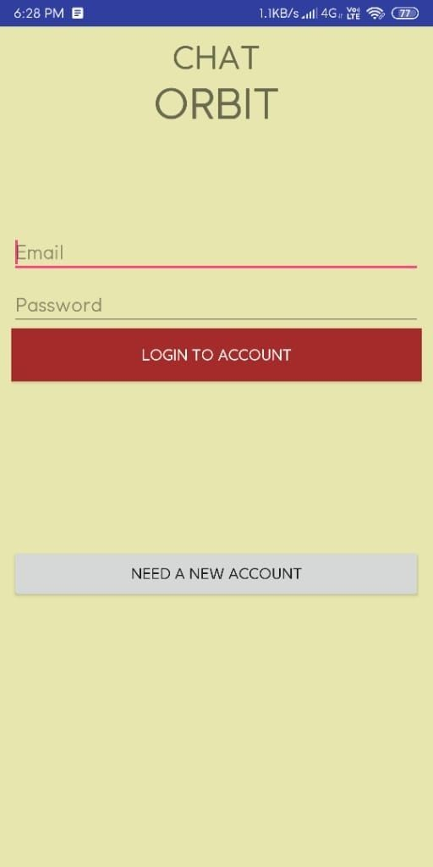
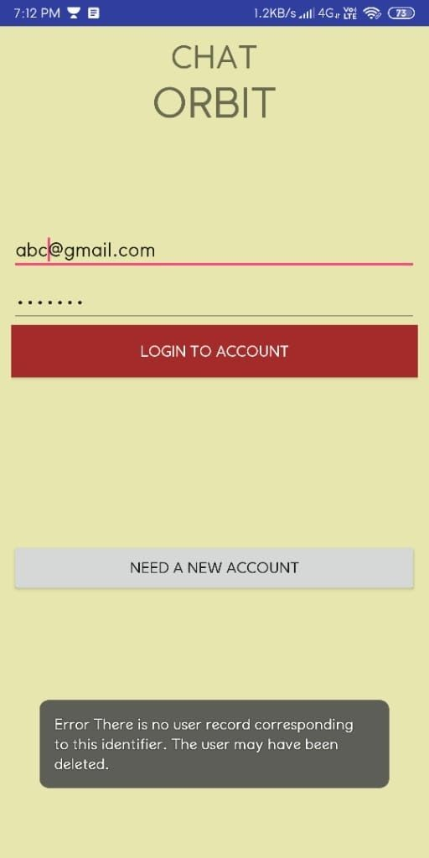
Login Page
If a user wants to go to the home page of the application, firstly a user has to enter the email Id and password and then press the login button. The entered Id and password check with database’s Id and password if a user entered the wrong Id and password application shows invalid Id and password.

Slide 3
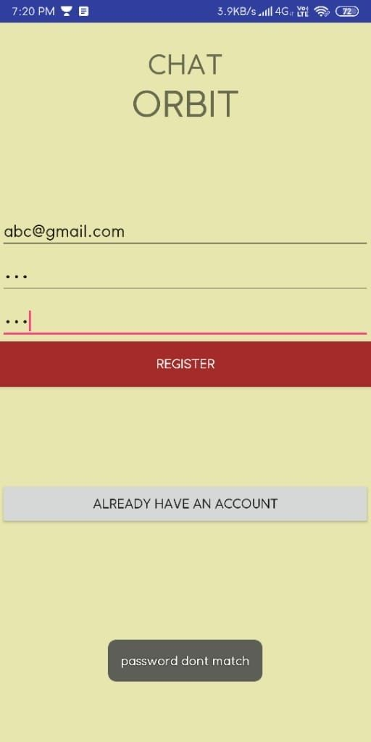
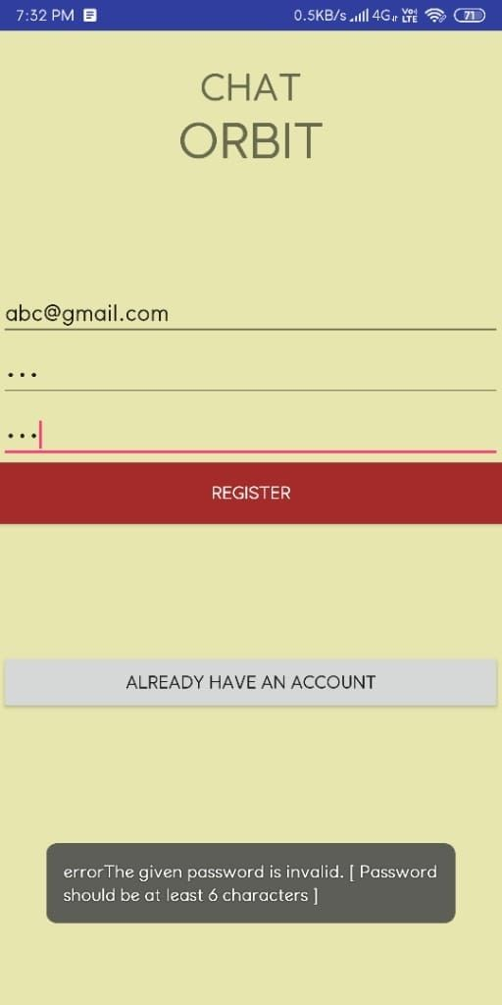
Registration Page
On the registration page, a user has to enter a valid email Id and a valid password of a minimum of 6 characters. If a user does not enter a valid password application shows a warning message (error: password should be at least 6 characters).

Slide 4
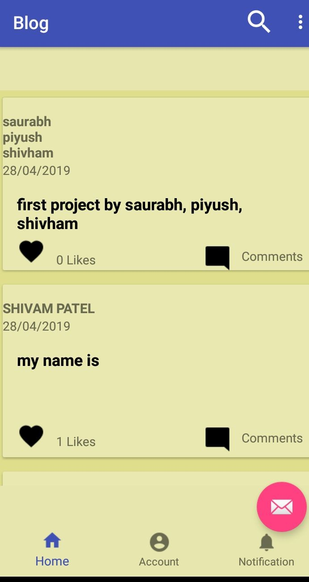
Main Page
On the home page of the application, user can do group chatting with friends, a user only needs an internet connection. A user able to give a like on chat and also able to leave a comment. A user can also see chat details.

Slide 5
Future Enhancement
In the future we will work on the various functions and facilities which make the app more interactive. Features like u will be able to change your existing password or u can delete your account if u don’t want to continue with us in future. Else we will try to bring features in which you will be able to upload photos and videos with text. Regular updates will be provided to the users according to the feedback which are provided to us by the users themselves .

