Slide 1
INTRODUCTION
This is an e-commerce website, in this website the user can buy clothes online, this website is completely responsive, we can run it in anything without any problem. User can also view his/her cart.
Technologies used:-
HTML, CSS, Javascript, XML.
Tools used:- Notepad++, chrome, visual studiocode.

Slide 2
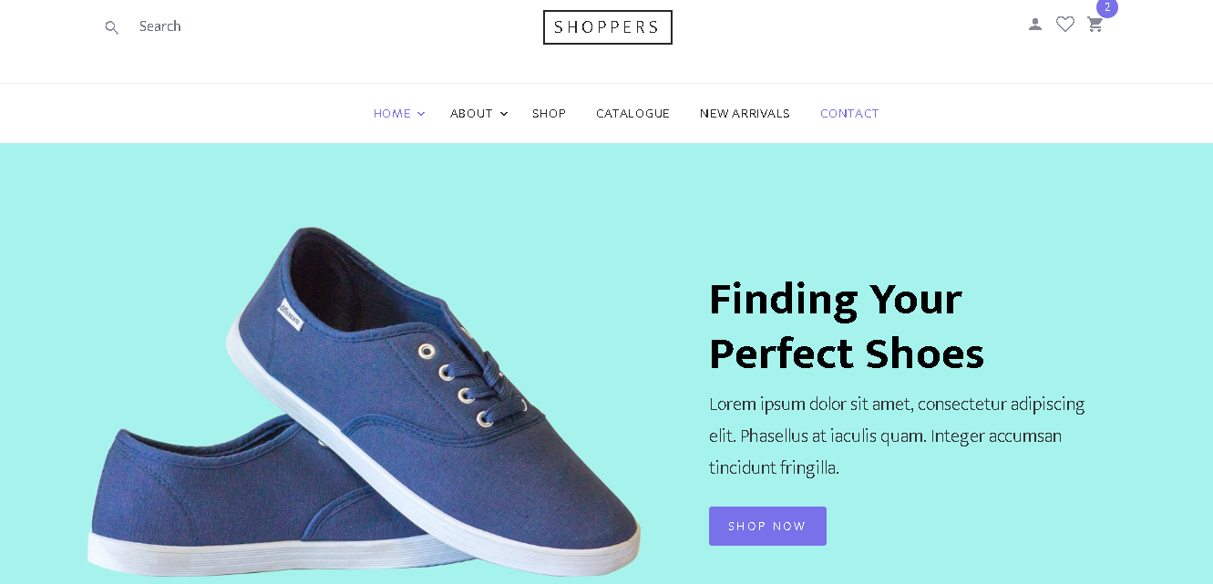
HOME PAGE
The Home page is a default page, a user is able to start their shoppping through this page. This page contains search bar on top right corner. A user can go directly on about, contact, shop and etc pages directly.

Slide 3
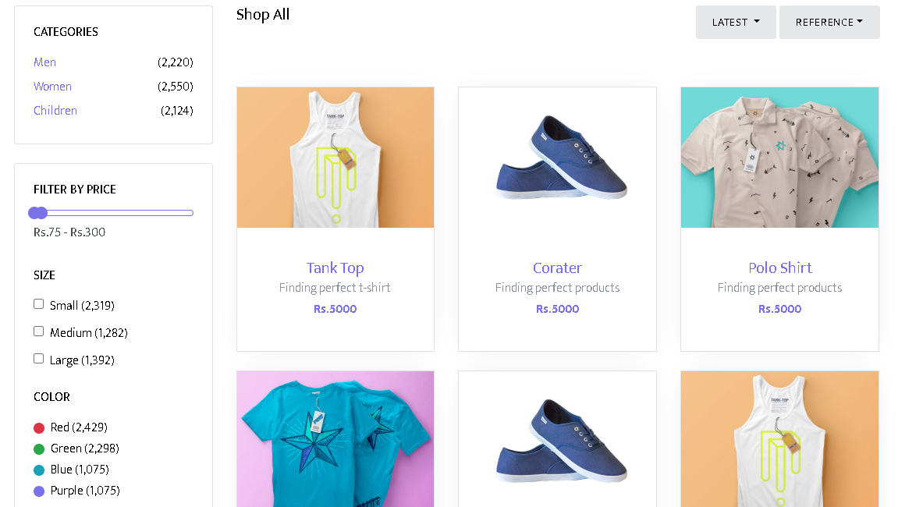
SHOP PAGE
In the shop page a use can see the products and their price . A user is able to filter the price of products, size and color.

Slide 4
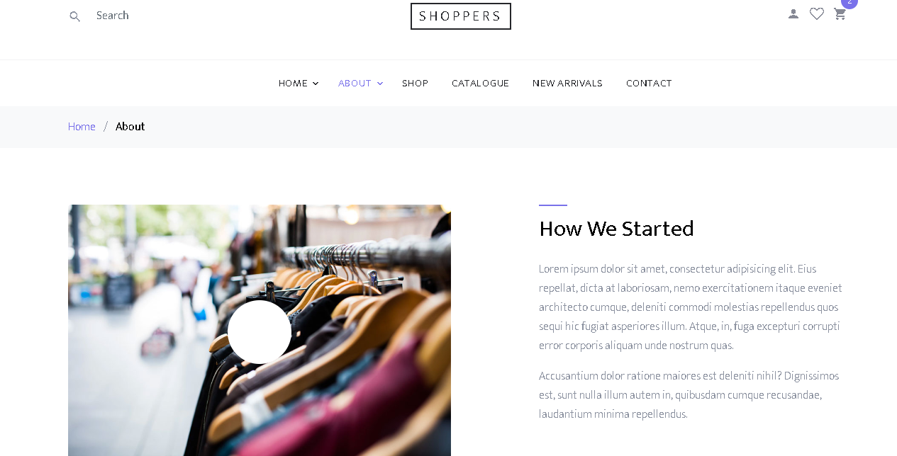
ABOUT PAGE
About page gives information about developers, how website made and which technologies and tools used.

Slide 5
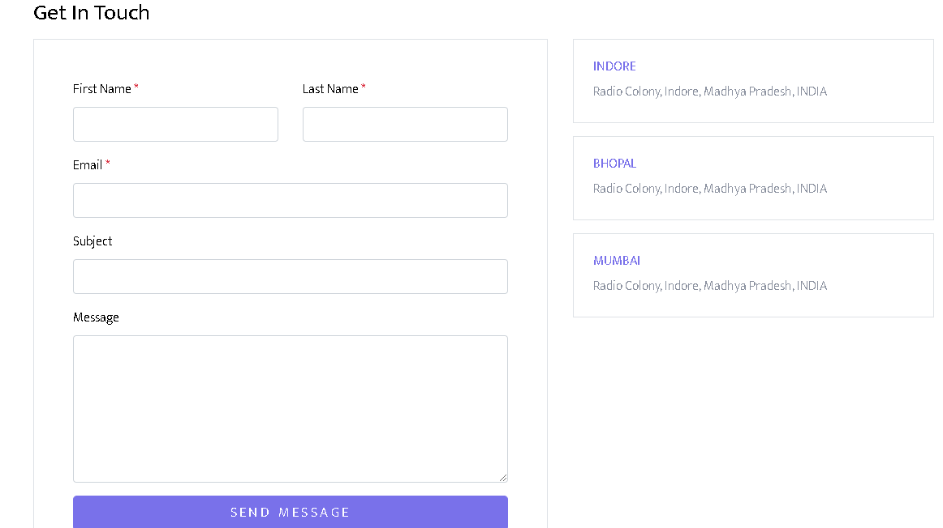
CONTACT PAGE
In the contact page a user can leave their personal iinformation, which helps a user to get update notification.

Slide 6
FUTURE ENHANCEMENT
Make it more attractive and user friendly.
Make it more featuristic, means starts payment feature using backend coding.
Add authentication (Login/Signup pages).
Add location tracking feature.

