Slide 1
Website based on health and Nutrition information
Website contains information related to food nutritions, vitamins, etc. A default home page is created which user can access without login to gather/read the information.
Once registration/login is done, a home page is displayed.
Front designing is done using html, css and bootstrap. Php is used for backend and mysql for database.
Tools used: xampp,sublime text editor.

Slide 2
introduction
The first page is the default for every user. Once the user do a registration/login user will be able to go to the home page. Once the user comes to the home page the user sees the basic definition of vitamins and nutritions, in the left side of the home page, there is a list with active hyperlinks. Every element of the list takes you to the next web page which contains health information related to link.
Let’s check few pages.

Slide 3
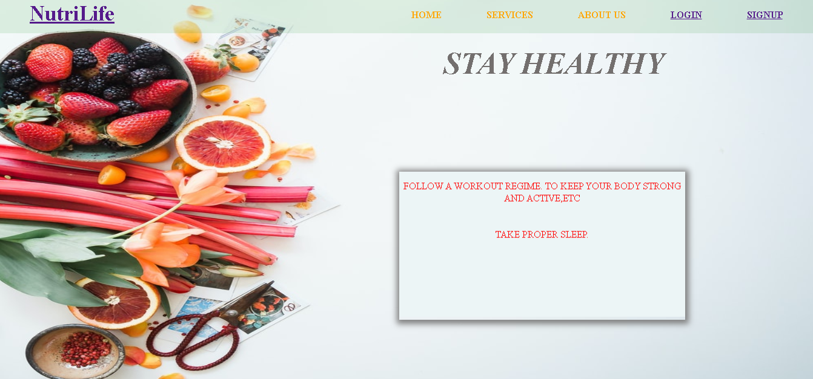
Default page
Default page having a news slider, login button, signup button, service button, and more. When the user clicks on the login/signup button code takes the user to login/signup page. News slider gives update news about heath and also gives tips to live healthy life

Slide 4
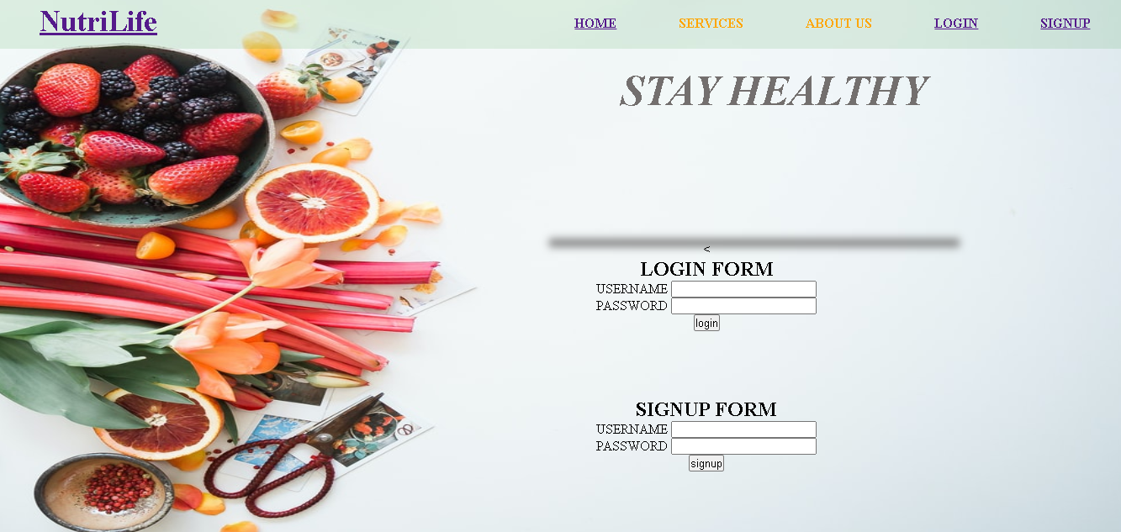
Login/signup page
Now the user has to do login or signup if not registered.
During login period the code validates the userid and password that the user entered valid id and password or not. Validation is done on the basis of database
Where the user’s data is present. Once the user complete successfully login website takes the user to the home page.

Slide 5
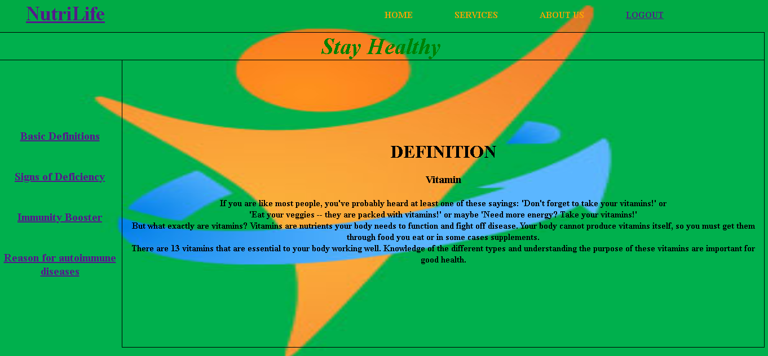
home page
The home page contains a definition related to vitamins and nutritions. On the left side of the home page, there is a list which contains elements and each element has their own page, to achieve this page user has to click on an element because elements contain the hyperlink. It has a login button, which takes the user to default page.

Slide 6
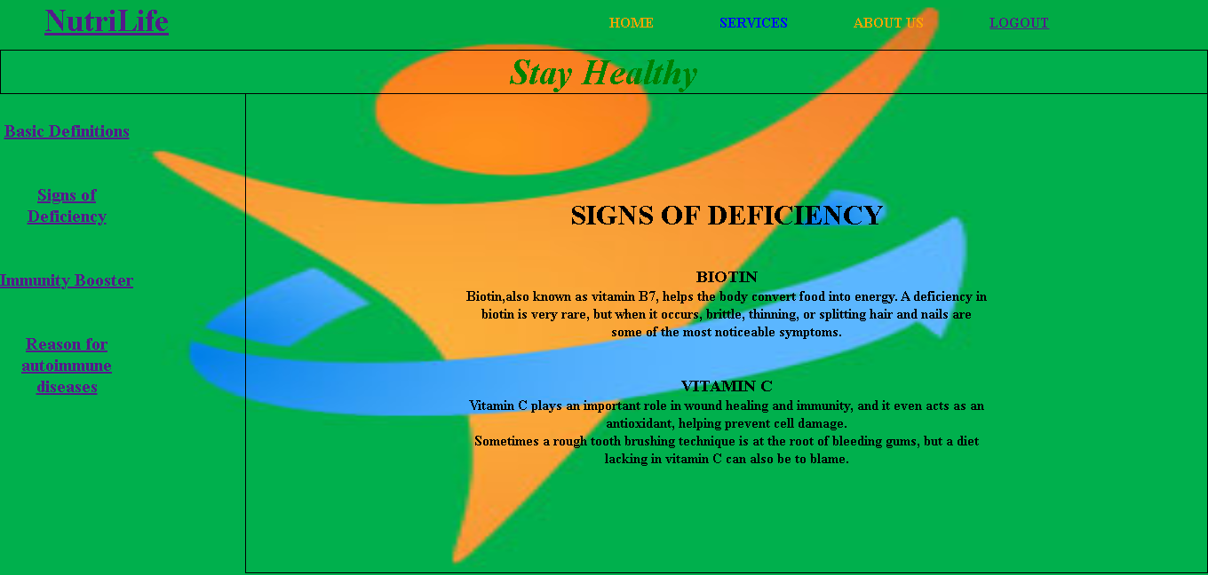
signs of deficiency pAGE
This page gives information about the deficiencies' sign, means which signs come when the body gets deficient in any vitamins and minerals. This page is connected to other pages, so the user can go on those pages directly and easily. This page also contains the logout option, which takes the user to the default page

Slide 7
FUTURE ENHANCEMENT
Make this website more informative.
Make it more aesthetical.
Make it more user friendly.
Make it more responsive.

