Slide 1
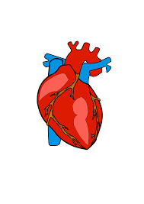
Advance Data Science Final Project
Heart Disease Prediction
Presented By -
Shreya Soni (NUID: 002146758)
Sanika Patne (NUID: 001099125)

Slide 2
Dataset
It contains 17 features and 1 target:
BMI
Smoking
Alcohol Drinking
Stroke
Physical Health
Mental Health
DiffWalking
Sex
AgeCategory
Race
Diabetic
PhysicalActivity
GenHealth
SleepTime
Asthma
KidneyDisease
SkinCancer
HeartDisease -> Target Variable

Slide 3
Algorithms Implemented -
Random Forest
Logistic Regression
K Nearest Neighbour
Decision Tree
XGBoost

Slide 4
Methods used to improve accuracy -
Hyper parameter tuning.
Regularization
Principal Component Analysis

Slide 5
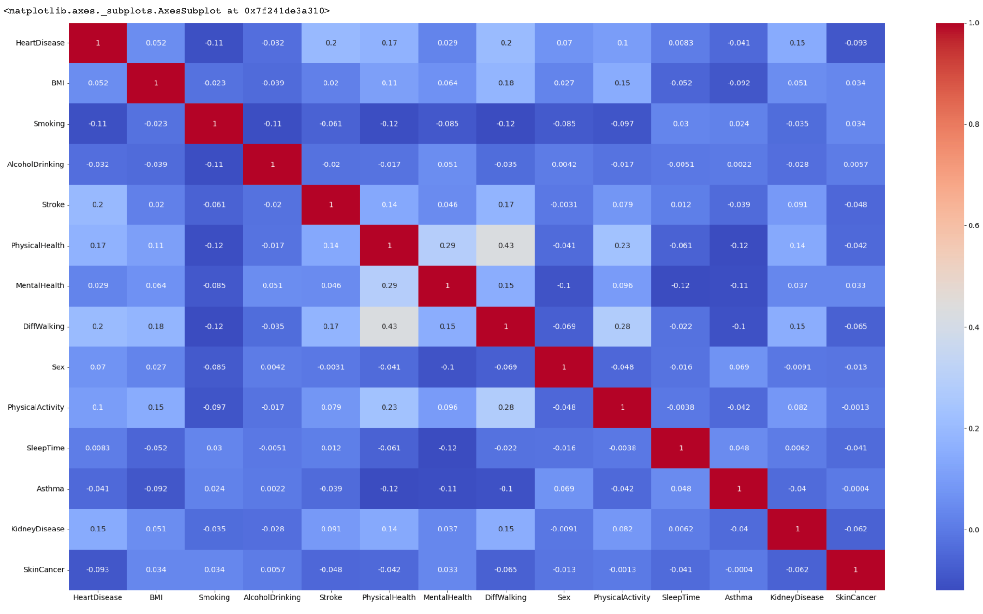

Slide 6
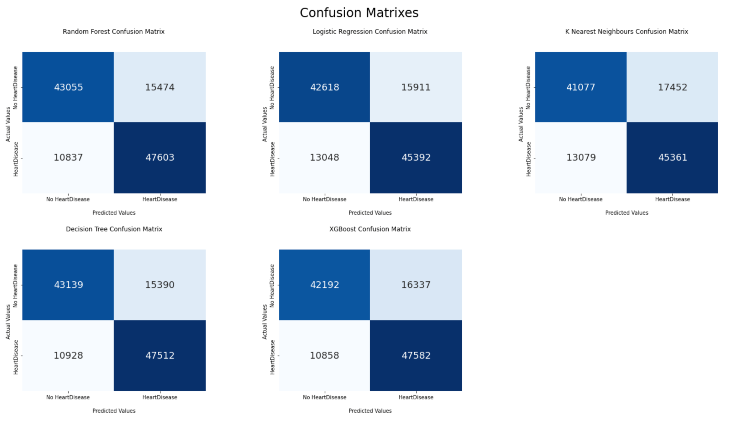

Slide 7
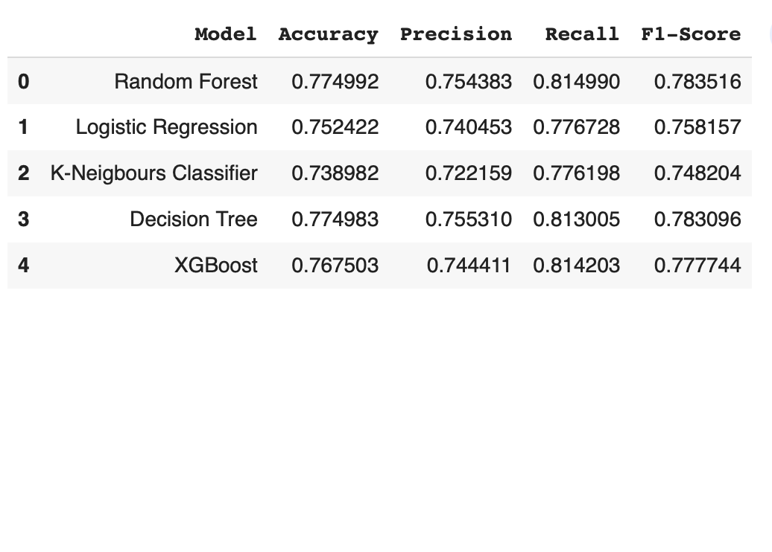
Conclusion
All the models results in almost similar accuracy.
Random Forest and Decision Tree gives the best score for the Precision and Recall. However, it is most useful when the dataset is imbalance.
F1-score combines the Precision and Recall metrics.

