Slide 1
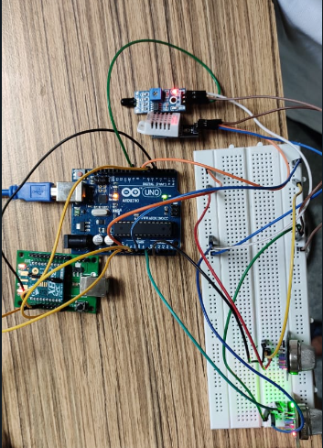
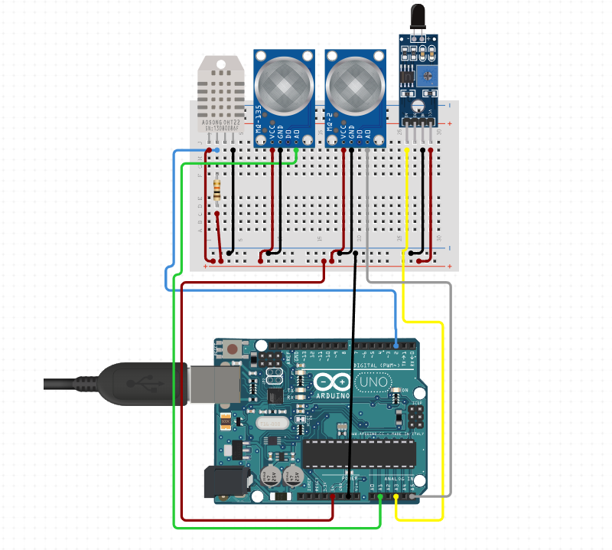
SMART FIRE DETECTION SYSTEM
IMPLEMENTATION
We have successfully created a smart wireless network which provides real time data about the conditions surrounding a localized fire. This implementation covers detecting high smoke levels and high levels of toxic gases (which are the main causes of death in a building fire). Data collected is parsed at the coordinator.
FUTURE SCOPE:
Data received from this mesh network can be uploaded to cloud for analysis. Safe routes to fire exits can be determined and shared with residents of the building leading them to safety till help arrives. Fire fighting crew can also be alerted and guided to the hazardous zones. Furthermore the spread of fire and smoke can also be estimated with the help of AI and ML.
COMPONENTS USED
DHT22 : Record Temperature and humidity of a room which are vital elements to figure out if it’s a fire or a false alarm
MQ135: Air Quality of a room to alert if a place is highly susceptible to fire outbreak
MQ2: Smoke detection to prevent fatality due to large amount of smoke
FLAME SENSOR: To detect flame through IR radiation
XBEE S2C: Create a mesh network for communication (relaying information from one end system to coordinator
ARDUINO UNO and RASPBERRY PI : Provide computational properties to end systems and coordinator.

