Slide 1

Removing Diffraction from X-ray Fluorescence Spectra for HfO2 Thin Film Characterization
Sonia Ghoshal
Mentor: Dr. Donald Windover
MML Div 643, Group 02

Slide 2

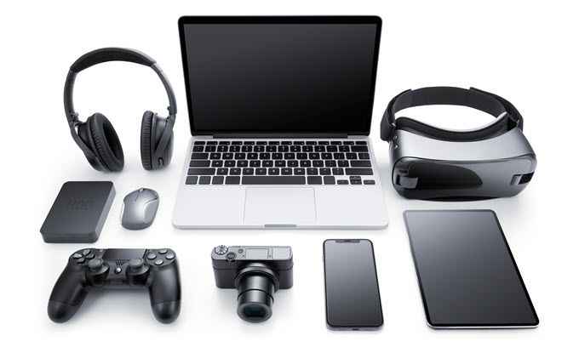
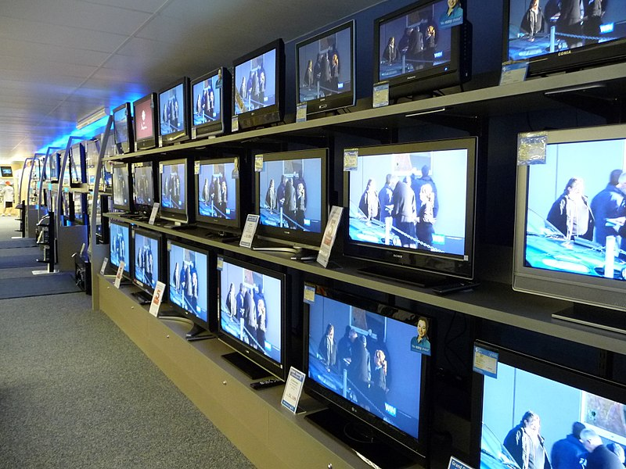
Motivation: Transistors
Gate
Source
Drain
Gate oxide (HfO2)
n+
n-channel
n+
p-type substrate (Si)
Ganninger, D. (2023, June 7). Why are mobile phones called cell phones? - Knowledge Stew - medium. Medium. https://medium.com/knowledge-stew/why-are-mobile-phones-called-cell-phones-5c7351c1be7d
Pawn, P. (2023, May 2). Sell my electronics. PB Pawn &Amp; Jewelry. https://www.pbpawn.com/sell-my-electronics/
Wags05 at English Wikipedia, Public domain, via Wikimedia Commons

Slide 3
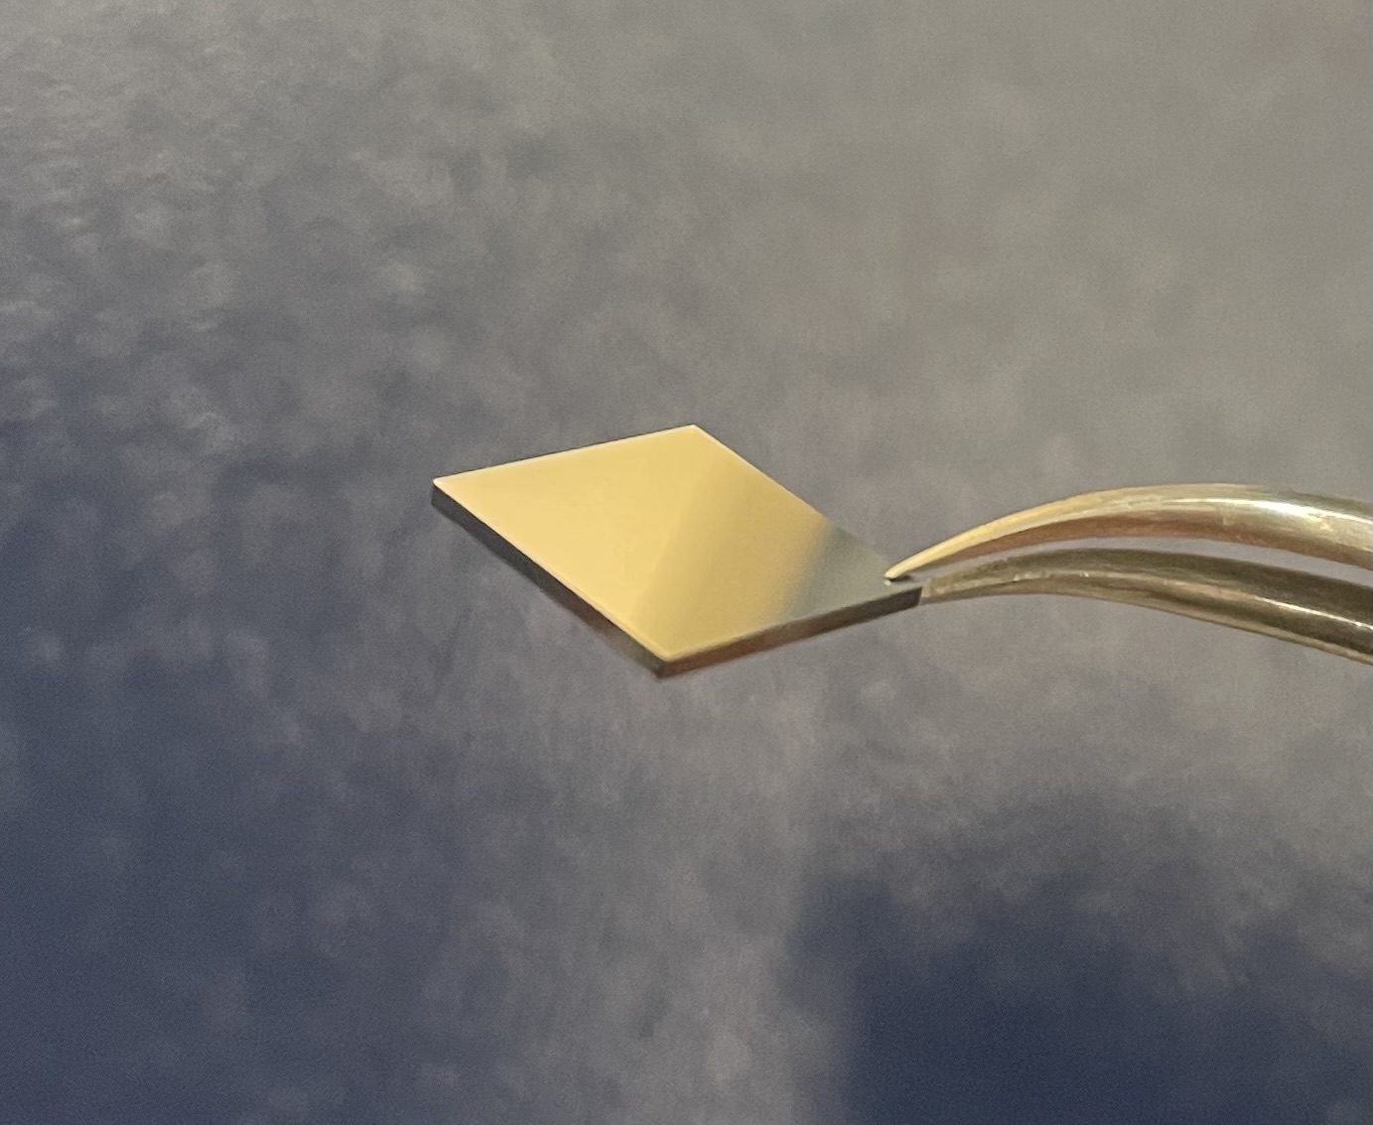
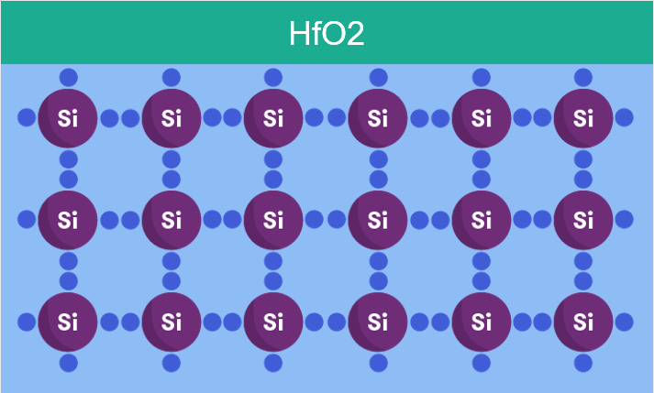
Goal
Assess the qualities of HfO2 films from manufacturers (thickness, uniform distribution, elemental composition)
Sarah. (2017, November 7). From sunlight to electricity. Curious. https://www.science.org.au/curious/technology-future/solar-pv

Slide 4
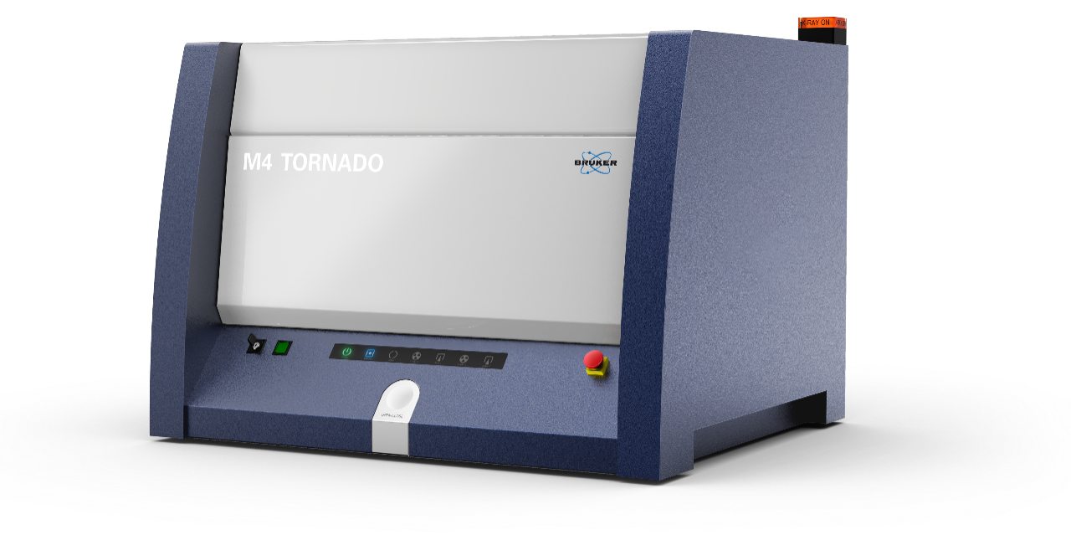
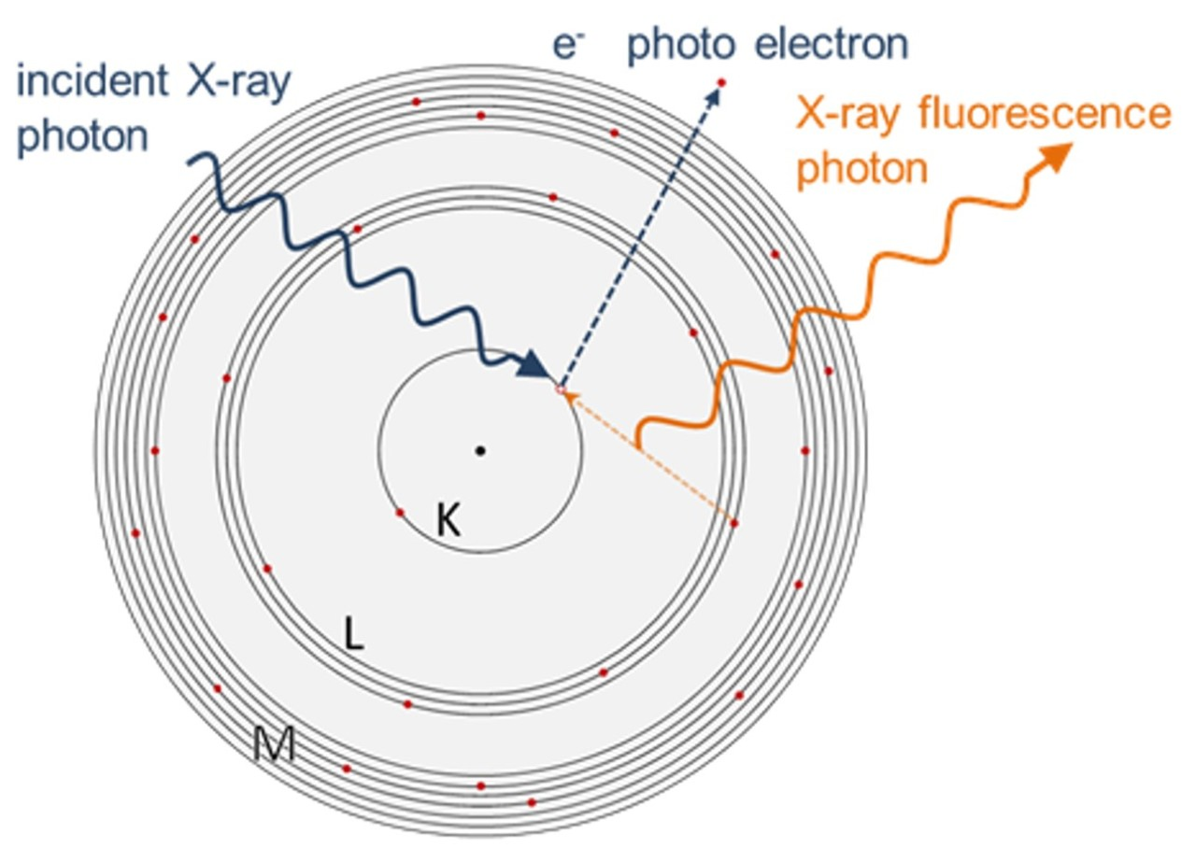
Tool: Micro-X-ray Fluorescence (mXRF)
x-ray source
x-ray beam
detector
sample
fluorescence
“fingerprint”
XMS. (n.d.). Bruker. https://www.bruker.com/en/products-and-solutions/elemental-analyzers/in-line-xrf-analyzers/xms-automated-xrf.html?source=bing&medium=cpc&campaign=GSN_|_North-America&content=03_-_GSN_|_Generic_|_In-Line-XRF&s_kwcid=AL!14677!10!83769453251626!83770229450087&msclkid=a47a2953beb5119e21904fe296eb2760

Slide 5
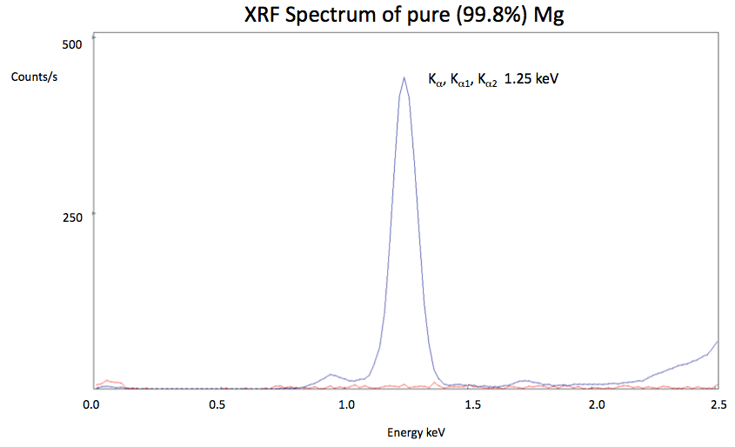
Tool: Micro-X-ray Fluorescence (mXRF)
XMS. (n.d.). Bruker. https://www.bruker.com/en/products-and-solutions/elemental-analyzers/in-line-xrf-analyzers/xms-automated-xrf.html?source=bing&medium=cpc&campaign=GSN_|_North-America&content=03_-_GSN_|_Generic_|_In-Line-XRF&s_kwcid=AL!14677!10!83769453251626!83770229450087&msclkid=a47a2953beb5119e21904fe296eb2760

Slide 6
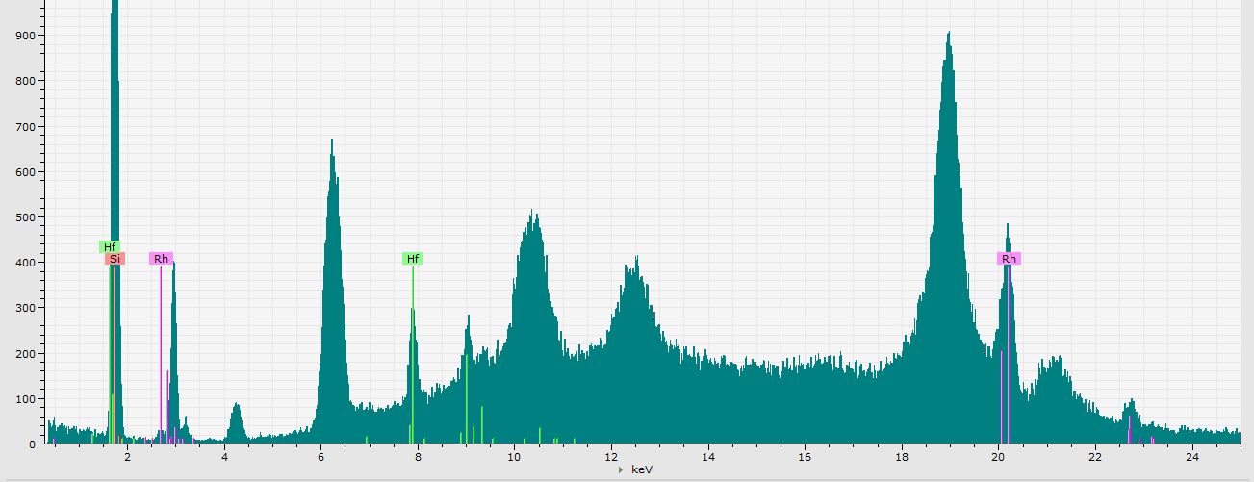
Problem: Diffraction
Light passing through a small slit scatters
= diffraction
Si lattice spacing → diffraction
Our samples have a relatively very thick layer of Si compared to the HfO2 layer
Diffraction peaks!

Slide 7
How do we remove diffraction?
rotate the sample
use software
apply filters

Slide 8

1) Filters
Thin sheets of Al, Ti, Cu
Purpose: decrease background radiation
TRADEOFF: removing noise at the expense of losing the actual signal
Findings: effective at reducing noise, but reduced Hf counts too much
x-ray source
x-ray beam
detector
sample

Slide 9
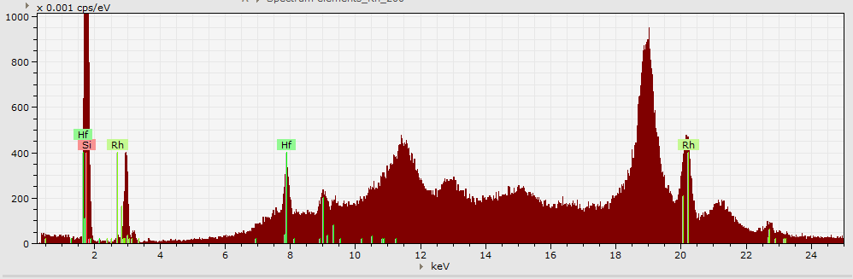
2) Rotation
Rotating the chip in the XY plane changes the diffraction pattern observed
Discovered that 40-45 degrees allows for the best separation of diffraction and fluorescence peaks
0°:

Slide 10
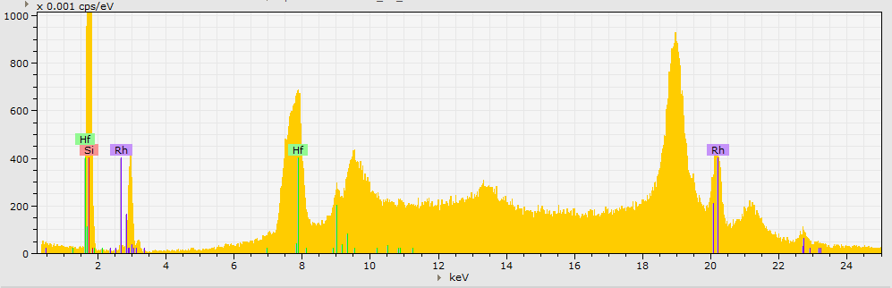
2) Rotation
Rotating the chip in the XY plane changes the diffraction pattern observed
Discovered that 40-45 degrees allows for the best separation of diffraction and fluorescence peaks
20°:

Slide 11
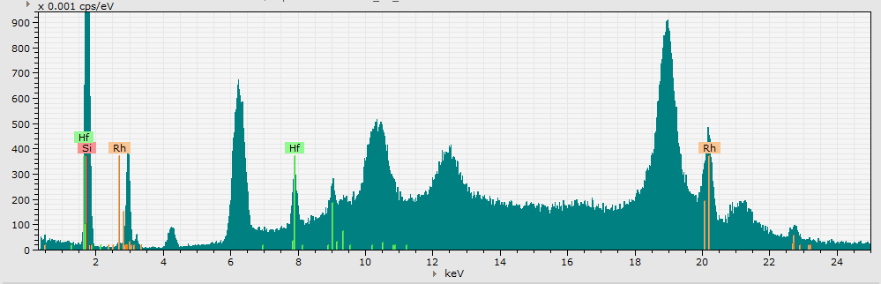
2) Rotation
Rotating the chip in the XY plane changes the diffraction pattern observed
Discovered that 40-45 degrees allows for the best separation of diffraction and fluorescence peaks
40°:

Slide 12
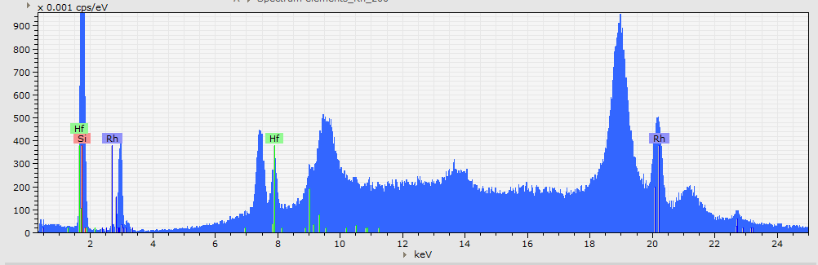
2) Rotation
Rotating the chip in the XY plane changes the diffraction pattern observed
Discovered that 40-45 degrees allows for the best separation of diffraction and fluorescence peaks
60°:

Slide 13
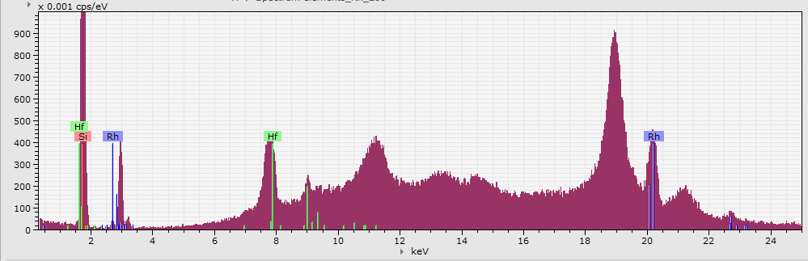
2) Rotation
Rotating the chip in the XY plane changes the diffraction pattern observed
Findings: 40°- 45°allows for the best separation of diffraction and fluorescence peaks
80°:

Slide 14
2) Rotation
Rotating the chip in the XY plane changes the diffraction pattern observed
Discovered that 40-45 degrees allows for the best separation of diffraction and fluorescence peaks
40°: best angle!

Slide 15
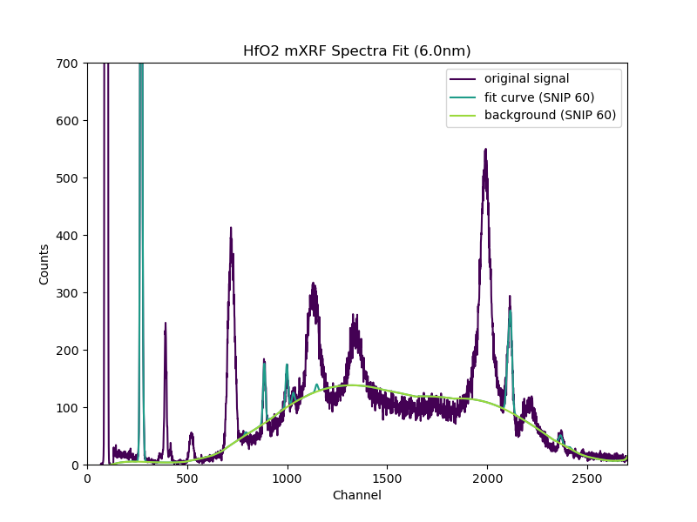
3) Using software:
Used PyMca software to find trendlines for the true fluorescence peaks and the background radiation
Hf

Slide 16
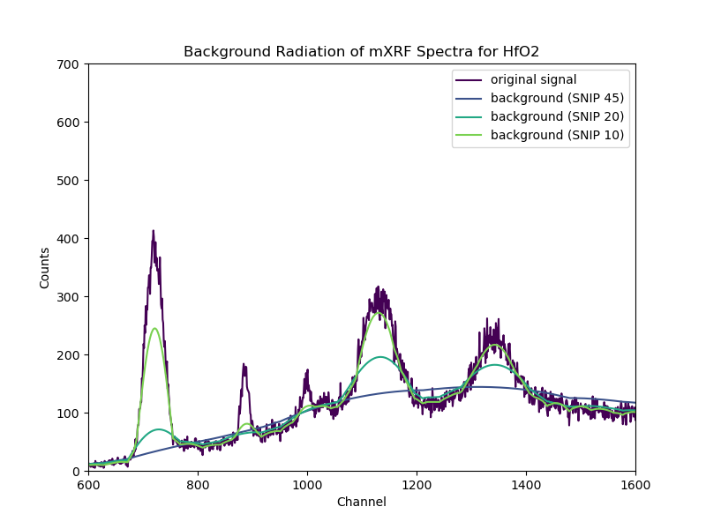
Finding the best fit:
Tested parameters to find the best fit for the diffraction peaks/background radiation
lower SNIP widths → more curvature
TRADEOFF: removing noise at the expense of losing the actual signal
Hf

Slide 17
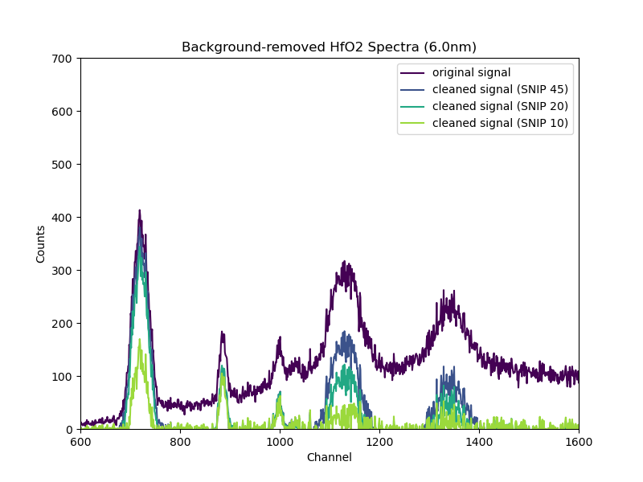
Computationally removing diffraction:
Removed background radiation to isolate the true fluorescence peaks
Findings: found a set of parameters (SNIP 10) that cleans up majority of diffraction while retaining Hf counts
Hf

Slide 18
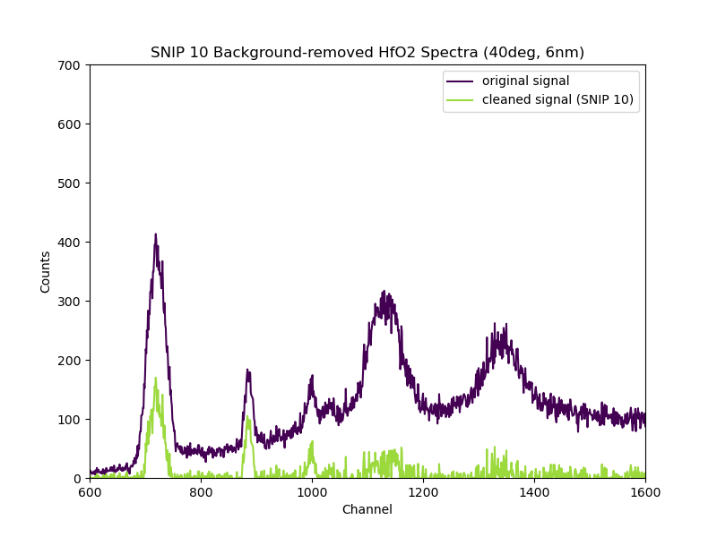
Recap
Rotating chip to ~40°- 45°, then using PyMca software with determined set of parameters allows for the removal of most of the diffraction and retainment of Hf counts
Allows for easier analysis of the xrf spectra
Future work: different gate oxide materials
Hf

Slide 19
Questions?

