Slide 1


Slide 2

Online Market place for used auto parts

Slide 3
Group Id: S24027DCF0 Student ID:(mc220205099) Supervisor Name : Sohail Aamir

Slide 4
INTRODUCTION OF PROJECT
ECO Trade Hub is an online marketplace designed for buying and selling used auto parts. The platform provides features for user registration, product listing, product search, order placement, user communication, and ratings and reviews. It aims to promote environmental sustainability by encouraging the reuse of auto parts. The platform also includes administrative functionalities for user and product management, as well as reporting.

Slide 5
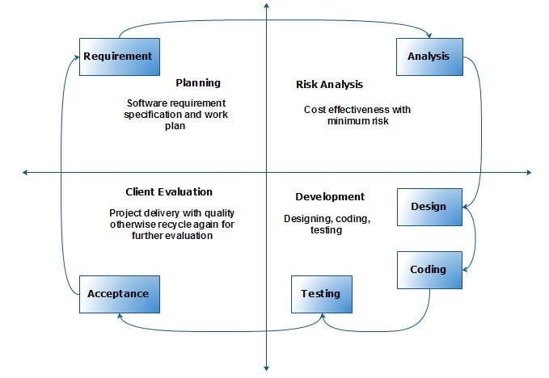

Slide 7
Business Rules Catalog
User Registration: Users must register to buy or sell products.
Product Listings: Sellers can list auto parts with details and images.
Search and Filter: Users can search and filter products.
Order Placement: Users can place orders and choose payment options.
User Communication: Buyers and sellers can communicate through the platform.
Ratings and Reviews: Buyers can rate and review products.
Admin Controls: Admins can manage users and product listings.

Slide 9
Team structure
Supervisor
Sohail Aamir
SRS
Sonia nazeer
Designe Document
Sonia nazeer
coding
Sonia nazeer

Slide 10
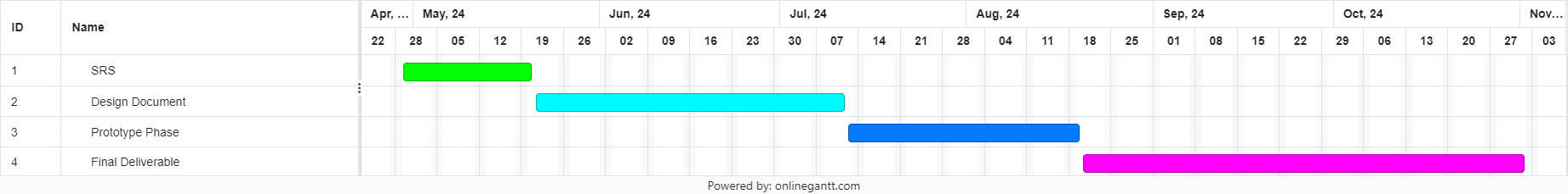
Project Schedule

Slide 11
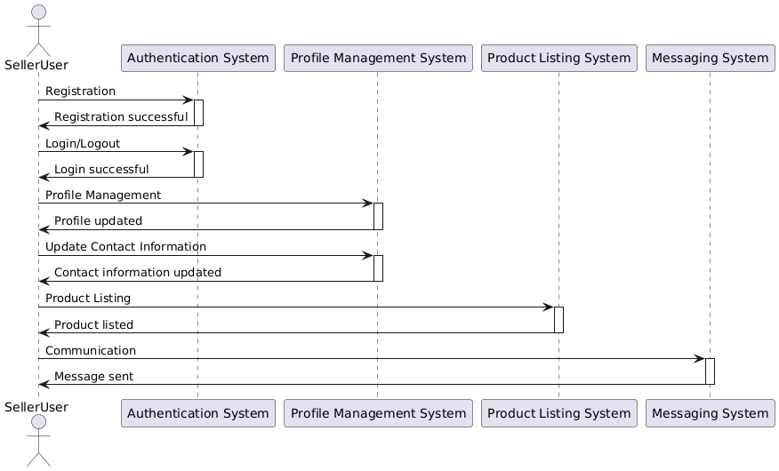
Seller/User Sequence Diagram

Slide 12
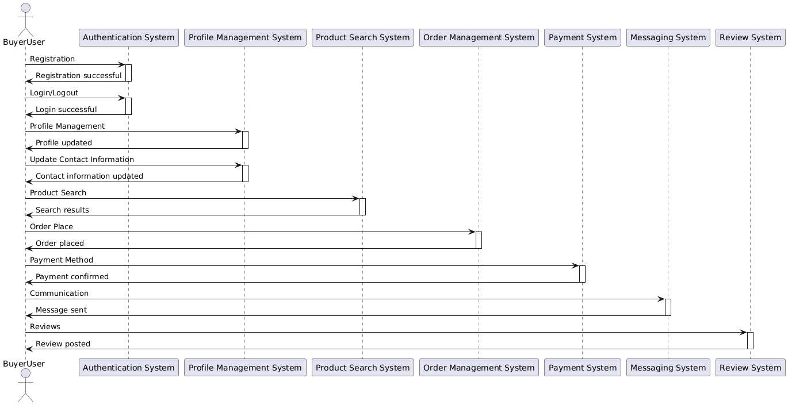
Buyer/User Sequence Diagram

Slide 13
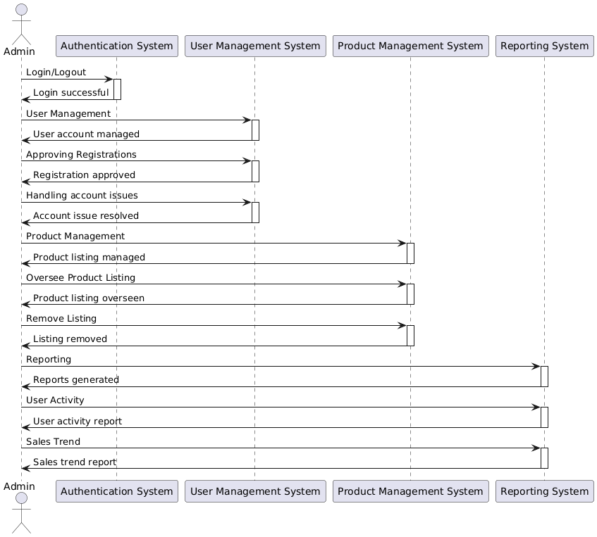
Admin Sequence Diagram:

Slide 14
Logical Model/Class Diagram

Slide 16
Entity-Relationship Diagram

Slide 17
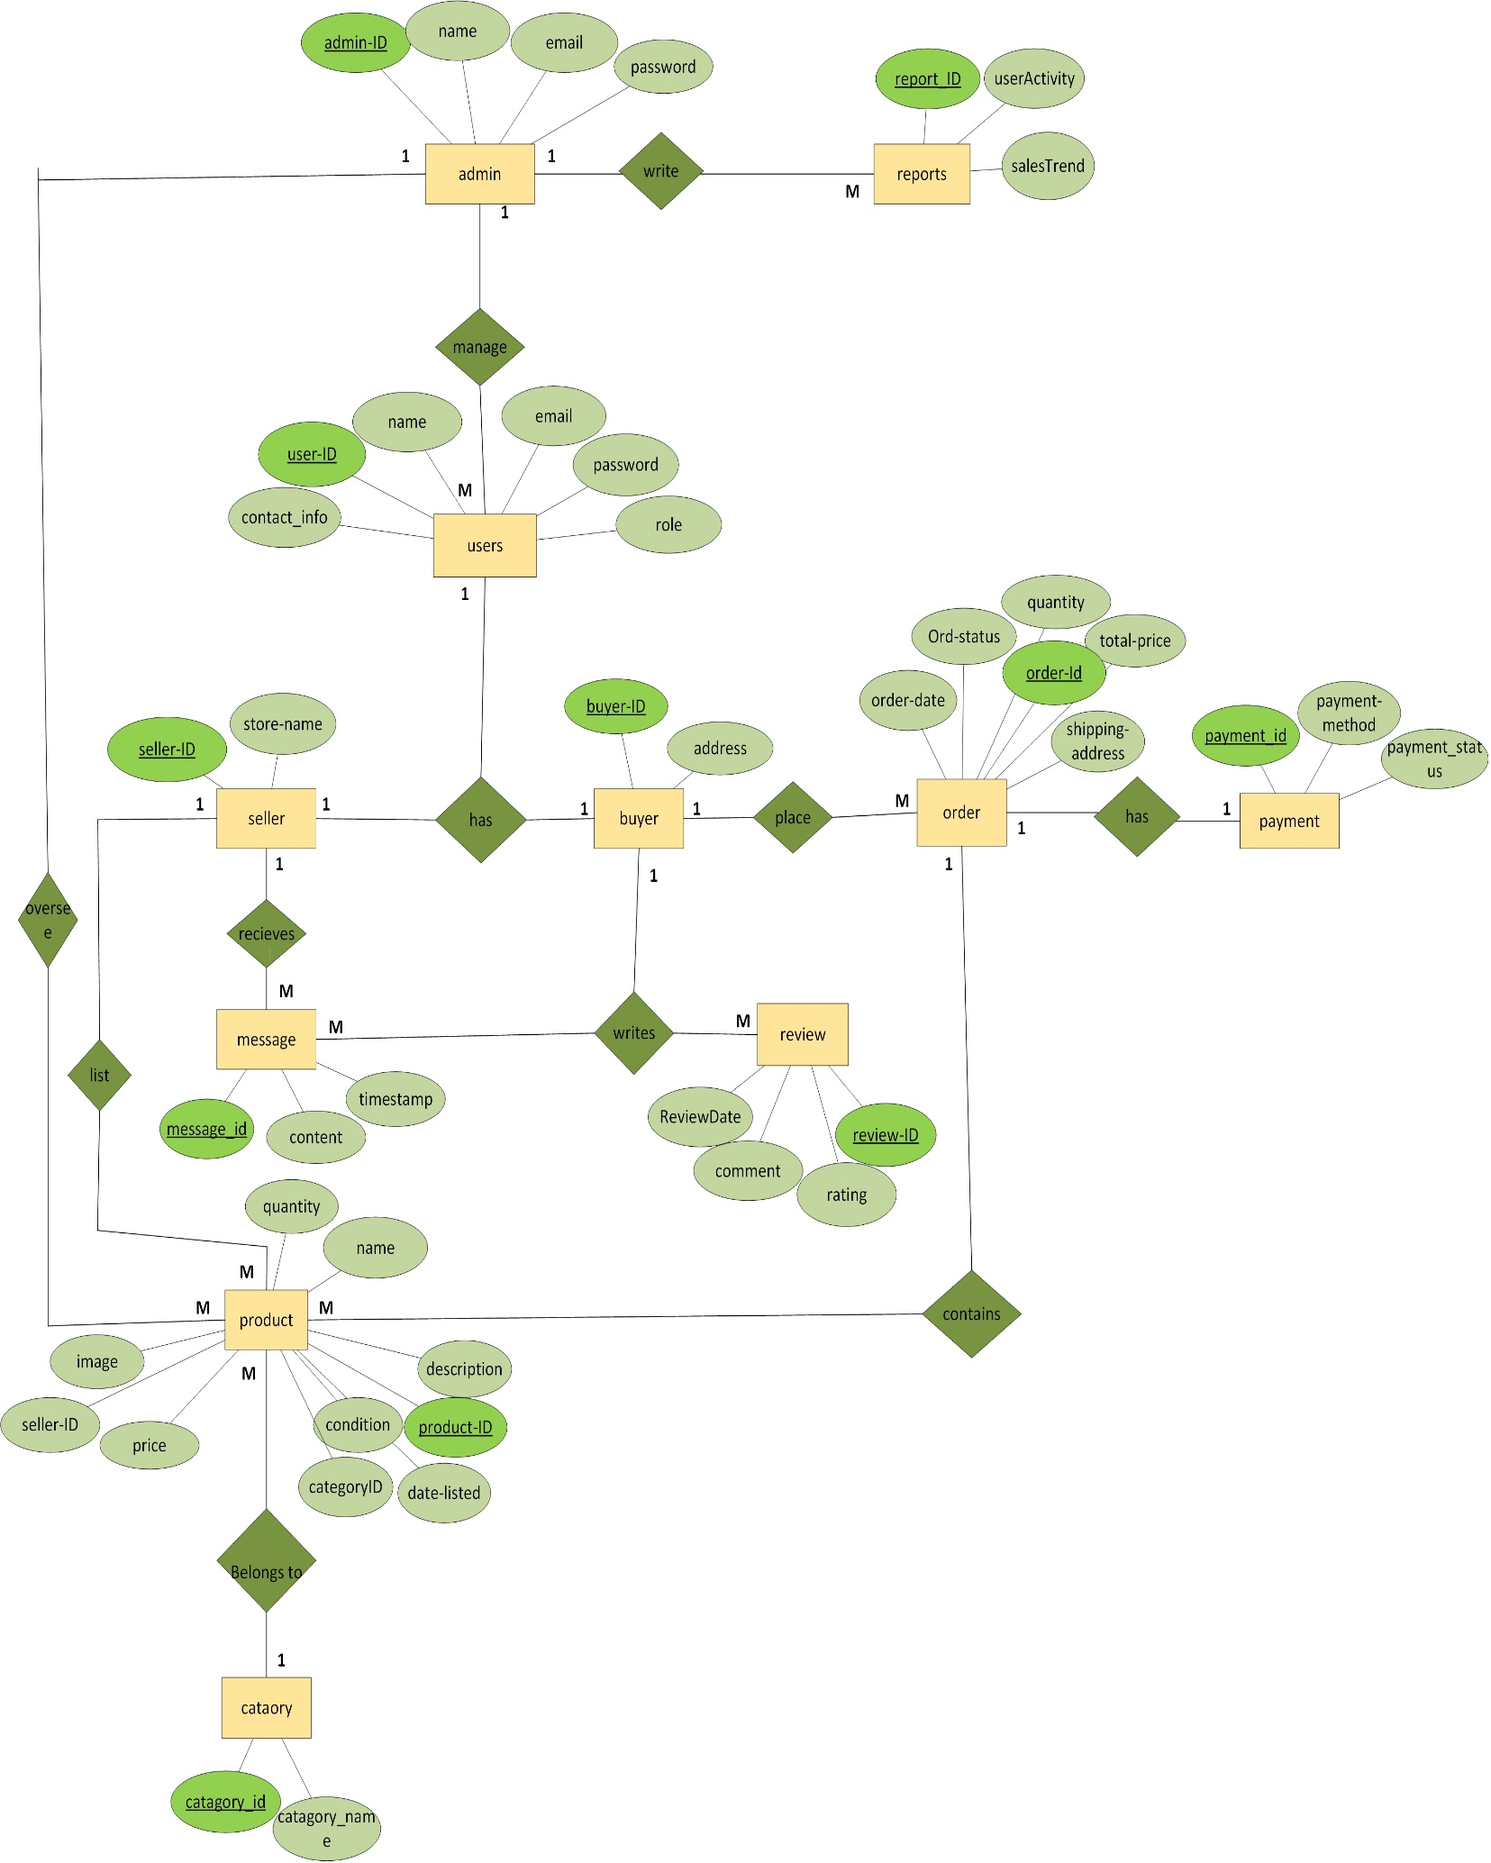

Slide 18
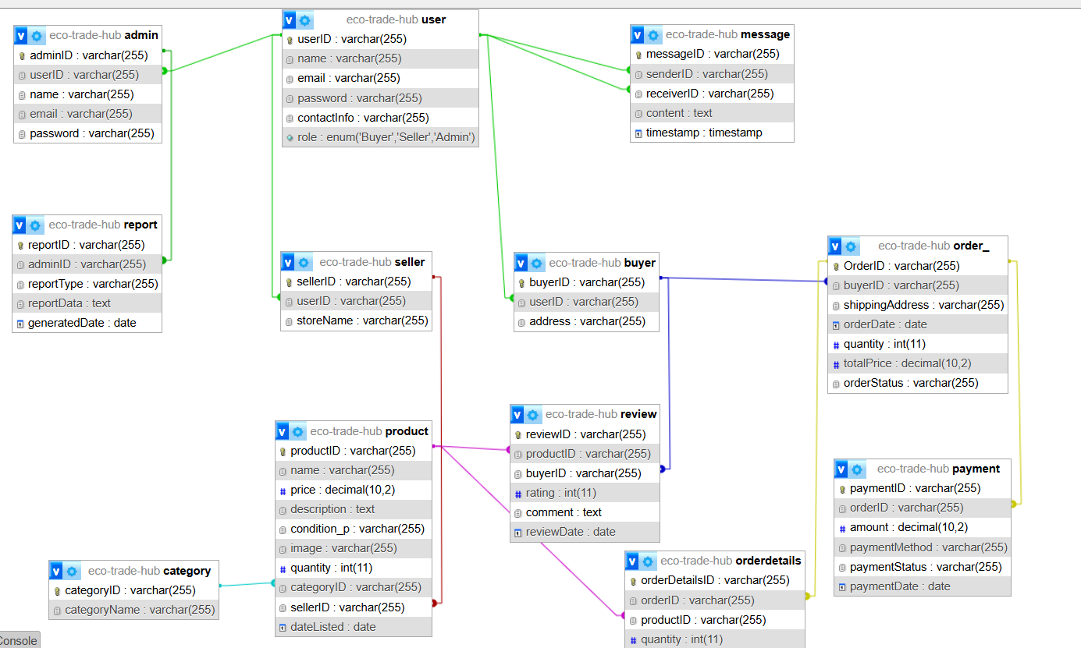
Database diagram

Slide 19


Slide 20
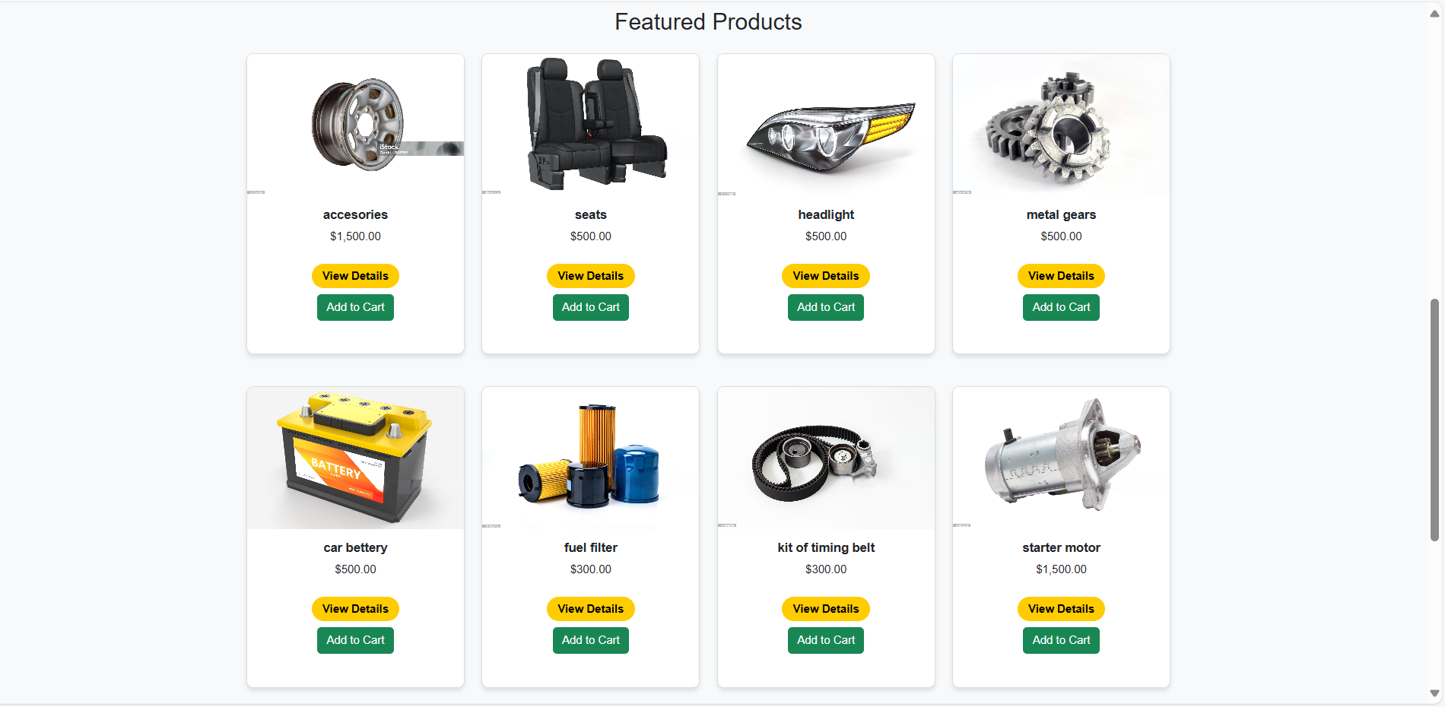

Slide 21
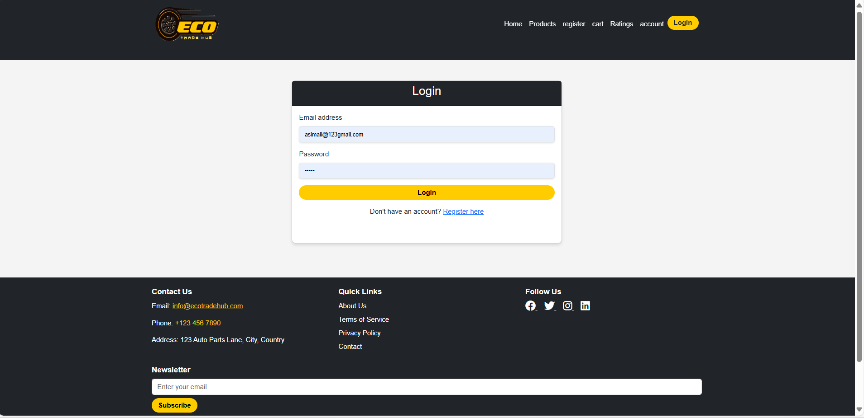

Slide 22
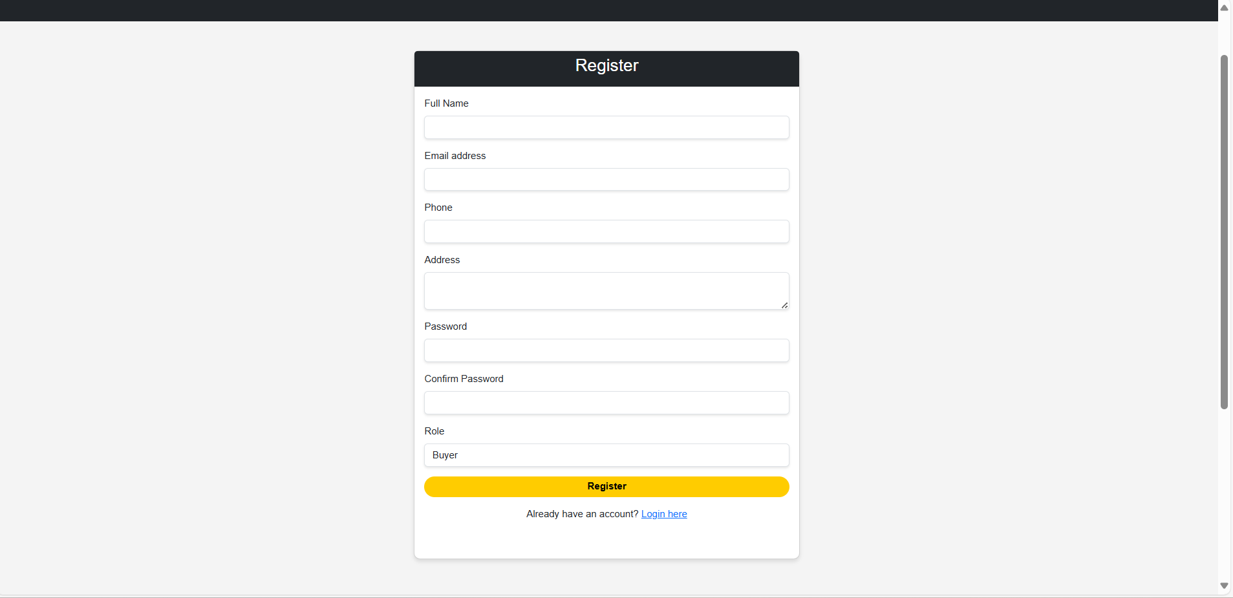

Slide 23
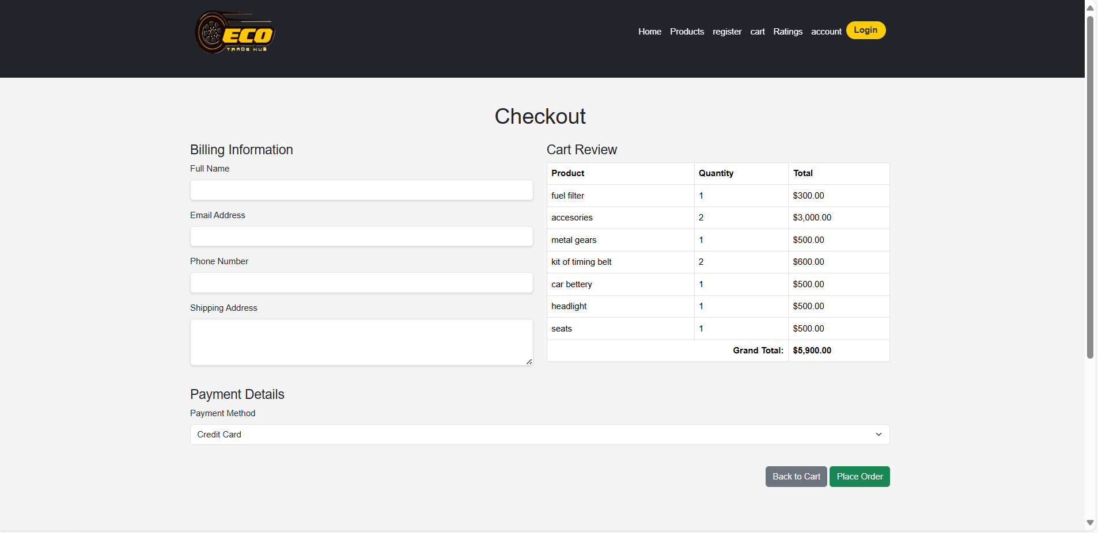

Slide 24
Development Tools & Technologies
Vs code
PHP
MYSQL
BOOTSTRAP
HTML
CSS
JAVASCRIPT
XAMPP

Slide 25
Thank you

