Slide 1
Predictive Analytics for Investments & Trading
Team : Neurons At Work
Sonia Bhargava
Siddhartha Asar
Ameya Phadke
Date 1 Mar 2017

Slide 2
Agenda
Problem Statement
Assumptions
Hypothesis & Dataset
Demonstration
Result & Accuracy parameters
Q&A

Slide 3
Problem Statement
Use Case Description
A Bank’s Investment arm or Brokerage division requires:
To build a system to analyze following parameters:
the trade data (stock or bond) ,
market trends
This analysis can then be used for:
Price predictions
Help in trading strategies
Our Assessment
Analyze different machine learning algorithms and assess its effectiveness on stock equity data
Train machine learning algorithm(s) on EOD historical market data of key stock(s) from different sectors of NSE stock exchange
Run the regression on test data set
Measure predictive power of algorithms
Suggest design for the system to predict stock prices for future

Slide 4
Assumptions
Current dataset confines to Indian NSE equity stock market
Due to time limitation we chose market data for only 15 stocks (3 from each prominent sector) but the model is scalable to cope up all listed equities. For demonstration, we are concentrating only on 1 stock – HDFC Banks
System is not undergoing high variance - Since we started with one stock and then added three stocks in different sectors to test and the goodness of fit decreased slightly. This indicates that the hypothesis could absorb additional data easily without compromising on the fit and is pretty generalized. Moreover if the network is trained on samples from one stock and test data belongs to another stock , it still works
The system can continuously predict future end of day prices provided it receives daily updated market data
The stock prices follow “ Brownian motion” which is a fairly complex stochastic process.
However we follow a momentum based approach and use momentum to predict price rather than simulate the stochastic “ random walk”. This reduces the problem to one of a complex continuous non-linear regression

Slide 5
Hypothesis & Dataset
Hypothesis
Using EOD parameters such as Closing Price Volume alone, We can train the selected machine learning algorithm and use it to predict future closing prices of equity stock
Model, then, can be scalable for bonds (if we select correct relevant features)
Dataset
Feature Selection
Moving average convergence/divergence (MACD)
This parameter is derived from closing prices but it gives the direction of price movement
It is supposed to reveal changes in the strength, direction, momentum, and duration of a trend in a stock's price
MACD is a good lagging momentum indicator and the predictive analysis needs to take the momentum explicitly into consideration
Volume
End of day Price
Total size – 300 days EOD market data available on NSE website
Training Set
Market data from 1 Jan 2017 to
Test Set (To make predictions)
Market data from 12 Jan 2018 to 19 Feb 2018

Slide 6
Demonstration
We decided to use MLP Regressor from Scikit Learn library (Multi-layer Perceptron regressor) with 6 hidden layers and 100 neurons
We saw that if hidden layers are increased further it does not change the result much
If the hidden layers are decreased below 5 the algorithm becomes highly biased
This model optimizes the squared-loss using LBFGS
LBFGS is an optimizer in the family of quasi-Newton methods

Slide 7
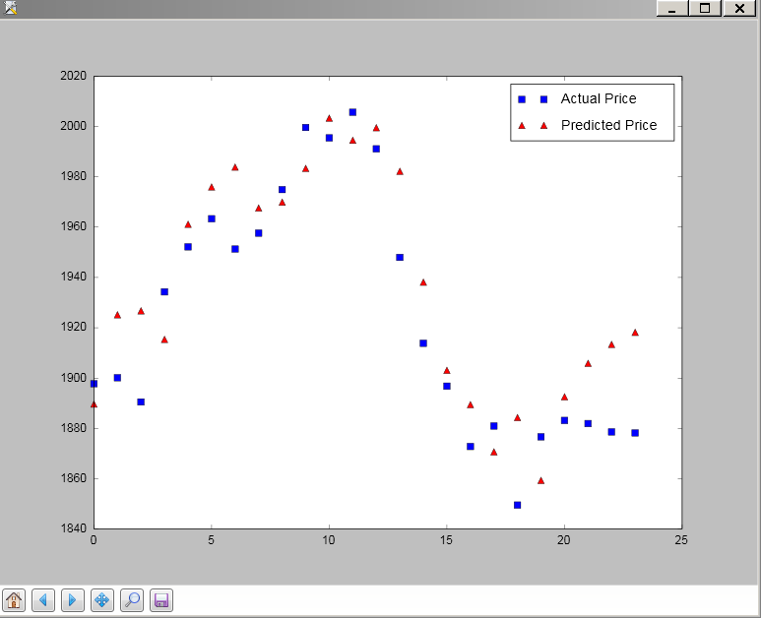
Result on Test Set – 8 Layer 100 Neurons

Slide 8
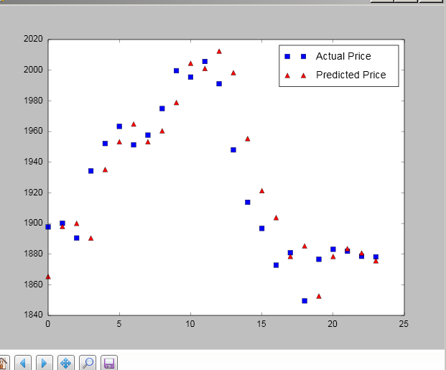
Result on Test Set – 8 Layer 70 Neurons

Slide 9
Accuracy Parameters: Coefficient of Determination(R^2)
 | 200 | 100 | 50 | 20
3-50-1 | 0.801114261775 | 0.783168955718 | 0.802561626107 | 0.649375010808
3-10-1 | -48.2975093141 | 0.762419542682 | -148.280571642 | -443.656982602
3-8-1 | 0.502378078638 | 0.39352696677 | 0.565451201901 | 0.616250129134
3-6-1 | -35.5463264049 | -589.206596133 | -523.858641691 | -1521.30421344
3-4-1 | -1492.84864408 | -1329.11426404 | -28.543838022 | 0.815199992638
The above table shows accuracy of the model when it’s structure is changed in terms of hidden layers and neurons.

Slide 10
Questions ?
Thank you ..!!

