Slide 1
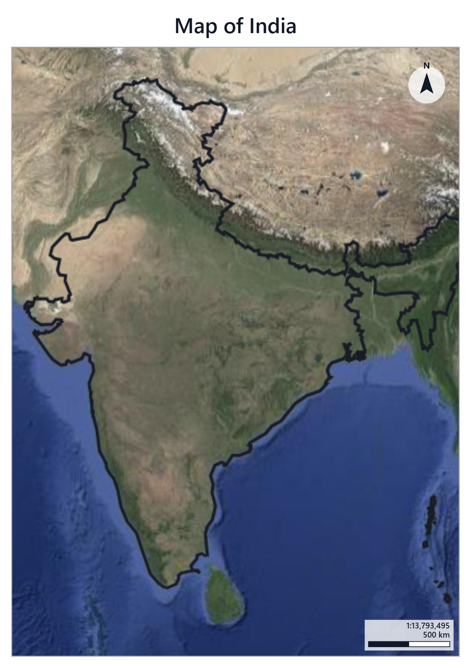
MAPPING WITH KIDS | BEFORE EXERCISE 1
Seeing Earth from Above
Satellites, GIS, points, lines and polygons, and how a map is made
Notes:
Welcome everyone. Today we find out how satellites take pictures of the Earth, and how GIS software turns those pictures into maps. By the end of the session you will build the map on the right yourself.

Slide 2
Today's journey
1
2
3
4
5
6
Remote sensing
Satellites and change
GIS and layers
Points, lines, polygons
Parts of a map
Make your own map
At the end you will open GeoLibre and build a Map of India.
Notes:
Walk through the six stops. Steps 1 to 5 are ideas, step 6 is hands-on in GeoLibre. Ask: has anyone used Google Maps or Google Earth before?

Slide 3
What is remote sensing?
Remote sensing means learning about something without touching it. Looking at a bird through binoculars is a simple kind of remote sensing.
WORD OF THE DAY
Remote sensing: gathering information about a place from far away, without touching it.
Weather satellite
Watches a cyclone form over the Bay of Bengal
Drone
Flies over a farm to see which crops need water
Space station camera
Photographs a coastline as it passes overhead
Notes:
Ask: what else can you sense without touching? (Hearing thunder, smelling food, seeing stars.) Satellites do the same, from hundreds of kilometres up.

Slide 4
How do satellites see the Earth?
Satellite
2. Light bounces off the ground and the satellite's camera catches it
Sun
1. Sunlight shines on the Earth
SEEING MORE THAN OUR EYES
Many satellites also see infrared light. Healthy plants shine brightly in infrared.
Earth
Notes:
The satellite does not shine a torch. The Sun lights up the Earth, light bounces back up, and the satellite camera records it, like a phone camera. Infrared is light our eyes cannot see. Scientists use it to check if crops and forests are healthy.

Slide 5
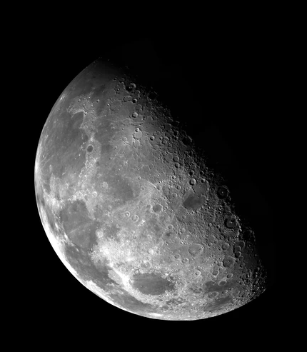
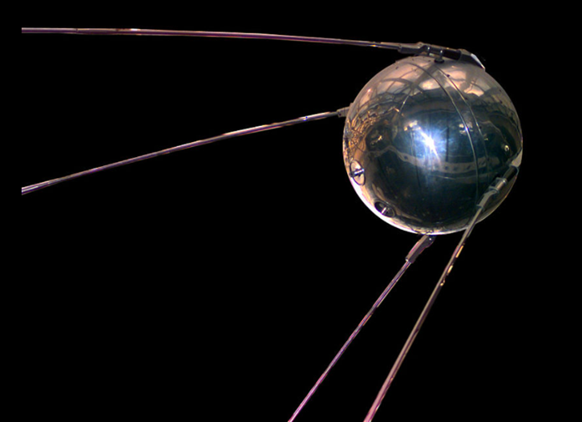
Natural and artificial satellites
A satellite is anything that travels around a planet.
FUN FACT
Sputnik-1 was the first artificial satellite. It was about the size of a beach ball.
Natural: the Moon
Artificial: Sputnik-1 (1957)
Notes:
Natural satellites are made by nature, like our Moon. Artificial satellites are made by people. Sputnik-1 was launched by the Soviet Union on 4 October 1957 and went around the Earth every 96 minutes. Today thousands of satellites circle the Earth.

Slide 6
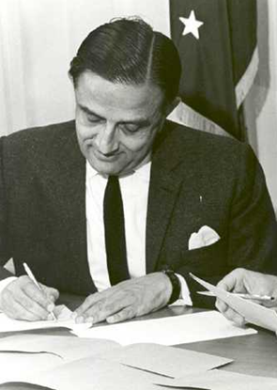
India goes to space
1962
INCOSPAR is set up, led by Dr Vikram Sarabhai
1963
First rocket launch from Thumba, Kerala
1969
ISRO, the Indian Space Research Organisation, is formed
1975
Aryabhata, India's first satellite, goes to space
2023
Chandrayaan-3 lands near the Moon's south pole
Dr Vikram Sarabhai, father of the Indian space programme
Notes:
India's space journey started in 1962 with INCOSPAR. The first rockets went up from Thumba near Thiruvananthapuram. ISRO was formed in 1969 and is headquartered here in Bengaluru. Indian satellites like Cartosat and Resourcesat take photos of India that are used to make maps.

Slide 7
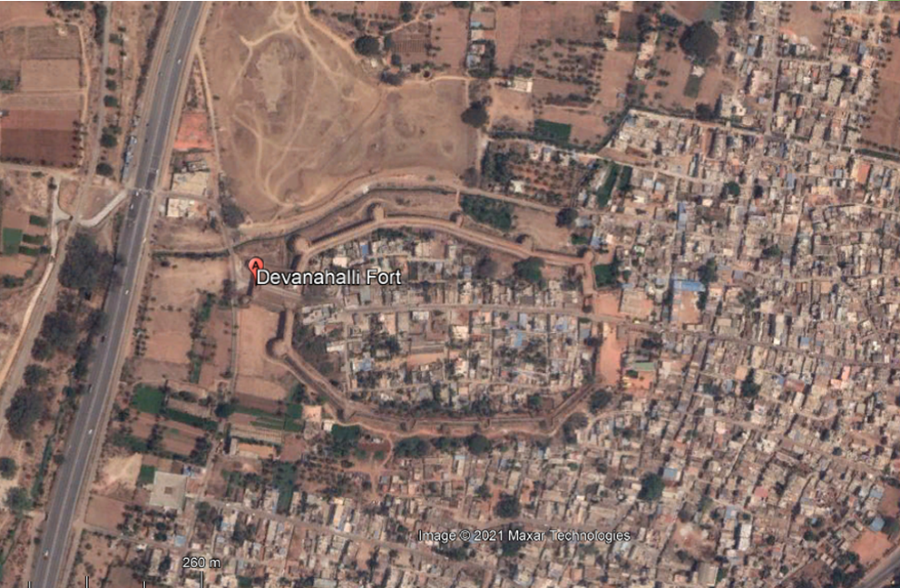
What can you spot from space?
Devanahalli Fort, near Bengaluru
The fort walls
A highway
Houses and streets
Open fields
Satellite image: Google Earth, Maxar 2021
Notes:
Give students a minute to find things before revealing the list. The curved shape is the old fort wall. The long straight line on the left is the highway to the airport. Ask: how can you tell a road from a wall?

Slide 8
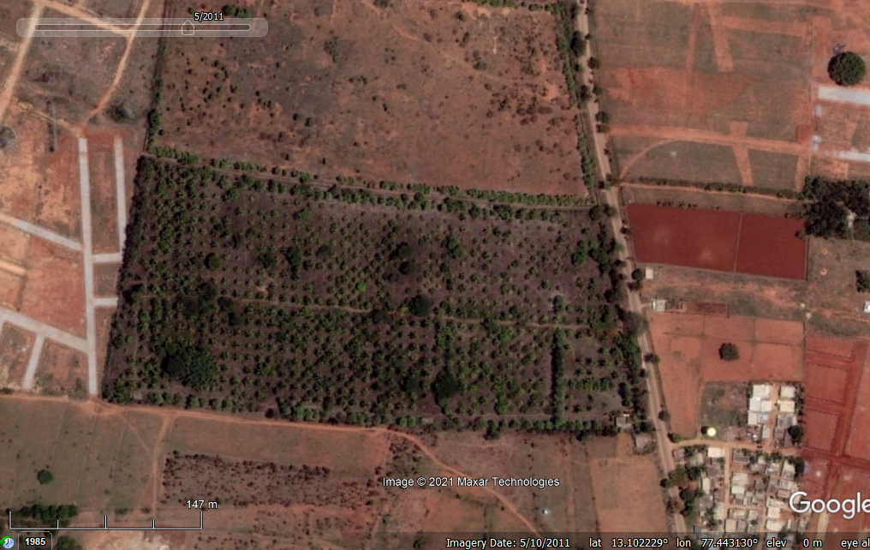
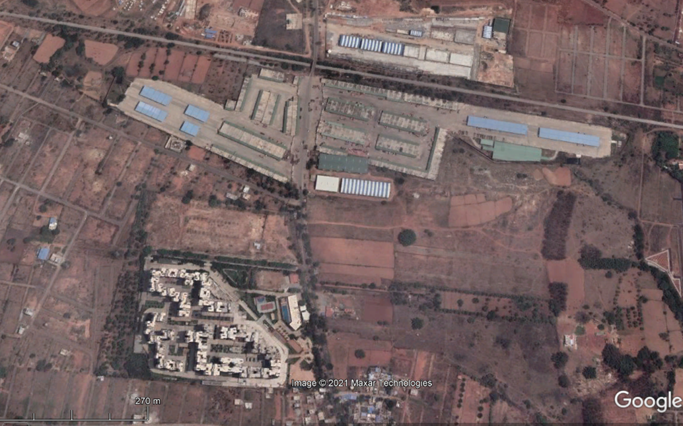
Satellites show how places change
2011
2021
The same neighbourhood near Bengaluru, ten years apart. What changed?
Try it yourself: earthengine.google.com/timelapse
Notes:
In 2011 the area was fields and an orchard. By 2021 there is a big market yard (APMC) and an apartment complex. Satellites have photographed Earth for over 50 years (Landsat started in 1972), so we can compare any place over time. If there is time, open the Timelapse site and look at your own city.

Slide 9
This is called land cover change
Land cover is whatever covers the ground. When it changes over the years, we call it land cover change.
Who uses it?
Built-up
Urban planners
Vegetation
See where a city is growing, and where to keep parks and lakes
Farmers and scientists
Water
Track crops, forests and droughts
Open land
Disaster teams
Find areas that flood easily
Notes:
Go back to the last slide: in 2011 that area was an orchard, and by 2021 it was buildings and a market yard. That is land cover change, from vegetation to built-up. Computers can sort every pixel of a satellite image into classes like these, then count how much of each there is, year after year. Urban planners use these maps to decide where a city should grow and which lakes, parks and forests must be protected.

Slide 10
Bengaluru: from Garden City to concrete city
Why it matters
Fewer lakes and wetlands: rain cannot soak in, so streets flood
Fewer trees: the city gets hotter
Less water in the ground: borewells go dry
FUN FACT
Scientists at IISc, in Bengaluru, measured this using satellite images from 1973 onwards.
Source: Ramachandra et al., Energy & Wetlands Research Group, IISc (2017)
Notes:
Bengaluru was once called the Garden City. Scientists at the Indian Institute of Science (IISc) used Landsat satellite images from 1973 to 2013 to measure the change. Built-up area grew from about 8% of the city to about 74%. Vegetation fell from about 68% to under 15%. Water bodies fell from 3.4% to under 1%. This is exactly the remote sensing we just learned about. Ask: what could we do to protect our lakes and trees? https://wgbis.ces.iisc.ac.in/energy/water/paper/Decaying_lakes_of_Bengaluru/

Slide 11
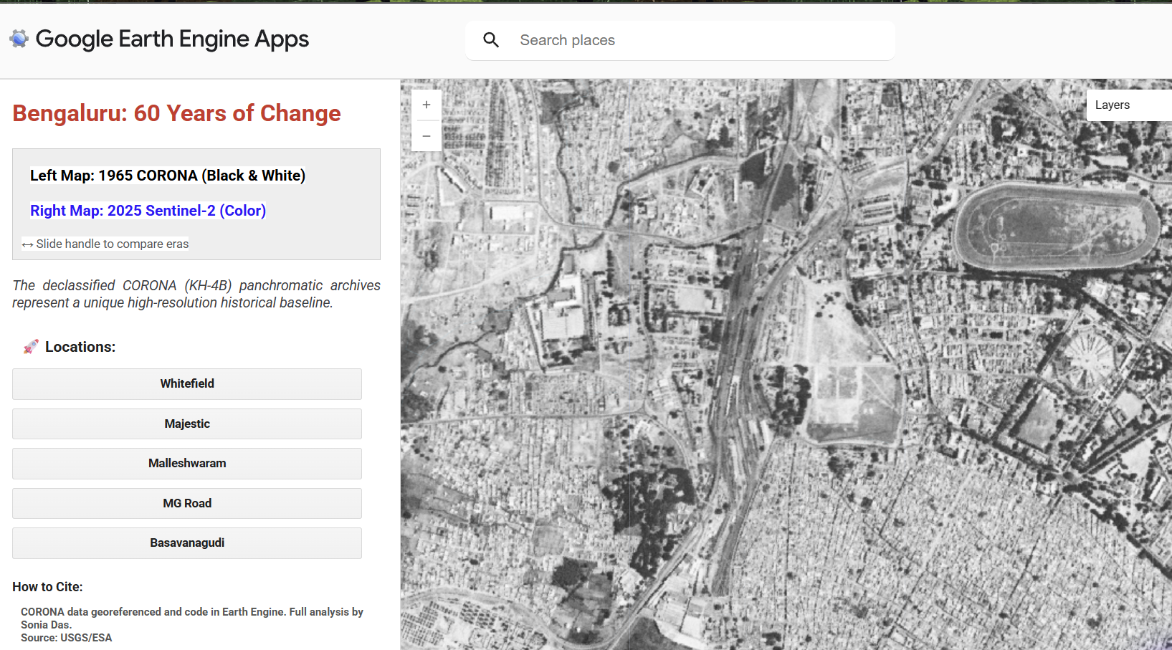
https://ee-soniacivil.projects.earthengine.app/view/bengaluru-in-1965

Slide 12
What is GIS?
GIS stands for Geographic Information System. It is software that stacks information about places into layers, like a sandwich.
City names
Country outline
WORD OF THE DAY
Layer: one slice of the map sandwich, such as a photo, borders or names.
Satellite photo
Notes:
A GIS map is like a sandwich or a stack of see-through sheets. The bottom layer is usually a satellite photo, called the basemap. On top we add borders, roads, rivers and names. In Exercise 1 you will add two layers: India's outline and the state outlines.

Slide 13
Points, lines and polygons
In GIS, almost everything on a map is drawn with just three shapes.
Point
Line
Polygon
A single spot
A path from place to place
A closed shape with an inside
Your school
A temple or a fort
A road or railway
A river
A park or a lake
A state
Notes:
Point: one location, like a pin on a map. Line: connects points, like a road. Polygon: a line that closes back on itself, so it has an inside and an area, like a lake or a state. Ask: is India a point, a line or a polygon? (It depends on the scale. On a world map Bengaluru is a point, but zoom in and it becomes a polygon.)

Slide 14
Spot the shapes
Can you guess?
Line
What is the red line?
What is inside the yellow polygon?
What is the blue point?
Polygon
Point
YOUR TURN
Find one more point, line and polygon in this picture.
Notes:
Answers: the red line follows the railway track. The yellow polygon is an apartment complex. The blue point is a single big tree. The large grey buildings at the top are the APMC market yard, which could be another polygon. The road running down the middle is another line.

Slide 15
Two kinds of map data
Raster
Vector
A grid of tiny coloured squares called pixels. A satellite photo is raster.
Points, lines and polygons. The India outline you load in Exercise 1 is vector.
Notes:
Zoom right into a satellite photo and it turns into squares: that is raster. Vector data stores shapes as corner points, so it stays sharp however far you zoom. In Exercise 1 the satellite basemap is raster and the GeoJSON outlines are vector.

Slide 16
What is a map?
1
A map is a picture of a place, drawn from above, that shows where things are and how they relate to each other.
2
1
Title
says what the map shows
2
North arrow
shows which way is north
3
3
Layers
a polygon layer on top
4
Scale bar
shows real distance
4
Notes:
Every good map answers three questions: what is it a map of (title), which way is north (north arrow), and how big are things really (scale bar). Many maps also have a legend that explains the colours and symbols. You will add the title, north arrow and scale bar yourself in step 6 of Exercise 1.

Slide 17
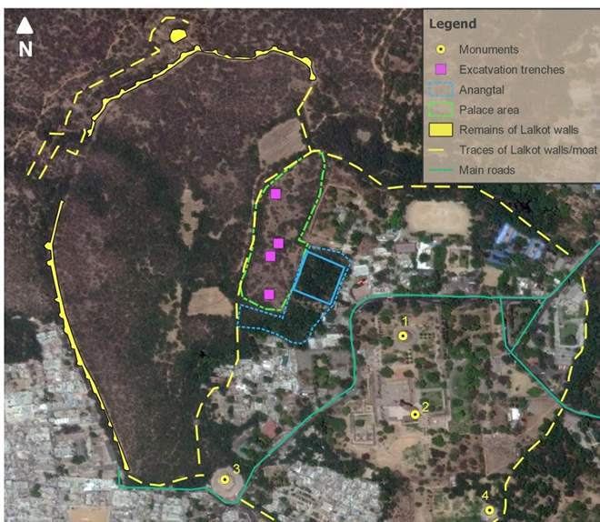
Maps tell stories
This map shows the old walls of Lal Kot, a fort in Delhi, drawn on top of a satellite photo.
Yellow dots are points: monuments
Dashed lines trace the old walls
Coloured shapes are polygons: the palace area
LEGEND
The box in the corner that explains what every colour and symbol means.
Author: Sonia Das
Notes:
Archaeologists use satellite images and GIS to find and map old forts. Point out the legend, the north arrow at top left and the scale bar. Ask: what story is this map telling? (Where the old fort was, and what is left of it today.)

Slide 18
Quick quiz
1
What does GIS stand for?
NEXT UP
Exercise 1: Map of India
2
Is the Moon a natural or an artificial satellite?
3
Give one example each of a point, a line and a polygon.
Open GeoLibre and build your own map, layer by layer.
4
What does a scale bar tell you?
Notes:
Answers: 1. Geographic Information System. 2. Natural. 3. Any sensible examples, such as a school (point), a road (line), a lake (polygon). 4. How far apart things really are on the ground. Then hand out the Exercise 1 tutorial.

