Slide 1
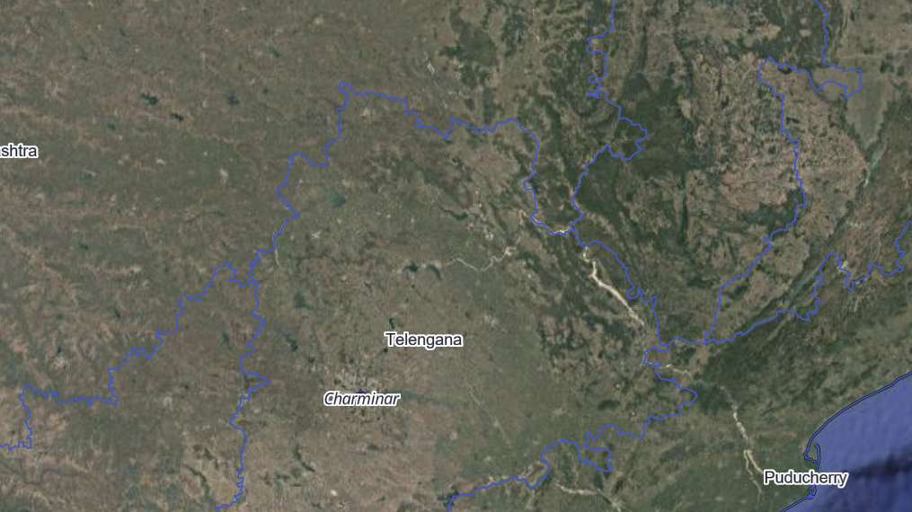
MAPPING WITH KIDS | BEFORE EXERCISE 2
Every Place Has an Address
Latitude, longitude, and turning a table into a map
Notes:
Welcome back, mapmakers. Last time we drew the outline of India. Today we learn the secret address that every spot on Earth has, and we use it to put famous places of India on our map.

Slide 2
Today's journey
1
2
3
4
5
6
Addresses on Earth
Latitude
Longitude
From table to dots
Colours and labels
Distance and buffers
At the end you will put 16 famous places of India on your own map.
Notes:
Steps 1 to 3 are about the numbers that tell us where a place is. Steps 4 to 6 are the GIS skills you will use in Exercise 2. Ask: who has visited a famous place in India? Which one?

Slide 3
Every place has two addresses
POSTAL ADDRESS
EARTH ADDRESS
Vidhana Soudha
Ambedkar Veedhi
Bengaluru 560001
Latitude: 12.98 N
Longitude: 77.59 E
A postal address only works if you know the street names. The Earth address works anywhere: in a city, a forest, or the middle of the sea.
WORD OF THE DAY
Coordinates: the two numbers, latitude and longitude, that pin down any spot on Earth.
Notes:
Every house, school and shop has a postal address. But a postman cannot deliver a letter to the middle of a forest. Scientists, pilots and ship captains use coordinates instead. Bengaluru is about 13 degrees north and 77.6 degrees east. Your phone's map app uses these numbers all the time.

Slide 4
Latitude: how far north or south
North Pole 90 N
Lines that go across, like the rungs of a ladder
Start at 0 at the equator, the middle of the Earth
Go up to 90 at the North Pole and the South Pole
60 N
30 N
Equator 0
FUN FACT
All of India is north of the equator. Its southern tip, Kanyakumari, is at about 8 N.
Notes:
Latitude lines run east-west around the Earth, but they measure how far north or south you are. A trick to remember: LAT-itude lines lie FLAT. The equator is 0. Places north of it are N, places south of it are S. Delhi is at about 29 N, Bengaluru at about 13 N, so Delhi is further north.

Slide 5
Longitude: how far east or west
Lines that go from the North Pole to the South Pole
Start at 0 at Greenwich, in London
Go up to 180 degrees east and 180 degrees west
INDIA ON THE GLOBE
India is east of Greenwich, between about 68 E and 97 E.
Prime meridian 0
Notes:
Longitude lines are called meridians. They all meet at the poles, like the segments of an orange. People agreed long ago to call the line through Greenwich in London zero. India is east of it, so Indian longitudes end in E. Latitude plus longitude gives one exact spot, like a square on a chess board.

Slide 6
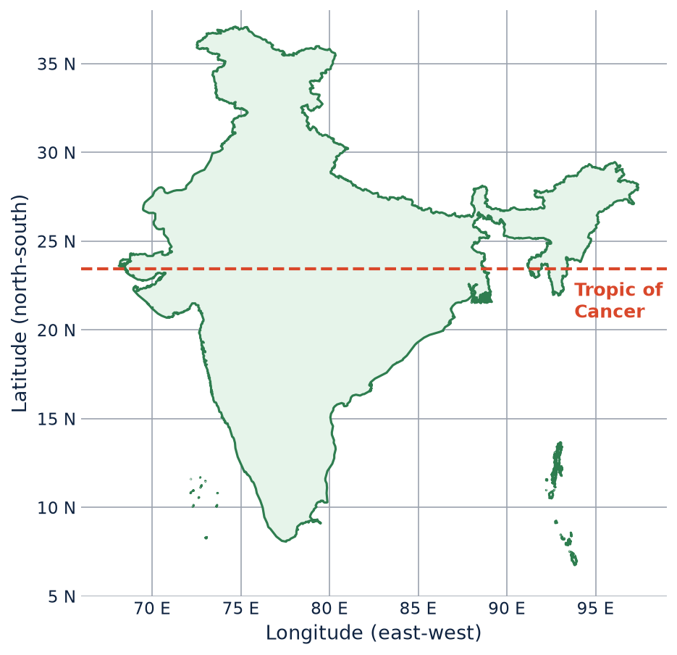
India on the grid
Each grey line is 5 degrees apart
Read a place's latitude on the left
Read its longitude along the bottom
TROPIC OF CANCER
This special line at 23.5 N runs right through the middle of India. Can you guess which states it crosses?
Notes:
Point to Bengaluru: about 13 N, 77.6 E. The Tropic of Cancer crosses eight states: Gujarat, Rajasthan, Madhya Pradesh, Chhattisgarh, Jharkhand, West Bengal, Tripura and Mizoram. Ask: is Bengaluru north or south of the Tropic of Cancer? (South.)

Slide 7
Game: find the place
Where on the map are these places?
A
27 N, 78 E
A white marble tomb
B
31.6 N, 74.9 E
A temple with a free kitchen
C
9.9 N, 78.1 E
A temple with colourful towers
Notes:
Students put a finger on the map where the lines cross. Answers: A is the Taj Mahal in Agra. B is the Golden Temple in Amritsar. C is the Meenakshi Temple in Madurai. All three are in today's data, so they will see them again in Exercise 2.

Slide 8
A table can hold places
name | type | city | latitude | longitude
Taj Mahal | Monument | Agra | 27.1751 | 78.0421
Hawa Mahal | Palace | Jaipur | 26.9239 | 75.8267
Golden Temple | Temple | Amritsar | 31.6200 | 74.8765
Kaziranga | Nature | Golaghat | 26.5775 | 93.1711
WORD OF THE DAY
CSV: Comma-Separated Values. A plain text table with commas between the values.
Each row is one place
Each column is one fact about it
Latitude and longitude tell the map where to put it
Notes:
This is part of the file you will use, famous_places.csv. It has 16 rows. If you open it in Notepad you will see commas between every value: Taj Mahal,Monument,Agra,27.1751,78.0421. Spreadsheets like Excel show the same file as a neat grid.

Slide 9
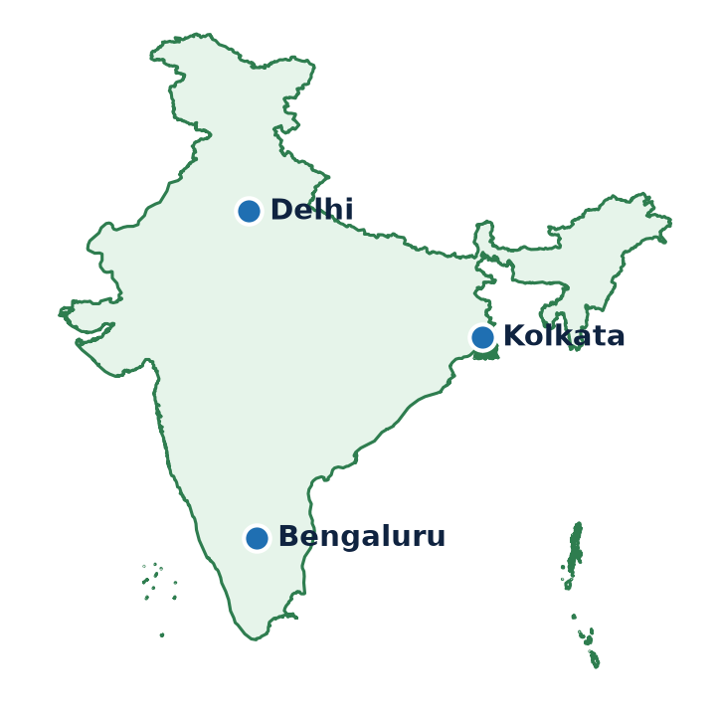
Each row becomes a dot
name | latitude | longitude
Delhi | 28.61 | 77.21
Kolkata | 22.57 | 88.36
Bengaluru | 12.97 | 77.59
REMEMBER FROM EXERCISE 1
Each place is a point: one dot, at one spot.
Notes:
The GIS reads each row, finds the latitude and longitude, and puts a dot there. Three rows give three dots. In Exercise 2 your table has 16 rows, so you will get 16 dots. In Exercise 1 India was a polygon. Here each city is so small on a map of India that a point is enough.

Slide 10
Sorting places into groups
Monument
Palace
Temple
Nature
Taj Mahal
Qutub Minar
Hawa Mahal
Mysore Palace
Golden Temple
Konark Sun Temple
Kaziranga
Valley of Flowers
WORD OF THE DAY
One look at the colours tells you what kind of place each dot is.
Categorized style: giving each group of things on a map its own colour.
Notes:
Our table has a type column with four groups. GIS software can colour the dots by that column automatically. Your colours in GeoLibre may be different from these, and that is fine. Ask: what group would your school go in? What new group could we add?

Slide 11
Maps that know facts
Two ways to see the facts
name: Hawa Mahal
city: Jaipur
type: Palace
fun_fact: has 953 small windows
LABEL
Text on the map that comes from one column, such as the name.
ATTRIBUTE TABLE
The whole table behind the dots. Click a row and its dot lights up.
Hawa Mahal
Notes:
A dot on a paper map is just a dot. A dot in GIS remembers every fact from its row in the table. A label writes one of those facts on the map. The attribute table shows all of them. If you change a name in the table, the label on the map changes too.

Slide 12
As the crow flies
The red line is the straight line between the two cities
The grey line is the road, which bends around hills, lakes and towns
Bengaluru
about 130 km
WORD OF THE DAY
about 145 km by road
Straight-line distance: the shortest distance between two places, as a bird would fly.
Mysuru
Notes:
A crow does not need roads, so it can fly straight. The straight line from Bengaluru to Mysuru is about 130 km. The road is about 145 km. In Exercise 2 the Measure tool gives you the straight-line distance. Ask: why might a train trip be longer still?

Slide 13
Draw a circle around a place: buffers
In GeoLibre, click a place and open Quick analysis. It can draw a 500 m buffer: a circle that covers every spot within 500 m of the place.
WORD OF THE DAY
500 m
Buffer: a zone that covers everything within a set distance of a place.
Taj Mahal
HOW PLANNERS USE IT
No new buildings are allowed within 100 m of a protected monument like the Taj Mahal. For 200 m beyond that, building needs special permission.
Notes:
A buffer is like drawing a circle with a compass, with the place at the centre. Everything inside the circle is within that distance. India's law for ancient monuments (the AMASR Act) uses two buffers around every protected monument: a 100 m prohibited area where nothing new can be built, and a further 200 m regulated area where building needs permission from the National Monuments Authority. Planners draw these buffers in GIS to check whether a new building is allowed. You will make your own buffers in Exercise 3.

Slide 14
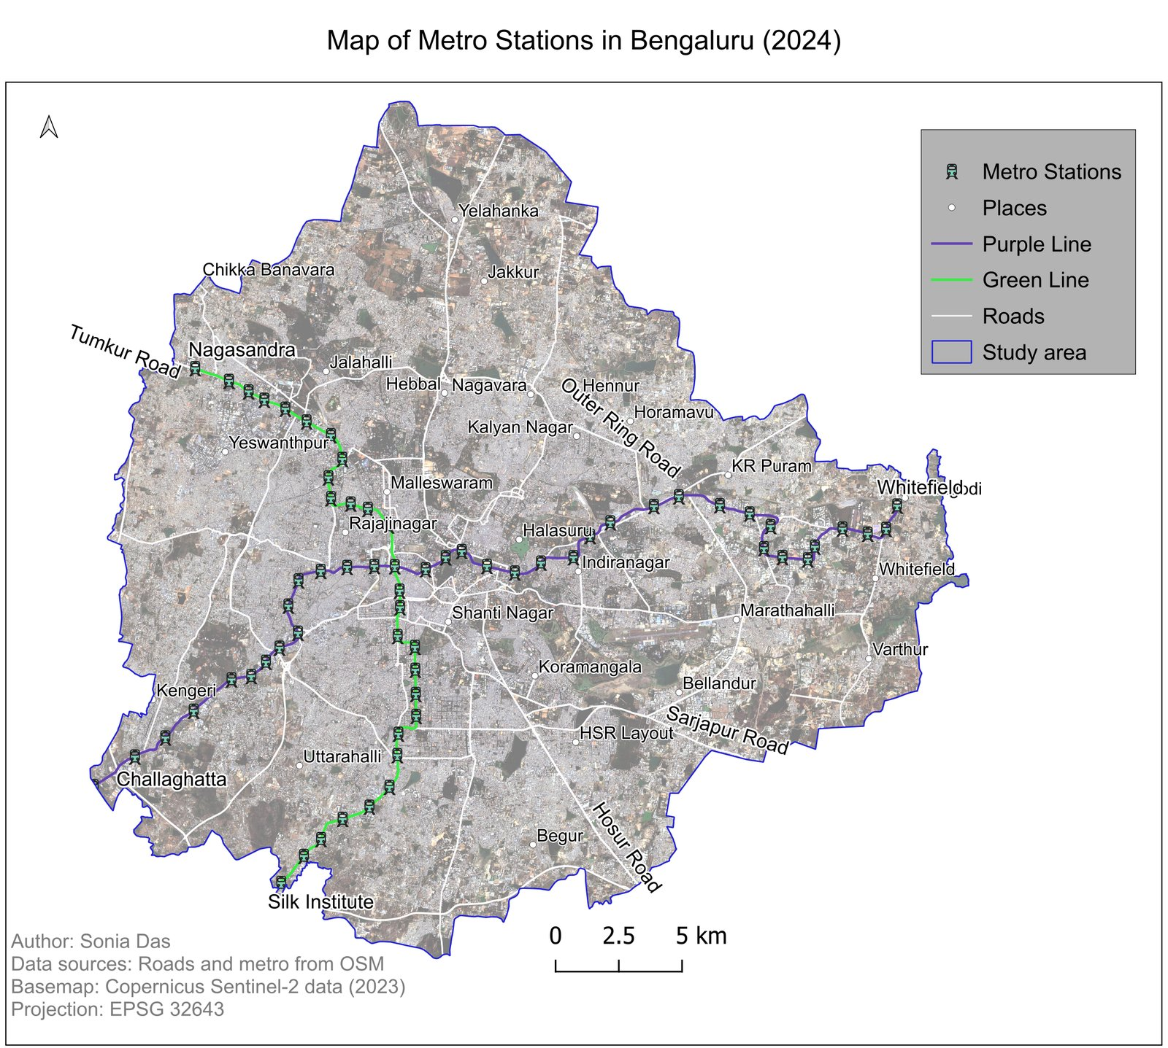
"500 m from the metro": what does it mean?
Zoom in on one station
Metro
Inside: within 500 m of the station
Outside: further than 500 m
500 m is about a 6 minute walk
Map by Sonia Das: metro stations in Bengaluru (2024)
Notes:
This is a real map of Bengaluru's Purple and Green metro lines. On a city map a 500 m circle is tiny, so on the right we zoom in on one station. When an advert says a flat is 500 m from the metro, it means the flat is inside a 500 m buffer around the station: about a 6 minute walk. Bengaluru's Transit-Oriented Development policy (2022) uses this same 500 m zone to plan more homes, offices and footpaths near stations, so more people can walk to the metro. Ask: is your home or school near a station? Find Indiranagar or Rajajinagar on the map.

Slide 15
GIS is all around us
HOME ADVERTS
CITY PLANNING
MONUMENTS
"Flat for sale, 500 m from the metro." That is a buffer around a station.
Bengaluru plans more homes and offices within 500 m of metro stations.
No new buildings within 100 m of a protected monument.
SCHOOLS
FOOD DELIVERY
EMERGENCIES
Young children should have a primary school within 1 km of home.
Apps only show restaurants close enough to deliver to you.
An ambulance is sent from the nearest hospital.
Next time you see a distance in an advert or an app, think: that's GIS!
Notes:
Every one of these is a question about distance from a place, which is what a GIS answers. The school rule comes from Karnataka's Right to Education rules: a primary school within 1 km walking distance. Delivery apps draw a zone around each restaurant. Emergency services look for the nearest hospital or fire station. Ask: where else have you seen a distance like this? In Exercise 3 you will draw these zones around your own city.

Slide 16
Your map checklist
1
Title: what is the map about?
Legend
North arrow: which way is north?
Monument
2
Palace
3
Scale bar: how far is it really?
Temple
4
Legend: what do the colours mean?
Nature
You added 1 to 3 in Exercise 1. The legend is new.
Notes:
Every good map has these four parts. Exercise 1 had a title, north arrow and scale bar. Because our dots now have different colours, the reader needs a legend to know what they mean. Without it, a red dot could mean anything.

Slide 17
Quick quiz
1
Which tells you how far north or south: latitude or longitude?
NEXT UP
2
Is India north or south of the equator?
Exercise 2: Famous Places of India
3
What does CSV stand for?
Turn a table of 16 places into your own map.
4
Why is a road trip longer than the straight-line distance?
5
What does "500 m from the metro" mean?
Notes:
Answers: 1. Latitude. 2. North, all of it. 3. Comma-Separated Values. 4. Roads bend around hills, lakes and buildings, but a straight line does not. 5. The place is inside a 500 m buffer around a metro station, about a 6 minute walk. Then hand out the Exercise 2 tutorial.

