Slide 1
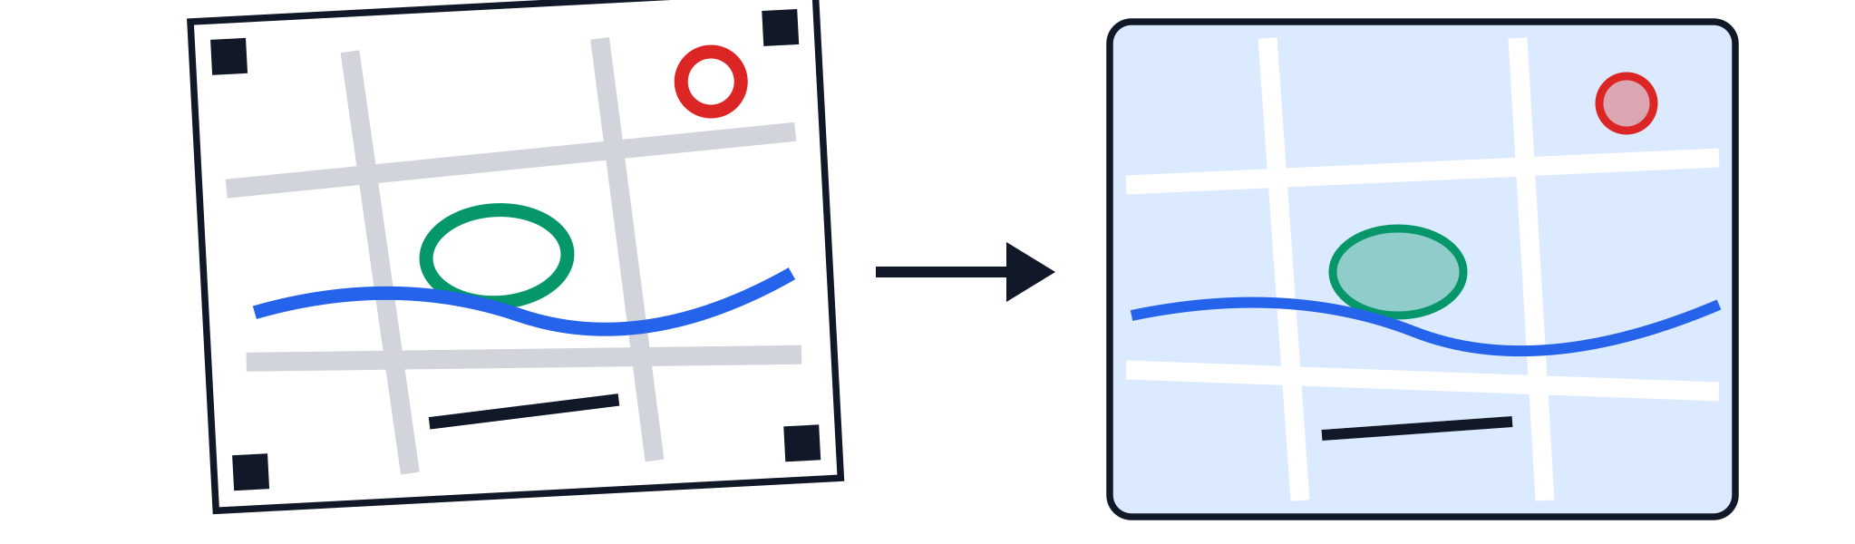
MAPPING WITH KIDS
A mapping activity · Ages 8–15
From Paper to Map
Become a neighbourhood mapper
Draw what you know about your streets on a paper map, then watch your drawing appear on a digital map of the world.
In two hours, your child will
1
Spot the parks, water, shops and shortcuts only locals know
2
Draw them on a printed street map with a colour-coded key
3
Photograph the map and see a computer turn it into real map data
4
Compare their drawing with satellite images of the same streets
Tools you'll meet: a free website that reads hand-drawn maps, and real map-making software to see everyone's drawings on one map.
WHEN
TIME
Every Saturday
10 am – 12 noon
from 24 October 2026
2 hours
Please note: this workshop involves walking around the neighbourhood and collecting data.
TO KNOW MORE
99161 28434

Slide 2
MAPPING WITH KIDS
A mapping activity · Ages 8–15
From Paper to Map
Become a neighbourhood mapper
Draw what you know about your streets on a paper map, then watch your drawing appear on a digital map of the world.
An introduction to mapping
A hands-on first look at how maps are made. Children draw the streets, parks and landmarks they know on a paper map, then turn their drawing into real digital map data.
WHEN
TIME
Every Saturday
10 am – 12 noon
from 24 October 2026
2 hours
Please note: this workshop involves walking around the neighbourhood and collecting data.
TO KNOW MORE
99161 28434

