Slide 1
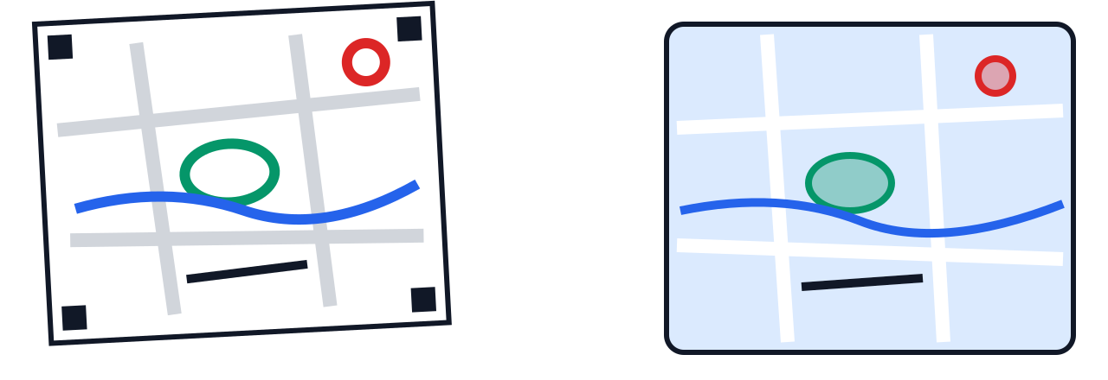
From Paper to Map
MAPPING WITH KIDS · A MAPPING ACTIVITY
Become a neighbourhood mapper
Notes:
0:00 to 0:05. Welcome everyone. Introduce yourself in one line. Ask: who has drawn a map before, even a treasure map or directions for a friend? Today everyone will make a real map from their own knowledge.

Slide 2
Today's plan
1
2
3
4
5
Warm up
Shapes
Draw
Upload
Share
What maps can't see
Point, line or polygon?
Your neighbourhood on paper
Paper becomes data
Our class map
15 min
10 min
40 min
20 min
30 min
Notes:
0:05 to 0:07. Walk through the plan quickly. Times add up to about 2 hours including the 5-minute welcome. Tell the kids the best part comes at the end: everyone's drawings on one big map.

Slide 3
What can't a satellite see?
PART 1 · WARM UP
You know things about your streets that no camera in space can.
Notes:
0:07. Short pause on this slide, then move on.

Slide 4

This is our neighbourhood from space
Insert a satellite screenshot of the area around the venue (Google Earth or GeoLibre satellite view)
Let's look closely
Can you find our building?
Where is the nearest park?
Can you see any water?
What is hidden under the trees?
Notes:
0:07 to 0:12. Before the session, take a screenshot of the venue area at street-block zoom and paste it in place of the dashed box. Let kids come up and point. Praise every find.

Slide 5


The satellite sees. You know.
A satellite sees
Only you know
Rooftops and roads
Trees and parks
Lakes and big drains
Playgrounds and open ground
The shortcut to school
The corner that floods when it rains
The shop with the best snacks
The road that is scary to cross
Notes:
0:12 to 0:16. Ask the class to add their own examples to the right-hand column. Write a few on the board. This is the knowledge they will put on their maps.

Slide 6
People have always made maps
Long ago
1802
2004
Today
Travellers and villagers drew maps by hand to show the way
The Great Trigonometrical Survey began measuring India
OpenStreetMap began: a world map drawn by volunteers
You make a map of your own neighbourhood
Notes:
0:16 to 0:19. Key message: maps are made by people. Surveyors once walked across India with heavy instruments. Now anyone, including kids, can add to the world map.

Slide 7


What is a sketch map?
Sketch map: a map drawn by hand by someone who knows a place well. It shows what people know, not just what a satellite photographs.
Our tool today: the Sketch Map Tool
A free website made by HeiGIT in Heidelberg, Germany. It prints paper maps and reads your drawings back.
Used around the world
Communities use it to mark places at risk from floods and other disasters, so help can reach them faster.
Notes:
0:19 to 0:22. Show the printed blank sketch map now so kids can see the edge patterns. Do not explain them yet; that comes in Part 4.

Slide 8
Every map is made of three shapes
PART 2 · MAP SHAPES
Notes:
0:22. Transition.

Slide 9
Point, line, polygon
Point
Line
Polygon
One spot on the map
A path from here to there
A closed shape with an inside
A shop, a bus stop, a tree
A road, a river, a drain
A park, a lake, a school ground
Notes:
0:22 to 0:25. Use your hands: point a finger for a point, draw a line in the air, trace a circle for a polygon. Kids copy the gestures.

Slide 10
Game: point, line or polygon?
Bus stop
Road
Park
?
?
?
Lake
Tree
Stormwater drain
?
?
?
Notes:
0:25 to 0:30. Read each item aloud. Kids shout point, line or polygon, or use the hand gestures. Then show the next slide with the answers.

Slide 11
Game: the answers
Bus stop
Road
Park
Point
Line
Polygon
Lake
Tree
Stormwater drain
Polygon
Point
Line
Notes:
0:30 to 0:32. Reveal. Trick question to discuss: a big tree could be a polygon on a very zoomed-in map, and a wide river could be a polygon too. It depends on the scale of the map.

Slide 12
Your neighbourhood on paper
PART 3 · LET'S DRAW
Hand out the printed maps and markers now.
Notes:
0:32. Hand out maps and the four markers. If a short walk outside is possible, do it now (10 minutes) and take the drawing time from Part 5.

Slide 13
Our colour key
Red
My favourite places
Blue
Water: lakes, drains, spots that flood
Green
Trees, parks and green spaces
Black
My path to school
You can change what each colour means, but keep these four colours. The computer reads them best.
Notes:
0:32 to 0:35. Agree the key as a class so the class map makes sense later. Kids write the key in the corner of their map, away from the edge patterns.

Slide 14





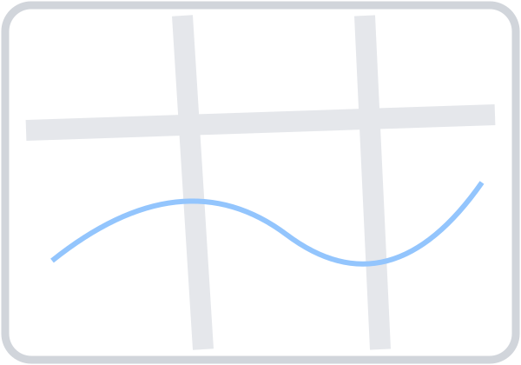


Drawing rules
Big circle for a place
Tiny dot
Closed outline for an area
Gap in the outline
Thick, dark marker
Thin, light pen
Never draw over the black patterns on the edges. They tell the computer where on Earth your map is.
Notes:
0:35 to 0:38. Demonstrate each rule on a spare map with the real markers. The edge rule matters most: a map with covered edge patterns cannot be read.

Slide 15


Keep it safe
Do mark
Don't mark
Your school, parks, shops, temples, bus stops and other public places
Your own home. Maps get shared, and your address is private.
Notes:
0:38 to 0:40. Keep this light but firm. Walk around during drawing and gently check that no one has marked a home.

Slide 16

Drawing time
Before you finish, check:
At least one thing in each colour
Big circles, closed outlines, thick lines
Nothing drawn on the edge patterns
Your colour key written in a corner
Your name on the back
30
minutes
Notes:
0:40 to 1:12. Keep this slide up while kids draw. Give a 10-minute and a 2-minute warning. Early finishers can help a neighbour or add more places.

Slide 17
Let the computer read your map
PART 4 · PAPER BECOMES DATA
Notes:
1:12. Transition. Collect the maps or have kids bring them up one table at a time.

Slide 18

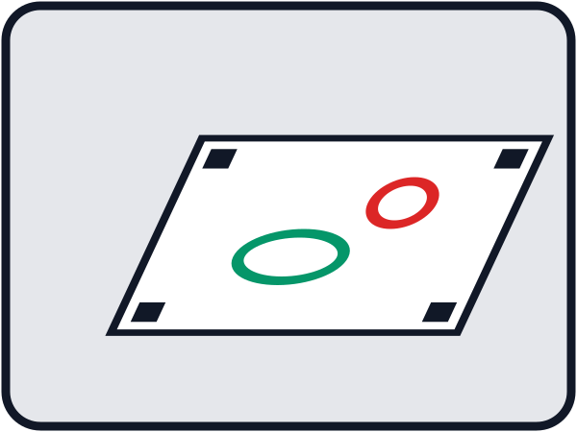
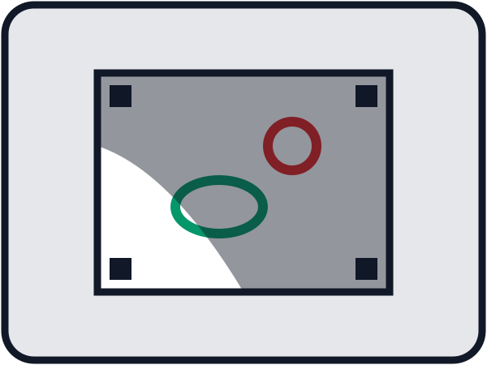

Good photo, bad photo
Straight above, whole sheet, even light
Taken at a slant
Shadow on the map
Edges cut off
Notes:
1:12 to 1:15. Ask kids to spot what is wrong in each bad photo before you say it. Then take the photos yourself, or let older kids do it with your phone. A scanner at 300 dpi works even better.

Slide 19



How the computer reads your map
Upload
Line up
Find colours
Map data
We send the photo to the Sketch Map Tool
Edge patterns tell it where on Earth the map is
It picks out each red, blue, green and black drawing
Your drawings come back as a GIS layer
New word: georeferencing. Matching a picture to real places on Earth.
Notes:
1:15 to 1:18. The edge patterns finally make sense here. Ask: how does the computer know where your map is? Let them guess before you explain.

Slide 20
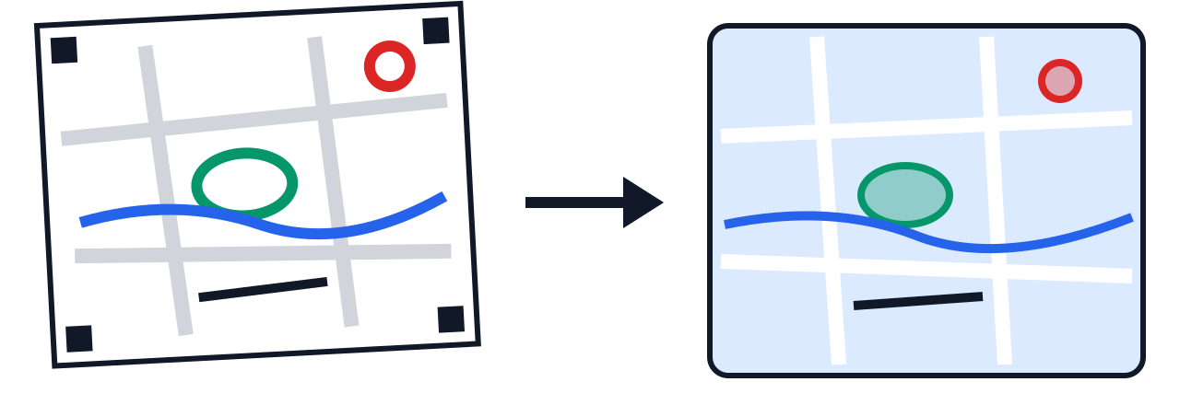
Live: let's upload!
sketch-map-tool.heigit.org
Choose Digitize
Choose file(s) and add the photos
Wait while it reads the maps
Download the results
While we wait: who thinks their map will come out perfectly? Who drew the most places?
Notes:
1:18 to 1:32. Switch to the browser. On upload, the tool asks whether to share the drawings with its researchers: choose Reject & Upload unless parents have agreed. Processing takes up to about 100 seconds per map. If anything fails, go to the next slide.

Slide 21
Backup: one we made earlier
Screenshot 1: the photo being uploaded
Screenshot 2: the tool's result
Screenshot 3: the drawing in GeoLibre on a satellite map
Use this slide only if the live upload does not work.
Notes:
Before the first session, run one sketch through the whole process at home and paste the three screenshots here. Skip this slide if the live demo worked.

Slide 22
Everyone's drawings on one map
PART 5 · OUR CLASS MAP
Notes:
1:32. Transition. Load all the GeoJSON files into GeoLibre together.

Slide 23
Our class map
Show GeoLibre live with every child's drawing loaded together, or paste a screenshot here
Notes:
1:32 to 1:40. The big moment. Turn layers on one by one so each child sees their own drawing appear. Switch to the satellite base map and compare.

Slide 24

What do we notice?
Which places did many of us mark?
Where does water collect when it rains?
Where are the green spaces, and where are none?
What would you change in our neighbourhood?
Notes:
1:40 to 1:50. Let kids answer from the class map. Point at the layers as they talk. There are no wrong answers here; the goal is noticing patterns.

Slide 25
What we learned today
People's knowledge belongs on maps
Points, lines and polygons
A colour key (legend)
Georeferencing: photo to real place
Paper drawings become GIS data
Many maps together tell a bigger story
Notes:
1:50 to 1:55. Quick recap. Ask each table to say one new word they learned.

Slide 26
Keep mapping!
THANK YOU, MAPMAKERS
Take your map home. Ask a grandparent or neighbour what they would add.
Notes:
1:55 to 2:00. Thank everyone, hand back the maps, and take a class photo with the maps if parents agree.

