Slide 1

Instagram
Master’s degree in Data Science & Engineering – FEUP
Data Warehouses
March 2023
Farzam Salimi, Nikolas Ivakko, Sónia Ferreira, Vasco Bartolomeu

Slide 2
Introduction
Data Warehouses
1980s
A system for reporting and data analysis and considered the core component of business intelligence
Instagram
2010
Photo and video sharing social media application

Slide 3
Assignment Requirements
Number of facts | Minimum 10,000
Facts and measures | Aggregated facts with at least one semi-additive measures
Number of dimensions | There must be at least 4 dimensions
Other requirements | Temporal dimensions, and common dimension to both facts
Teacher approval | Must be approved by the teacher

Slide 4
Subject Description
Target | Instagram Social Network
Available datasets | Locations, Posts and Profiles
Goals: | Post analysis and profile statistical analysis
 | Database consistency check

Slide 5
Data Source Selection
Source
Kaggle.com
Files
Instagram location
Instagram posts
Instagram profiles
Size
42 million posts
1.2 million locations
4.5 million profiles

Slide 6
ETL Process
Kaggle
Extraction
Extraction of the data by downloading csv files
Python
Transformation
Fill in null values and resize the columns
Postgres
Load
Load the database and execute queries

Slide 7
Dimensional bus matrix
Data mart | Star | Dimension | Location | Profile | Day | Time
Instagram | Post |  | x | x | x | x
 | Statistics |  |  | x | x | x

Slide 8
Dimensions
Stores information about where the post was made.
Stores information about the date of the post event. Lowest granularity is a year measure and highest granularity is day.
Location
Date
Profile
Time
Stores information about the profile that publishes the post.
Stores information about the time of the post event. Lowest granularity is an hour measure and highest granularity is seconds.

Slide 9
Fact Tables
Post
Statistics
Registers a post event (video or photo) at a given Timestamp and associates the event with a Location and a Profile. This table also stores statistics of the post.
A post is characterized by the combination of a profile at a given location and time.
Evaluates Profile statistics like number of followers, number of posts and number of following at a given point in time.
Each statistic instance is characterized by a measure of a profile at a given point in time.

Slide 10
Measures
1
Number of likes
Post
How the post was approach by the community
2
Number of comments
KPI
3
Number of followers
Statistics
How the profile connections are evolving
4
Number of following

Slide 11
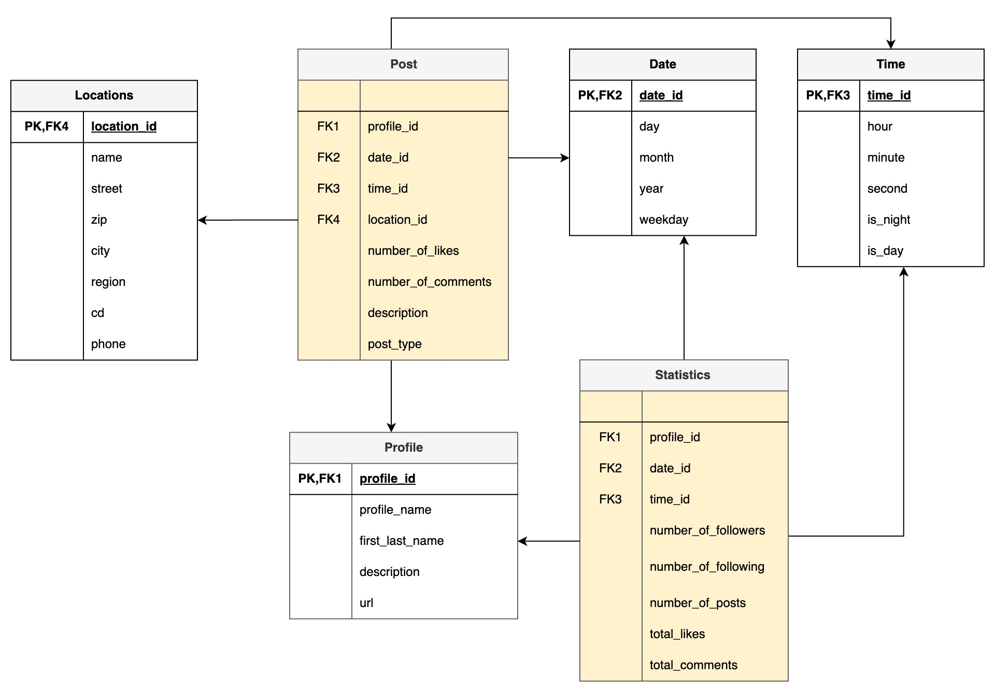
Dimensional Model

Slide 12
Conclusion
We discussed the subject of our data warehouse which is instagram.
We reviewed the requirements of the assignment.
The dimensional bus matrix has been presented.
Built a dimensional model and are able to target different KPIs
Currently working on loading the data and visualization

Slide 13
Thanks!
DO YOU HAVE ANY QUESTIONS?

